Slide 1
Customer Churn & Retention Analytics
Customer Engagement & Churn Risk Analysis
| SQL | Power BI

Slide 2
Executive Summary
57% churn rate indicates critical retention issue
Low engagement drives churn
High support tickets increase churn
57% revenue at risk
Inactive users contribute majority of churn
Recommendations:
Target low engagement users
Improve customer support experience (Improve onboarding, Enhance support)
Focus on early lifecycle retention
Target high-risk users
Fix payment issues

Slide 3
Business Problem
High churn impacting revenue
Lack of churn visibility
No segmentation of high-risk customers
Data Overview:
Customer demographics, usage, support, payments
Engineered: Usage Group, Risk Segment, Activity Level

Slide 4
Dashboard Overview
Executive Summary Page
Customer Behaviour Analysis
Risk Segmentation Dashboard
KPI monitoring and segmentation approach

Slide 5
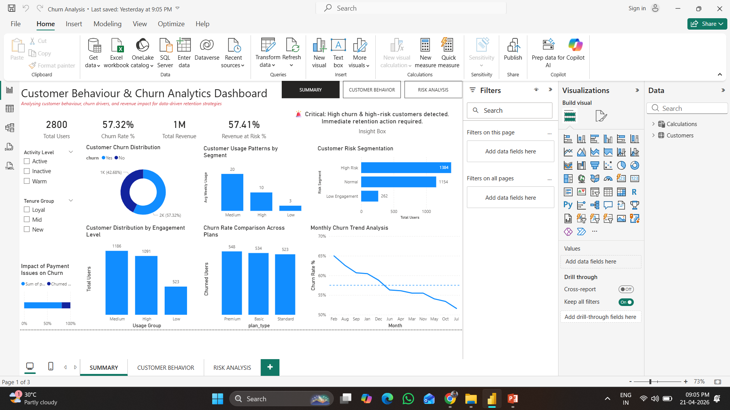
Summary Dashboard
Users: 2800, Churn Rate: 57%, Revenue at Risk: 57%, Inactive: 1350

Slide 6
CUSTOMER BEHAVIOR ANALYSIS
Churn Rate by Usage Group
Low usage customers → highest churn
Medium usage → majority customer base.
High usage → most retained users
Engagement is key driver

Slide 7
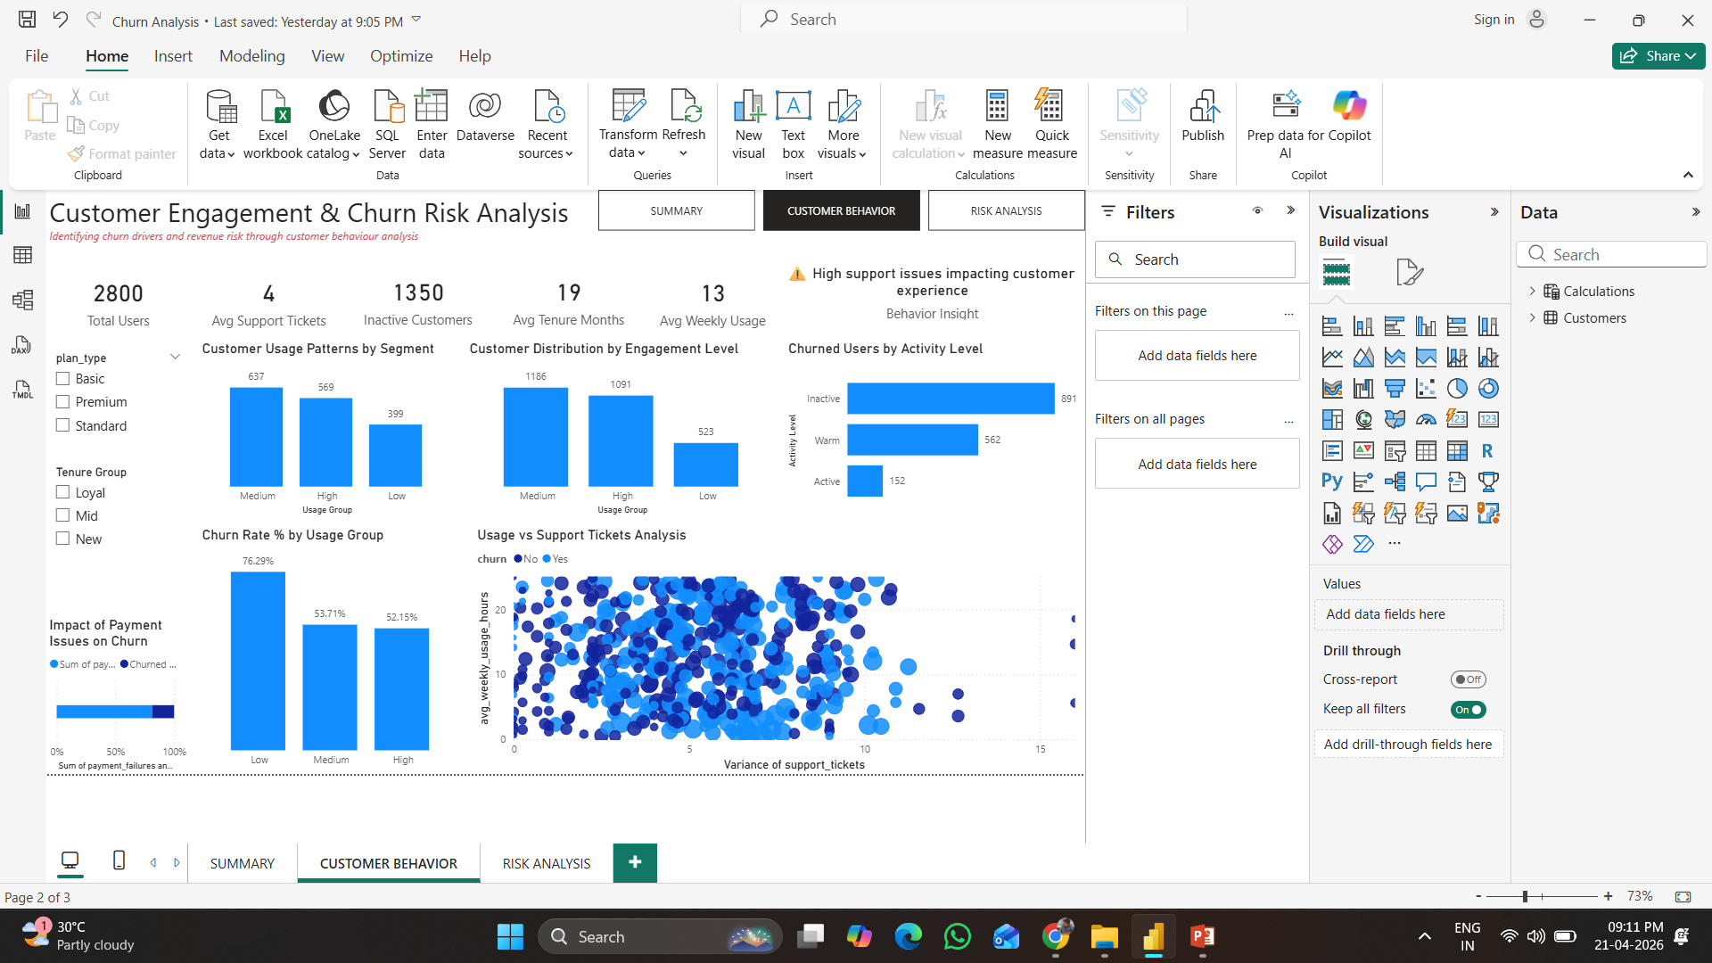
Customer Behaviour
High support + low usage = churn risk
Customer experience impacts retention
Key focus area for business improvement

Slide 8
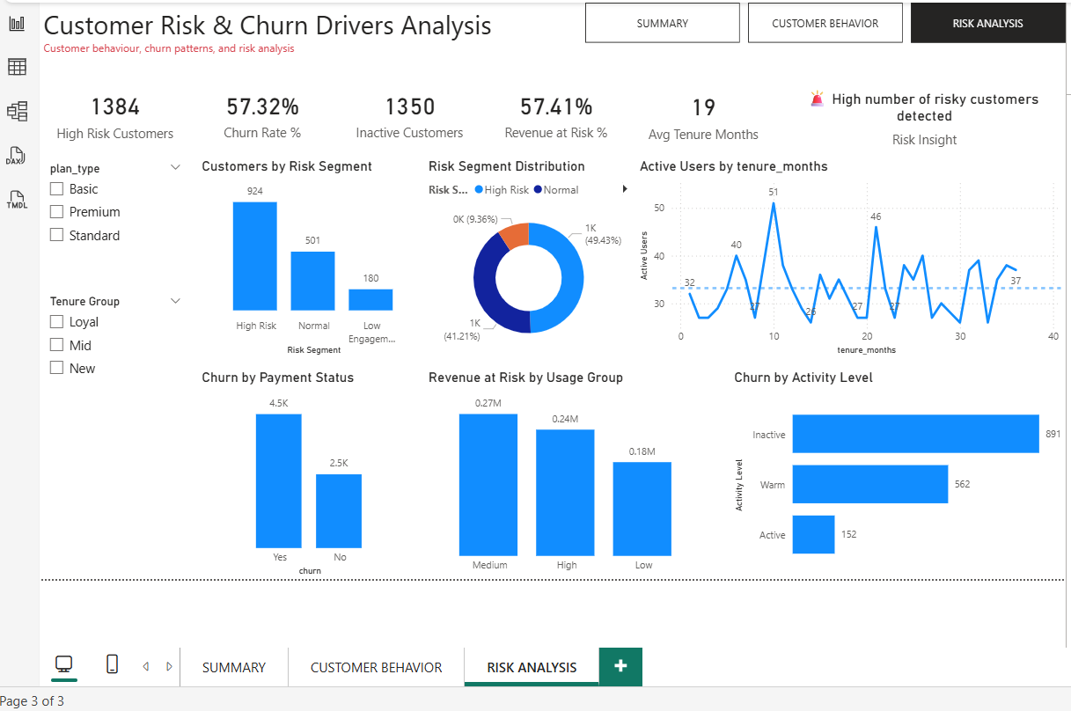
Risk Analysis
High-risk users dominate churn
Need targeted retention
57% revenue at risk
Engaged users drive revenue

Slide 9
BUSINESS RECOMMENDATIONS
Engagement Strategy
Personalized campaigns
Product onboarding improvements
Support Optimization
Reduce ticket resolution time
Improve UX
Retention Targeting
Focus on high-risk users
Offer incentives
Payment Fixes
Reduce failed transactions

Slide 10
Impact
Expected Outcome:
↓ Churn Rate
↑ Customer Retention
↑ Revenue Stability

Slide 11
Thank You

