Slide 1
Customer Retention & Engagement Insights
Raven Stack SaaS
Tech Stack: MySQL, Power BI

Slide 2
Executive Summary
High churn (~70%)
Low activity drives churn
Support issues increase churn
Churn occurs within first 90 days
High MRR customers retain

Slide 3
Business Problem
High churn impacting revenue
Lack of visibility into customer behaviour
Need data-driven retention strategy
Dataset Overview
Accounts, Subscriptions, Feature Usage,
Support Tickets, Churn Events
Methodology
SQL EDA → SQL joins & CTEs → Data Modelling → Power BI → Insight Generation

Slide 4
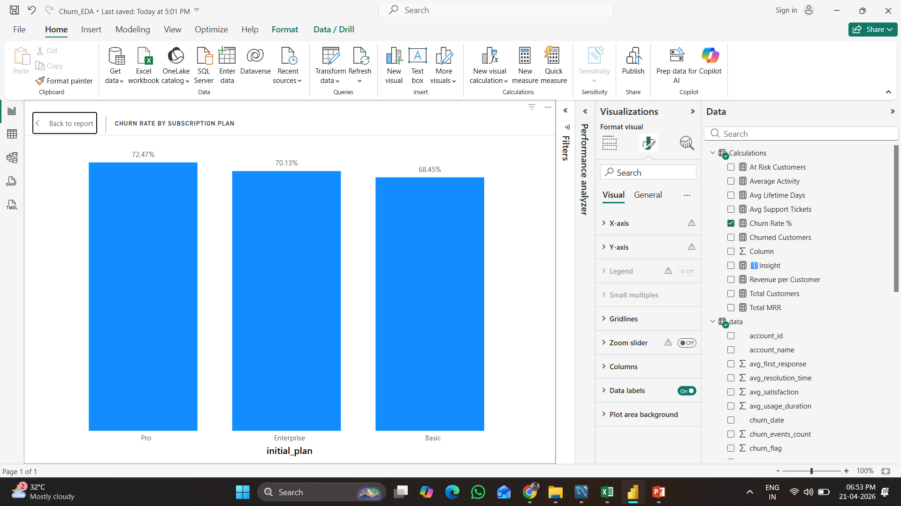
Churn Analysis
Higher churn in Pro-tier plans
Low activity users churn most
High activity → strong retention

Slide 5
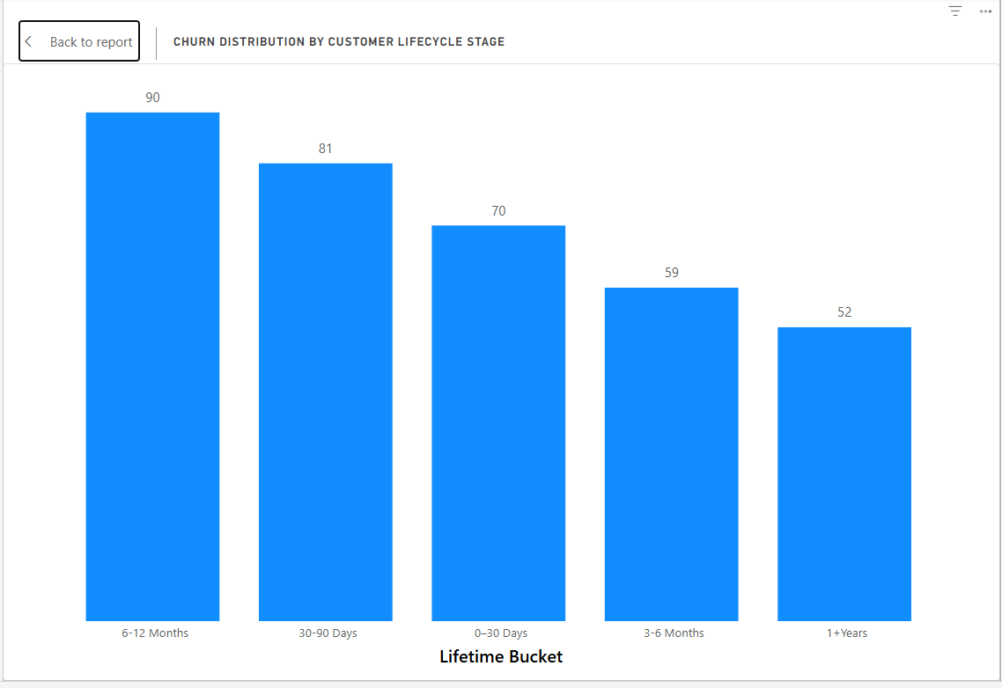
Customer Lifecycle
Major churn in first 90 days.
Most churn happens in early stage.
Onboarding is critical

Slide 6
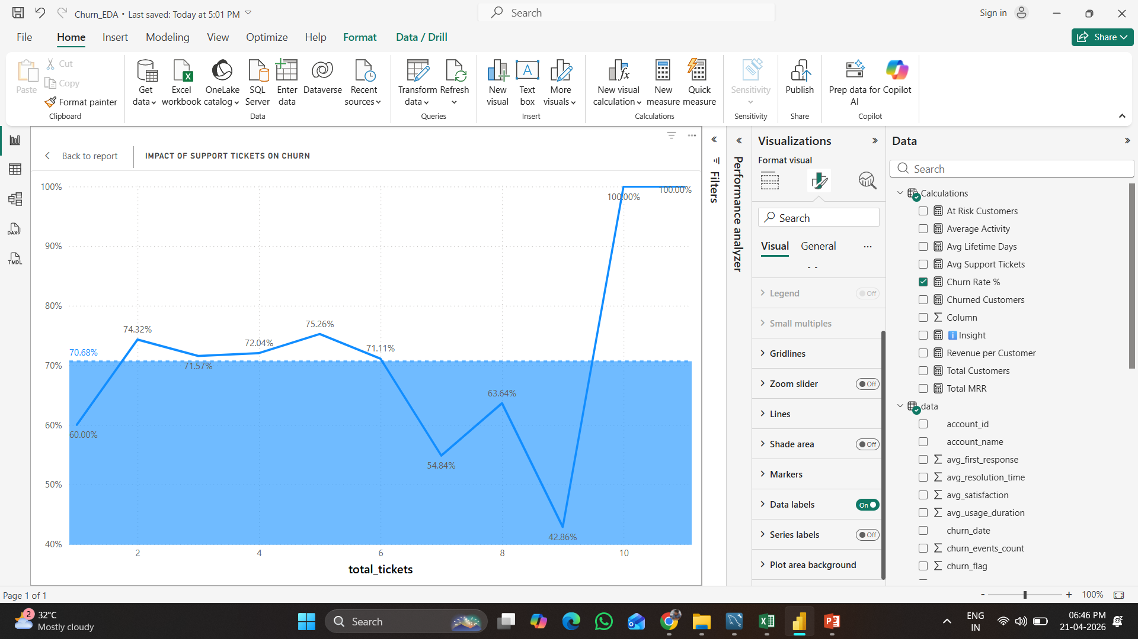
Support Impact
More tickets → higher churn
More tickets = dissatisfaction
Strong churn predictor

Slide 7
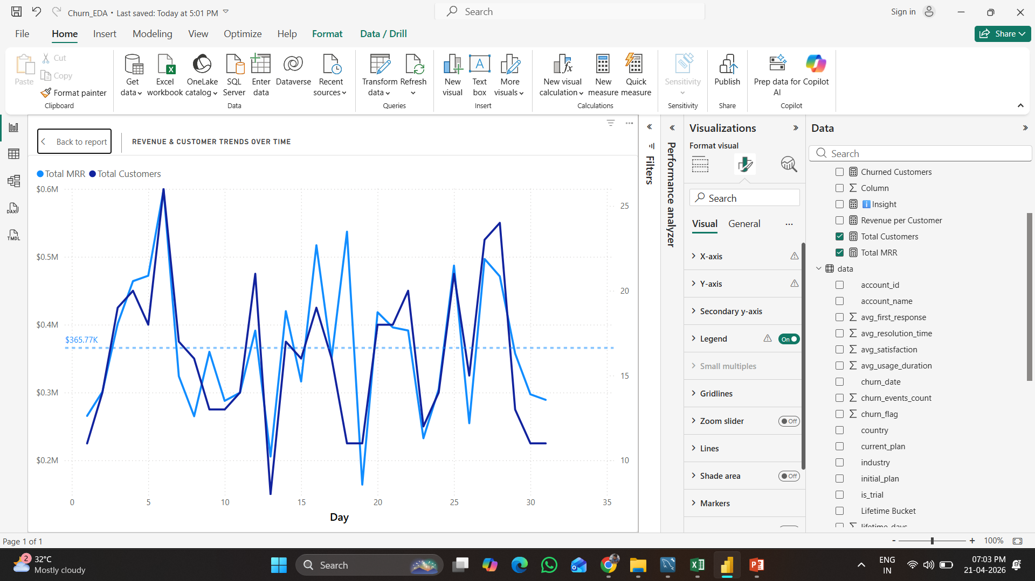
Revenue Analysis
Revenue concentrated in high-value customers
Low-value users churn more

Slide 8
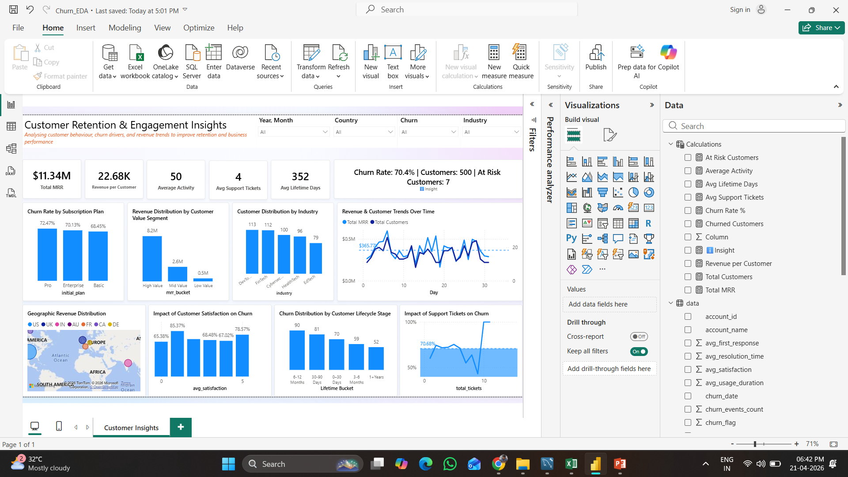
Dashboard Overview
Power BI dashboard with KPIs, filters, insights

Slide 9
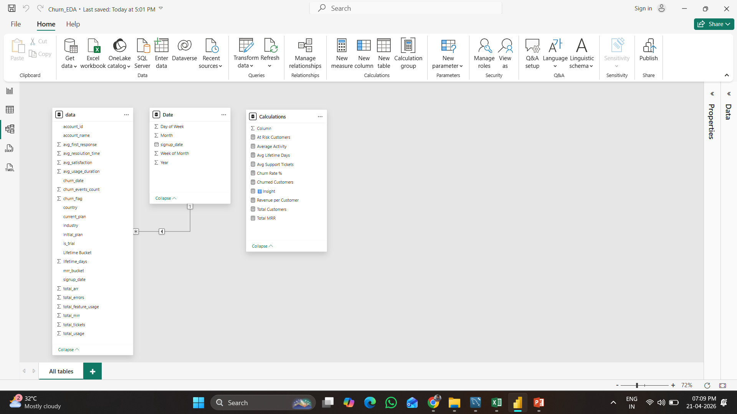
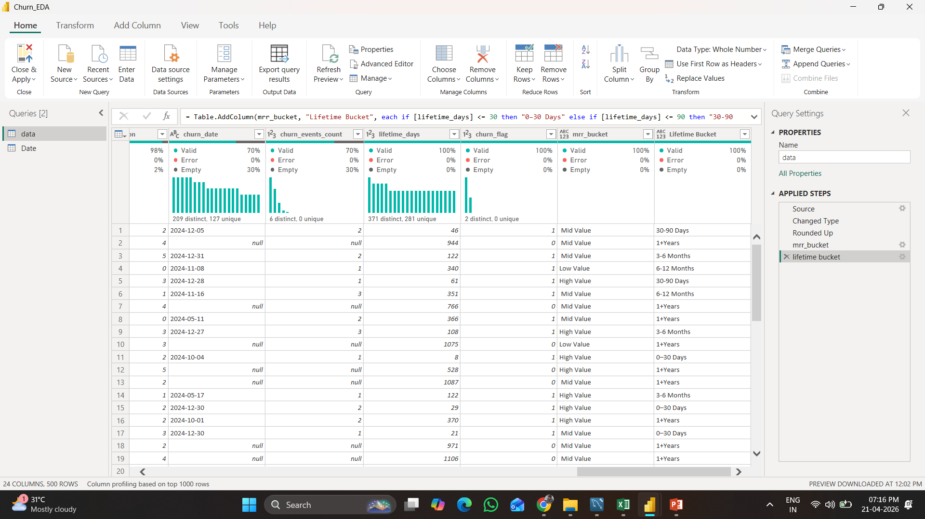
Data Overview & Data Modelling

Slide 10
Key Insights
Engagement, support, lifecycle drive churn
Engagement drives retention
Support impacts churn
High-value customers are critical
Early churn is the biggest issue

Slide 11
Recommendations
Improve onboarding, engagement, support
Improve onboarding flow
Drive feature adoption
Enhance support response time
Target at-risk users

Slide 12
Impact
Reduce churn 15–25%, increase retention
Increase customer lifetime value
Improve customer satisfaction
Boost revenue retention

