Slide 1
Customer Retention & Churn Analytics
Analyzing customer behavior, churn drivers, and revenue impact to improve retention strategies

Slide 2
Executive Summary
Churn Rate: 26.99%
Revenue Loss: 3.41M
Key Drivers: Contract type, tenure, competitor
Action: Target high-risk segments

Slide 3
Business Problem
High customer churn leading to revenue loss.
Need to identify key drivers and reduce churn.
Data Overview
Telecom dataset including customer demographics, services, revenue, and churn status
Data Preparation
Cleaned missing values
Created Churn Status flag
Unpivoted service columns

Slide 4
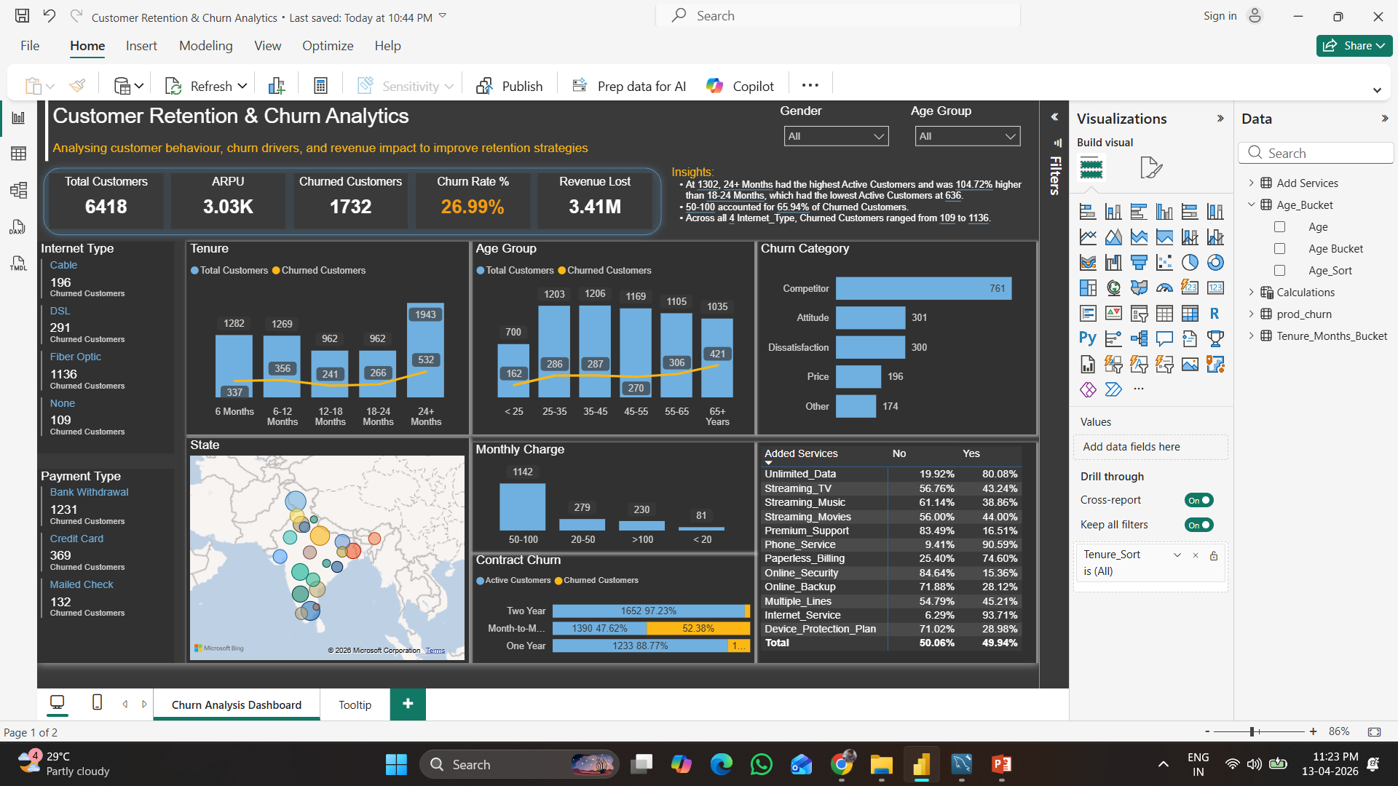
Dashboard Overview
Interactive dashboard showing churn KPIs, customer segments, and churn drivers.

Slide 5
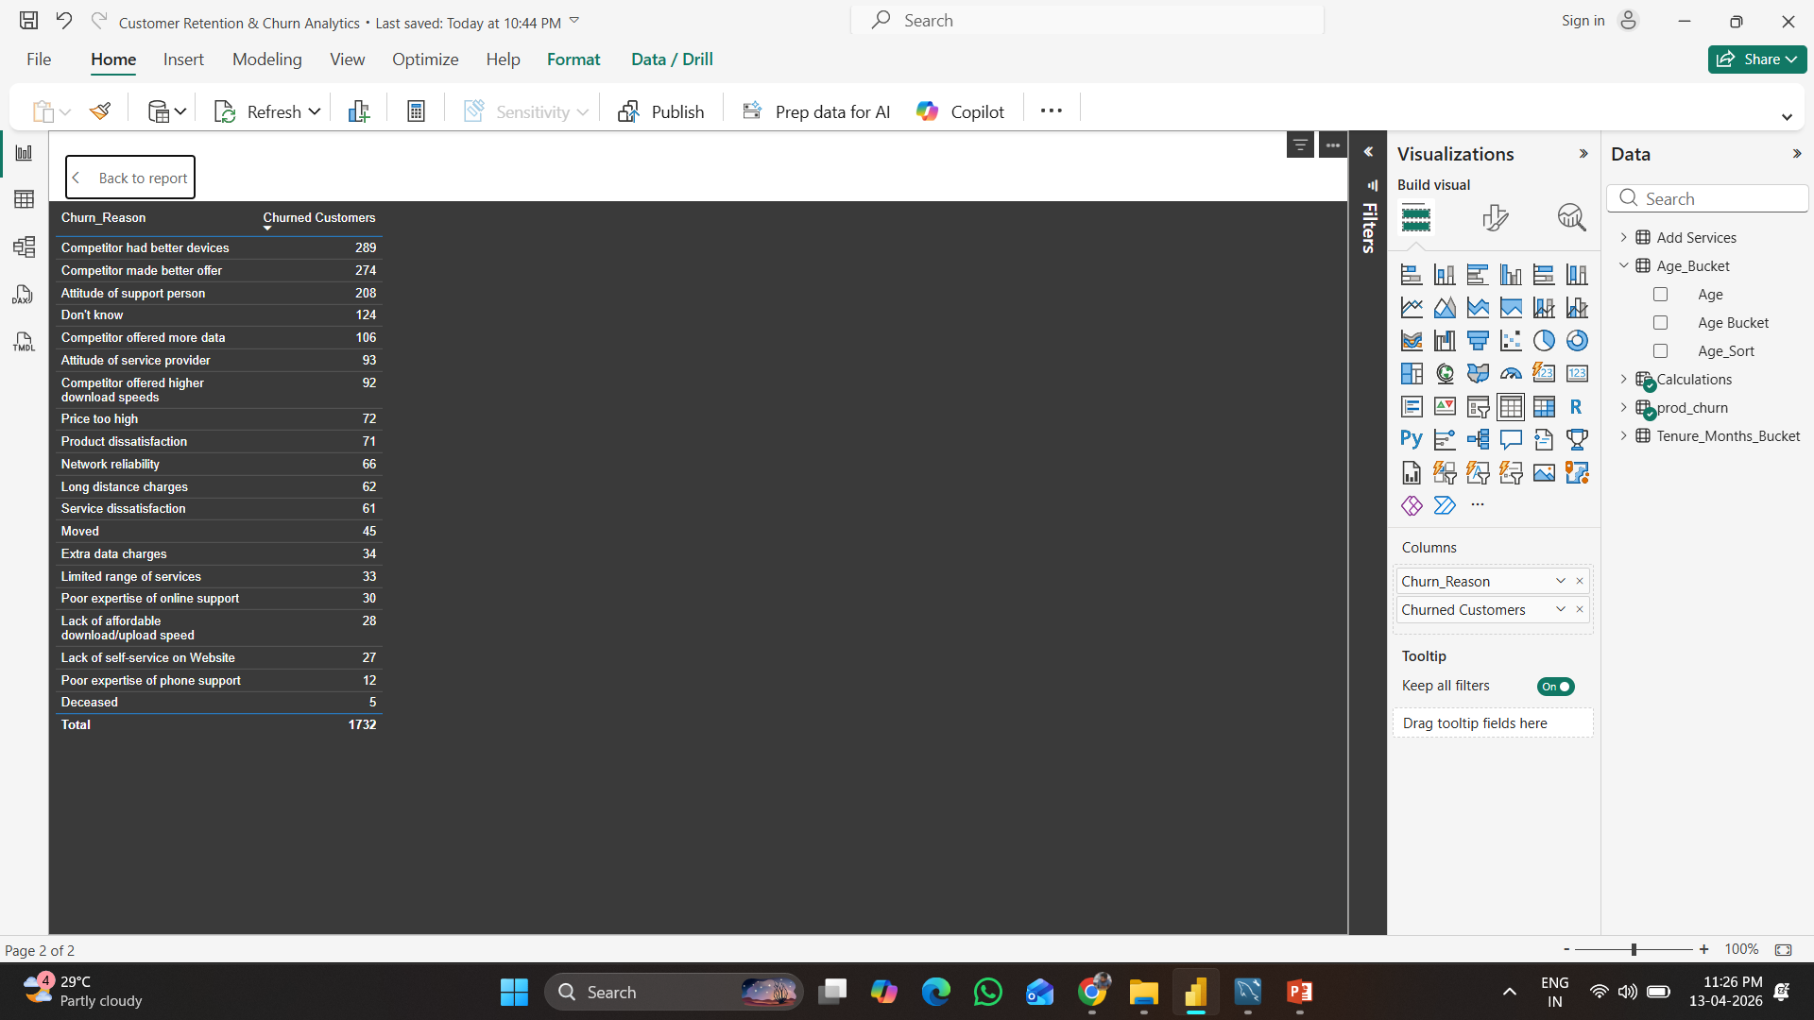
Key KPIs
Total Customers
Churn Rate %
Revenue Lost
ARPU
Churn Drivers
Competitor offers
High pricing
Poor service experience

Slide 6
Story: Where is the Problem?
High churn observed in Month-to-Month customers and low tenure segments
Top reasons include competitor offers, pricing, and dissatisfaction
Story: Who is at Risk?
New customers, Fiber users, and high monthly charge segments

Slide 7
Business Recommendations
Offer long-term contracts
Improve service quality
Target high-risk customers
Impact
Potential to reduce churn and increase customer lifetime value
Before: High churn, unclear drivers
After: Identified drivers, targeted actions, potential churn reduction.

Slide 8
Conclusion
Data-driven approach helps improve retention and business performance

