Slide 1
E‑Commerce Funnel Performance & Revenue Insights
SQL + Power BI

Slide 2
Executive Summary
High traffic (10K users) but low conversion (~10%) indicates funnel inefficiency
Largest leakage at Checkout → Purchase stage (payment/trust friction)
Fast converters drive disproportionate share of revenue
Opportunity: optimize checkout UX and retarget high-intent users to unlock revenue

Slide 3
Business Objective
Analyze user funnel behavior
Identify drop-offs
Understand revenue drivers
Segment users for targeted strategy

Slide 4
Approach
1. Data Cleaning & Validation
2. Funnel Analysis
3. Conversion Analysis
4. Revenue Analysis
5. Segmentation
6. Recommendations

Slide 5
Data & Approach
Event-level dataset: Browse → Add to Cart → Checkout → Purchase
Dimensions: Channel, Device, Region, Category; Metric: Revenue
Pipeline: Data Quality → Funnel → Conversion → Revenue → Segmentation
Model: Event table + User-level table (time-to-purchase, segments)

Slide 6
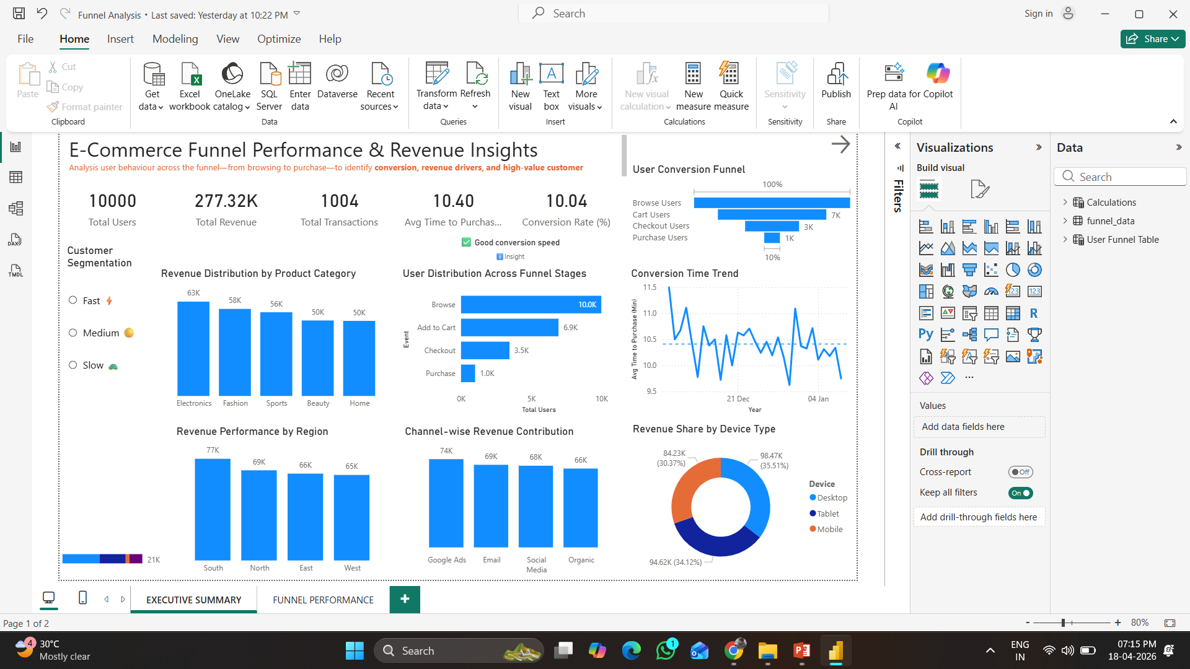
Dashboard

Slide 7
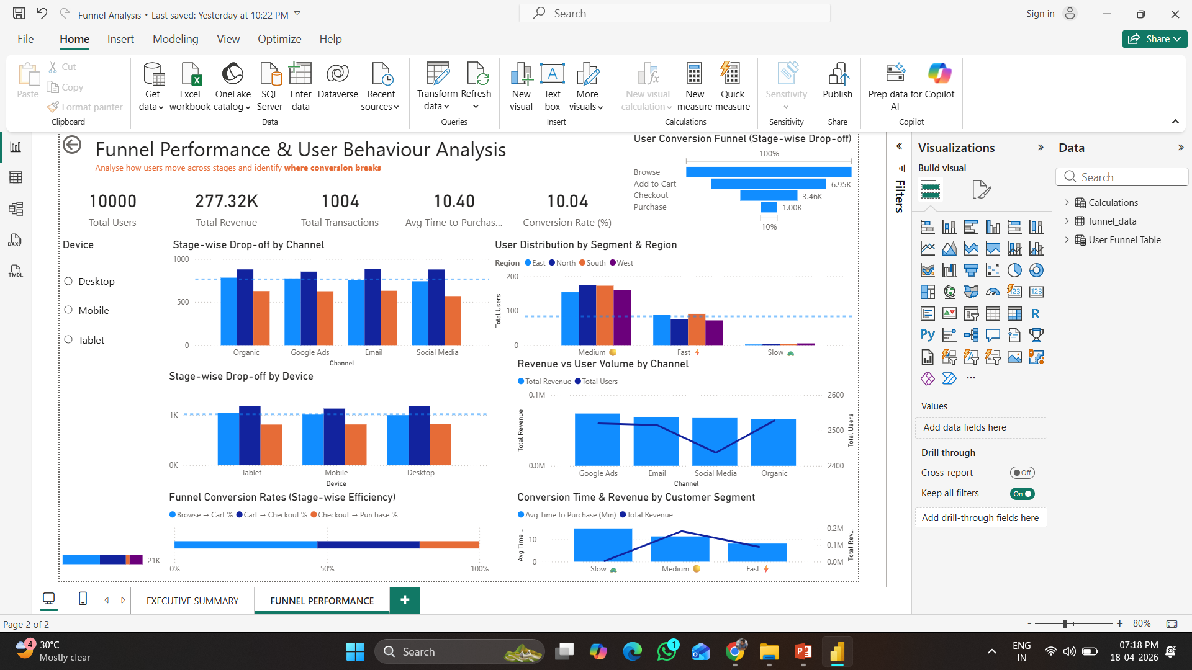
Dashboard

Slide 8
Key Performance Indicators
10,000
Total Users
277.32K
Total Revenue
1,004
Total Transactions
10.40 min
Avg Time to Purchase
10.04%
Conversion Rate

Slide 9
User Conversion Funnel (Stage-wise Drop-off)
Browse → Add to Cart → Checkout → Purchase
Major drop-offs observed at checkout stage
Low final conversion

Slide 10
Stage-wise Conversion Rates
Browse → Cart moderate
Cart → Checkout stable
Checkout → Purchase lowest → key issue

Slide 11
User Drop-off Across Funnel Stages (in thousands)

Slide 12
Revenue Contribution by Channel

Slide 13
Revenue Share by Device Type

Slide 14
Customer Segmentation (Conversion Speed)
Fast converters → high revenue
Slow users → opportunity for retargeting

Slide 15
Key Findings
Checkout → Purchase conversion is the weakest stage (~28–30%)
Browse → Cart shows moderate engagement (~65–70%)
Revenue concentrated in a few channels; efficiency varies
Revenue concentrated in specific channels
High-value users drive majority of revenue
Fast converters (low time) correlate with higher revenue contribution

Slide 16
Recommendations
Optimize checkout UX: simplify steps, enable guest checkout, reduce latency
Increase trust: payment badges, clear returns, price transparency
Retarget high-intent users (cart/checkout abandoners) with offers
Reallocate spend to high-ROI channels; test creatives for low performers
Personalize journeys: fast users → upsell; slow users → nudges/discounts

Slide 17
Expected Impact
+2–5% absolute lift in conversion rate
+10–20% increase in transactions
+15–25% uplift in revenue with better channel allocation
Reduced drop-offs at checkout and faster conversion cycles

Slide 18
Skills Demonstrated
SQL: CTEs, aggregations, funnel & segmentation logic
Power BI: data modeling, DAX, KPI design, storytelling dashboards
Analytics: funnel diagnostics, cohort thinking, KPI interpretation
Consulting: problem framing, insight generation, actionable recommendations

Slide 19
Closing
End-to-end analysis links user behavior to revenue outcomes
Clear, actionable roadmap to improve conversion and profitability
Ready to apply this approach to real business problems

