Slide 1
E-Commerce Sales Analysis
Power BI + MySQL

Slide 2
Executive Summary
$863K total revenue across 2023–2025
54.8% profit margin indicating strong pricing strategy
West region contributes highest revenue
Grinders & Brewers is top-performing category
Seasonal spikes observed (Q4 peaks)
Top 5 products drive major share of revenue

Slide 3
Business Problem
Understand drivers of revenue and profitability
Identify top products and customers
Evaluate regional performance
Detect seasonality and trends
Enable data-driven decisions

Slide 4
Data & Approach
Data Sources: Orders (2023–2025), Customers, Products
MySQL: Data cleaning, transformation, KPI computation
Power BI: Dashboard, DAX measures, interactivity
CTE used to combine multi-year data
KPIs built: Revenue, Profit, Margin, Orders

Slide 5
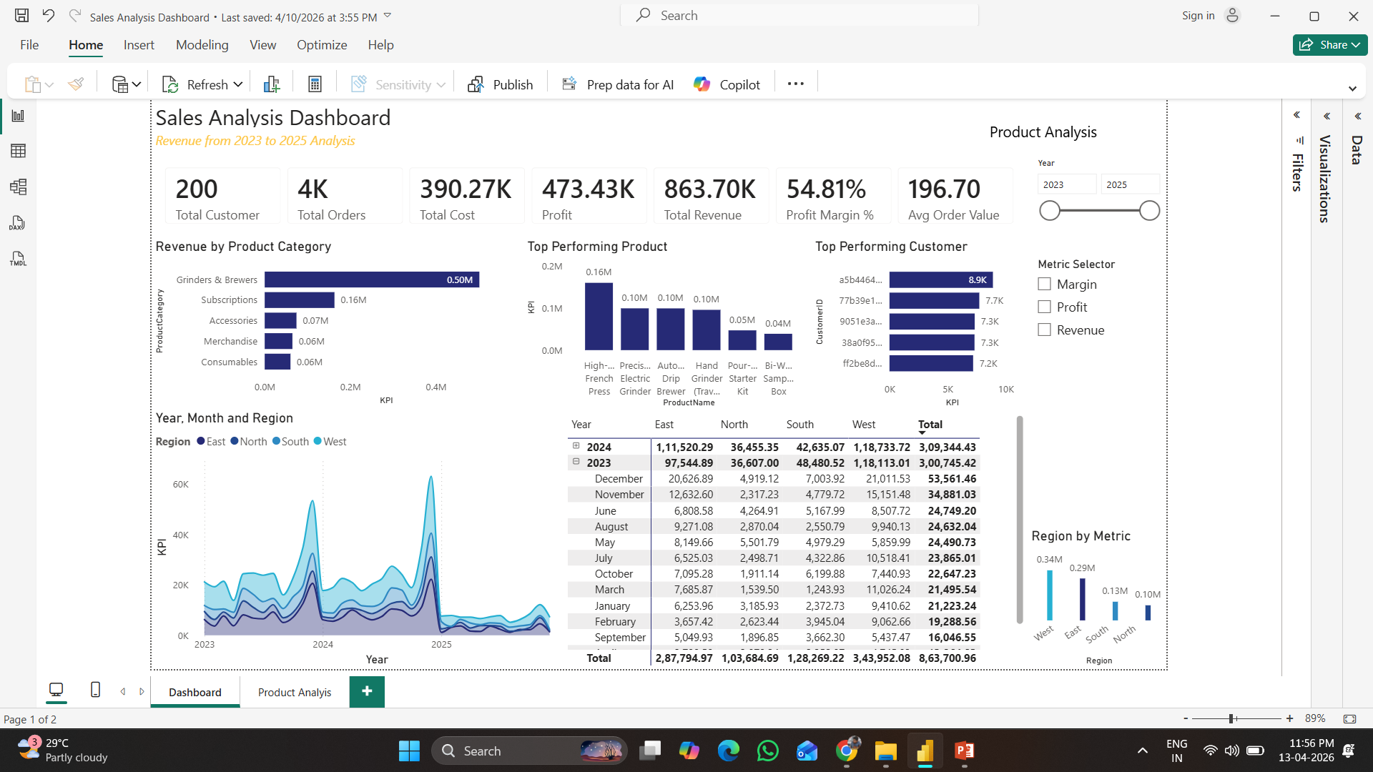
Dashboard Overview
Main dashboard with KPIs, trends, and category insights

Slide 6
Revenue & Trend Insights
Revenue shows clear seasonal spikes
Peak performance in late-year periods
Trend indicates growth opportunities
Supports better demand forecasting

Slide 7
Product Performance
Grinders & Brewers drives highest revenue
Accessories and consumables lag behind
Top 5 products dominate revenue (Pareto effect)
Opportunity to bundle low-performing products

Slide 8
Regional Analysis
West region is top performer
Other regions show lower contribution
Potential for market expansion
Need to investigate regional gaps

Slide 9
Customer Insights
Small group of customers drives majority revenue
Strong repeat purchase behavior
High-value customers identified
Opportunity for loyalty programs

Slide 10
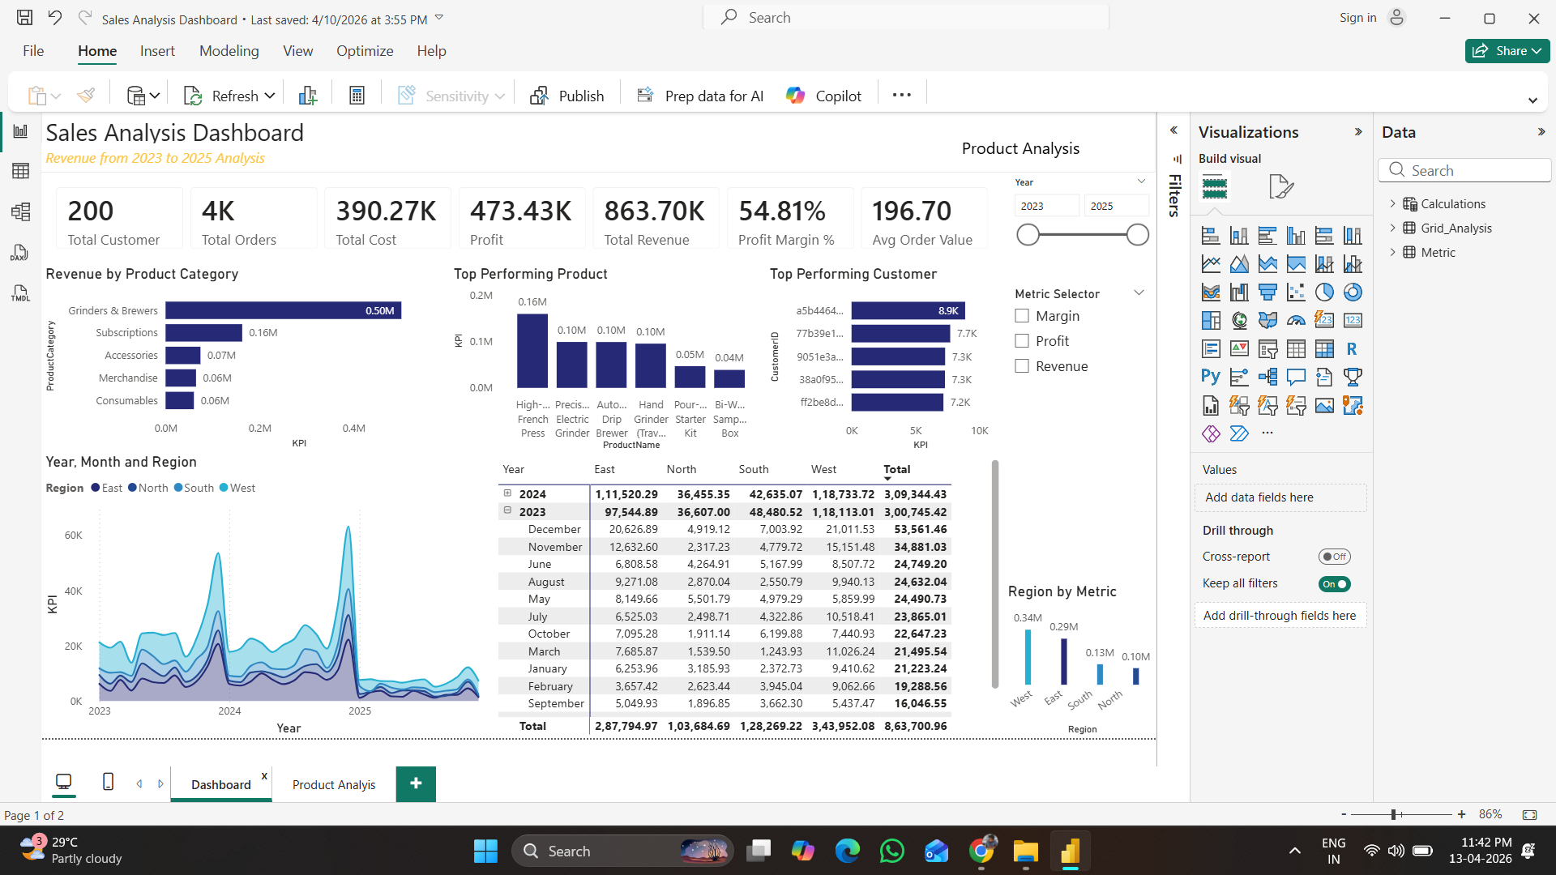
Dashboard Deep Dive 1

Slide 11
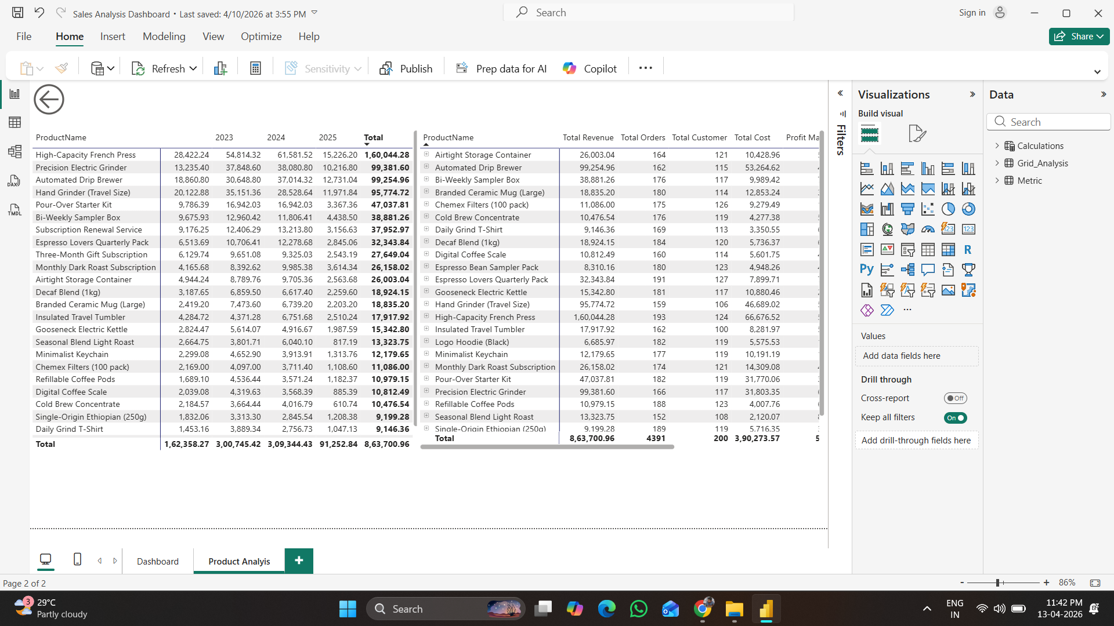
Dashboard Deep Dive 2

Slide 12
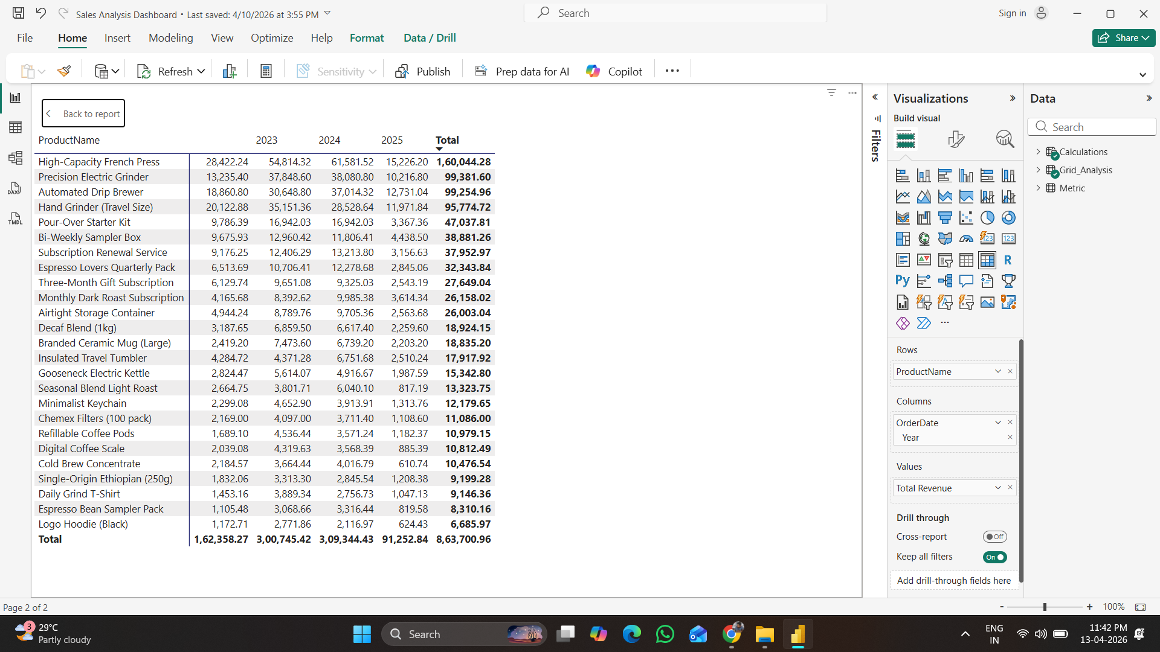
Dashboard Deep Dive 3

Slide 13
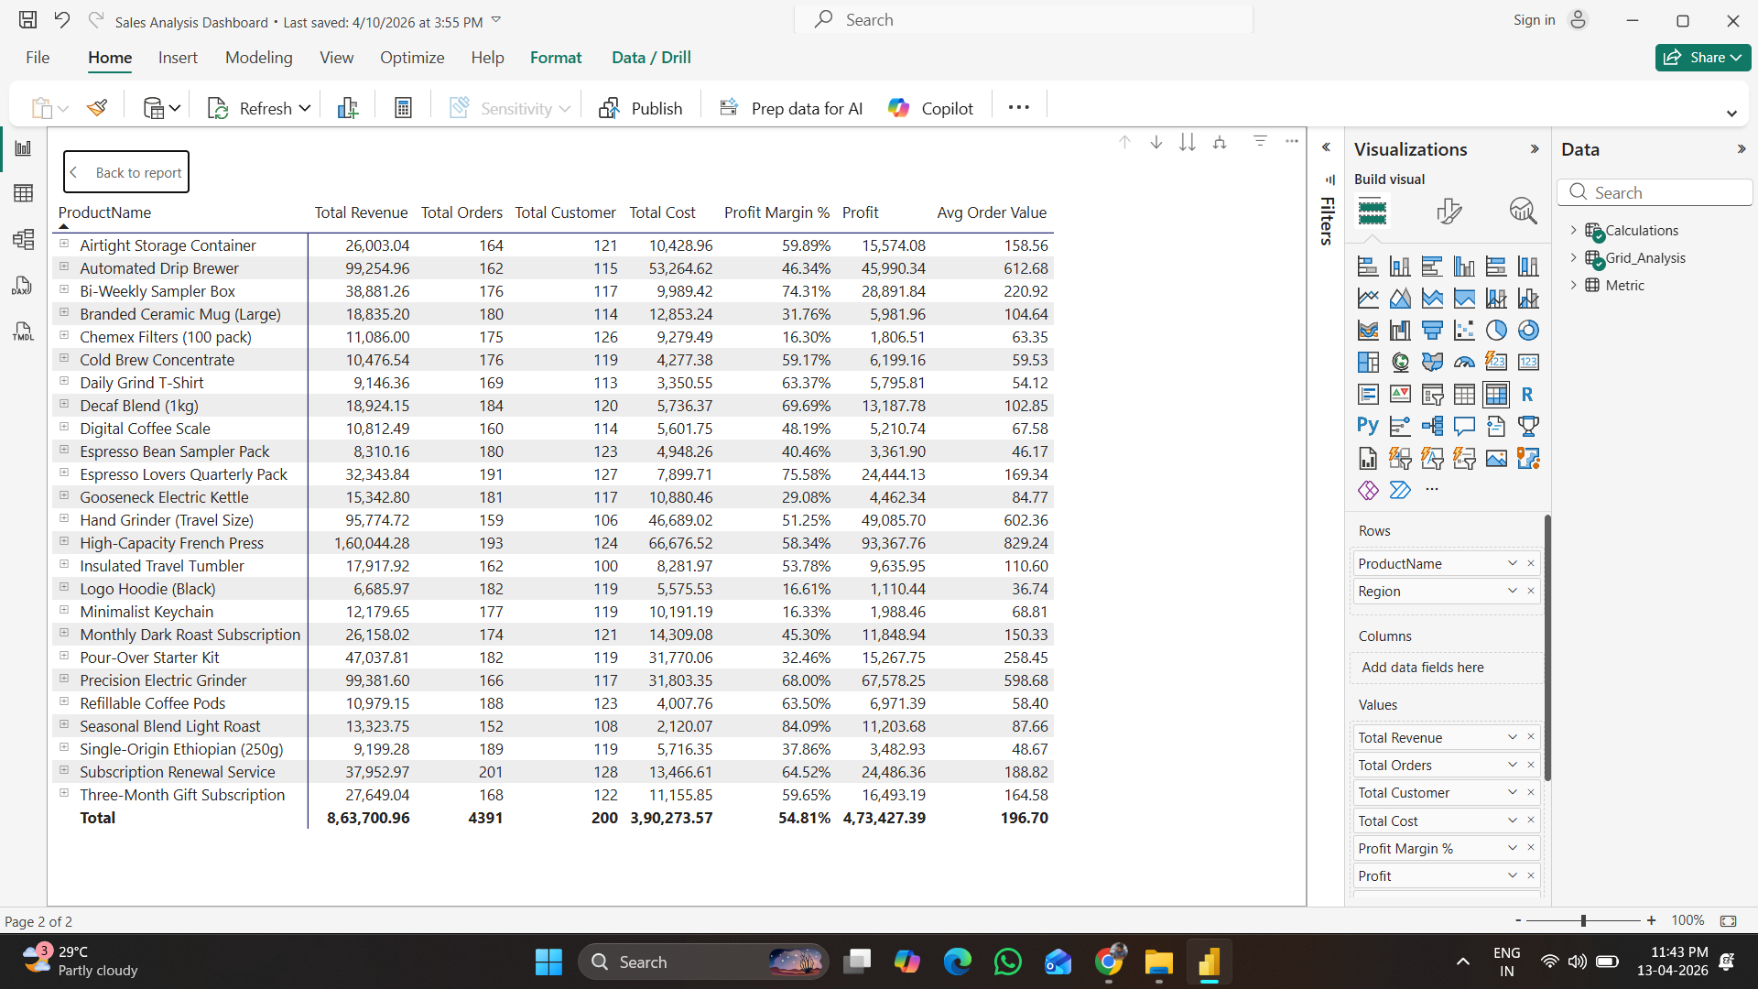
Dashboard Deep Dive 4

Slide 14
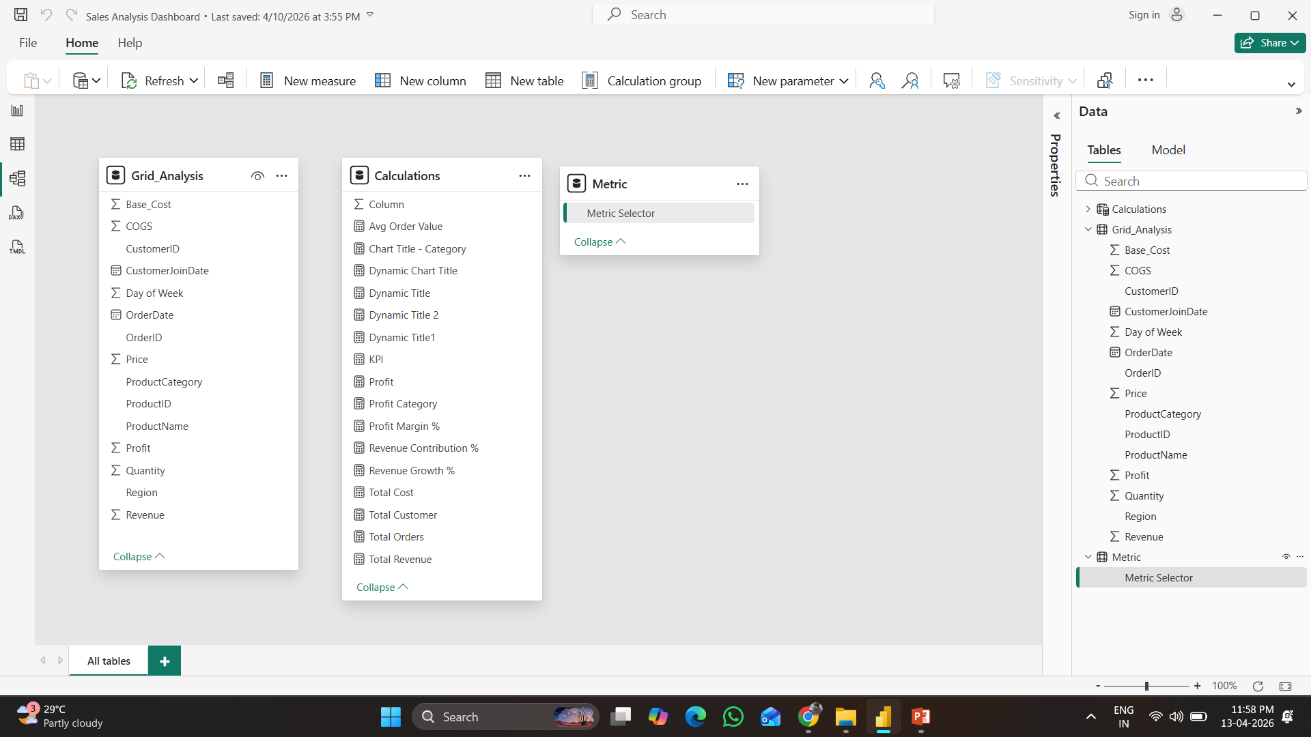
Data Modelling Deep Dive 5

Slide 15
Profitability Insights
Some high-revenue products have lower margins
Opportunity to optimize cost structure
Focus on high-margin categories
Improve pricing strategies

Slide 16
Key Recommendations
Scale top-performing products
Expand in high-performing regions
Optimize pricing for low-margin products
Implement loyalty programs
Align inventory with seasonal demand

Slide 17
Impact Delivered
End-to-end analytics solution built
Automated reporting using SQL + Power BI
Improved business decision-making
Interactive dashboards with drill-through

Slide 18
Key Learning
Developed an end-to-end sales analytics solution
Used MySQL for data modeling and Power BI for visualization
Delivered insights on product, customer, and regional performance
Enabled data-driven decision-making

