Slide 1
Sales Performance Dashboard Analysis
MYSQL | Power BI

Slide 2
Executive Summary
Revenue: 3M | Profit: 935K | Margin: 31.64%
Strong performance with high profitability.
Top product drives major revenue share.

Slide 3
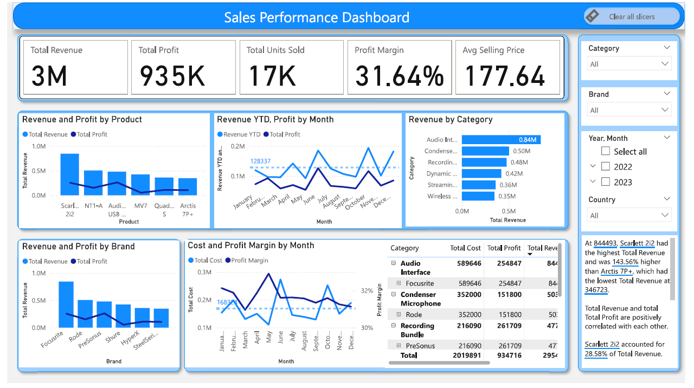
Dashboard

Slide 4
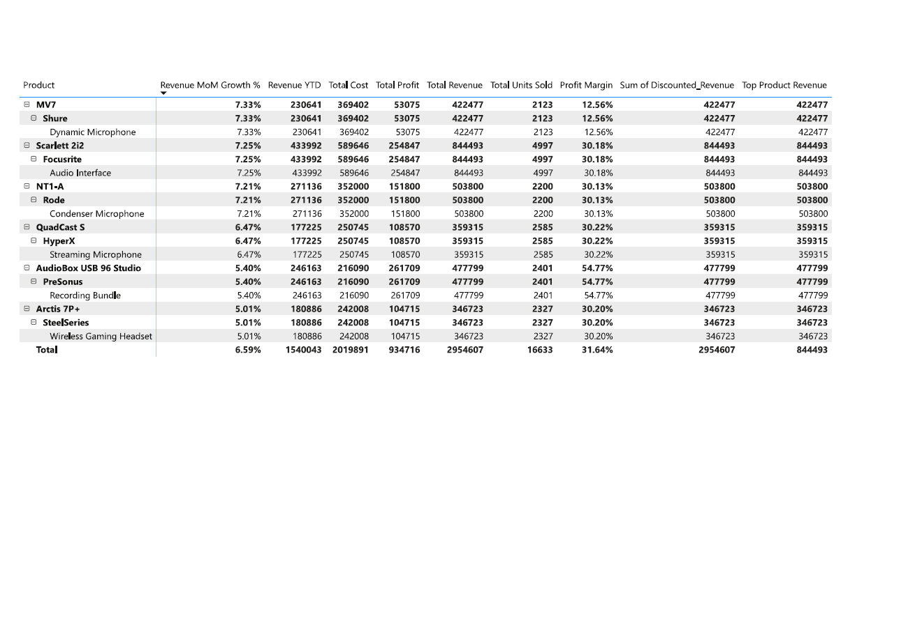
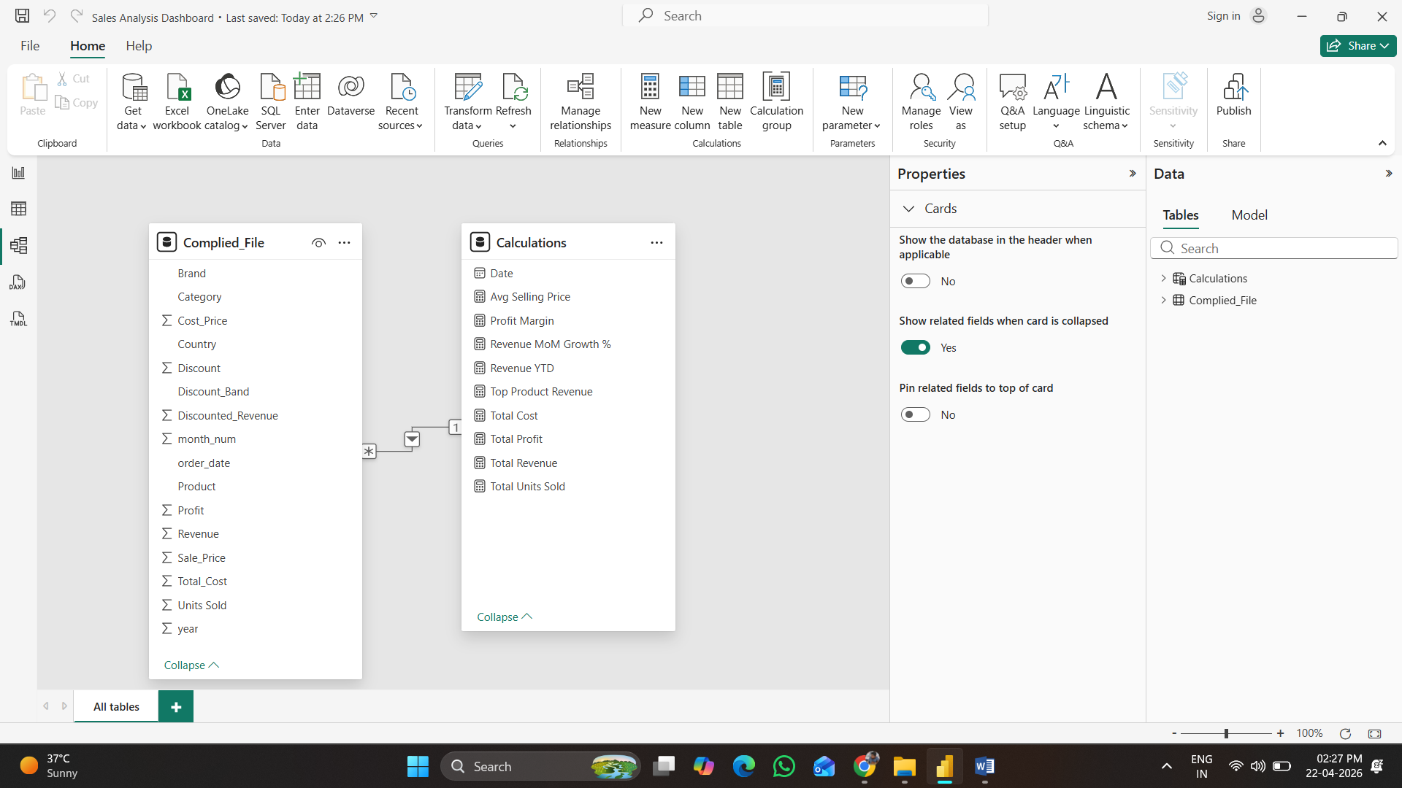
Data Modelling & Dashboard

Slide 5
Business Performance Overview
17K units sold
Avg Selling Price: 177.64
Healthy revenue-profit relationship
Consistent growth across months

Slide 6
Top Product Insights
Scarlett 2i2 generates highest revenue (~844K)
Strong demand driver
Focusrite brand dominates revenue contribution

Slide 7
Category Analysis
Audio Interface leads (~0.84M)
Condenser & Recording categories strong
Opportunity in lower categories

Slide 8
Monthly Trends
Revenue fluctuates with peaks mid-year
Profit follows revenue trend
Seasonality impact observed

Slide 9
Brand Performance
Focusrite highest performer
Rode & PreSonus mid-tier
SteelSeries lowest contribution

Slide 10
Profitability Insights
Profit margin ~31.64%
Some products exceed 50% margin
Cost optimization opportunity exists

Slide 11
Key Business Recommendations
Scale top products (Scarlett 2i2)
Increase marketing for high-margin items
Optimize low-performing brands
Leverage seasonal peaks

