Slide 1
Zepto Retail Analytics
Case Study | SQL + Power BI

Slide 2
Executive Summary
Revenue driven by few key categories
Discount strategy not directly impacting sales
Inventory inefficiencies causing revenue leakage
Opportunity to optimize pricing & stock management

Slide 3
Business Problem
Identify revenue drivers across categories
Evaluate discount effectiveness
Analyze inventory risks
Improve overall retail performance

Slide 4
Data Overview
1667 products analyzed
Key metrics: Revenue, Quantity, Discount %
Categories: FMCG, Produce, Essentials
Data cleaned and transformed using SQL

Slide 5
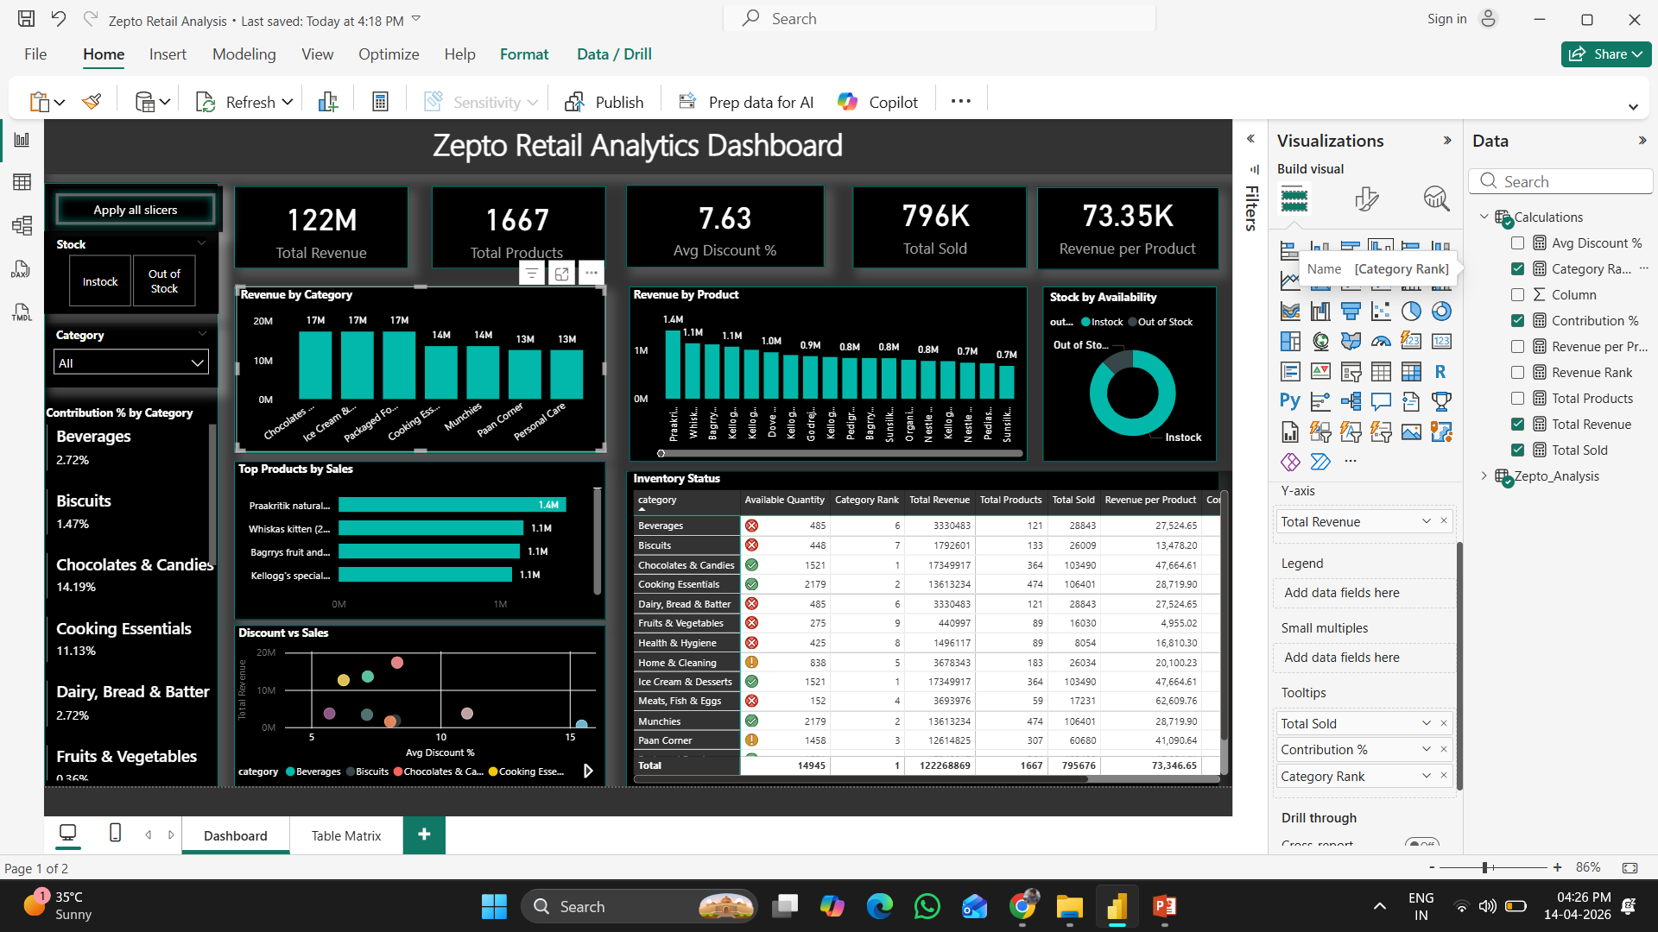
Dashboard Viz 1

Slide 6
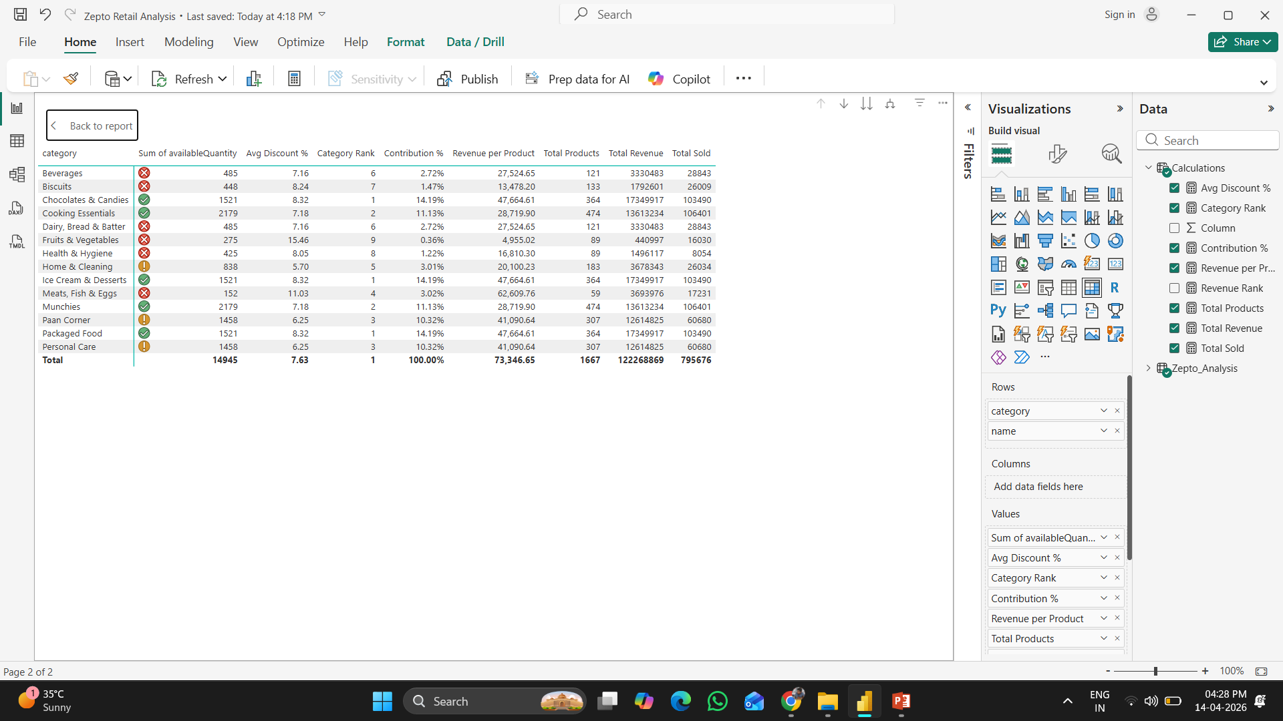
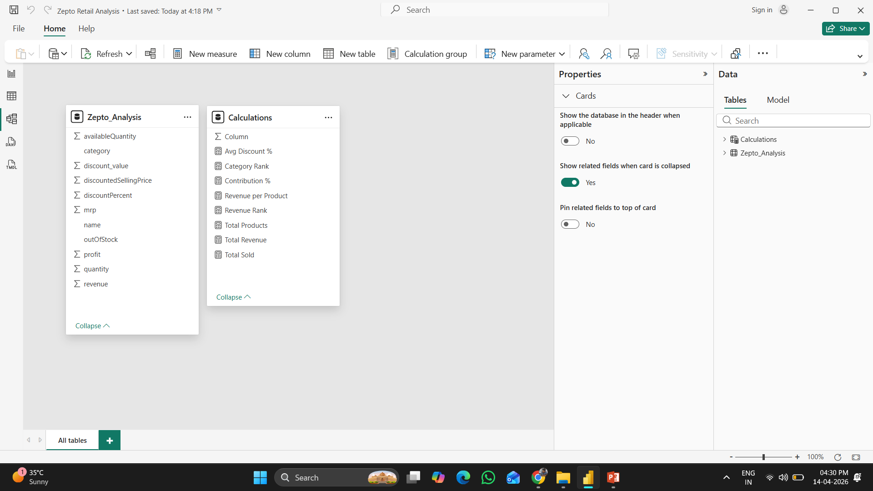
Dashboard Viz 2
Table Matrix
Data modelling

Slide 7
Key Metrics
Total Revenue: 122M
Total Products: 1667
Avg Discount: 7.63%
Total Sold: 796K
Revenue per Product: 73K

Slide 8
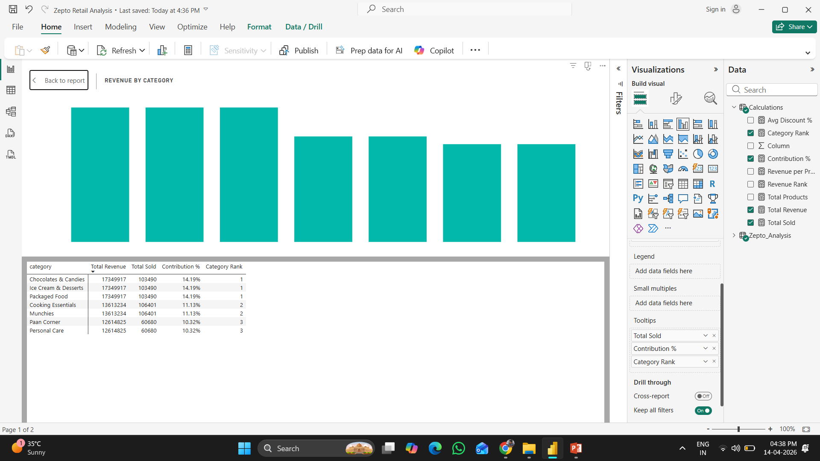
Category Performance Insights
Fruits & Vegetables dominate revenue
Cooking Essentials contribute significantly
Long tail categories contribute minimal revenue
Top Product Insights
Top 10 products drive majority sales
High dependency on few SKUs
Opportunity to diversify product performance

Slide 9
Discount Strategy Analysis
Higher discounts do not guarantee higher sales
Optimal pricing strategy needed
Potential margin loss due to excessive discounting

Slide 10
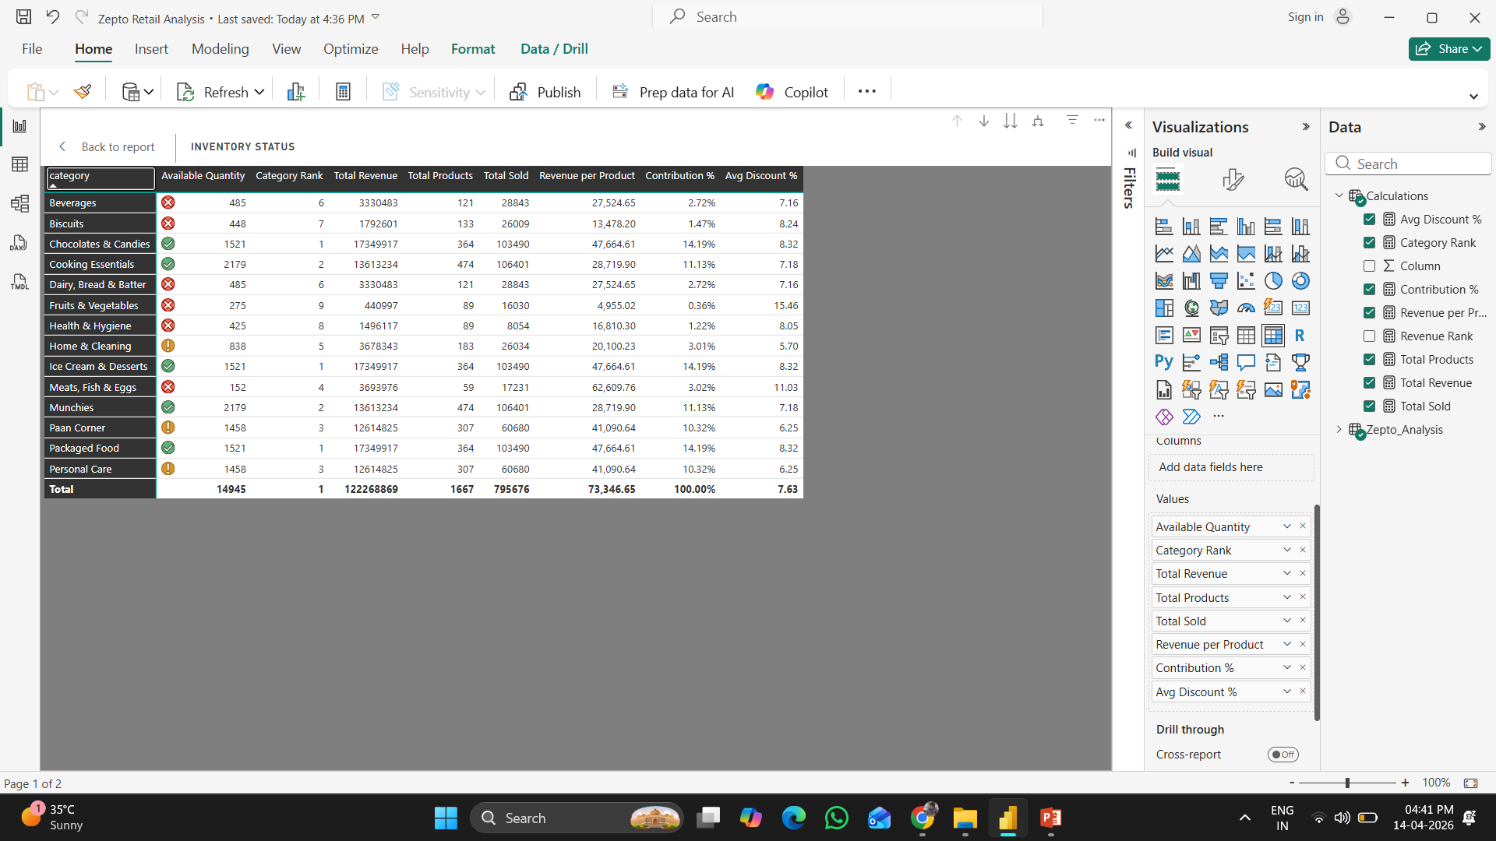
Inventory Insights
Out-of-stock high-value items detected
Low stock products risk future sales
Inventory imbalance across categories

Slide 11
Key Findings
Revenue concentration risk exists
Inventory inefficiencies impacting growth
Discount strategy needs optimization

Slide 12
Recommendations
Optimize pricing using data-driven approach
Improve inventory planning & forecasting
Focus on high-performing categories
Reduce dependency on top SKUs

Slide 13
Expected Business Impact
Increase revenue by optimizing pricing
Reduce stockouts and lost sales
Improve profitability
Enable better strategic decisions

Slide 14
Conclusion
Data-driven insights unlock growth potential
Power BI dashboard enables real-time monitoring
Scalable solution for retail analytics

