Slide 1
Customer Growth & Retention
Analyzing Revenue, Churn & Customer Behavior
Business Case Study | Power BI & SQL Portfolio

Slide 2
Executive Summary
High churn (~75%) threatens revenue despite strong performance
₹51M+ revenue driven by engaged users
Engagement is primary revenue driver
Immediate retention strategy required

Slide 3
Problem & Objective
Limited visibility into customer lifecycle
No clear link between engagement & revenue
High churn without root cause clarity
Build analytics Dashboard to drive decisions
Data & Approach
Integrated Customers, Subscriptions, Transactions, Activity
Star schema using customer_id
Analyzed behavior → revenue → churn
Built using Power BI (DAX) & MYSQL

Slide 4
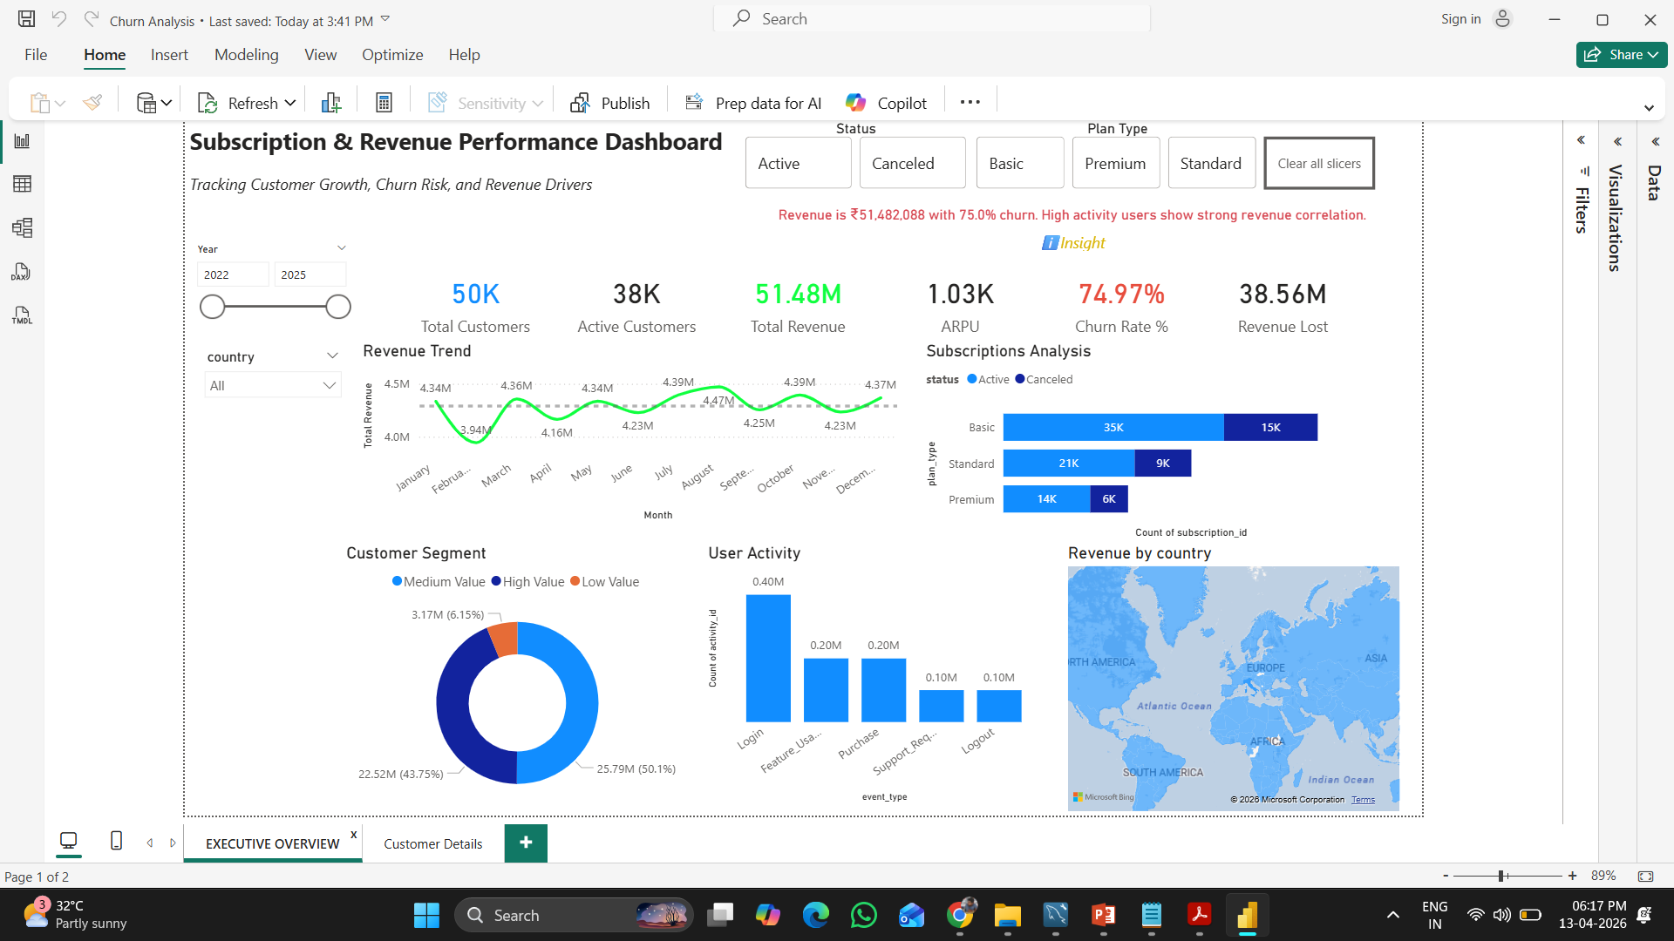
Revenue Performance & Churn
KPIs: Revenue, Customers, ARPU, Churn
Low activity is a leading indicator of churn risk
Retention presents the highest-impact opportunity to improve revenue and profitability
High churn threatens revenue, while engagement emerges as the key lever for growth.

Slide 5
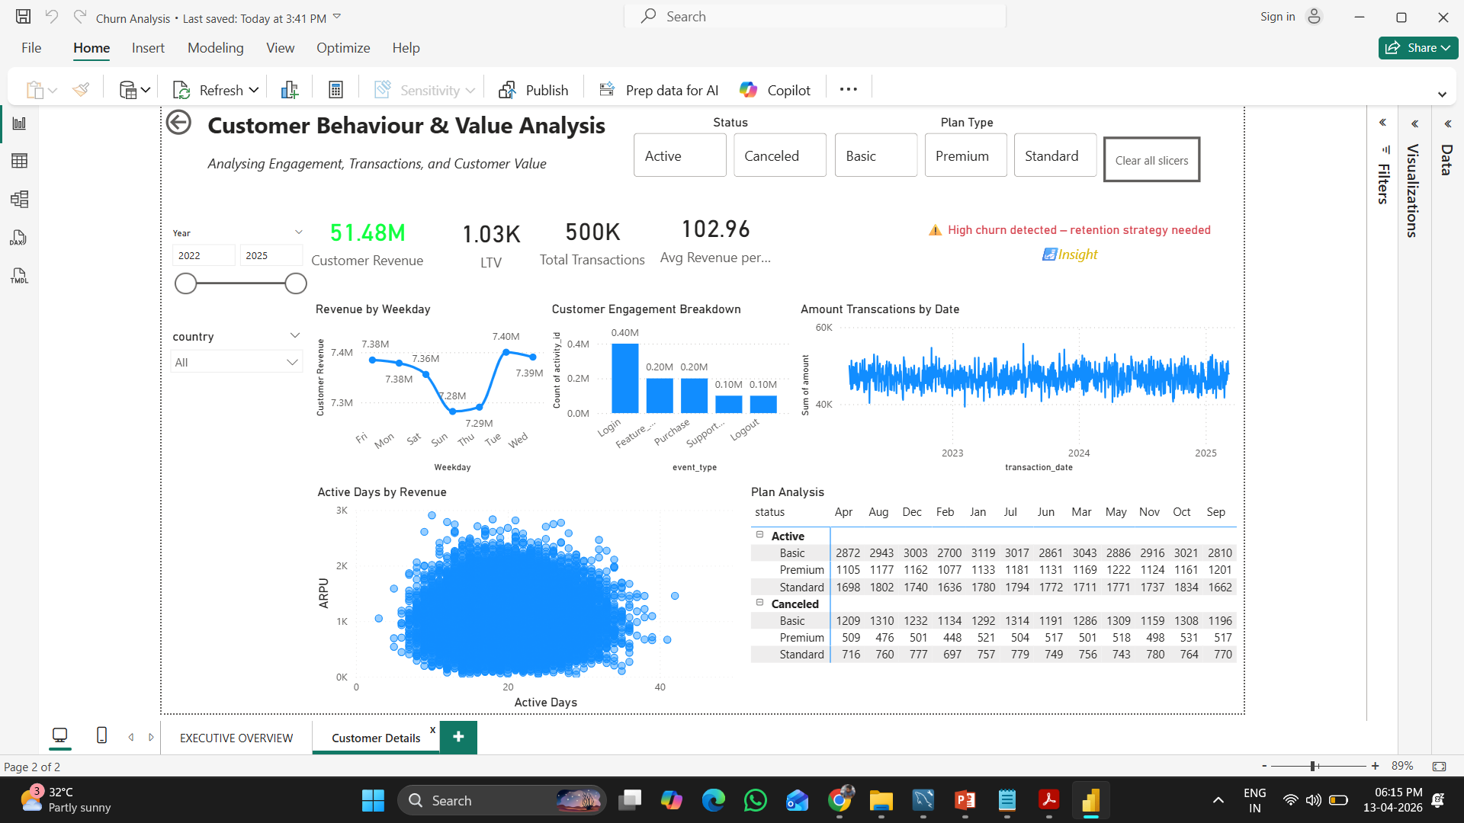
Customer Behavior Insights

Slide 6
Executive Takeaways
Retention is biggest growth lever
~75% churn is critical risk
Engagement drives revenue
Reducing churn improves sustainability
Recommendations & Impact
Target high-value customers & re-engage inactive users
Optimize pricing & subscription plans
Use activity signals for churn prediction
Improve retention → increase revenue

