Slide 1

Fundamentals of Reinforcement Learning and its Applications in Energy Efficient Wireless Sensor Networks
Presented By
Shubham Kumar
2448015
Guided By
Prof. Bharat Gupta
Electronics and Comm.
Department of Electronics and Communication Engineering National Institute Technology
Patna 800005

Slide 2
Presentation Roadmap
Motivation & Problem Statement
Introduction to Reinforcement Learning
Model Free Reinforcement Learning Algorithm
Q-Learning Demonstration in Gridworld Problem
Research Contribution in Energy Efficient WSNs
Experimental Results & Analysis
Conclusion & Future Directions

Slide 3
Motivation & Problem Statement
Use Case: Wireless Sensor Networks (WSNs) are widely used in healthcare, smart cities, environment monitoring and other various application in IoT.
Challenge: Sensor nodes are battery-powered and often deployed in harsh/inaccessible environments, thats why replacing batteries are costly or sometimes impossible.
Problem: Traditional routing/clustering protocol leads to imbalanced energy consumption, causing early node deaths and reducing overall network lifetime.
Need: A lightweight, adaptive mechanism that dynamically optimizes energy consumption to prolong network lifetime.
Motivation for RL: Reinforcement learning can deploy optimal energy-efficient strategies through interaction with the environment, without much computational overhead.

Slide 4
Literature Review
Paper & Year | Optimization Technique Used | N/w Lifetime Improved | Limitations / Research gap
Al-Kaseem et al. (2021) Optimized Energy-Efficient Path Planning with Multiple Mobile Sinks[2] | Ant Colony Optimization + Genetic Algorithm + Simulated Annealing | 66% vs. standard LEACH | Heavy computation demand Static environment
Raed et al. (2022) Efficient Energy Mechanism for Underground Mining Monitoring[3] | Enhanced LEACH + DEECP | 25% vs standard LEACH | No mobility support Static environment
Salman et al. (2022) Optimization of LEACH Protocol for WSNs in Terms of Energy Efficiency and Network Lifetime[4] | Particle Swarm Optimization | 30% vs. standard LEACH | No mobility support Non heterogeneous environmnt
Gamal et al. (2022) Enhancing Lifetime of WSNs Using Fuzzy Logic LEACH and Particle Swarm Optimization[5] | Fuzzy + Particle Swarm Optimization | 18% vs. standard LEACH | Increased control overhead from fuzzy inference
Mohapatra et al. (2022) Mobility Induced Multi-Hop LEACH Protocol in Heterogeneous Mobile Network[6] | Modified multi-hop LEACH | 20% vs. standard LEACH | Assumes uniform mobility Non heterogeneous environmnt

Slide 5
Research Objectives
Understand RL Fundamentals: Study key concepts including Value Iteration, Policy Iteration, Monte Carlo, SARSA and Q-Learning.
Demonstrate RL Concepts: Implement Gridworld example on 2×8 LED matrix grid for intuitive visualization.
Optimize WSN Energy Efficiency: Apply Q-Learning for adaptive Cluster Head (CH) selection in a cluster based network.
Compare Performance: Evaluate network lifetime, against baseline protocols such as
Distributed Energy-Efficient Clustering Protocol (DEECP)
Enhanced Distributed Energy-Efficient Clustering Protocol (E-DEECP)

Slide 6

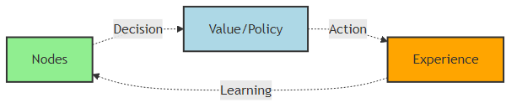
Introduction to Reinforcement Learning
Definition: Reinforcement Learning (RL) is a learning paradigm where an agent learns to make decisions by interacting with an environment to maximize cumulative reward.
Agent Environment Interaction:
Agent: Makes decisions by taking actions
Environment: Responds with new states and rewards/penalty
Goal: Find an optimal policy that maximizes expected return
Trial-and-Error Learning: Agent explores actions, observes outcomes and updates its strategy iteratively.
Agent learning behavior

Slide 7
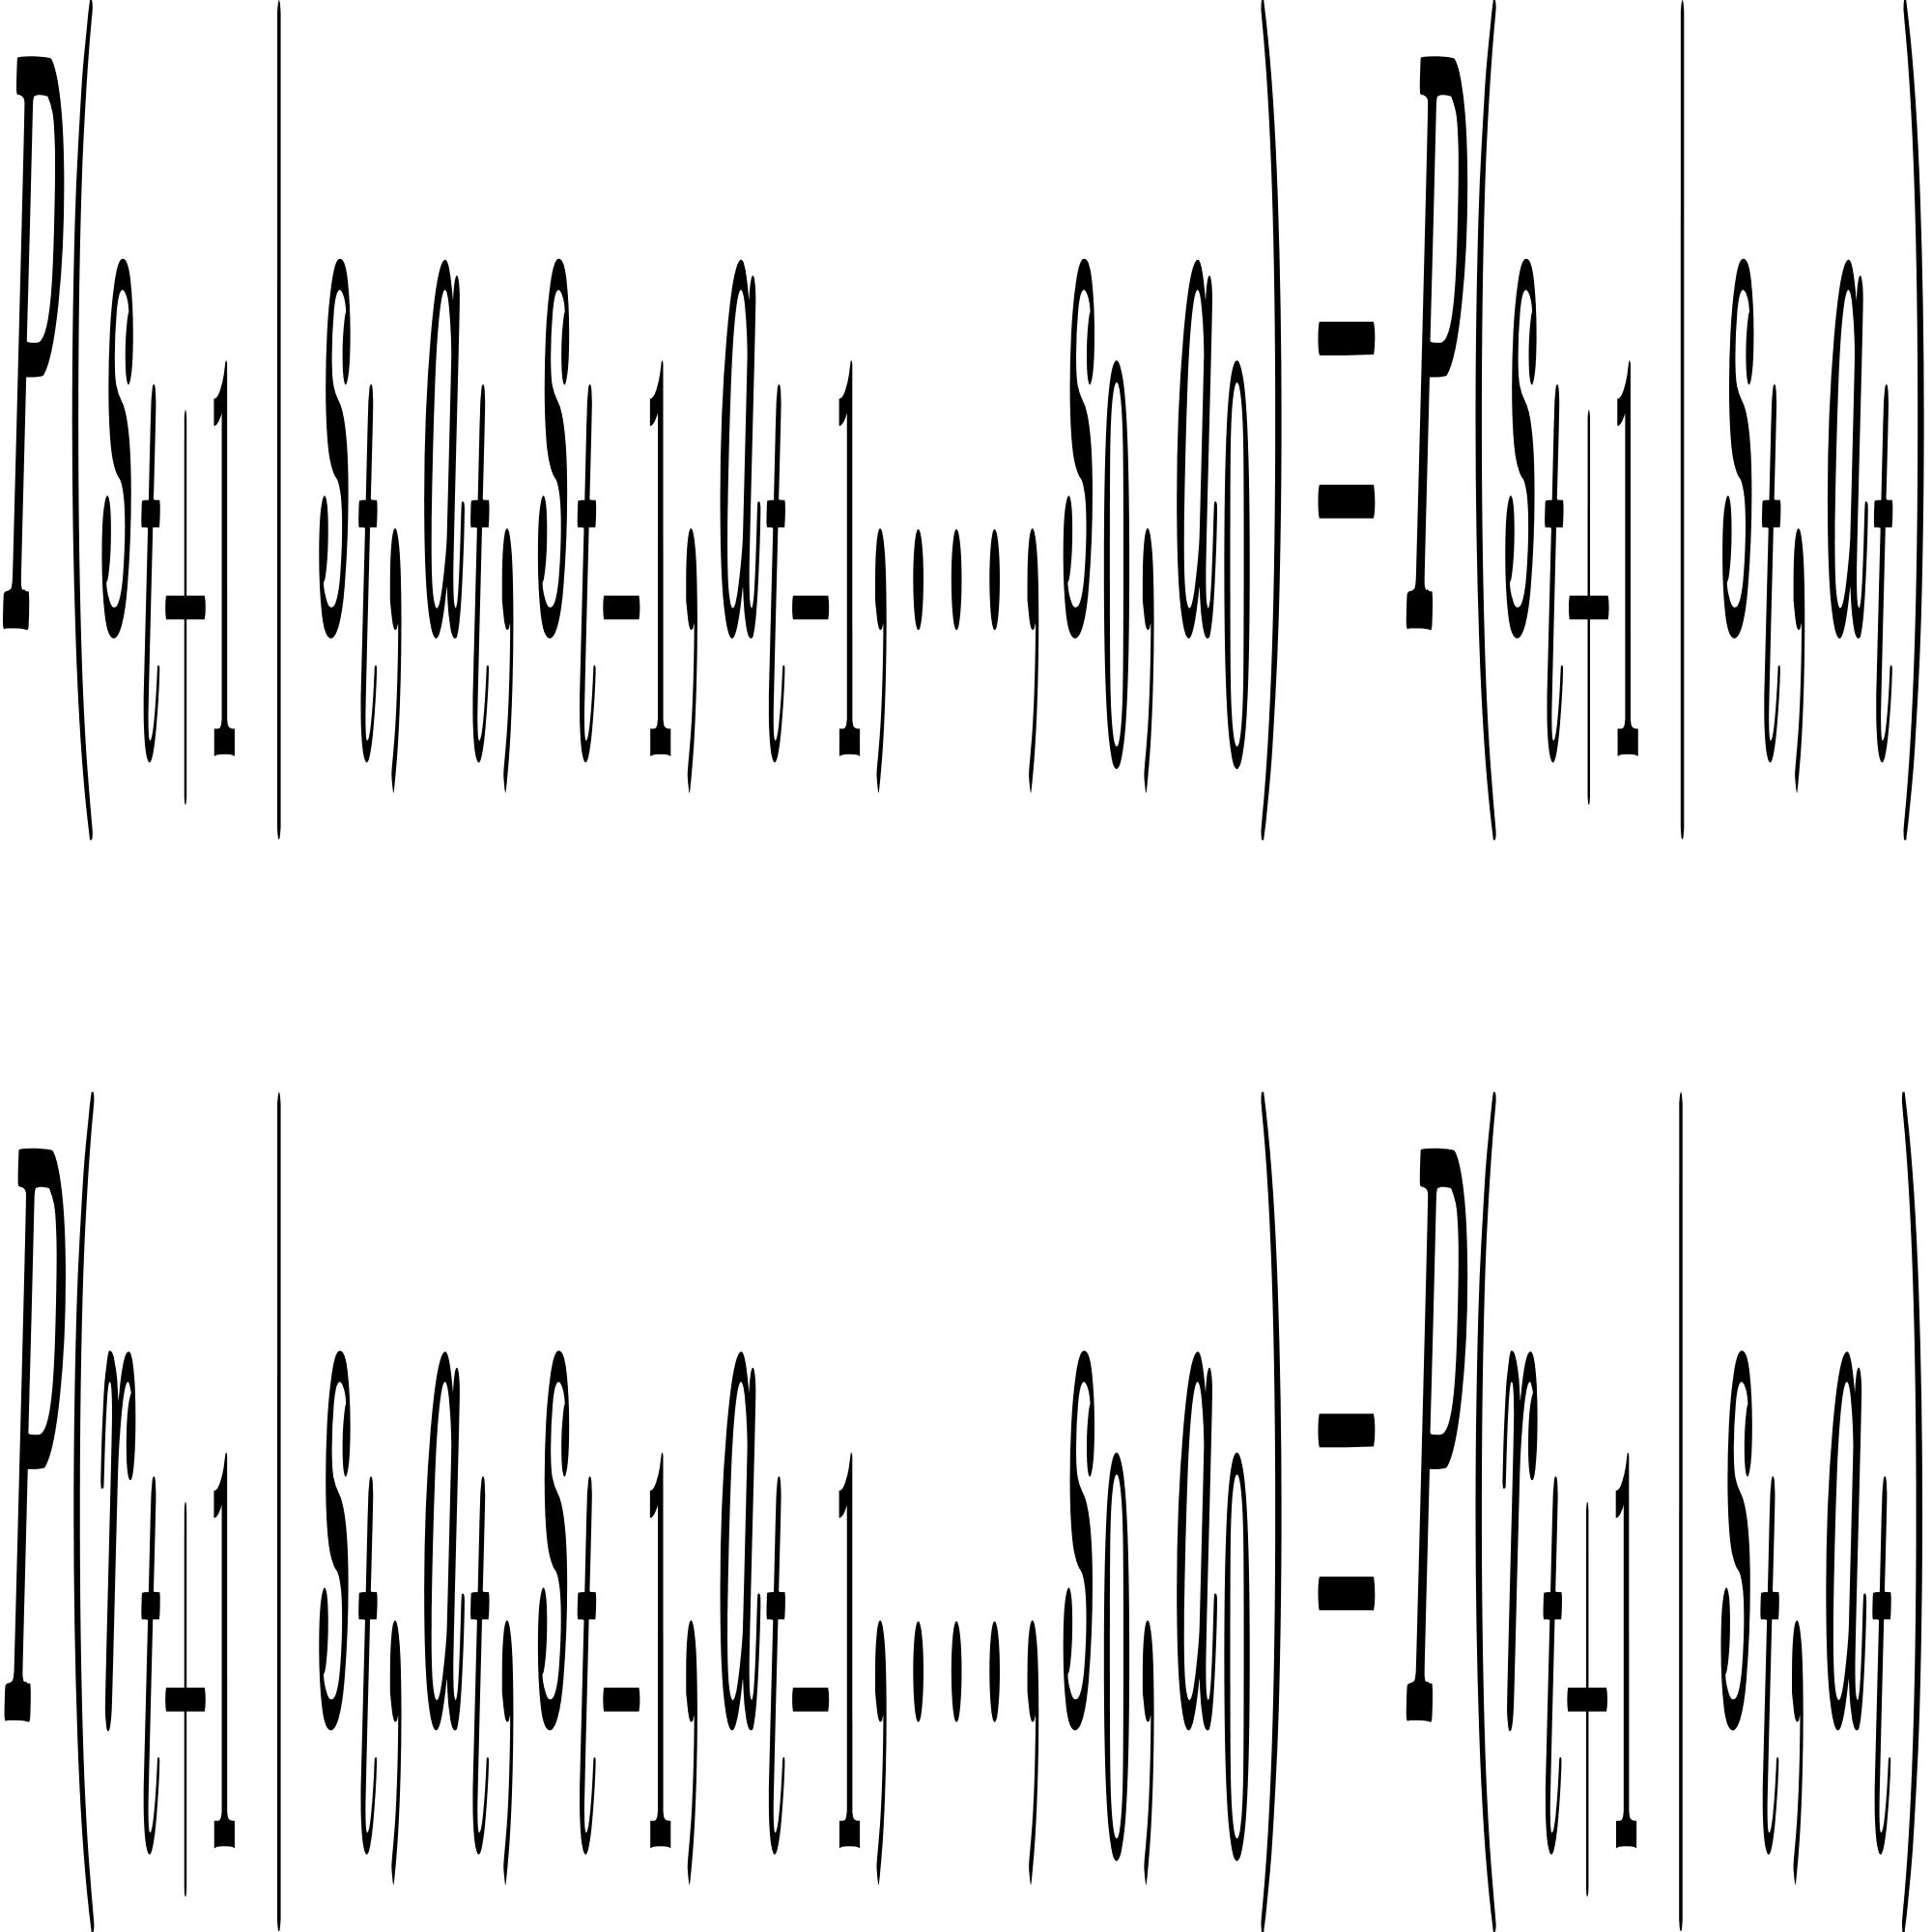



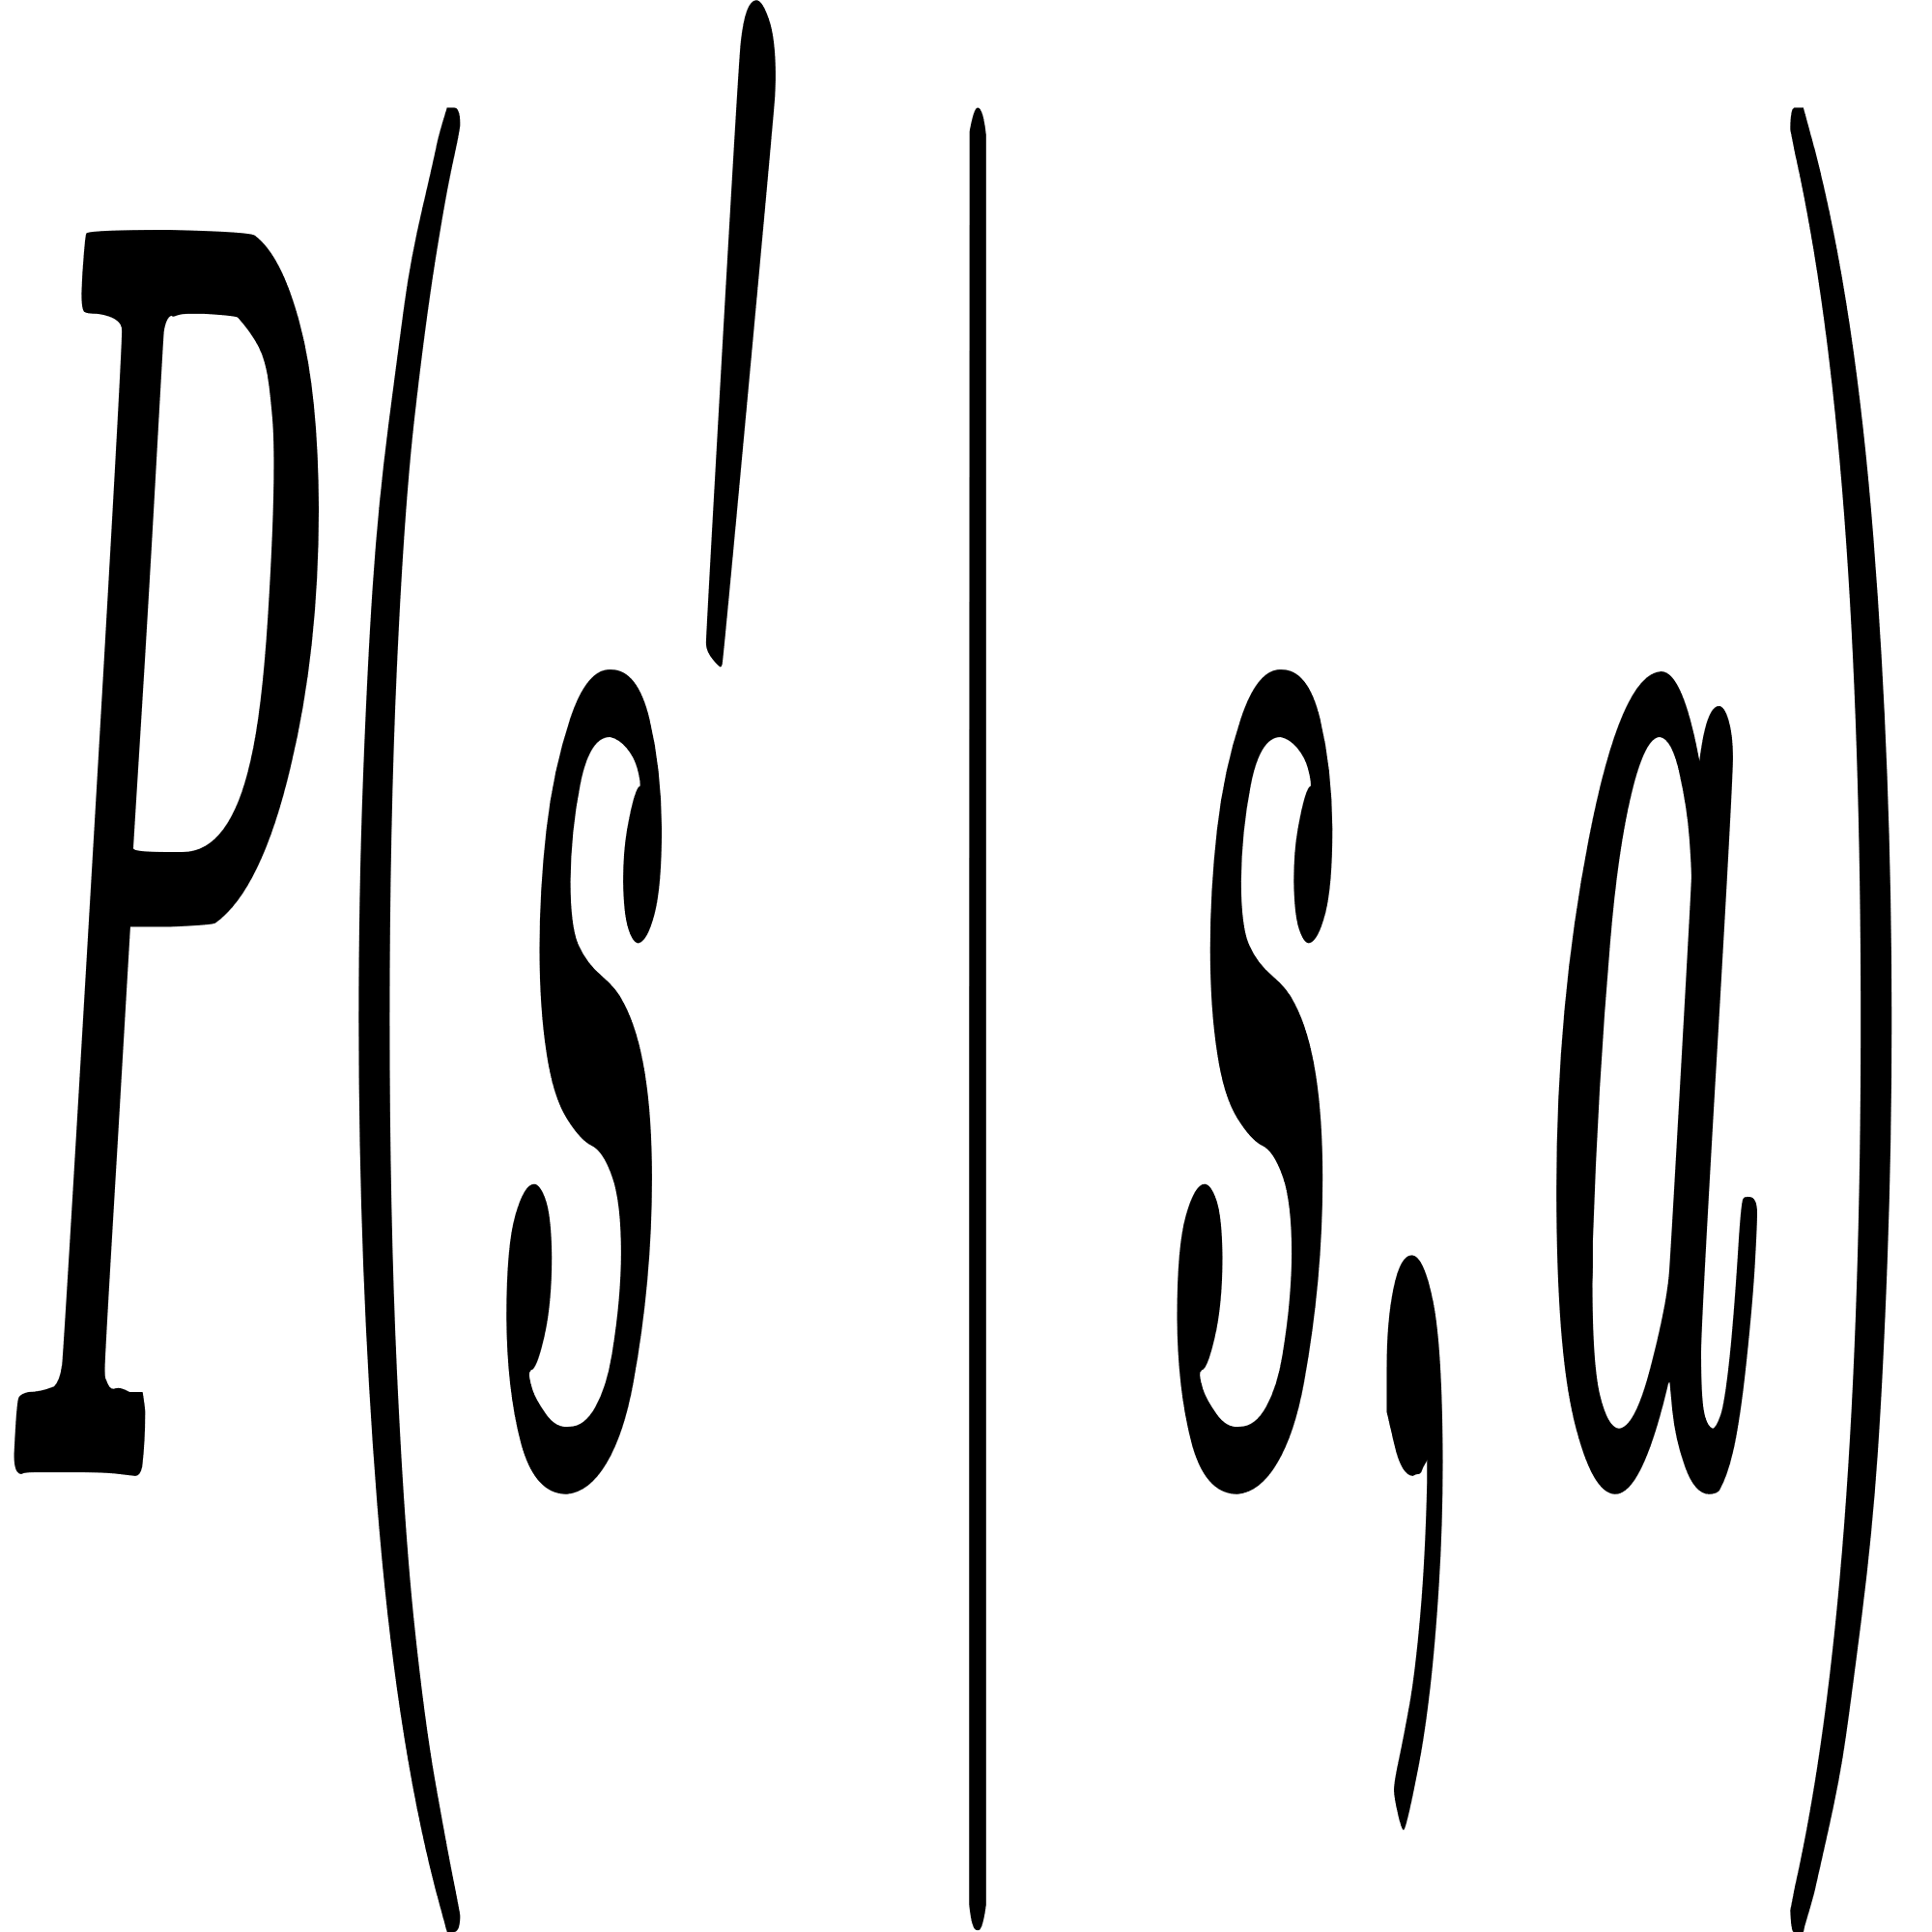
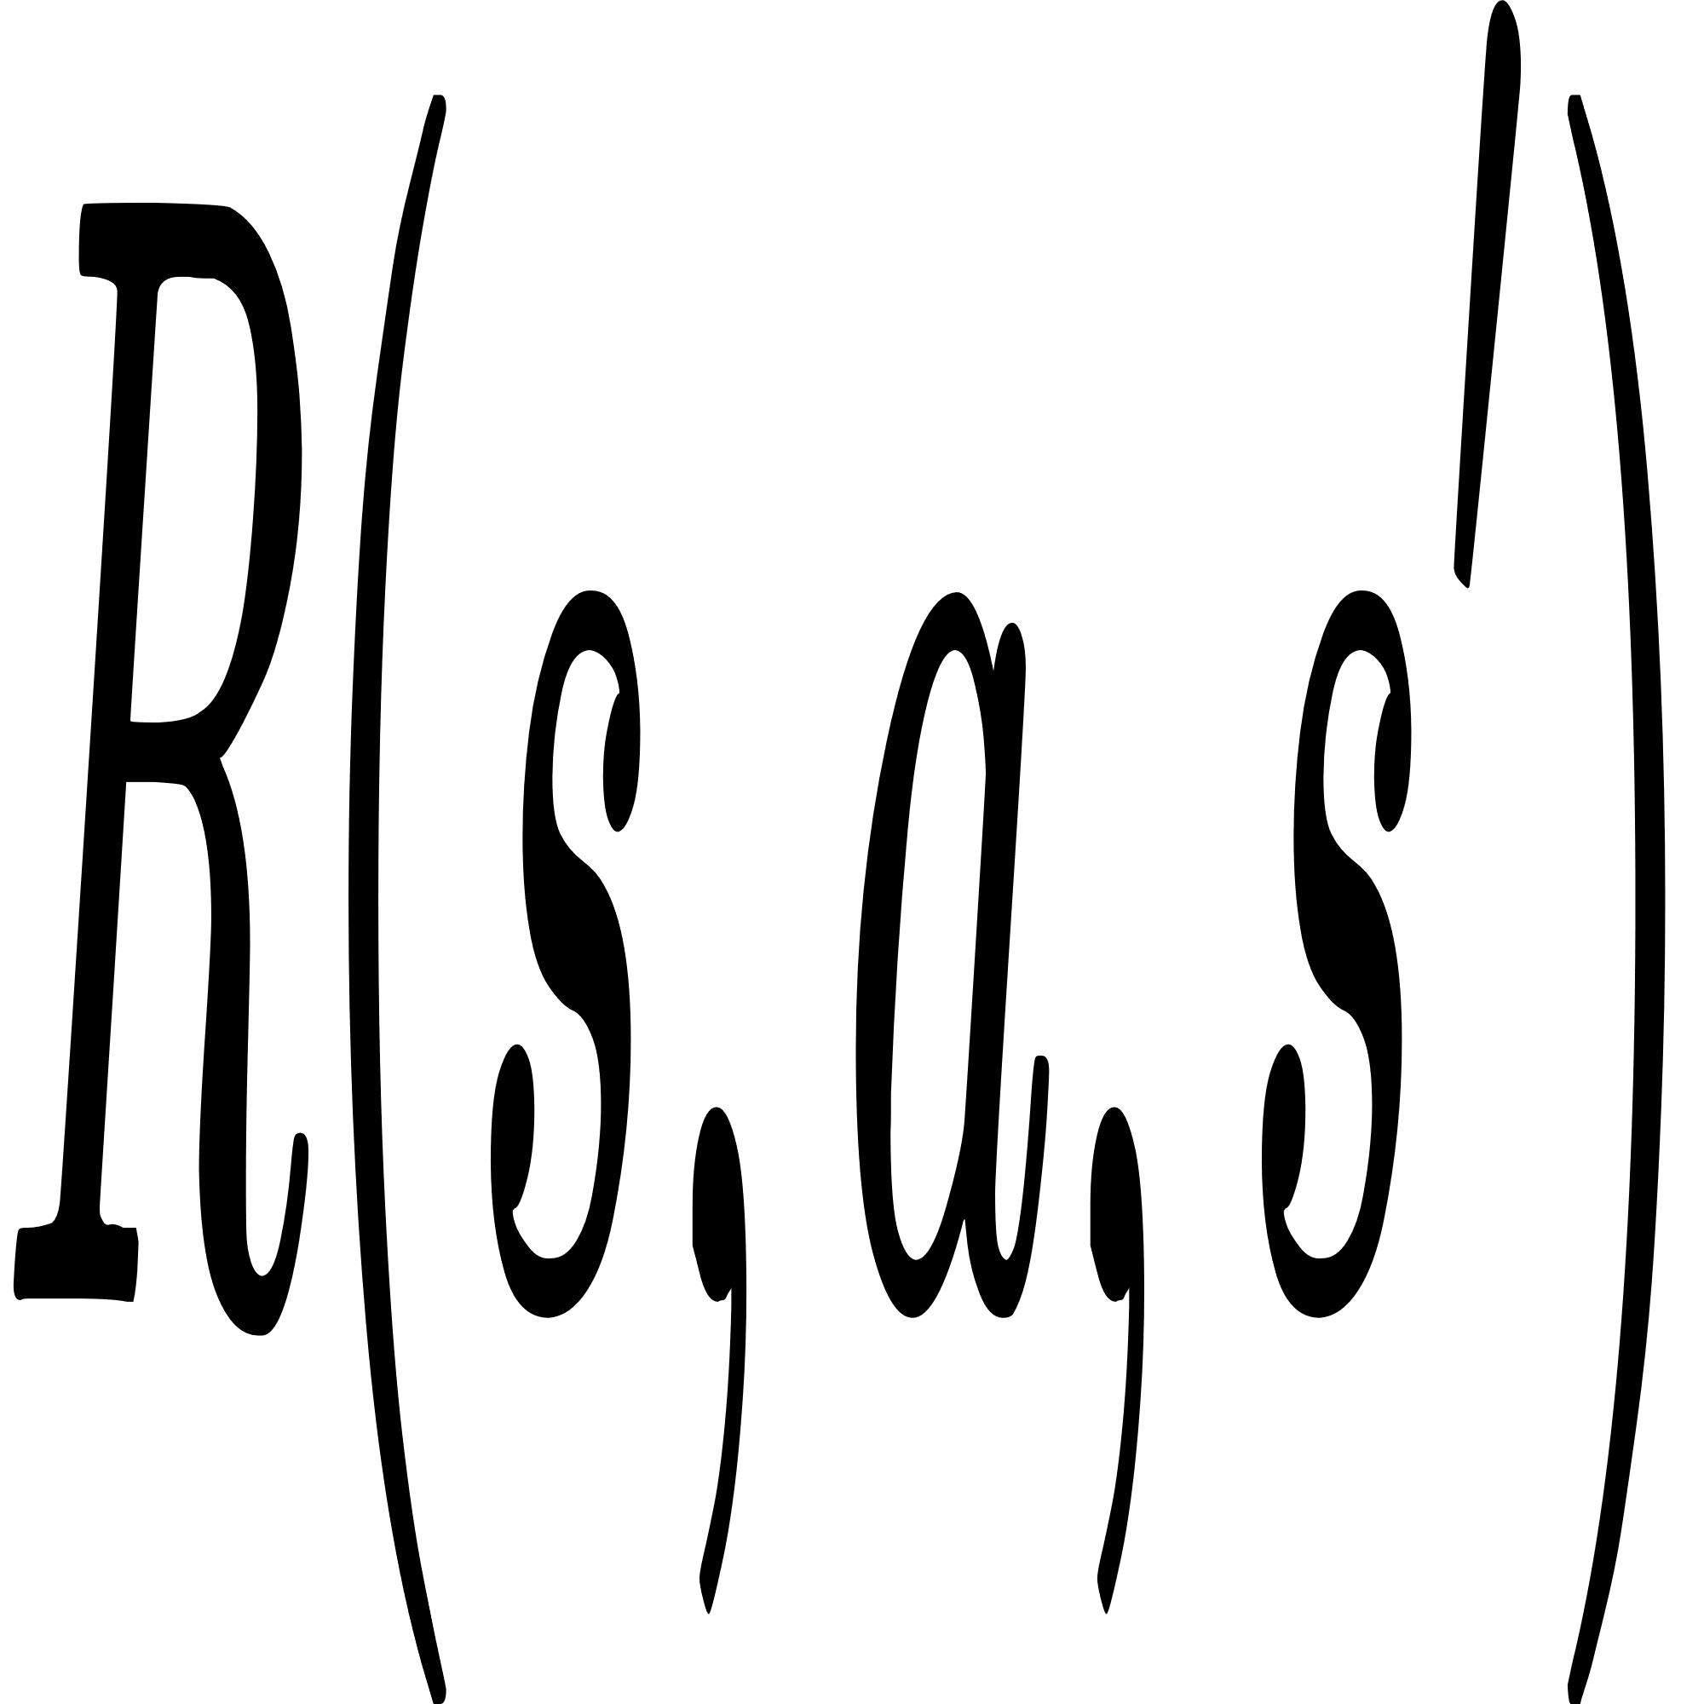

Modeling RL with Markov Decision Processes
Foundation: RL rely on the fact that environment satisfies the Markov property that is the next state depends only on the current state and action, not on the history.
where
: state of current timestamp
: choosing action of current timestamp
: getting rewad at current timestamp
: transition probability
Components: MDP defines the environment States S, Actions A, Transition Probability , Reward as well as Discount Factor Gamma .
Model: The transition dynamics of environment and reward function are considered as model.

Slide 8


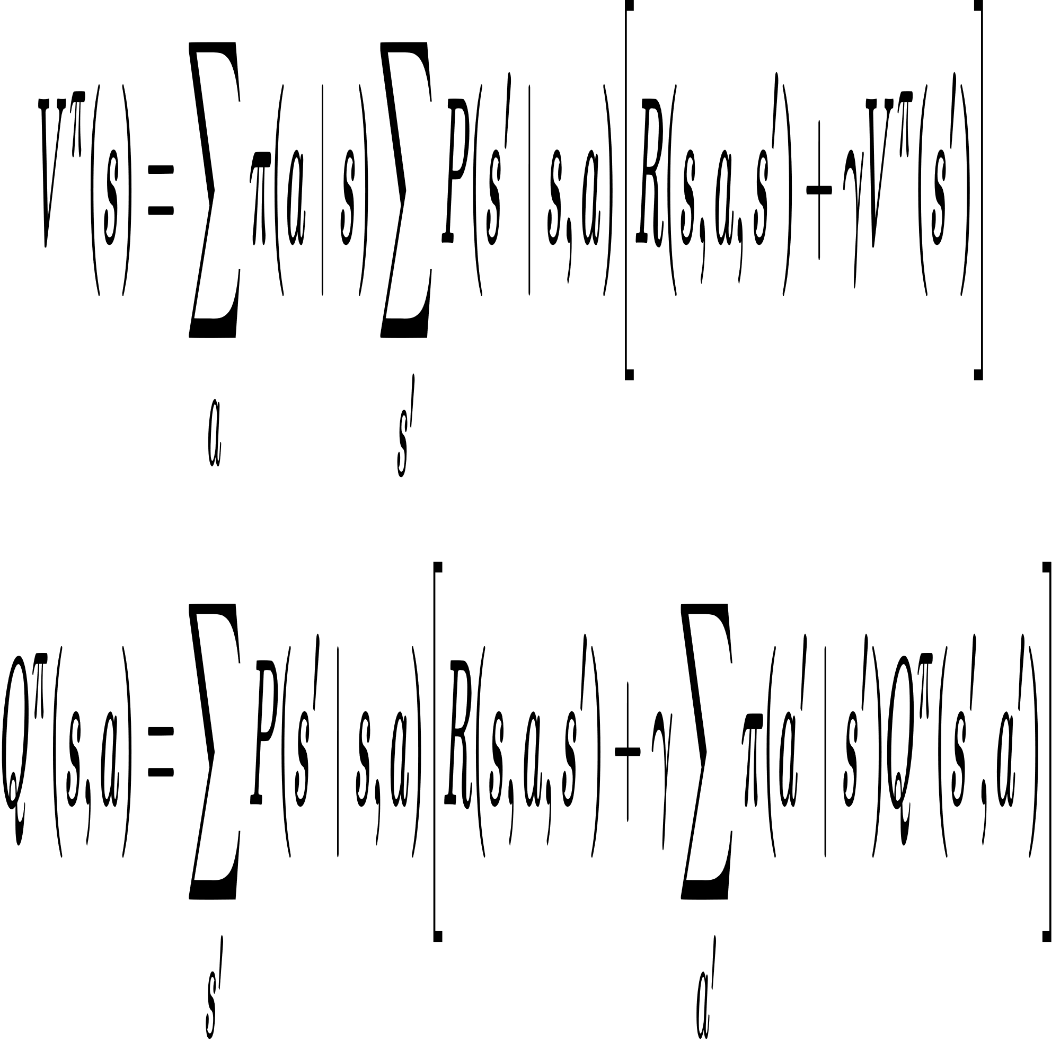
Value Functions and Bellman Equations
State Value Function : It maps expected return under policy 𝜋, using MDP transition probabilities and reward function.
Action-Value Function : It maps state-action pairs to expected return based on MDP dynamics. It allows RL to determine which action in a given state is best.
Bellman Equations: Encode recursive relationship between the current value of a state and values of successor states using MDP’s transition and reward functions.
All variables as defined previously.
Use Case: Using these equations, we iteratively compute the optimal state value or optimal policy, as the Bellman equation is bound to converge.

Slide 9
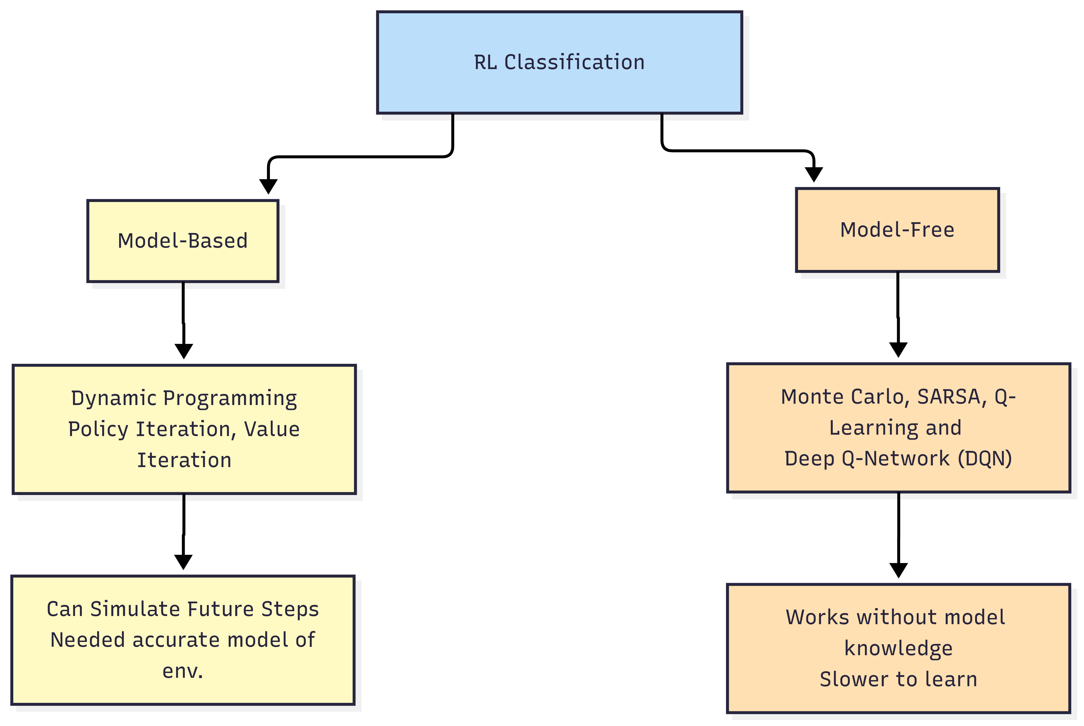
Classification of Reinforcement Learning
Q-Learning classification

Slide 10
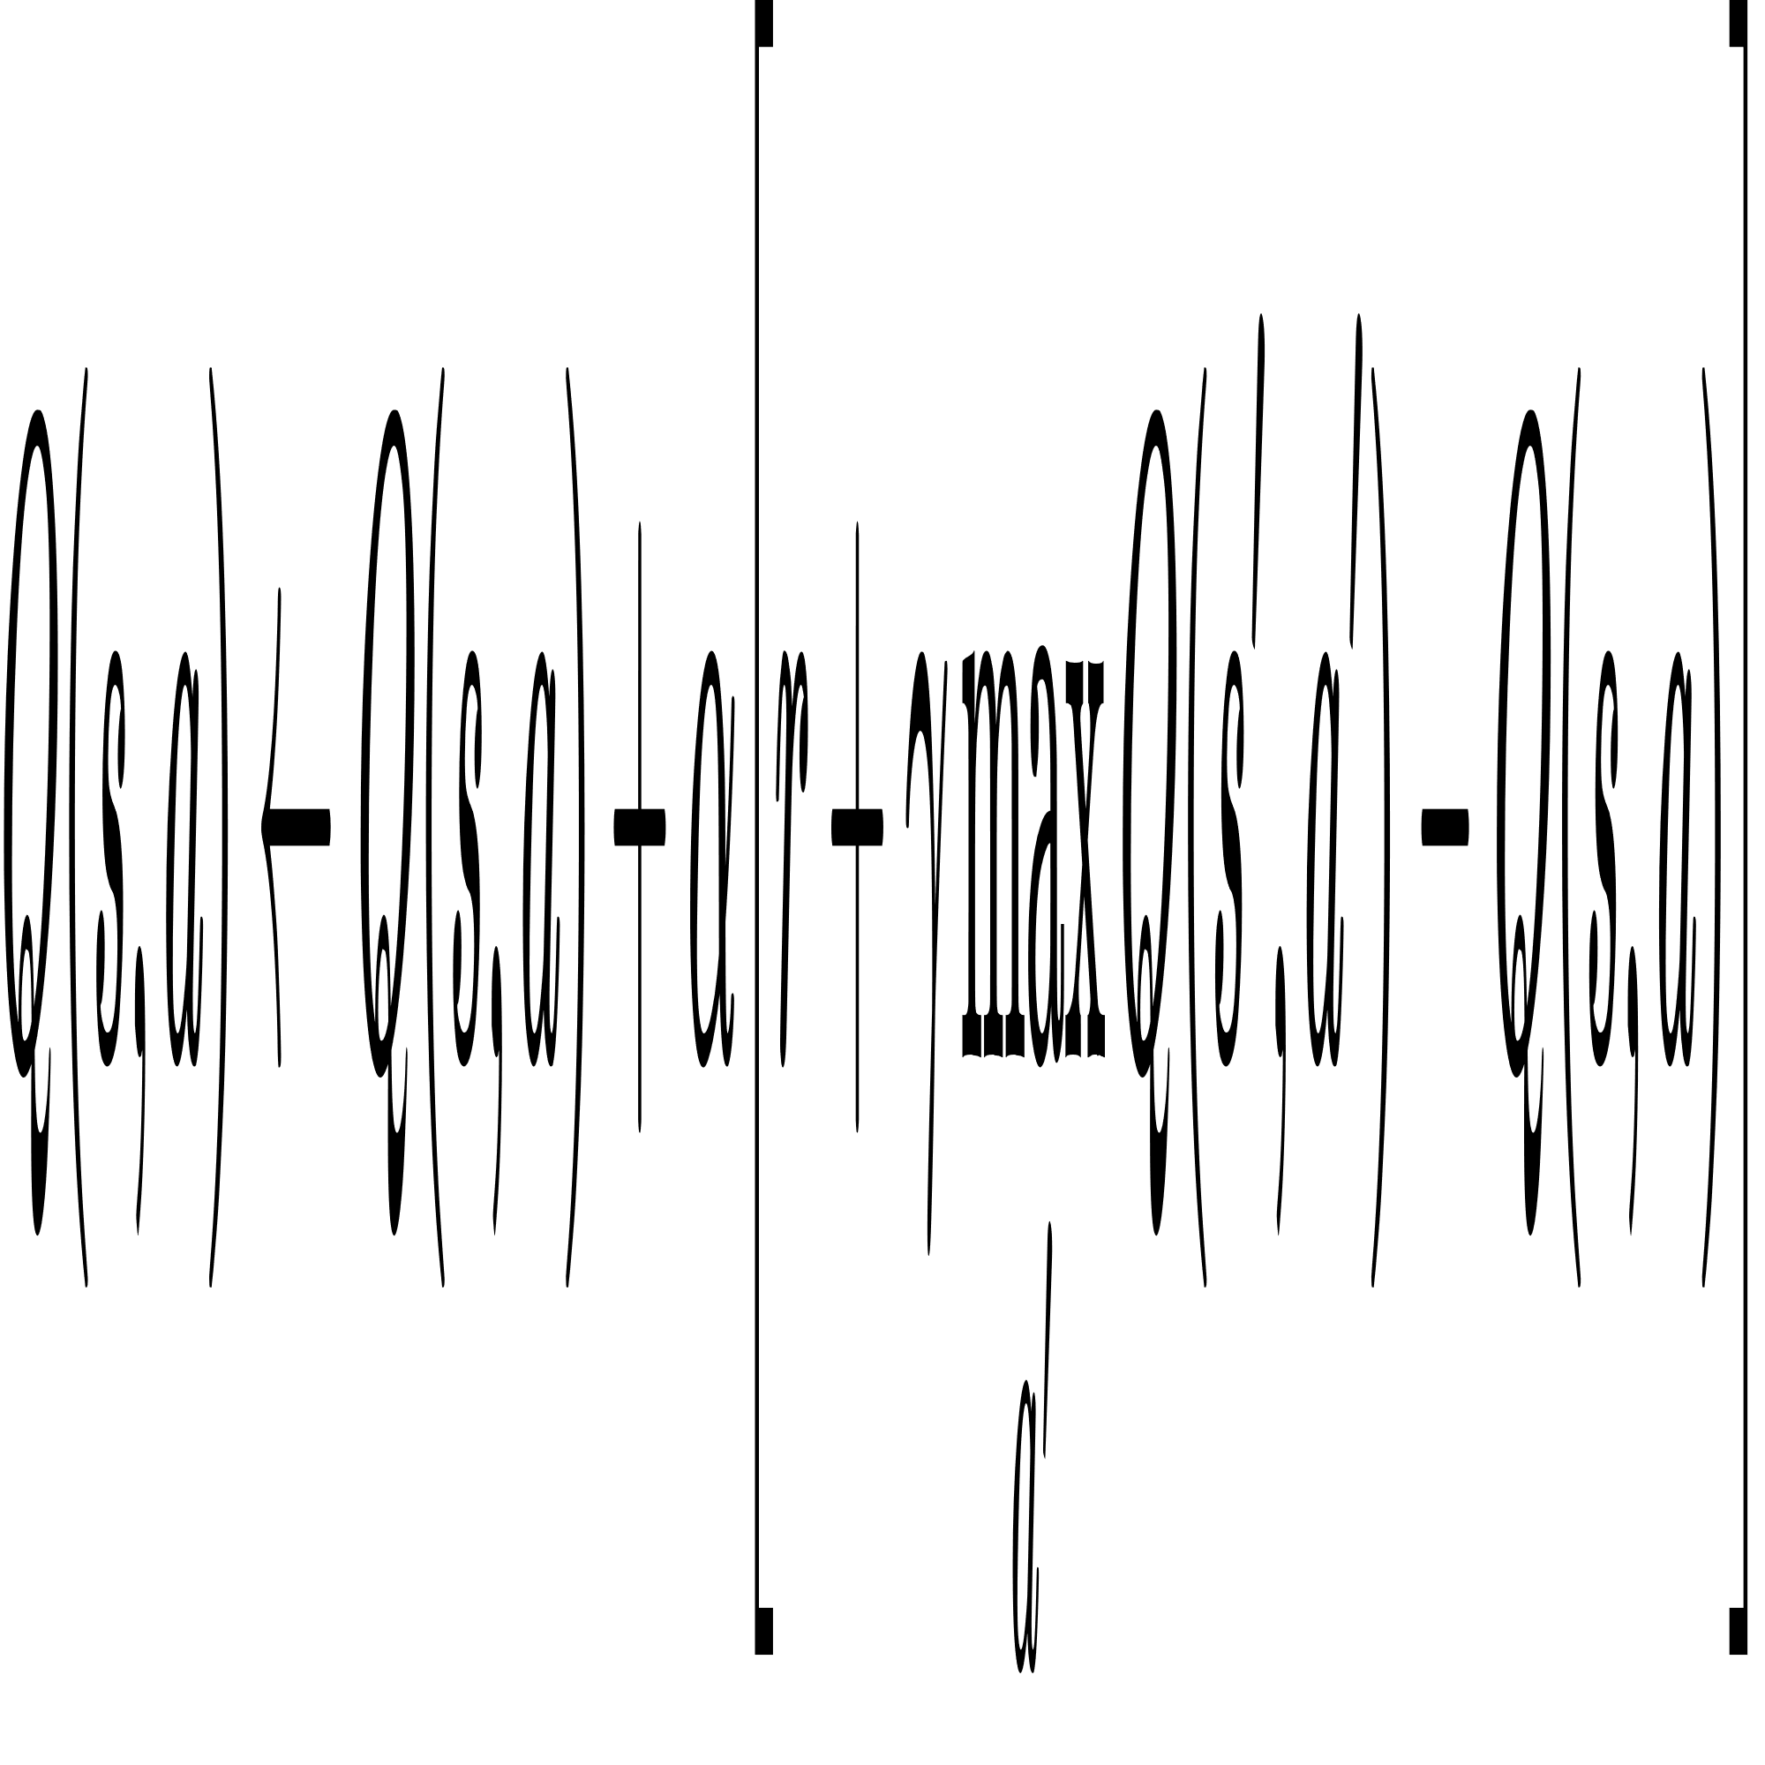
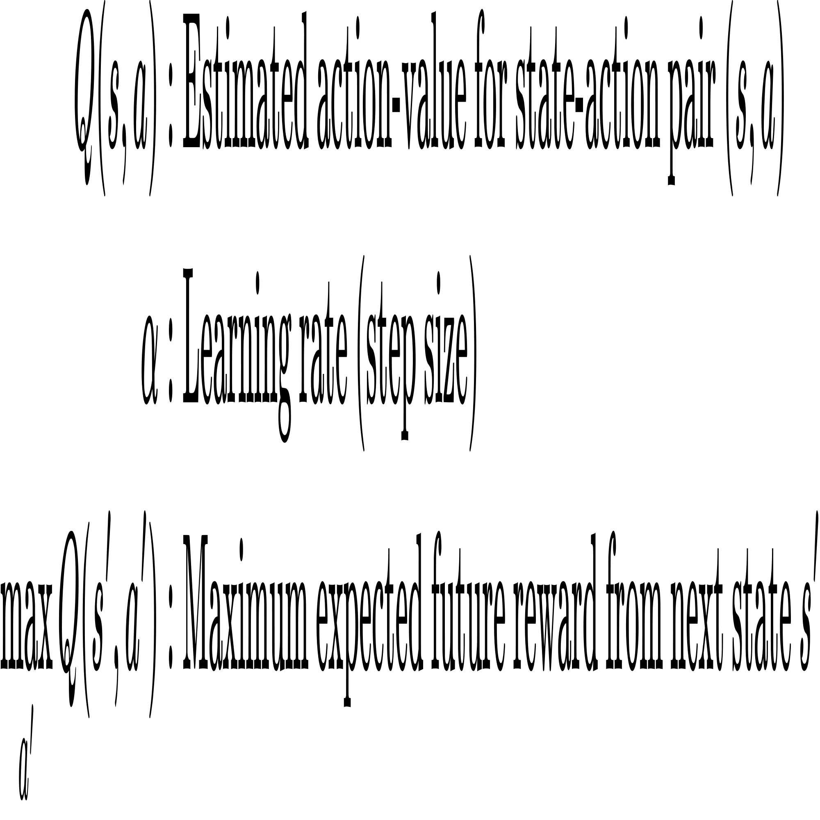
Model Free RL Q-Learning
Overview: Q-Learning helps the agent learn the optimal action-value function 𝑄∗(s,a) through trial-and-error, maintaining a Q-table for all state-action pairs.
Q-Learning Update Formula: This iterative formula solves the Bellman optimality equation for action values, allowing direct convergence to the optimal policy.
Q-Table: Stores Q(s,a) for all state-action pairs, where rows represent states and columns represent actions, holding expected rewards to guide the agent toward optimal actions.

Slide 11
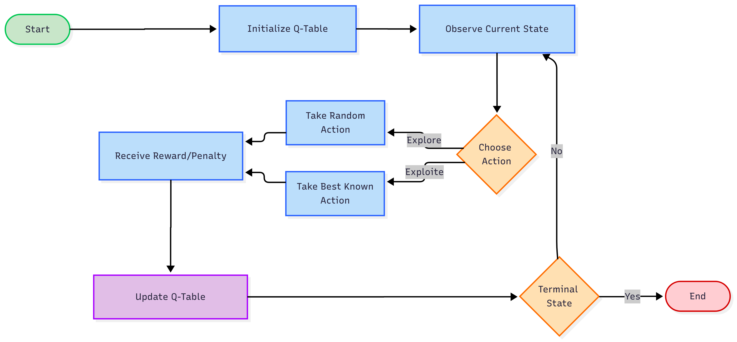
Q-Learning Workflow
Q-Learning behavior

Slide 12
Q-Learning Demonstration
Environment Setup:
LED Matrix: 2×16 grid representing the environment.
Actions: Up, Down, Left, Right (4 possible moves).
Agent: 2×2 block that moves through the matrix to find optimal policy to reach terminal state.
Learning Process:
Agent starts at a random state for each episode.
Moves based on ε-greedy policy using Q-table.
Receives rewards for reaching target cells or avoiding obstacles.
Q-values updated iteratively via Q-Learning formula.
Outcome:
Over the time, agent learns optimal paths through the matrix.
Q-Table guides movement toward high-reward states.
Enhances agent’s adaptability and robustness in changing environments.

Slide 13
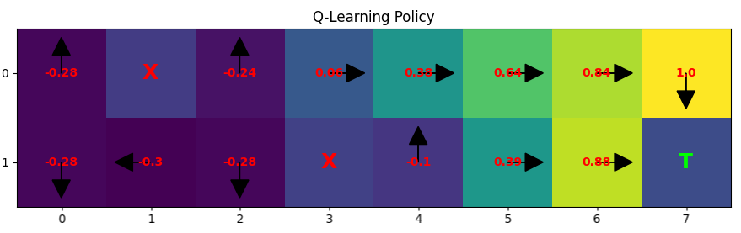
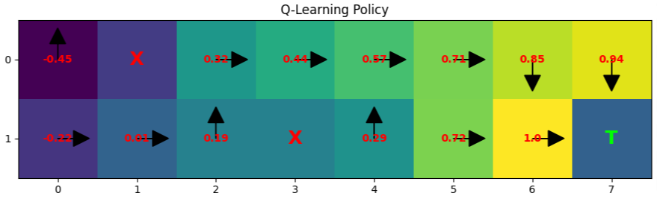
Q-Learning Demonstration
Policy after 20 episodes of iteration.
Policy after 50 episodes of iteration

Slide 14
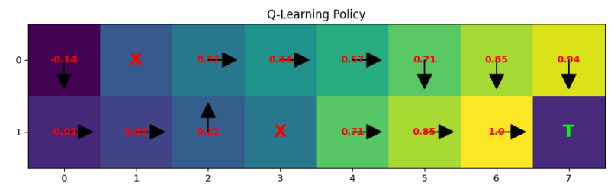
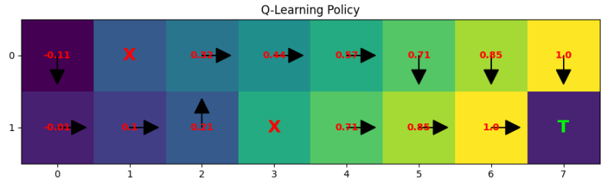
Q-Learning Demonstration
Policy after 100 episodes of iteration
Policy after 1000 episodes of iteration

Slide 15
Need for Q-Learning in WSNs
Deployment Challenges:
WSNs are generally placed in harsh and inaccessible environments.
Need a mechanism to prolong network lifetime and maintain reliability.
Limitations of Existing Protocols
LEACH: Random CH selection energy imbalance & early node death.
DEECP: Considers residual energy but still probabilistic/static.
E-DEECP: Classifies heterogeneity into only three categories and distance to base startion, but lacks adaptability.
All rely on static heuristics, hence not suitable for dynamic environments.
Advantages of Q-Learning
Adaptive & Dynamic: Learns from network state by updating Q-Table
Balanced Energy Consumption: Prevents overuse of high-energy nodes.
Heterogeneous Support: Works well in networks with multi level of node energy levels.

Slide 16
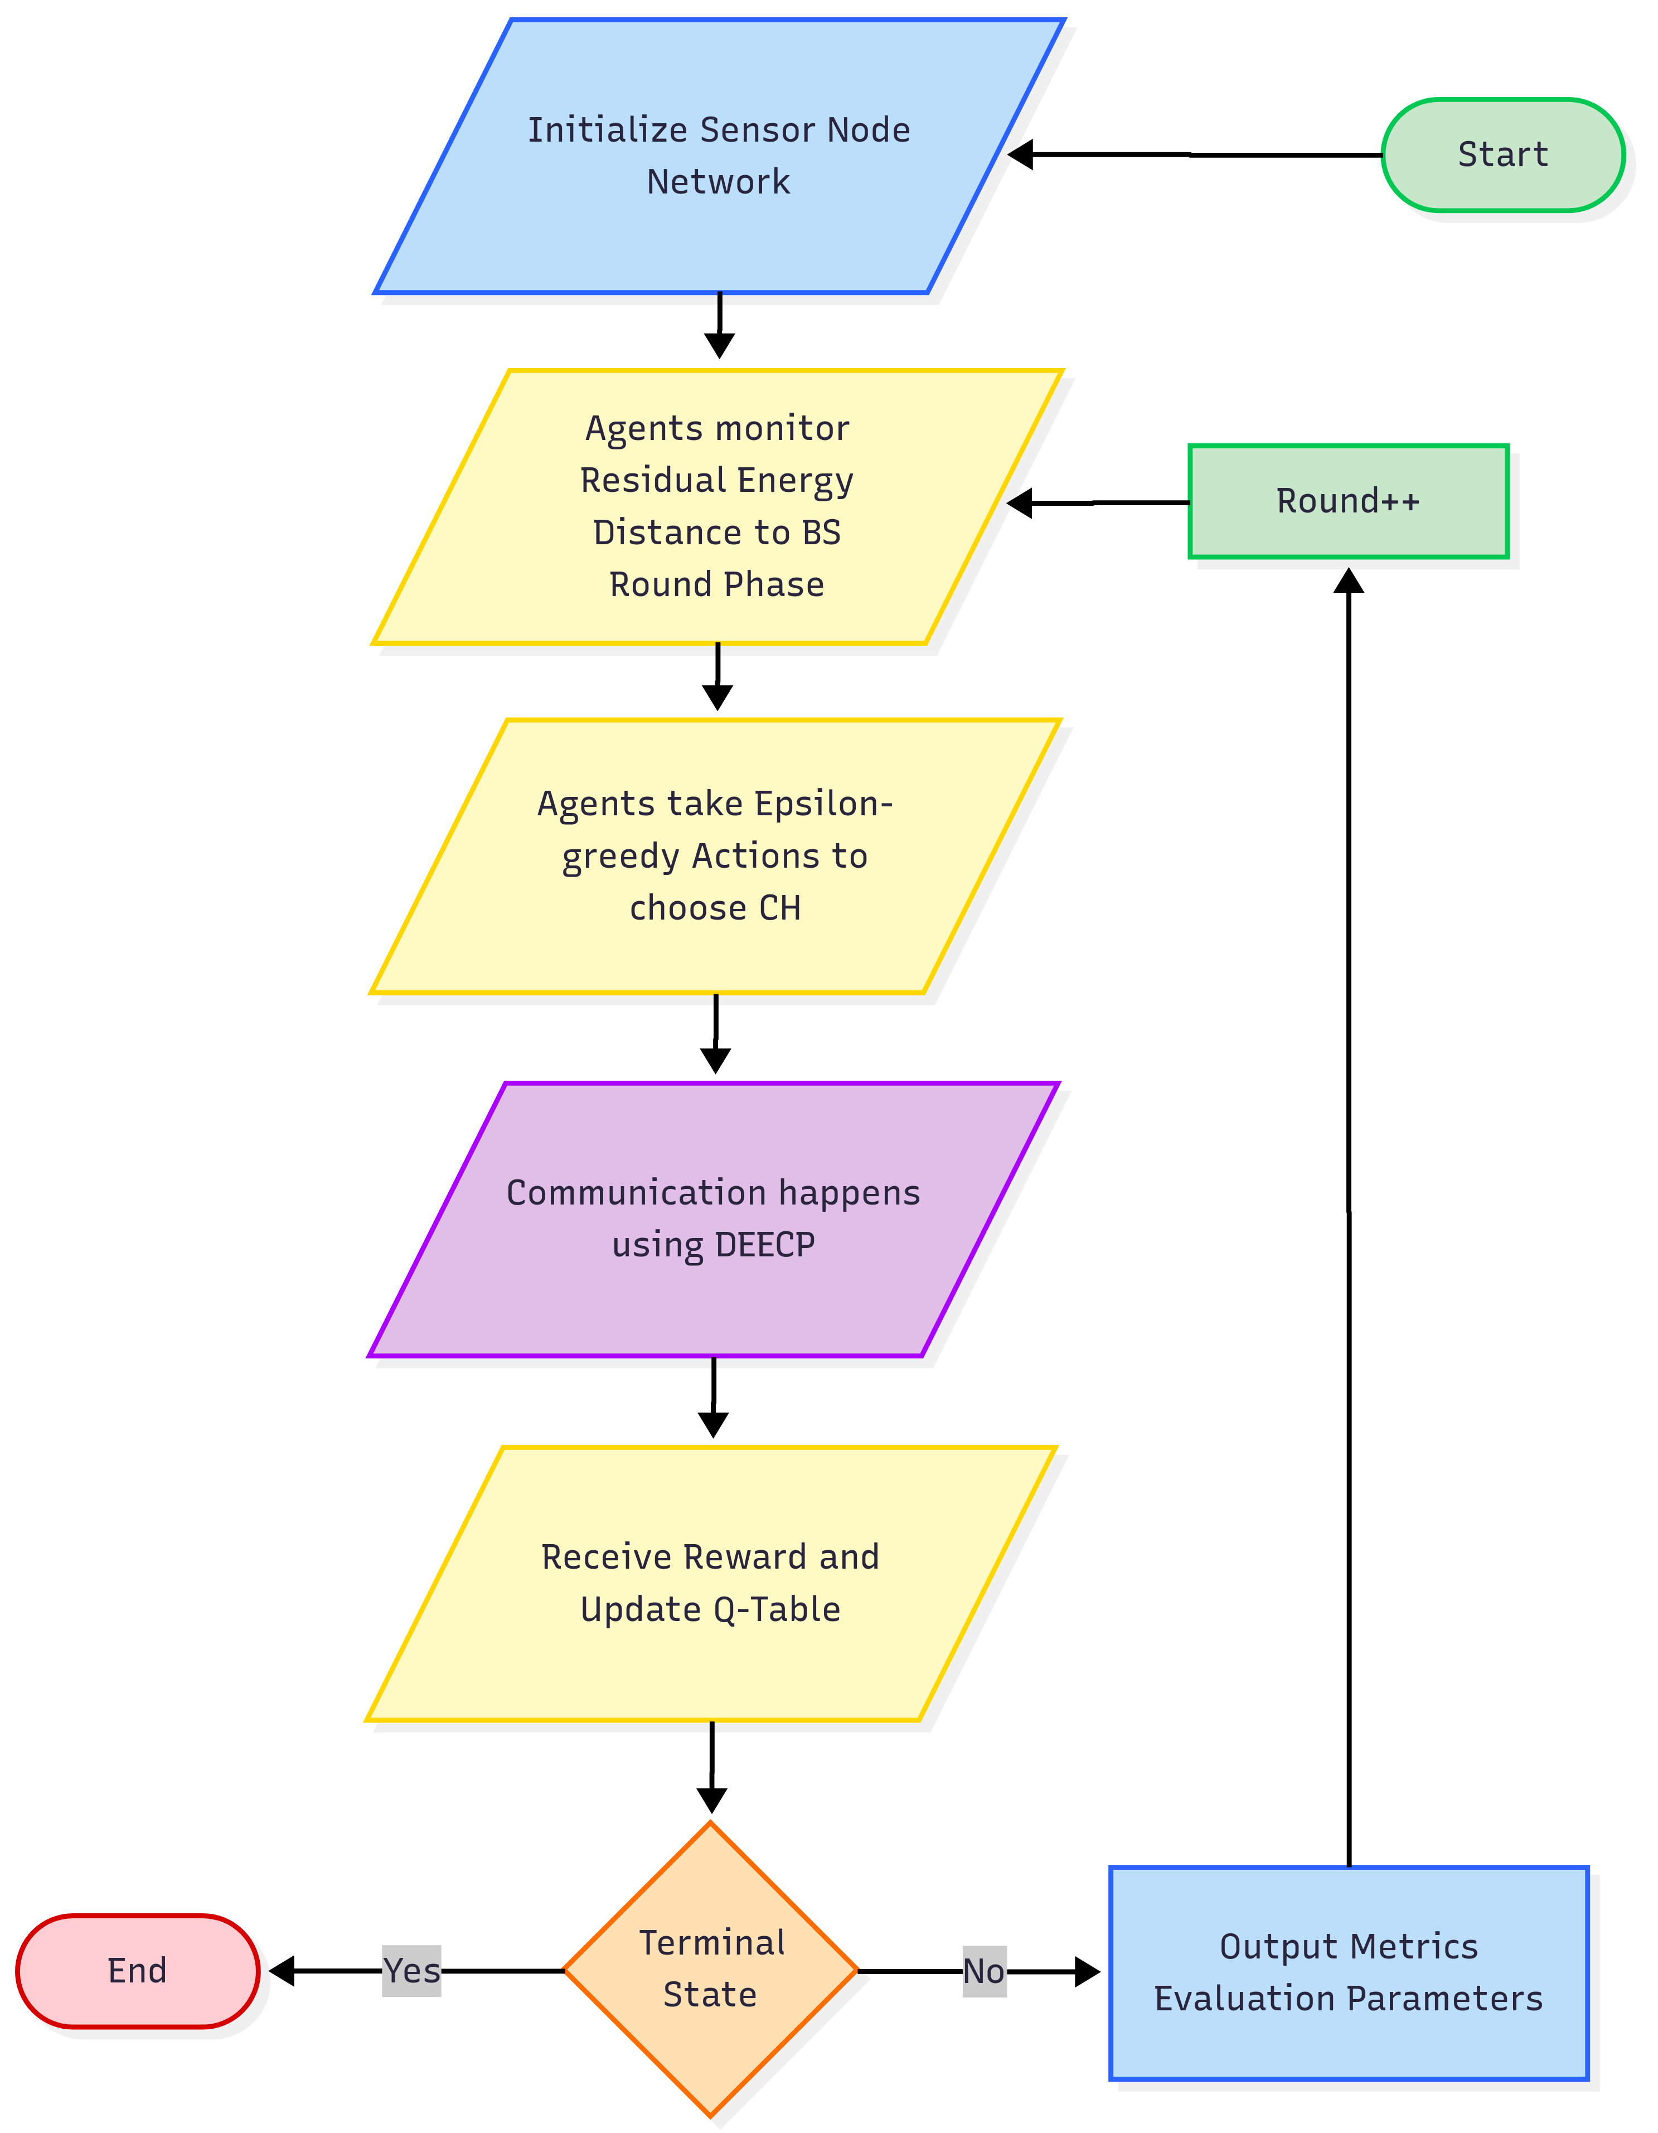
Q-Learning in WSNs
(our contribution)
Framed WSN nodes as Q-Learning agents: Each node learns instead of relying on static/probabilistic CH selection.
Defined State Parameters: Residual Energy, Distance to BS & Round Phase to guide intelligent decision-making.
Action Space: Nodes dynamically decide whether to become Cluster Head (CH) or stay as a normal node using ε-greedy algorithm.
Reward Mechanism: Designed to encourage balanced energy use and penalize premature depletion or node death.
Continuous Learning: Q-Table updates over rounds and nodes improve CH selection strategy over time.

Slide 17
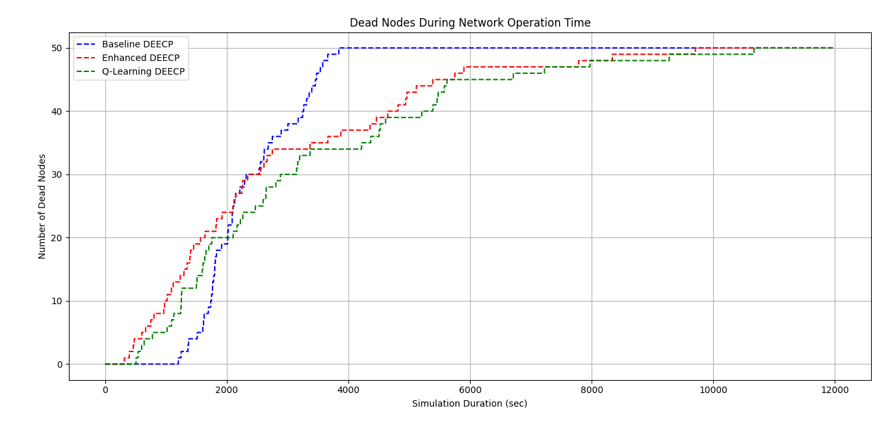
Simulation Results

Slide 18
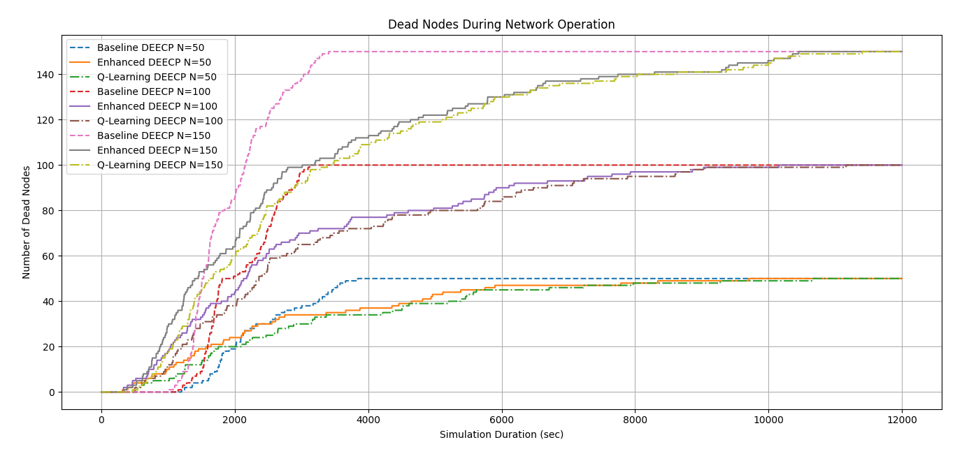
Simulation Results

Slide 19
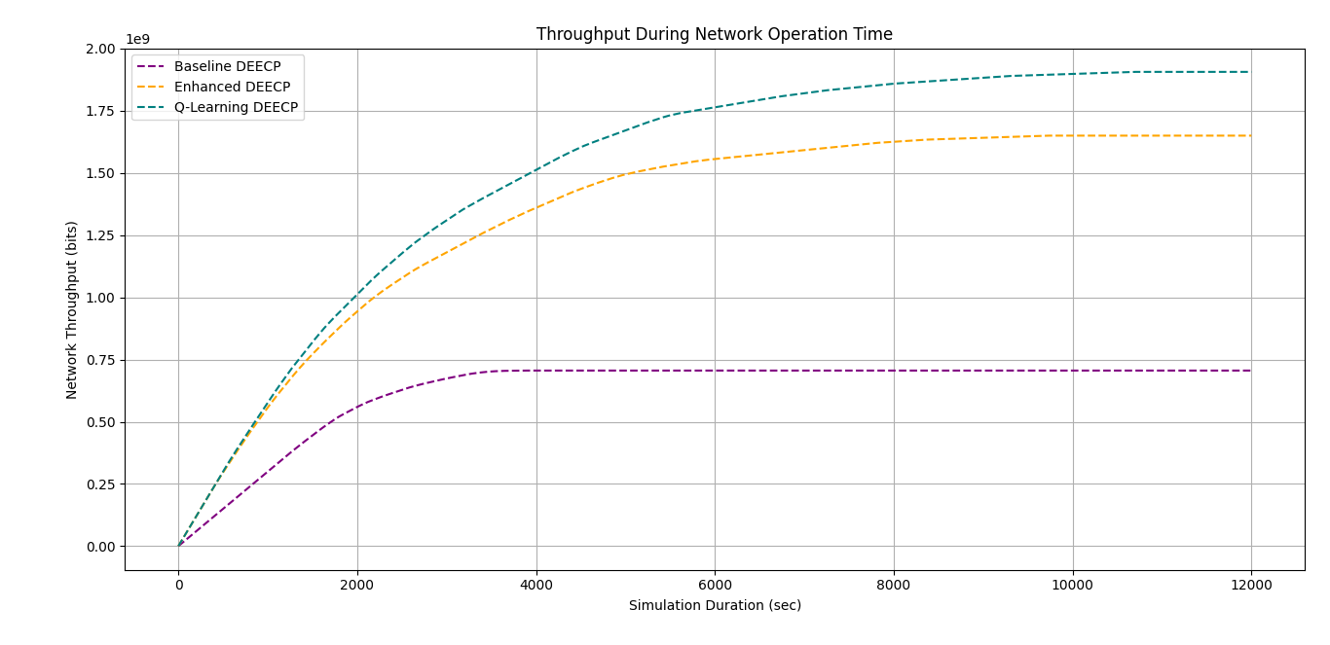
Simulation Results
~13%
~140%

Slide 20
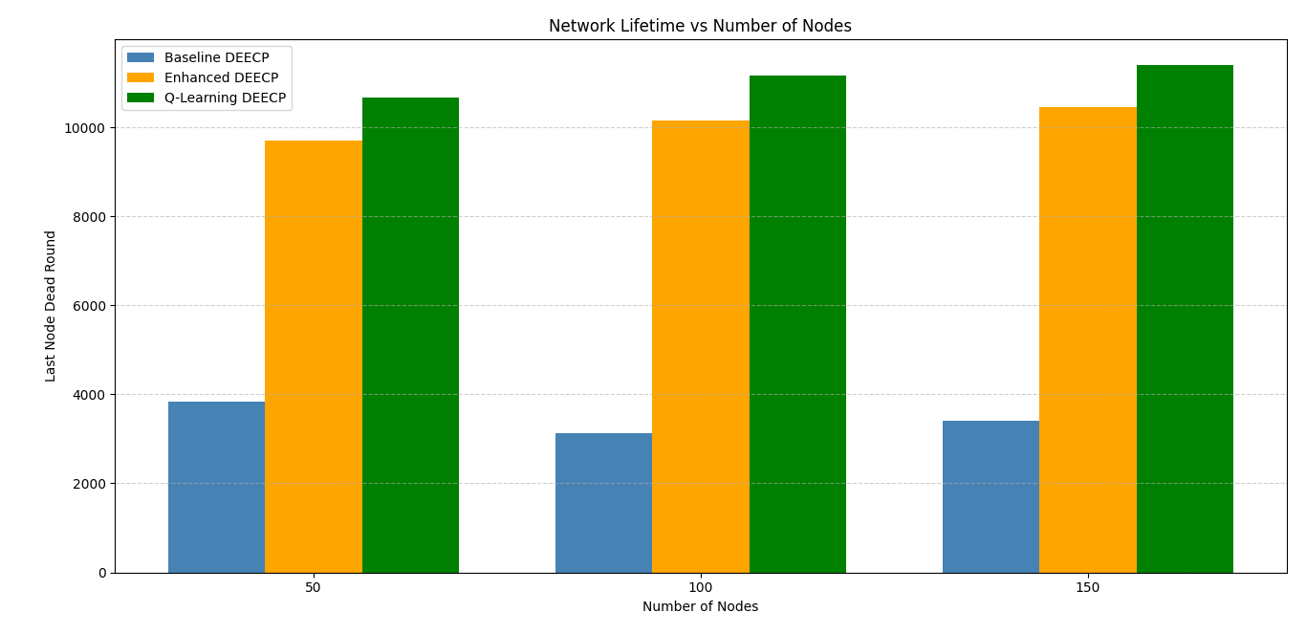
Simulation Results
~10%
~10%
~10%
~150%
~160%
~155%

Slide 21
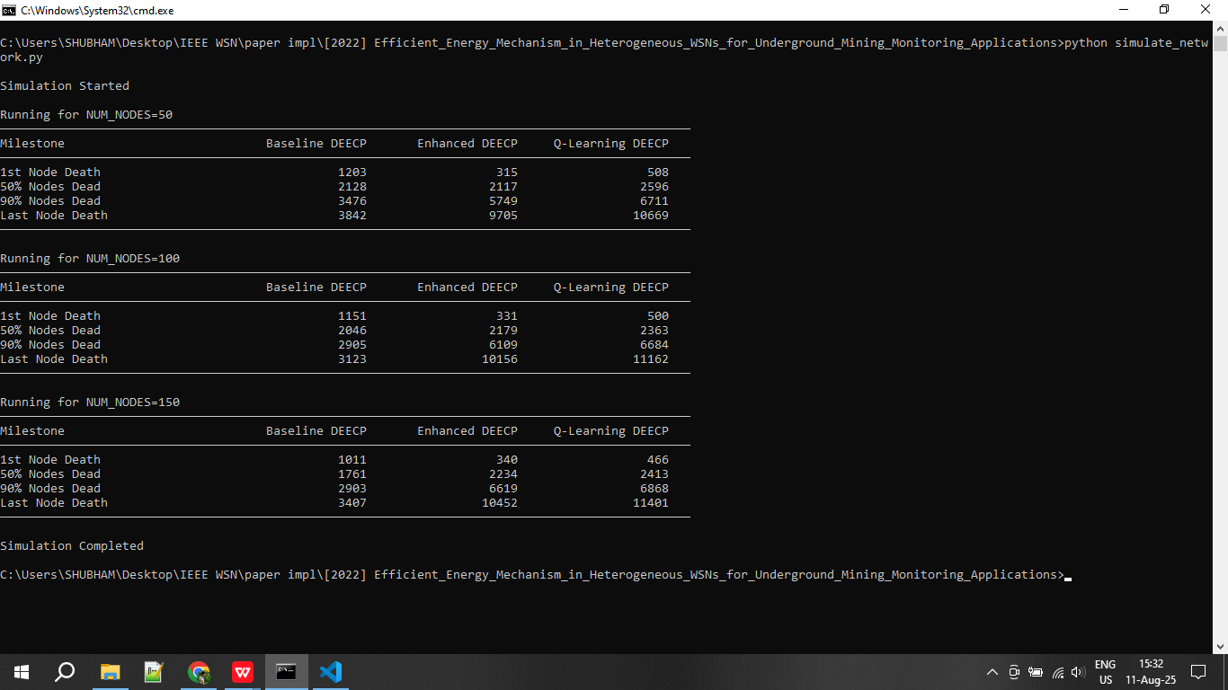
Simulation Results

Slide 22
Conclusion
Enhanced DEECP improves over baseline DEECP by introducing three-level energy model and distance-aware CH selection, but still relies on static thresholds that limits adaptability.
QL-DEECP integrates Q-Learning into CH selection:
Adaptive & dynamic decision-making.
Balances energy consumption across nodes.
Improves fairness in CH election.
QL-DEECP vs Baseline DEECP
+160% Network Lifetime
+140% Throughput
QL-DEECP vs Enhanced DEECP (E-DEECP)
+10% Network Lifetime
+13% Throughput
Future Work:
Integrate swarm intelligence with Q-Learning for further optimization.
Address trade-offs between deployment cost and performance in dense networks.

Slide 23
References
[1] S. M. Chowdhury and A. Hossain, ‘‘Different energy saving schemes in wireless sensor networks: A survey,’’ Wireless Pers. Commun., vol. 114, no. 3, pp. 2043–2062, Oct. 2020
[2] B. R. Al-Kaseem, Z. K. Taha, S. W. Abdulmajeedand H. S. Al-Raweshidy, “Optimized energy–efficient path planning strategy in WSN with multiple mobile sinks,” IEEE Access, vol. 9, pp. 79994–80007, Jun. 2021, doi: 10.1109/ACCESS.2021.3087086
[3] R. Alsaqour, E. S. Ali, R. A. Mokhtar, R. A. Saeed, H. Alhumyaniand M. Abdelhaq, “Efficient energy mechanism in heterogeneous WSNs for underground mining monitoring applications,” IEEE Access, vol. 10, pp. 100123–100138, Jul. 2022, doi: 10.1109/ACCESS.2022.3188654.
[4] F. M. Salman, A. A. Mohammedand A. F. Mutar, “Optimization of LEACH protocol for WSNs in terms of energy efficiency and network lifetime,” Journal of Cyber Security and Mobility, vol. 12, no. 3, pp. 275–296, May 2023, doi: 10.13052/jcsm2245-1439.1232.
[5] M. Gamal, N. E. Mekky, H. H. Solimanand N. A. Hikal, “Enhancing the lifetime of wireless sensor networks using fuzzy logic LEACH technique-based particle swarm optimization,” IEEE Access, vol. 10, pp. 36935–36948, Mar. 2022, doi: 10.1109/ACCESS.2022.3163254.
[6] S. Mohapatra, P. K. Behera, P. K. Sahoo, S. K. Bisoy, K. L. Huiand M. Sain, “Mobility induced multi-hop LEACH protocol in heterogeneous mobile network,” *IEEE Access*, vol. 10, pp. 132895–132907, Dec. 2022, doi: 10.1109/ACCESS.2022.3228576.
[7] Available Online Book and Resources: https://github.com/imshubhamcodex/ql--resources

Slide 24
Thank You
Open to Q&A

