Slide 1

Fundamentals of Reinforcement Learning and its Applications in Energy Efficient Wireless Sensor Networks
Presented By
Shubham Kumar (2448015)
Electronics and Comm.
Guided By
Prof. Bharat Gupta
Electronics and Comm.
Department of Electronics and Communication Engineering National Institute Technology
Patna 800005

Slide 2
Presentation Roadmap
Background – context of mining and fatalities statistics
Literature Review – overview of existing clustering and routing protocols
Motivation & Problem Statement – challenges of energy imbalance and lack of adaptability.
Introduction to Reinforcement Learning – basics of RL and its role in decision-making
Model Free Reinforcement Learning Algorithms – focus on Q-Learning
Q-Learning in Gridworld Problem – demonstration of optimal policy learning
Conclusion – key findings : Q-Learning improves adaptability and energy efficiency
Future Work – extensions with swarm intelligence, reward shaping and hyperparameter tuning

Slide 3
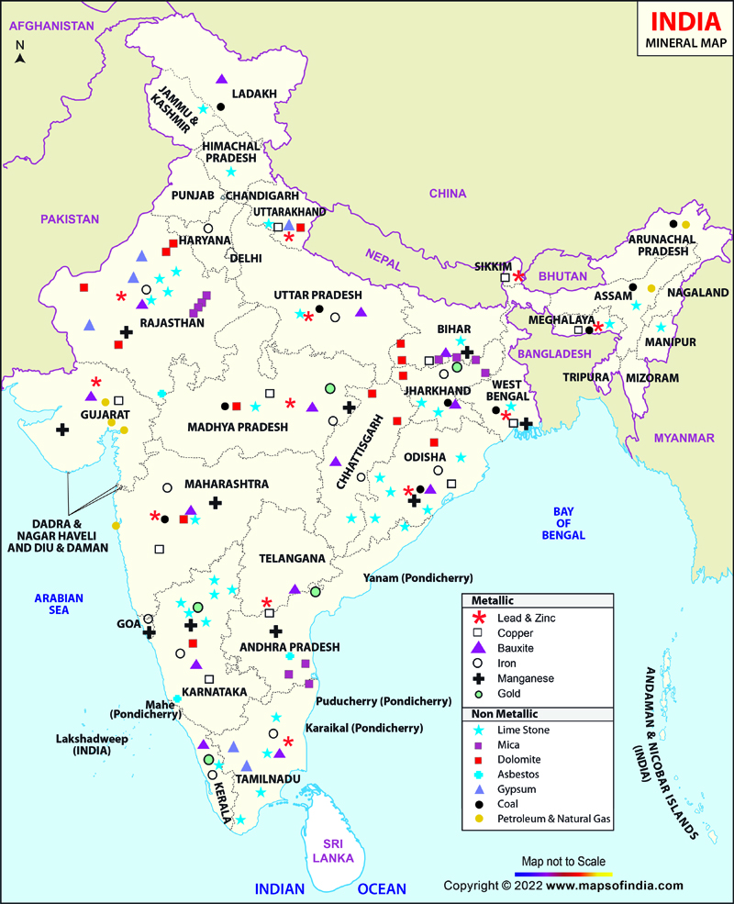
Background
Mining Industry: The India’s major mining regions are Jharkhand, Odisha, Chhattisgarh, Madhya Pradesh and Karnataka.
Common Risks:
Gas leaks
Explosions
Roof collapses
Equipment Failures
India’s mining sector:
Non Metallic mines (53 operational)
Depth: Typically from 200 m to 600 m.
Long: Typcally 2km to 4km.
Metallic mines (182 operational)
Depth: Typically from 1km to 4km.
Long: Typcally 2km to 5km.
Data Source: DGMS [1]
Fig 1: Mines Location

Slide 4
Mining Fatalities Statistics
Over 10 year period(2010 to 2020), total coal mine accidents reported is arround 30,025 and leads to total deaths of 49,615.
Globally, the annual number of fatal mining accidents is estimated to be in the range of 300 to 400.
The signal attenuation and harsh environment leads to poor communication which often a major factor in delayed evacuations, higher fatalities during emergencies.
Table1. Mines fatalities in India (2025)[1]
Data Source: DGMS [1]
Date | Location | Accident | Fatalities
March 6, 2025 | Betul district, Madhya Pradesh (WCL, Chhatarpur mine) | Roof collapse inside an underground coal mine | 3 killed, 1 injured
March 5, 2025 | Chikhla mine (MOIL), Bhandara, Maharashtra | Slab collapse at ~100 m depth | 4 miners died
January 6, 2025 | Umrangso, Assam | Coal mine flooded | At least 9 miners died

Slide 5
Literature Review
Paper & Year | Optimization Technique Used | N/w Lifetime Improved | Limitations / Research gap
Al-Kaseem et al. (2021) Optimized Energy-Efficient Path Planning with Multiple Mobile Sinks[2] | Ant Colony Optimization + Genetic Algorithm + Simulated Annealing | 66% vs. standard LEACH | Heavy computation demand Static environment
Raed et al. (2022) Efficient Energy Mechanism for Underground Mining Monitoring[3] | Enhanced LEACH + DEECP | 25% vs standard LEACH | No mobility support Static environment
Salman et al. (2022) Optimization of LEACH Protocol for WSNs in Terms of Energy Efficiency and Network Lifetime[4] | Particle Swarm Optimization | 30% vs. standard LEACH | No mobility support Non heterogeneous environmnt
Gamal et al. (2022) Enhancing Lifetime of WSNs Using Fuzzy Logic LEACH and Particle Swarm Optimization[5] | Fuzzy + Particle Swarm Optimization | 18% vs. standard LEACH | Increased control overhead from fuzzy inference
Mohapatra et al. (2022) Mobility Induced Multi-Hop LEACH Protocol in Heterogeneous Mobile Network[6] | Modified multi-hop LEACH | 20% vs. standard LEACH | Assumes uniform mobility Non heterogeneous environmnt

Slide 6
Literature Review
Paper & Year | Optimization Technique Used | N/w Lifetime Improved | Limitations / Research gap
Botao Zhu et al. (2022) UAV Trajectory Planning in Wireless Sensor Networks by Deep Reinforcement Learning[7] | Used Deep Q-Network using neural network | Better Routing | Centralize control Computation heavy
Tadele A. Abose et al. (2023) Optimized Cluster Routing Protocol With Energy-Sustainable Mechanisms for Wireless Sensor Networks[8] | Stable Election Protocol | 36% vs standard LEACH | No Multi-hopping
Saikat Chandra et al. (2024) LoRa-Based IIoT Network for Underground Coal Mine Environment[9] | Used LoRa to perform P2P communication | N/A | Clustering is missing
Aleem & Thumma (2025) Hybrid DEEC EEKA RL in IoT- WSNs[10] | Residual energy ratio (DEEC) EEKA constraints | 17.5% vs standard LEACH | Computational overhead from RL

Slide 7
Mining Fatalities Trend
Data Source: DGMS[1]

Slide 8
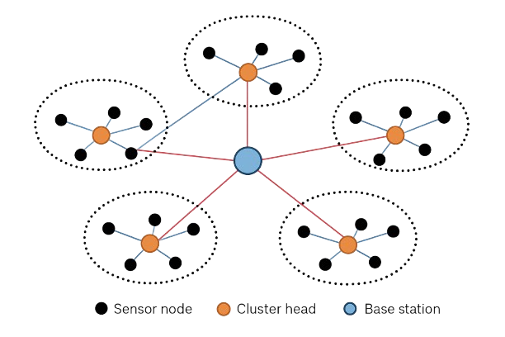
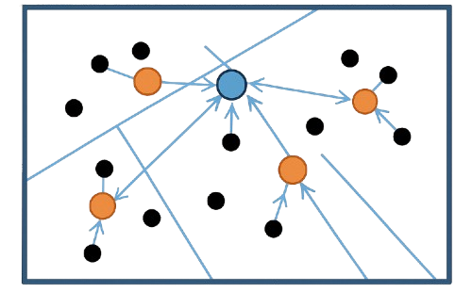
WSNs in Underground Mines
Definition: Wireless Sensor Networks (WSNs) are networks of distributed, battery-powered sensor nodes that communicate wirelessly to monitor environment and physical parameters.
Advantages in Mining:
Real-time hazard detection (gas leaks, roof fall risks, fires)
Early warning systems that improved worker safety
Reduced dependency on manual inspections
Fig 2: Wireless Sensor Network in Mines

Slide 9
Motivation & Problem Statement
Challenge:
Sensor nodes are battery-powered and deployed in harsh/inaccessible underground environments.
Replacing or recharging batteries is costly, unsafe or sometimes impossible.
Problem:
Traditional clustering and routing protocols (e.g., LEACH, DEECP) rely on static or probabilistic thresholds and do not support node heterogeneity, which leads to:
Uneven energy consumption across nodes
Premature node deaths in critical regions
Significant reduction in overall network lifetime and reliability.
Need:
A lightweight, adaptive mechanism that incorporates node heterogeneity.
Learn and dynamically optimize energy consumption and thereby prolong the network lifetime.

Slide 10
Research Objectives
Enhance Existing Protocol:
Extend the Enhanced DEECP protocol by integrating Q-Learning for intelligent Cluster Head (CH) selection.
Exploit Node Heterogeneity:
Design a heterogeneity-aware CH selection mechanism that balances energy consumption across different node types.
Improve Network Lifetime:
Achieve at least a 10% increase in network lifetime compared to Enhanced DEECP by reducing premature node deaths and energy imbalance.

Slide 11
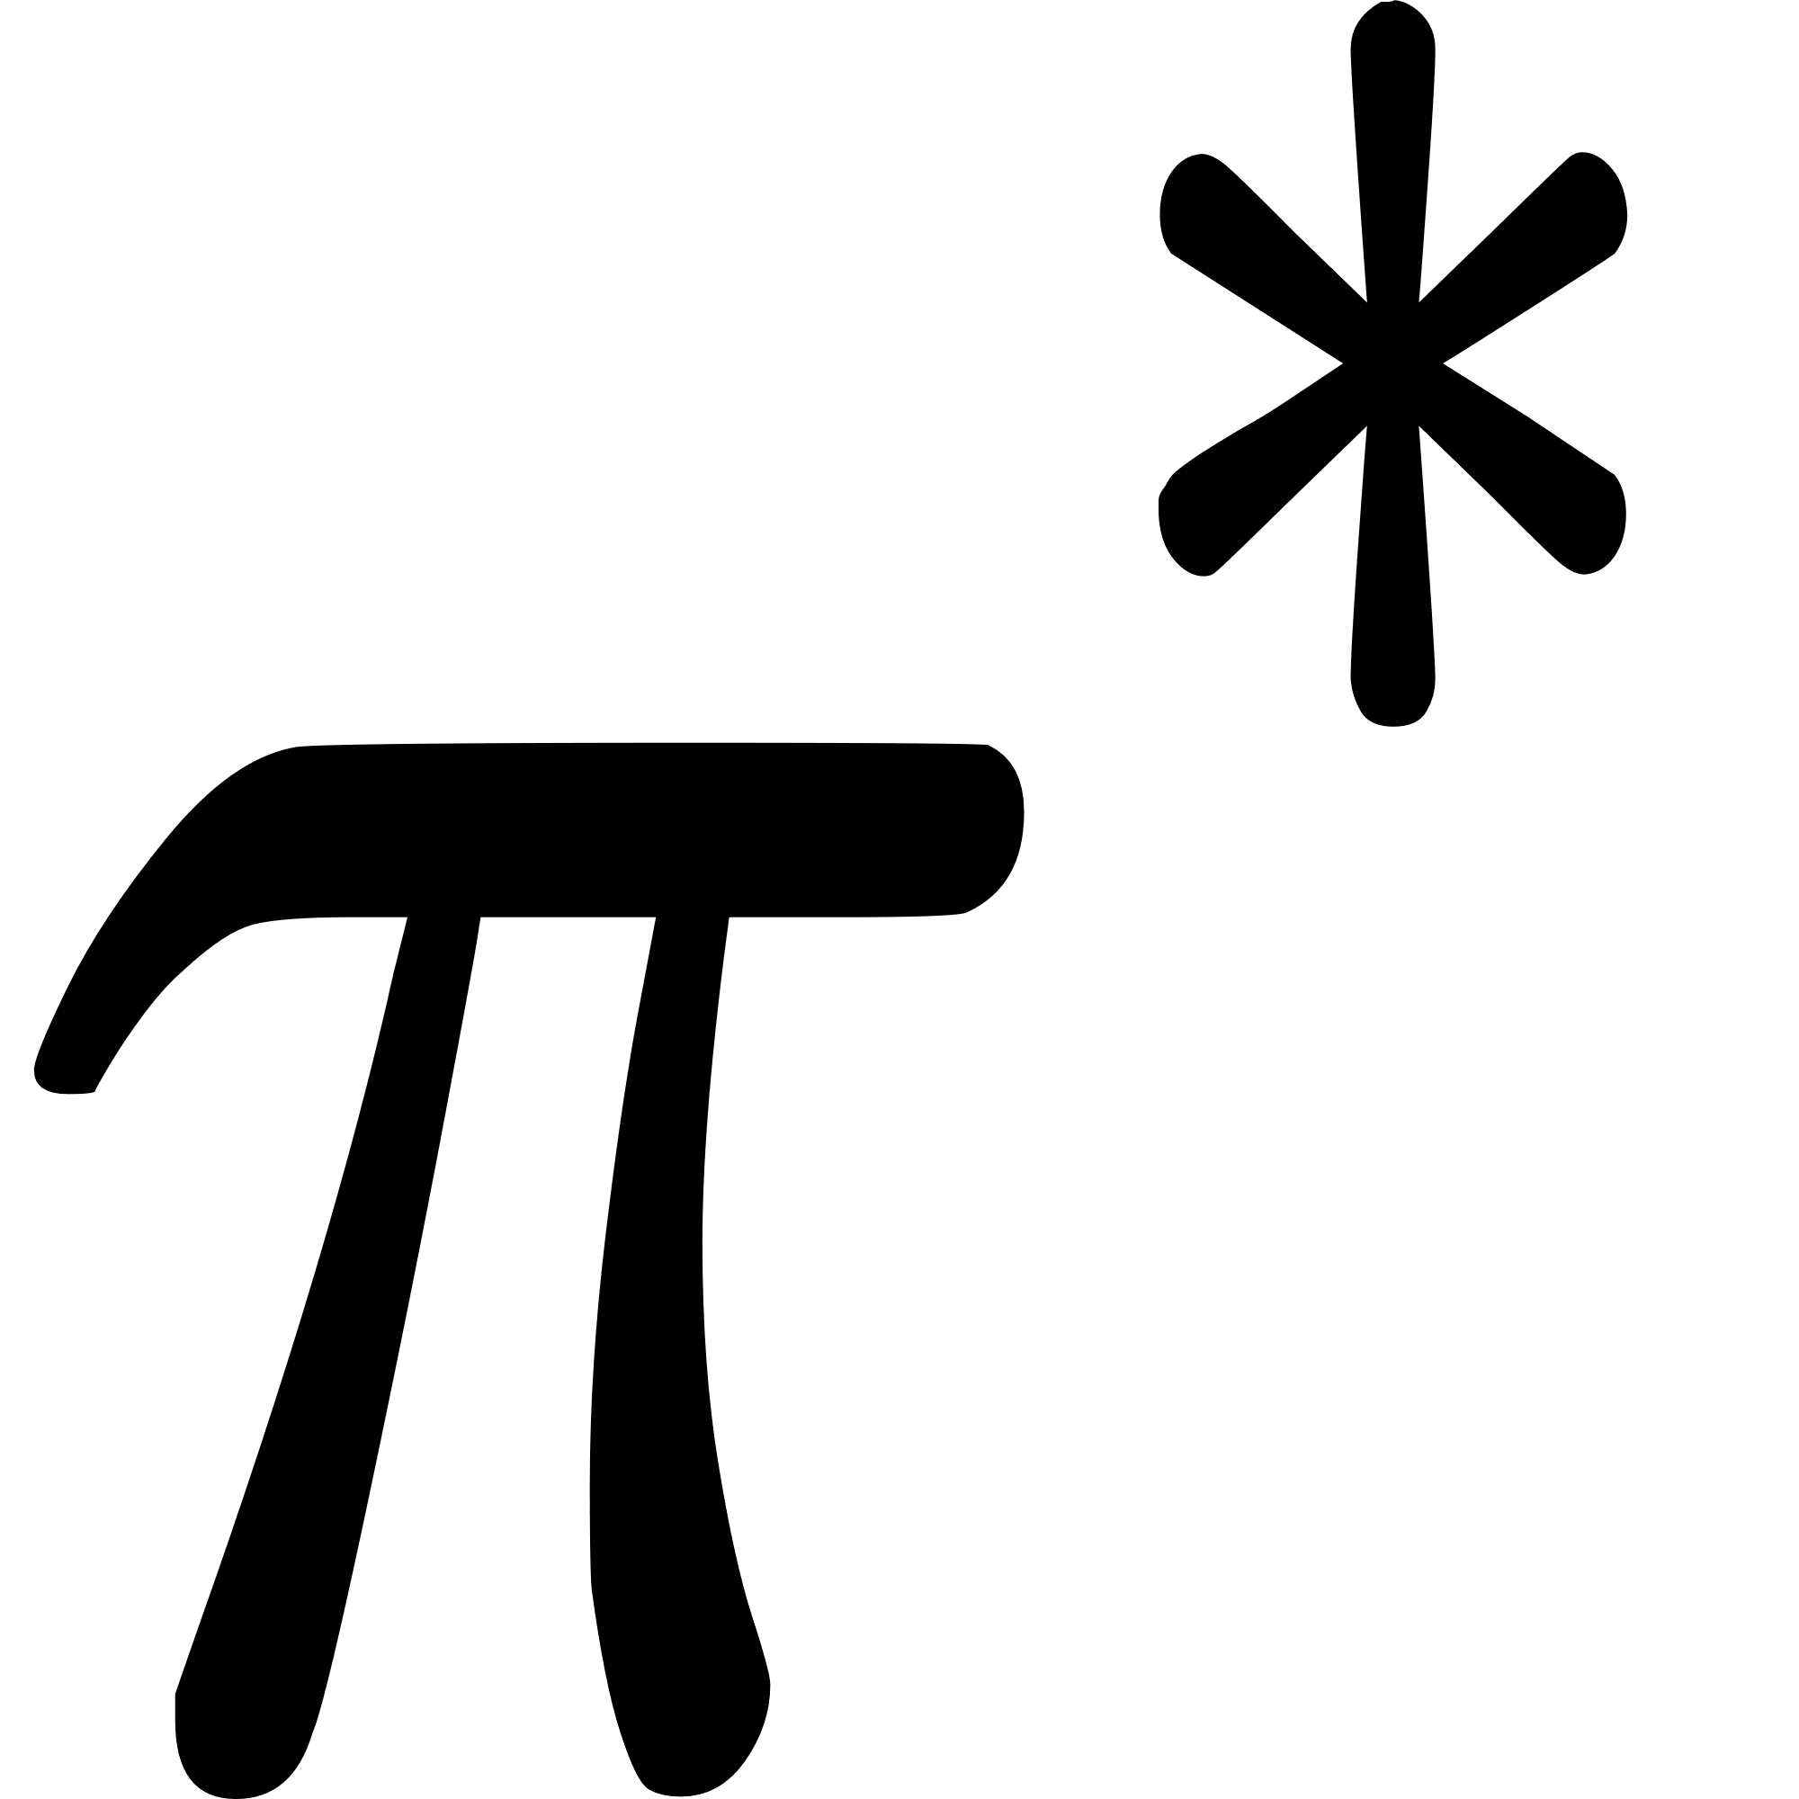
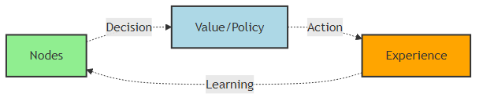
Introduction to Reinforcement Learning
Definition: Reinforcement Learning (RL) is a learning paradigm where an agent learns to make decisions by interacting with an environment to maximize cumulative reward.
Agent Environment Interaction:
Agent: Makes decisions by taking actions
Environment: Responds with new states and rewards/penalty
Goal: Find an optimal policy that maximizes expected return
Trial-and-Error Learning: Agent explores actions, observes outcomes and updates its strategy iteratively.
Fig 3: Agent learning behavior

Slide 12
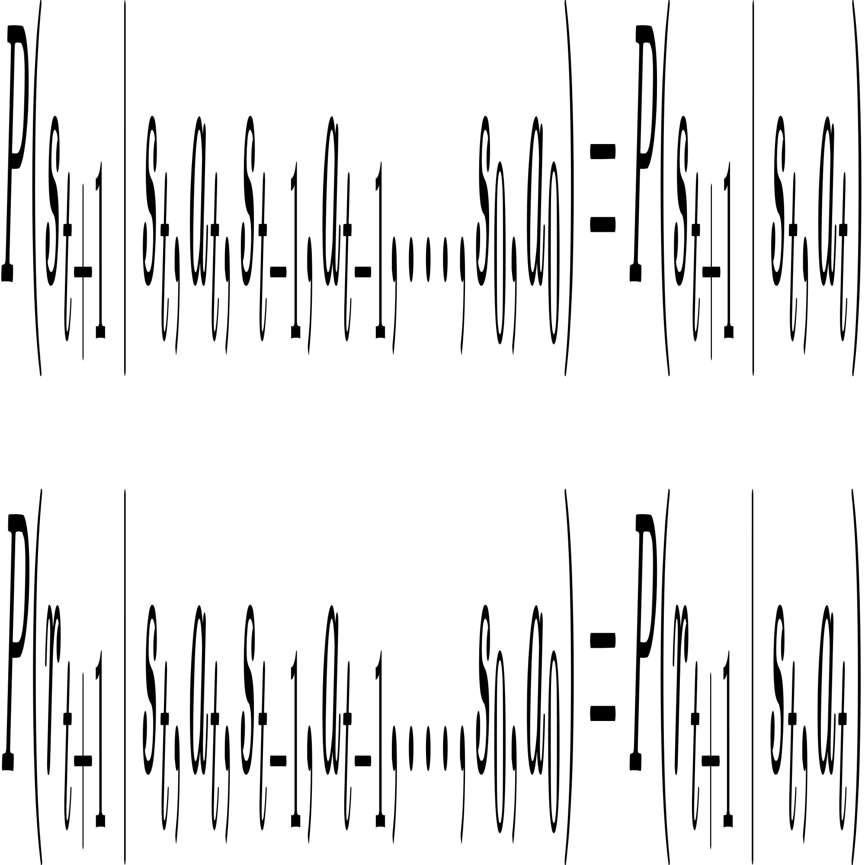
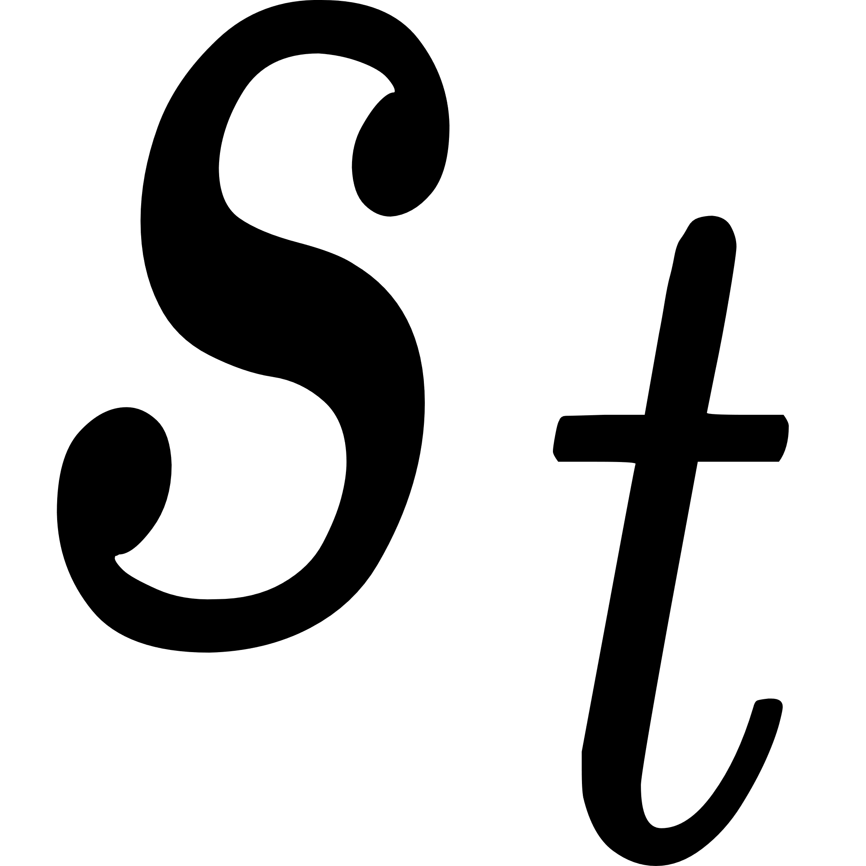


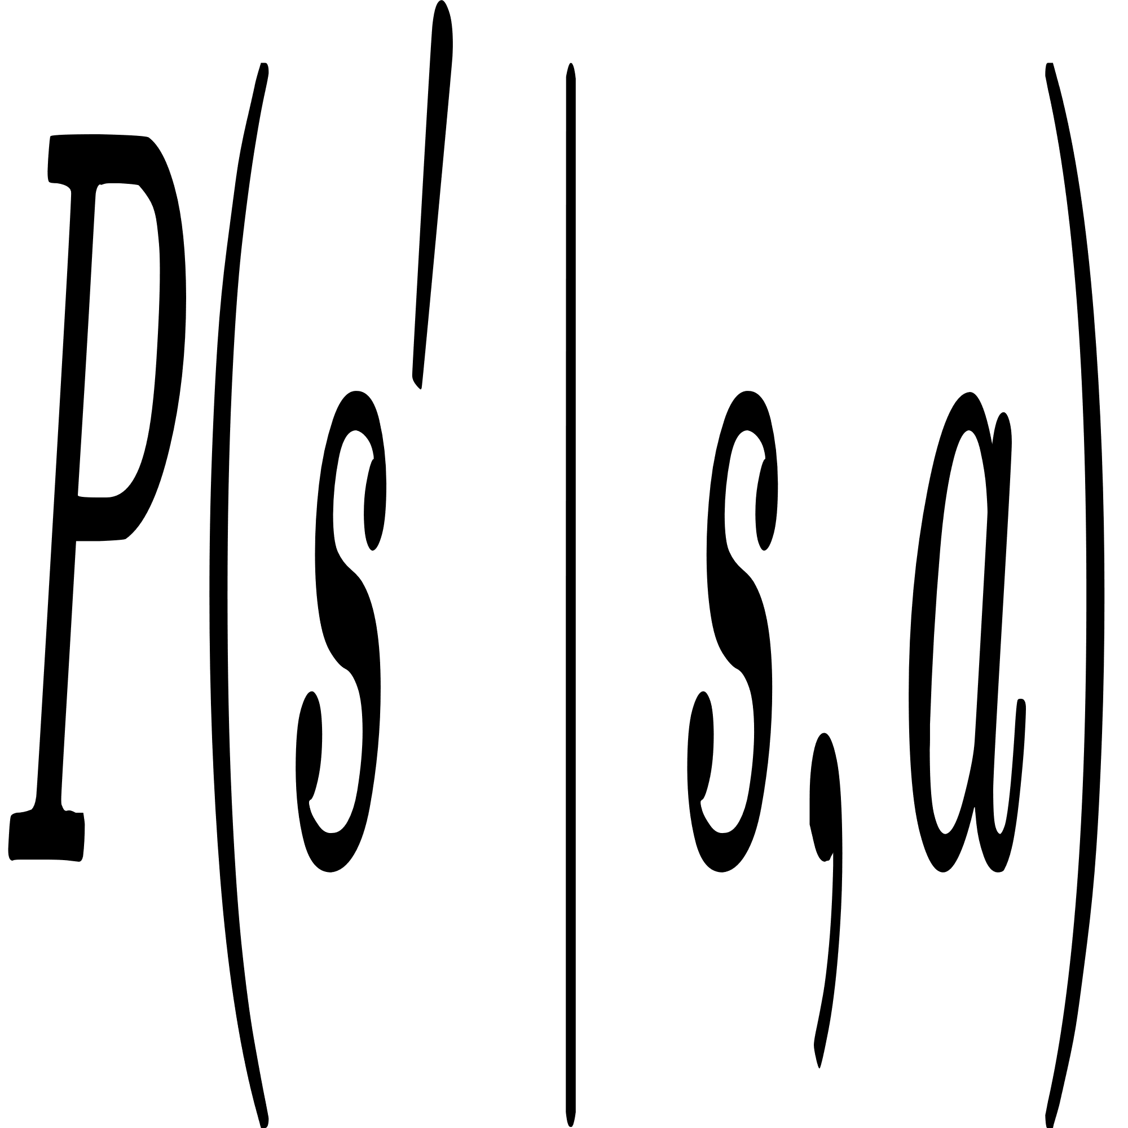
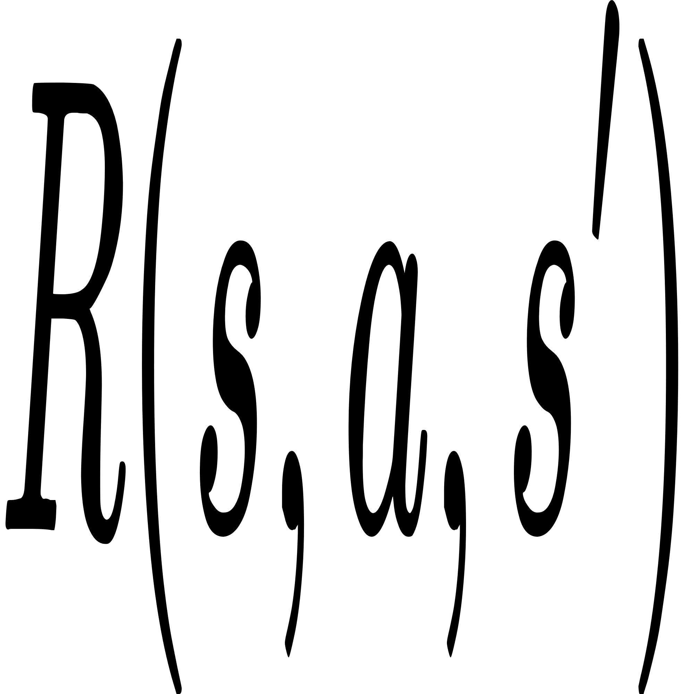

Modeling RL with Markov Decision Processes
Foundation: RL rely on the fact that environment satisfies the Markov property that is the next state depends only on the current state and action, not on the history.
where
: state of current timestamp
: choosing action of current timestamp
: getting rewad at current timestamp
: transition probability
Components: MDP defines the environment States S, Actions A, Transition Probability , Reward as well as Discount Factor Gamma .
Model: The transition dynamics of environment and reward function are considered as model.

Slide 13


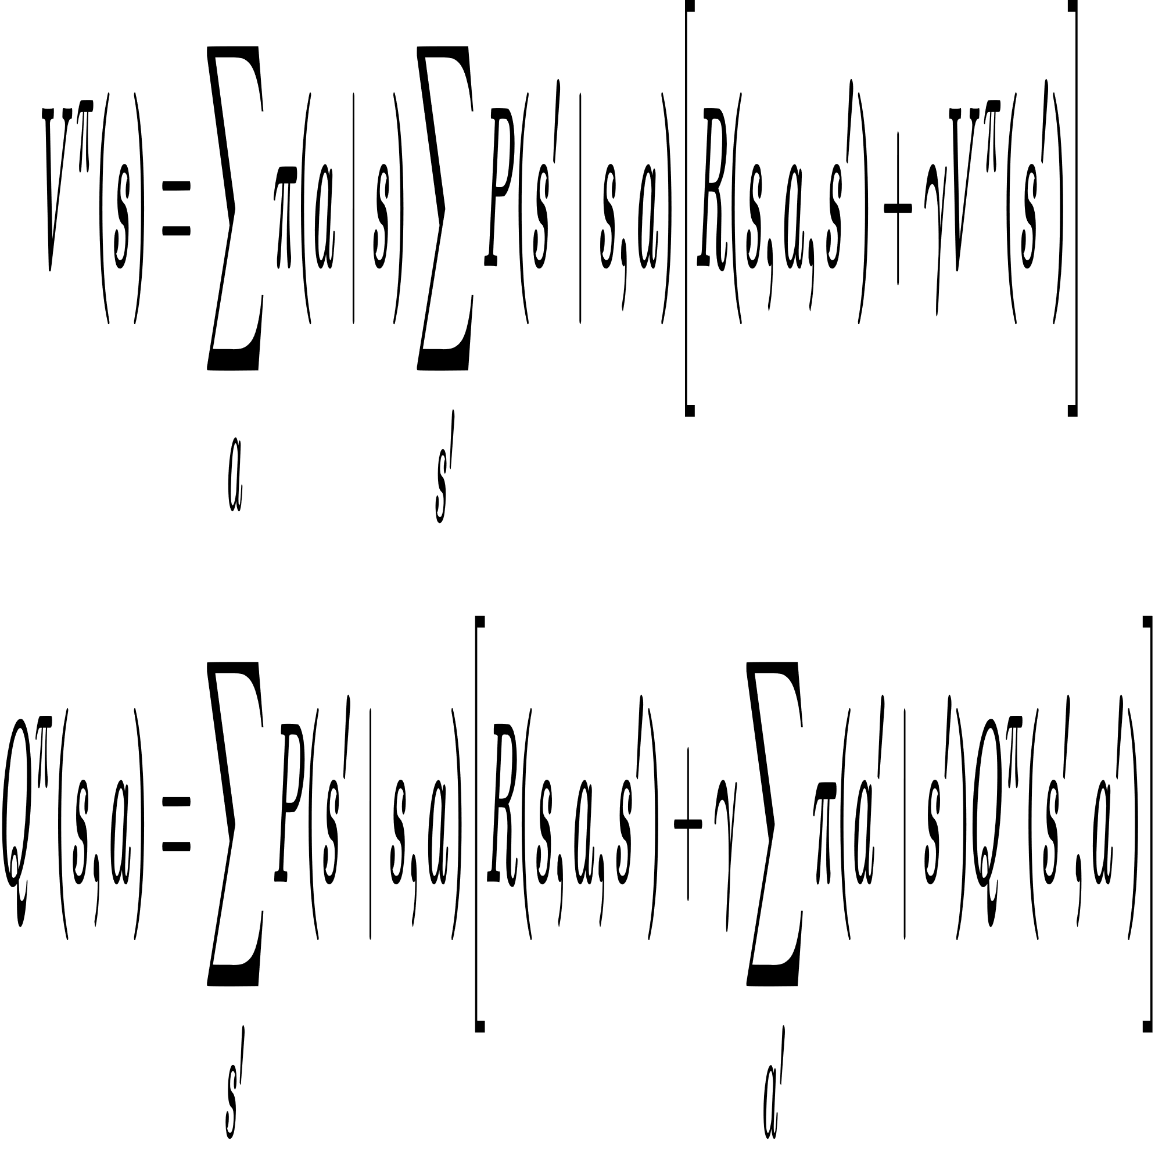
Learning Functions and Bellman Equation
State Value Function : It maps expected return under policy 𝜋, using MDP transition probabilities and reward function.
Action-Value Function : It maps state-action pairs to expected return based on MDP dynamics. It allows RL to determine which action in a given state is best.
Bellman Equations: Encode recursive relationship between the current value of a state and values of successor states using MDP’s transition and reward functions.
All variables as defined previously.
Use Case: Using these equations, we iteratively compute the optimal state value or optimal policy, as the Bellman equation is bound to converge.

Slide 14
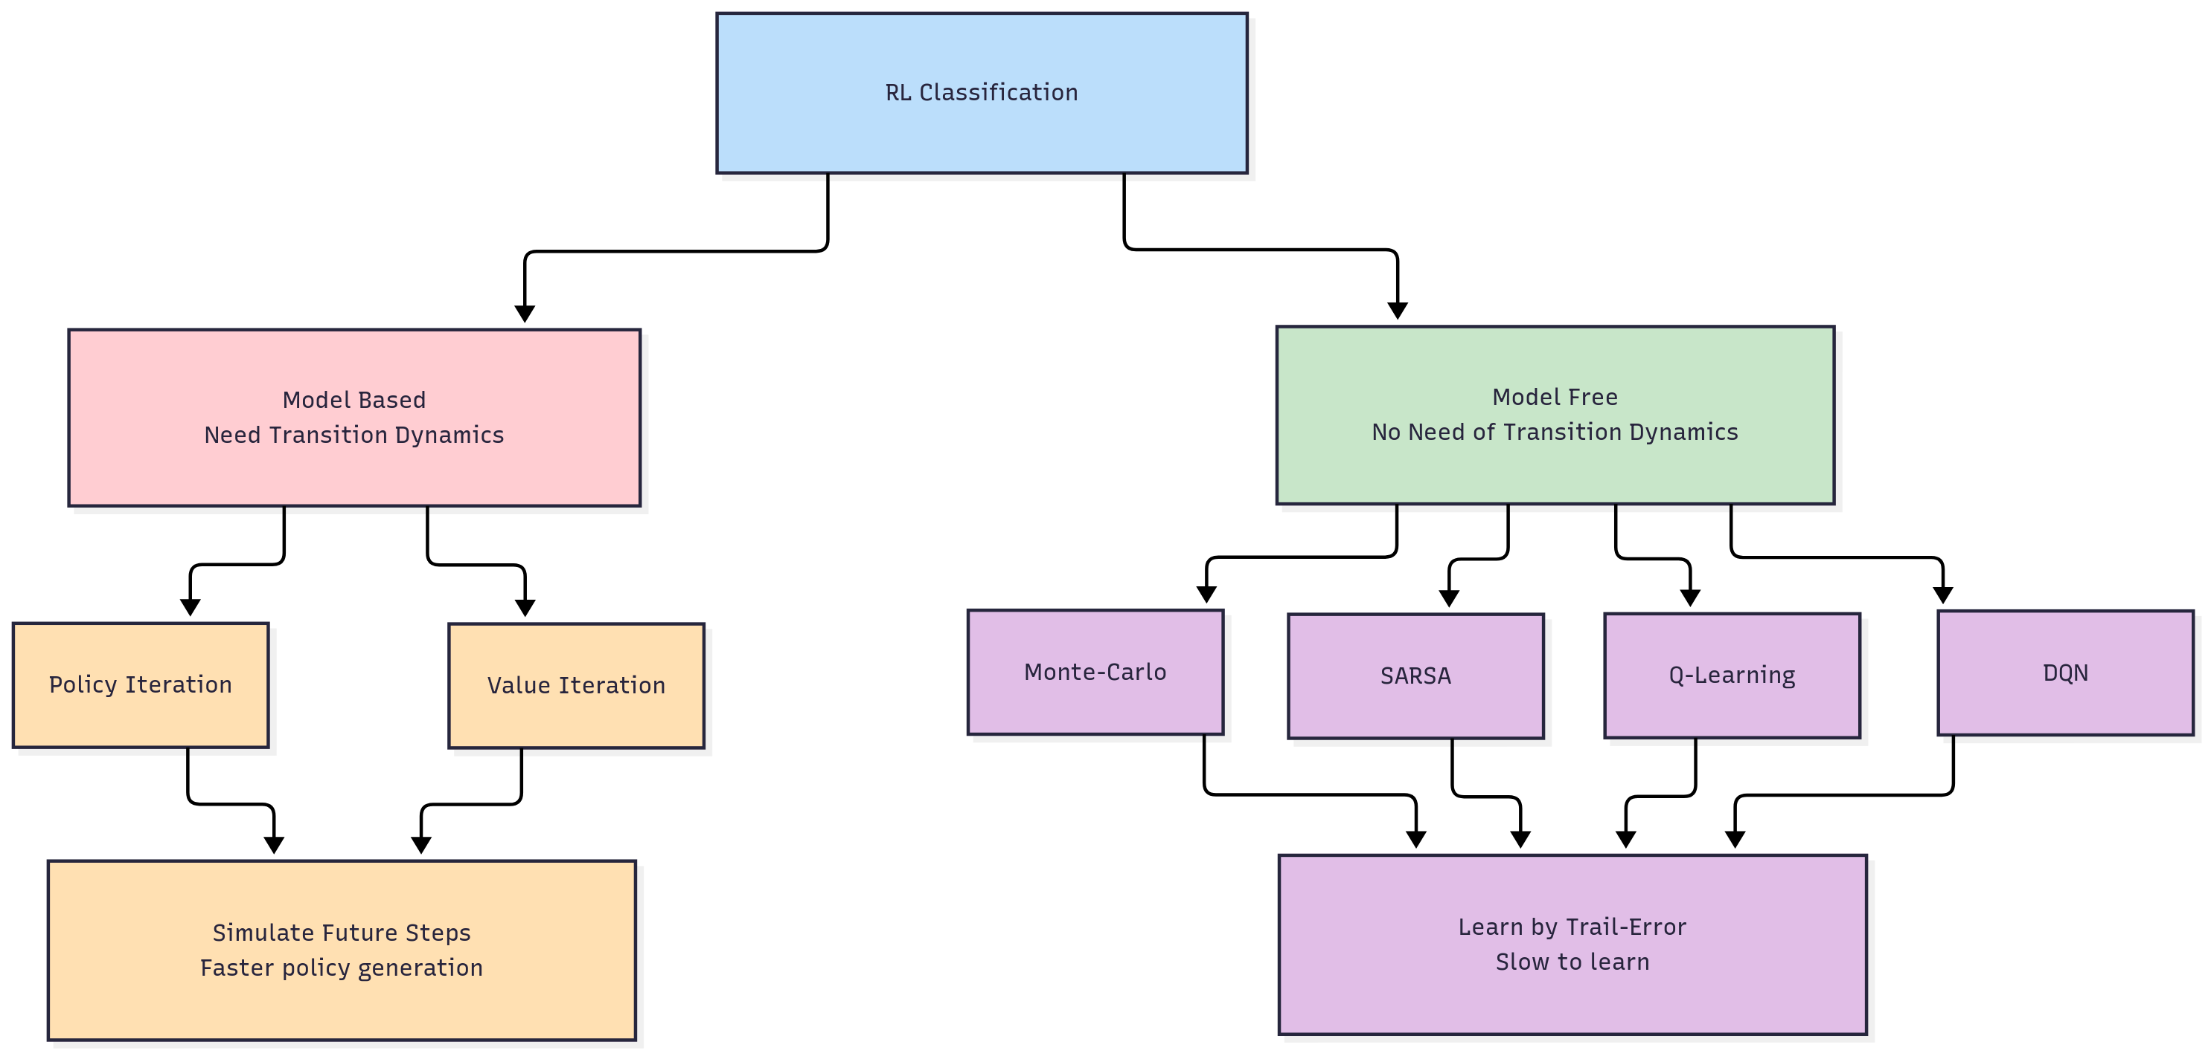
Classification of Reinforcement Learning
Fig 4: Reinforcement Classification

Slide 15
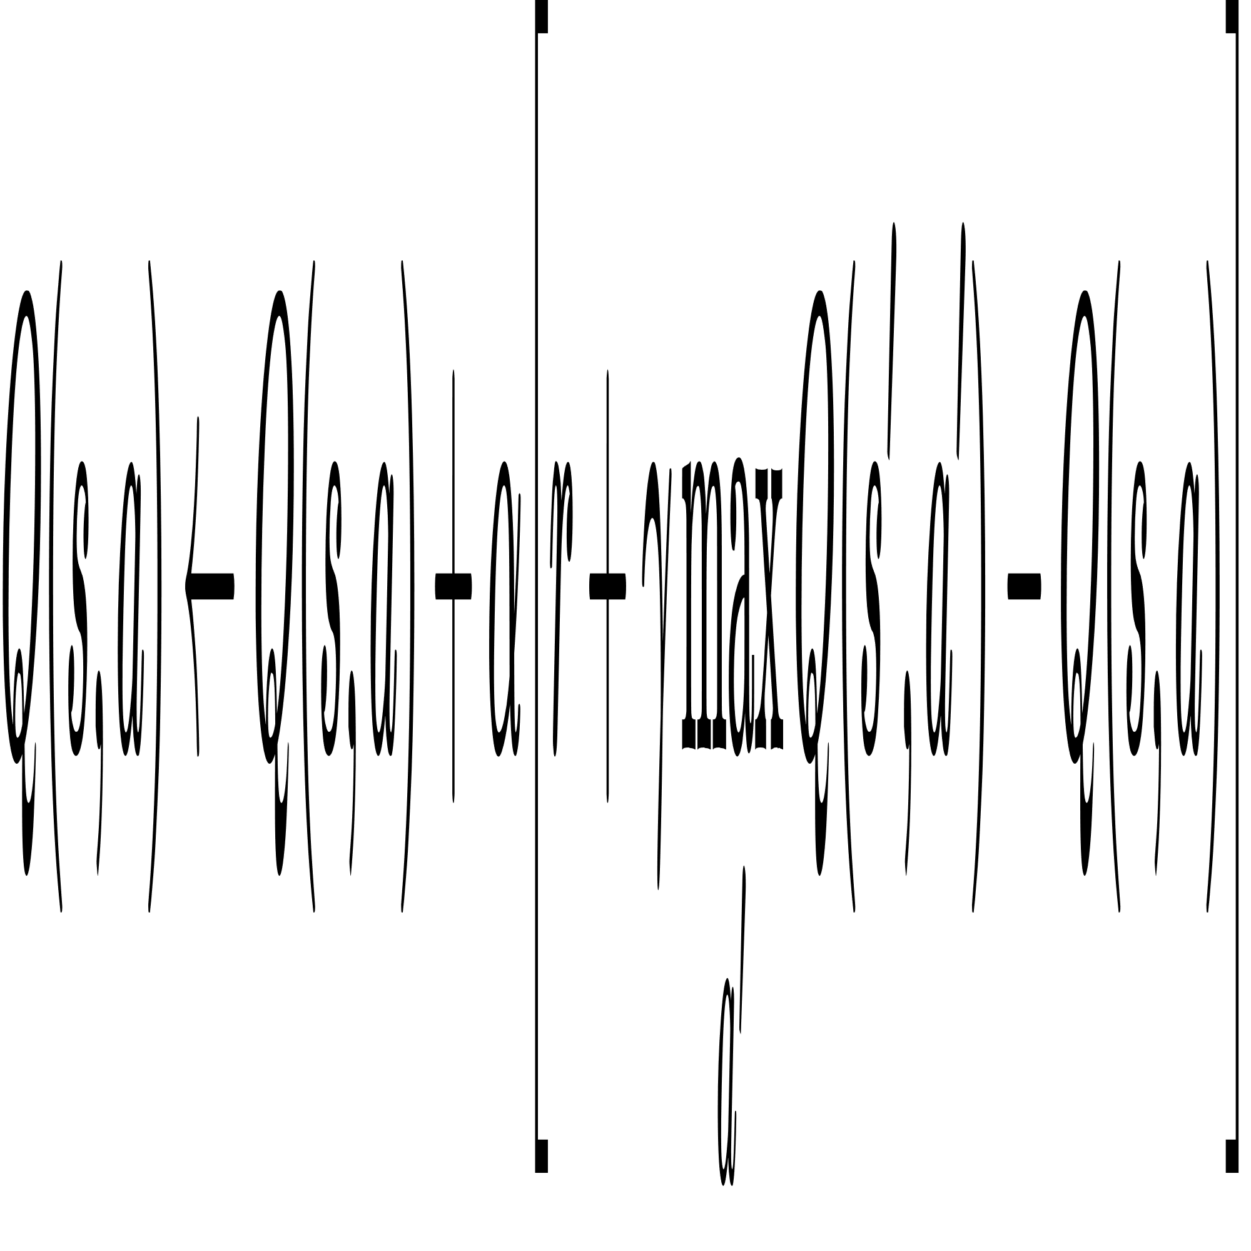
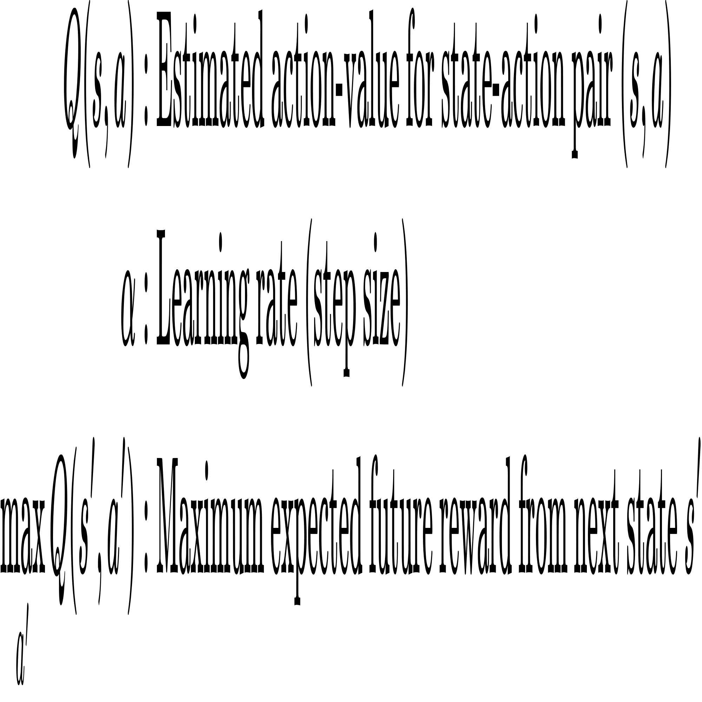
Model Free RL: Q-Learning
Overview: Q-Learning helps the agent learn the optimal action-value function 𝑄∗(s,a) through trial-and-error, maintaining a Q-table for all state-action pairs.
Q-Learning Update Formula: This iterative formula solves the Bellman optimality equation for action values, allowing direct convergence to the optimal policy.
Q-Table: Stores Q(s,a) for all state-action pairs, where rows represent states and columns represent actions, holding expected rewards to guide the agent toward optimal actions.

Slide 16
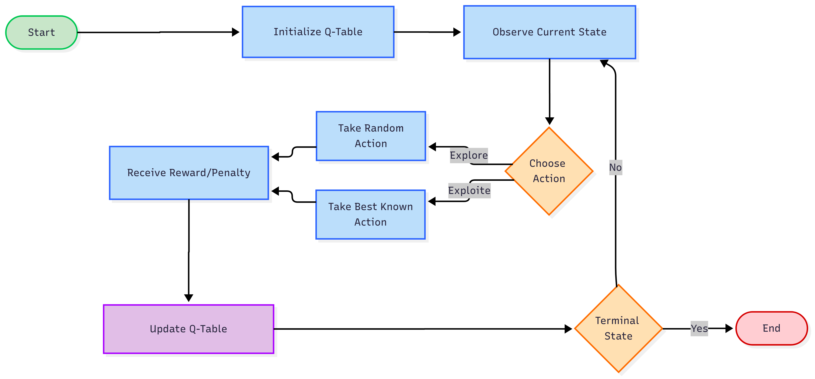
Q-Learning Workflow
Fig 5: Q-Learning behavior

Slide 17
Q-Learning Simulation
Environment Setup:
Grid Matrix: 5x5 grid representing the environment.
Actions: Up, Down, Left, Right (4 possible moves).
Agent: It moves through the matrix to find optimal policy to reach terminal state.
Learning Process:
Agent starts at a random state for each episode.
Moves based on ε-greedy policy using Q-table.
Receives rewards for reaching target cells or avoiding obstacles.
Q-values updated iteratively via Q-Learning formula.
Outcome:
Over the time, agent learns optimal paths through the matrix.
Q-Table guides movement toward high-reward states.
Enhances agent’s adaptability and robustness in changing environments.

Slide 18
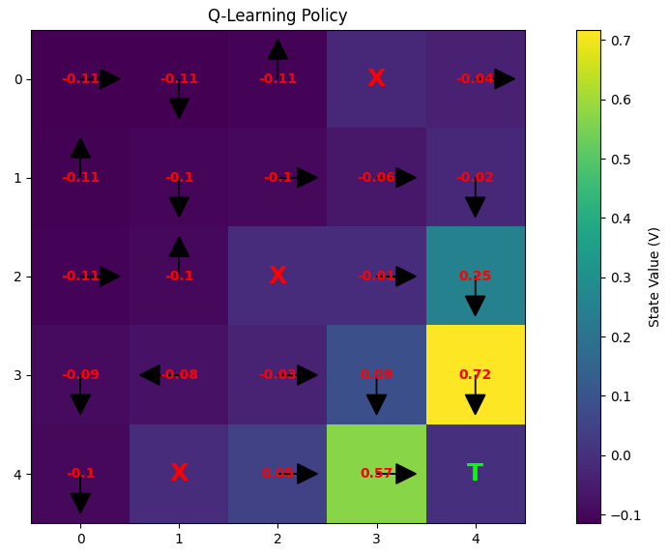
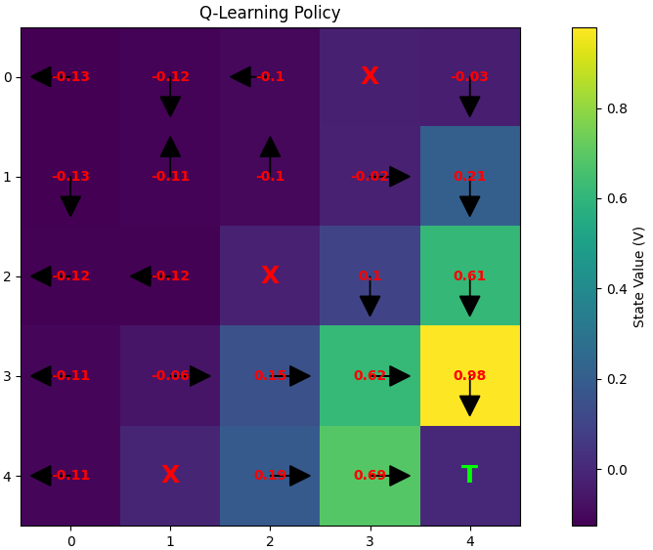
Q-Learning Simulation Results
Fig 6: Policy Heat Map (early stage)
Fig 7: Policy Heat Map (post early stage)
Policy after 20 episodes of iteration.
Policy after 50 episodes of iteration

Slide 19
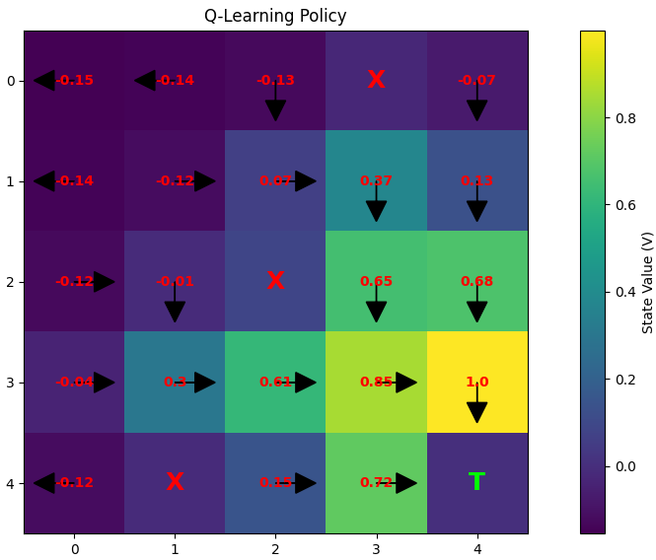
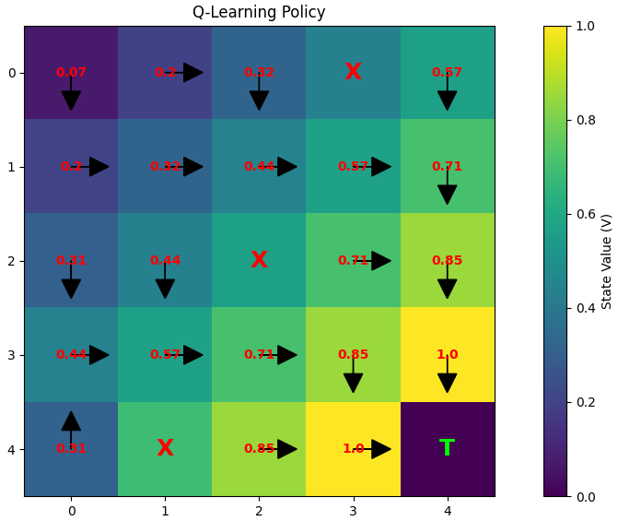
Q-Learning Simulation Results
Fig 8: Policy Heat Map (mid stage)
Fig 9: Policy Heat Map (late stage)
Policy after 100 episodes of iteration
Policy after 1000 episodes of iteration

Slide 20
Conclusion
The Gridworld example demonstrated how Q-Learning can learn an optimal policy through trial-and-error interactions.
Applying the same principle to Cluster Head (CH) selection in WSNs:
Makes the system adaptive with dynamic decision-making.
Balances energy consumption across heterogeneous nodes.
Improves fairness in CH election, reducing premature node deaths.
Overall, Q-Learning integration has the potential to prolong network lifetime compared to traditional approaches.

Slide 21
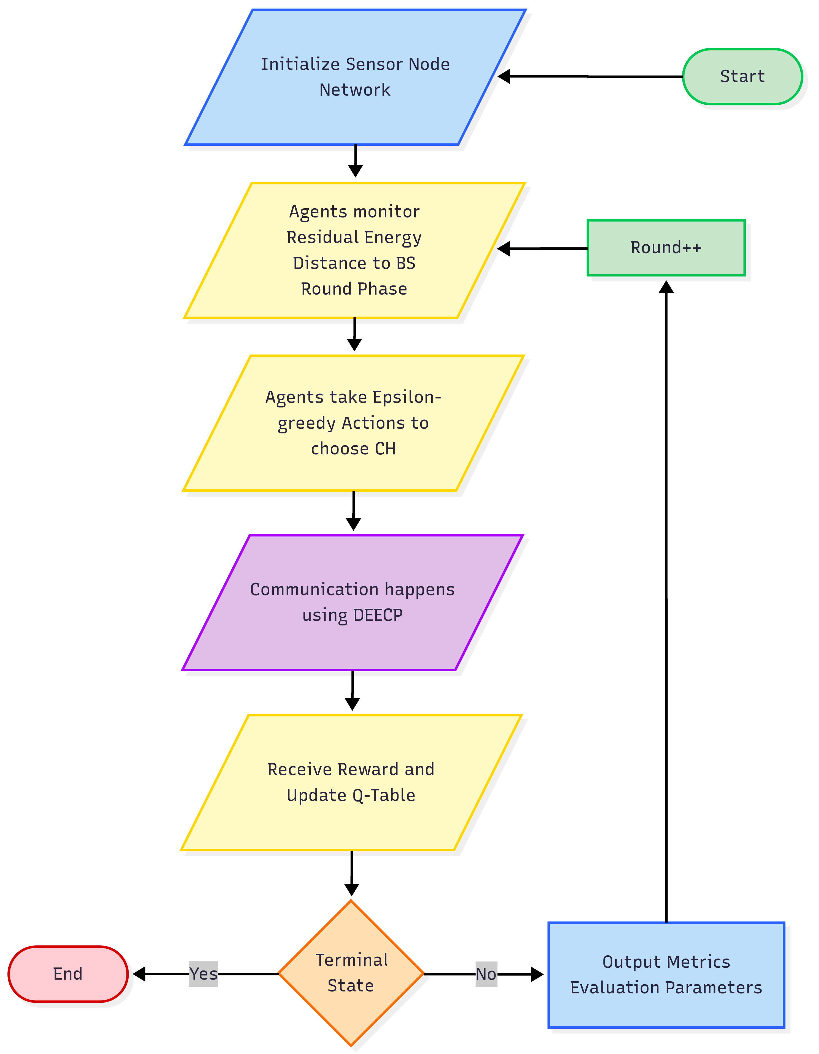
Future Work
Immediate Extension:
Integrating Q-Learning into CH Selection:
Enable adaptive and dynamic decision-making.
Balance energy consumption across heterogeneous nodes.
Scope for Further Enhancement:
Combine Swarm Intelligence with Q-Learning for deeper optimization.
Define more granular state spaces to capture diverse network conditions.
Apply efficient reward shaping strategies to accelerate learning.
Perform systematic hyperparameter tuning (e.g., learning rate α, discount factor γ, exploration rate ε).
Fig 10: Process Flow Chart

Slide 22
References
[1] Online Data Source: Directorate General of Mines Safety (DGMS) - https://www.dgms.gov.in
[2] B. R. Al-Kaseem, Z. K. Taha, S. W. Abdulmajeedand H. S. Al-Raweshidy, “Optimized energy–efficient path planning strategy in WSN with multiple mobile sinks,” IEEE Access, vol. 9, pp. 79994–80007, Jun. 2021, doi: 10.1109/ACCESS.2021.3087086
[3] R. Alsaqour, E. S. Ali, R. A. Mokhtar, R. A. Saeed, H. Alhumyaniand M. Abdelhaq, “Efficient energy mechanism in heterogeneous WSNs for underground mining monitoring applications,” IEEE Access, vol. 10, pp. 100123–100138, Jul. 2022, doi: 10.1109/ACCESS.2022.3188654.
[4] F. M. Salman, A. A. Mohammedand A. F. Mutar, “Optimization of LEACH protocol for WSNs in terms of energy efficiency and network lifetime,” Journal of Cyber Security and Mobility, IEEE vol. 12, no. 3, pp. 275–296, May 2023, doi: 10.13052/jcsm2245-1439.1232.
[5] M. Gamal, N. E. Mekky, H. H. Solimanand N. A. Hikal, “Enhancing the lifetime of wireless sensor networks using fuzzy logic LEACH technique-based particle swarm optimization,” IEEE Access, vol. 10, pp. 36935–36948, Mar. 2022, doi: 10.1109/ACCESS.2022.3163254.
[6] S. Mohapatra, P. K. Behera, P. K. Sahoo, S. K. Bisoy, K. L. Huiand M. Sain, “Mobility induced multi-hop LEACH protocol in heterogeneous mobile network,” *IEEE Access*, vol. 10, pp. 132895–132907, Dec. 2022, doi: 10.1109/ACCESS.2022.3228576.

Slide 23
References
[7] Zhu, B., Bedeer, E., Nguyen, H. H., Barton, R., & Henry, J. (2022). “UAV Trajectory Planning in Wireless Sensor Networks for Energy Consumption Minimization by Deep Reinforcement Learning”. IEEE Transactions on Vehicular Technology, 70(9), 9540–9554. doi:10.1109/TVT.2021.3102161
[8] Abose, T. A., Tekulapally, V., Kejela, D. C., Megersa, K. T., Daka, S. T., & Jember, K. A. (2024). “Optimized Cluster Routing Protocol With Energy-Sustainable Mechanisms for Wireless Sensor Networks.” IEEE Access, 12, 99661-99671. doi:10.1109/ACCESS.2024.3429645
[9] Chowdhury, A. R., Bakshi, S. C., Pramanik, A., & Roy, G. C. (2024). “Design and Study of LoRa-Based IIoT Network for Underground Coal Mine Environment.” IEEE Access. DOI: 10.1109/ACCESS.2024
[10] Abdul Aleem & Rajesh Thumma “Optimizing Energy Efficiency in IoT-Enabled Wireless Sensor Networks Using an Integrated EEKA-K-means Approach” by EEE Sensors Journal, 2025. DOI: 10.1109/JSEN.2025.3582381
[11] Available Online Book : https://web.stanford.edu/class/psych209/Readings/SuttonBartoIPRLBook2ndEd.pdf
[12] Available Online Book and Resources: https://github.com/imshubhamcodex/ql--resources

Slide 24
Thank You
Open to Q&A

