Slide 1

AI Variant • EXCELR
Axon Healthcare Analytics Project
Objective: Transform healthcare data into actionable insights for operational, financial and management decision-making.
BUSINESS DOMAIN
Healthcare/EMR Hospital Operations
PROJECT TYPE
Data Analytics & Business Intelligence
ROLE
Data Analyst
TOOLS
SQL | Excel | Tableau | Power BI
Presented By: Group:6
ANANYA • SHUBHAM • SURAJ
Healthcare EMR Analytics • Business Presentation

Slide 2
02 | BUSINESS OBJECTIVES
What business problem are we solving?
Turn fragmented EMR activity into consistent, decision-ready views for leadership, clinical teams and finance.
01
PATIENT CARE
02
OPERATIONS
03
TREATMENT
Understand demographics, chronic conditions, follow-up intensity and treatment outcomes.
Monitor visits, cancellations, completion, provider workload and department demand.
Compare treatment mix, cost and outcomes to support service-level performance monitoring.
04
DIAGNOSTICS
05
REVENUE
06
INSURANCE
Track lab volume, abnormal results and pending workload.
Measure billed revenue, insurance coverage, patient payments and outstanding balances.
Monitor claim status, approval patterns and payer-level performance.
Decision principle: one metric definition → one backend logic → multiple BI views
2

Slide 3
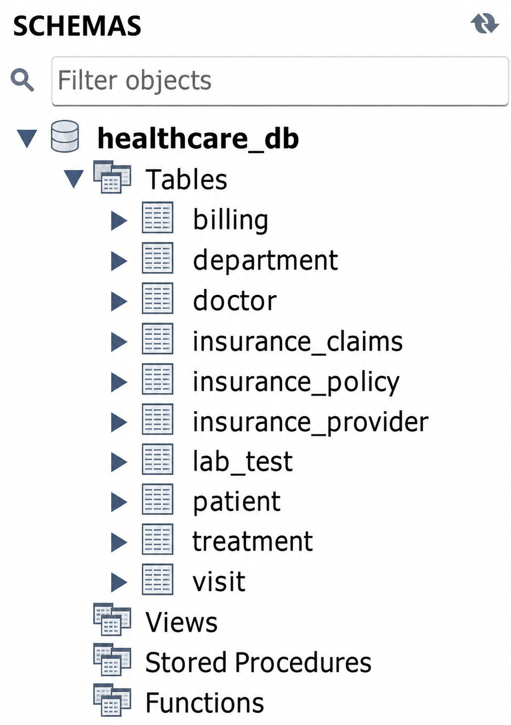
03 | DATA OVERVIEW
Data Overview & SQL Database Structure
CORE DATA FOUNDATION
Patient
10,000
Patient ID
Patient demographics
Doctor
1,000
Doctor ID
Provider / specialty
Department
5
Department ID
Department master
Visit
10,000
Visit ID
Central encounter fact
Treatment
10,000
Treatment ID / Visit ID
Treatment + outcome
Lab Test
10,000
Lab Result ID / Visit ID
Diagnostic results
Billing
10,000
Bill ID / Visit ID
Revenue-cycle data
3

Slide 4
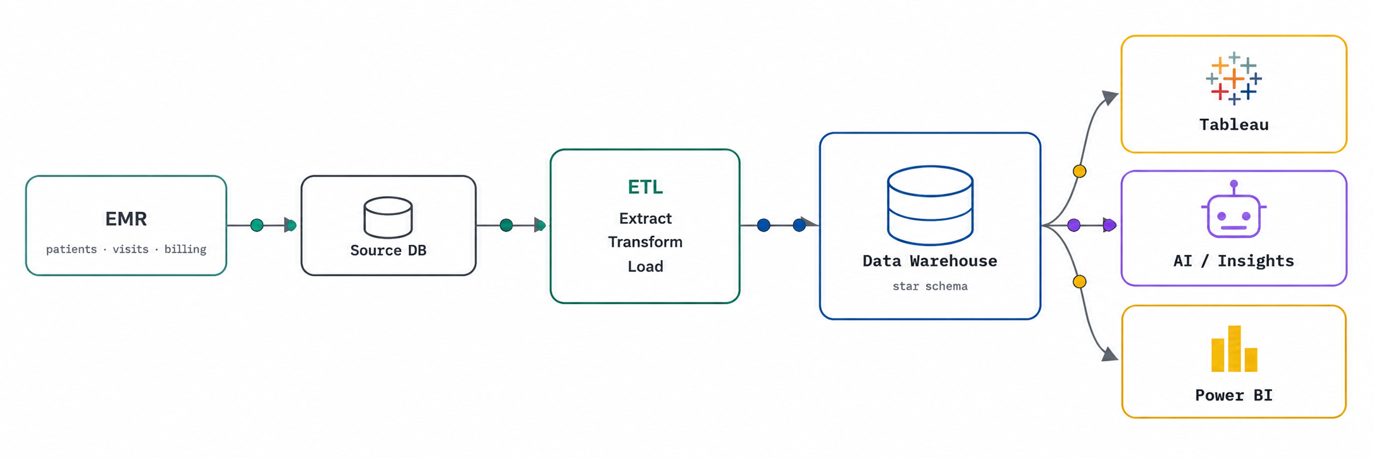
04 | DATA FLOW
From raw EMR data to business insight
The same business dataset moves through preparation, backend logic, BI presentation and QA.
4

Slide 5
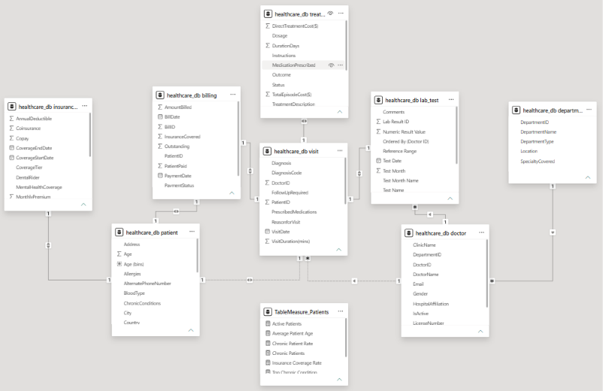
05 | DATA MODELING
One analytical model, three working environments
POWER BI
Prefer a Star Schema for analytics.
Separate Fact Tables and Dimension Tables.
Create relationships using primary/foreign keys.
Build DAX measures on top of the model for KPIs.
Semantic / DAX layer
TABLEAU
Use Relationships to connect related tables.
Use Joins when row-level combination is required.
Maintain appropriate dimensions and measures for analysis.
Build the model to support interactive dashboards and drill-down analysis.
Relationship / visual layer
EXCEL
Use Excel Tables for structured source data.
Use Power Pivot / Data Model to connect multiple tables.
Define relationships using common keys.
Use the model for PivotTables, KPIs and reporting.
Preparation layer
Modeling rule: Visit = central encounter fact; Treatment, Lab Test and Billing attach through Visit ID.
5

Slide 6
06 | KPI DICTIONARY
Important KPIs + SQL logic
Numbers below are calculated from the actual uploaded dataset. SQL snippets follow the supplied query logic.
KPI
COMPLETION RATE
VALUE
SQL LOGIC
SELECT
ROUND(
SUM(CASE
WHEN visit_status = 'Completed' THEN 1
ELSE 0
END) * 100.0 / COUNT(*),
2
) AS Completion_Rate
FROM visit;
Total Patients
10,000
COUNT(patient_id)
Total Doctors
1,000
COUNT(doctor_id)
Total Visits
10,000
COUNT(visit_id)
Average Patient Age
48.94
AVG(age)
Visit Completion Rate
32.66%
Completed / total visits
TREATMENT SUCCESS
Treatment Success Rate
33.01%
Successful / treatment rows
SELECT
ROUND(
SUM(CASE
WHEN outcome = 'Successful' THEN 1
ELSE 0
END) * 100.0 / COUNT(*),
2
) AS Treatment_Success_Rate
FROM treatment;
Follow-Up Rate
49.84%
Yes / visit rows
Average Treatment Cost
$2,540.59
AVG(total_episode_cost)
Total Lab Tests
10,000
COUNT(lab_result_id)
Abnormal Lab Rate
33.54%
Abnormal / lab rows
INSURANCE APPROVAL
Total Revenue Billed
$25.41M
SUM(amount_billed)
SELECT
ROUND(
SUM(CASE
WHEN claim_status = 'Approved' THEN 1
ELSE 0
END) * 100.0 / COUNT(*),
2
) AS Insurance_Approval_Rate
FROM ins_claims;
Outstanding Balance
$7.06M
SUM(outstanding)
Insurance Coverage Rate
57.02%
Insurance covered / billed
Claim Approval Rate
60.75%
SELECT ROUND(SUM(CASE WHEN claim_status = 'Approved' THEN 1 ELSE 0 END)* 100.0 / COUNT(*), 2
) AS Claim_Approval_Rate
FROM ins_claims;
Source: supplied SQL query file + actual EMR dataset
6

Slide 7
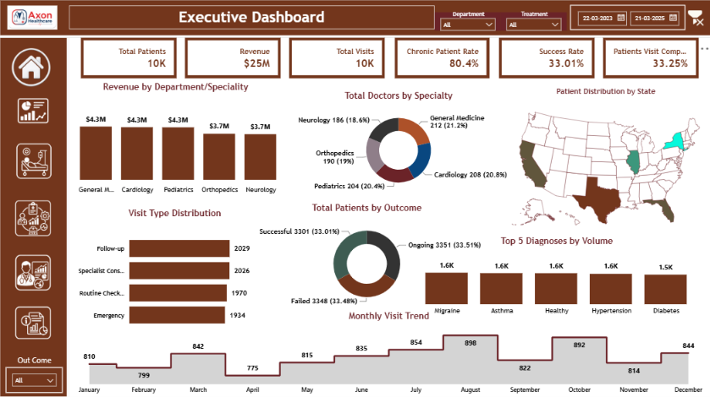
07 | Dashboard 1
Executive Healthcare Performance Dashboard
Management View
Insight 01
10K patients and 10K visits indicate a significant healthcare service volume.
Insight 02
32.66% visit completion rate highlights an operational improvement opportunity.
Insight 03
33.01% treatment success rate indicates scope for improving treatment outcomes.
Insight 04
$25.41M revenue billed shows strong overall financial activity.
6

Slide 8
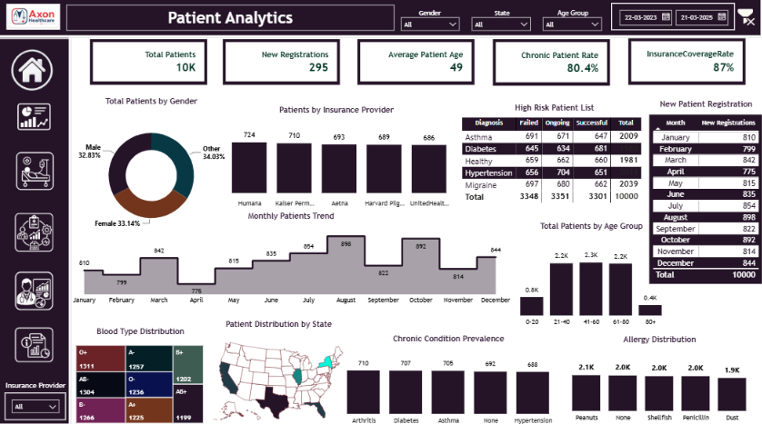
08 | DASHBOARD 2
Patient Utilization & Operational Performance
Where is healthcare demand concentrated, and how efficiently are resources being utilized?
Management View
Insight 01
80.35% chronic patient rate indicates a high long-term care burden.
Insight 02
Average patient age is 48.94 years, showing a mature patient population.
Insight 03
Chronic conditions are concentrated around Hypertension, Diabetes and Asthma.
Insight 04
Patient demographics and insurance coverage can support targeted care planning.
Healthcare Analytics | Data Analyst Portfolio | Group 6
7
6

Slide 9
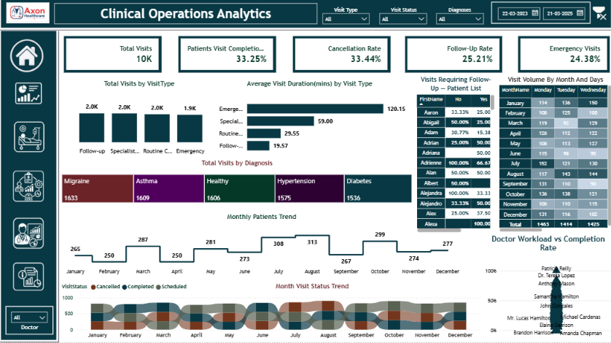
09 | DASHBOARD 3
Clinical Operations Dashboard
Management View
Insight 01
Visit completion and cancellation rates are key operational efficiency signals.
Insight 02
Follow-up cases require focused monitoring for better care continuity.
Insight 03
Diagnosis volume helps identify high-demand clinical conditions.
Insight 04
Doctor workload analysis supports better staffing and capacity planning.
6

Slide 10
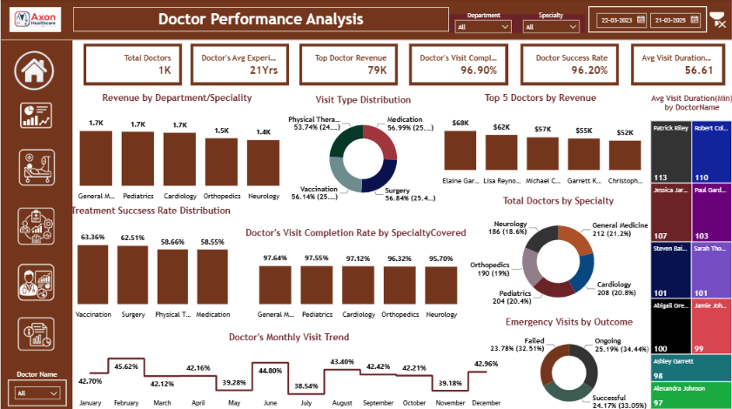
10 | DASHBOARD 4
Doctor Performance Dashboard
Management View
Insight 01
Doctor workload varies across specialties and departments.
Insight 02
Completion rate helps identify operational performance gaps.
Insight 03
Success rate highlights differences in clinical outcomes.
Insight 04
Revenue contribution helps identify high-value doctor performance.
6

Slide 11
11 | FROM DATA TO DECISIONS
What management can do with the analysis
The value is not the chart itself — it is the decision the chart makes easier.
01
DEMAND PLANNING
02
VISIT OPERATIONS
03
CHRONIC CARE
Migraine is the top diagnosis (2,039 visits).
33.44% cancelled vs 32.66% completed.
80.35% of patients are marked chronic.
Use diagnosis + month concentration to plan capacity.
Review scheduling, reminders and slot allocation.
Prioritize follow-up capacity and long-term care pathways.
04
DIAGNOSTIC WORKLOAD
05
REVENUE CYCLE
06
PAYER PERFORMANCE
33.54% abnormal lab results.
$7.06M outstanding.
60.75% claim approval rate.
Monitor abnormal-result workflow and escalation.
Prioritize collections and payment-status monitoring.
Compare payer approval patterns and investigate friction.
Business impact lens: capacity • care pathways • diagnostic workflow • provider performance • revenue recovery
11

Slide 12
12 | BUSINESS IMPACT & CONCLUSION
From data to a defensible business story
01
PROBLEM
02
APPROACH
Improved Decision-Making: Management gets a single view of key healthcare KPIs.
Operational Efficiency: Identified gaps in visit completion, follow-ups and doctor workload.
Better Clinical Monitoring: Treatment outcomes and abnormal lab patterns become easier to track.
Revenue Visibility: Improved monitoring of billing, insurance claims and outstanding revenue.
Data-Driven Planning: Insights support better resource allocation, care planning and revenue management.
Healthcare data was spread across multiple areas, making it difficult to monitor patients, clinical operations, treatments, doctors, labs and revenue in one place.
Integrated and analysed healthcare data using Excel, SQL, Power BI and Tableau to build KPIs, dashboards and business-focused analysis.
03
EVIDENCE
04
OUTCOME
10K Patients | 10K Visits | 1K Doctors | 10K Lab Tests | $25.41M Revenue | 32.66% Visit Completion | 33.01% Treatment Success.
Converted raw healthcare data into actionable insights that support better clinical decisions, operational planning, treatment monitoring and revenue management.
BUSINESS IMPACT
Thank You
AXON Healthcare Analytics • AI Variant
12

