Slide 1

AI 511-Machine Learning
Prof Neelam Sinha
Prof Dinesh Babu
Final Project PPT
Team - Gryffindor
Aakanksha Rani (MT2022001)
Akanksha Shukla (MT2022008)

Slide 2
Problem No.-01
YAHOO-TROLL-QUESTION-DETECTION
Problem Statement - As a last-ditch attempt to give Yahoo Answers some legitimacy in the era of Quora and Reddit, Yahoo's CEO Merissa Meyer has tasked you with creating a machine learning model to detect spam and troll questions so that they can be removed. To this end, you are given a hand-labeled dataset consisting of questions with unique IDs and whether they are troll questions or not.

Slide 3
Natural Language Processing
NLP is the technology used to help machines to understand and learn text and language . It is done to teach machines to understand and make sense of human language. It is a discipline that focuses on the interaction between data science and human language, and is scaling to lots of industries.
Use Cases of NLP :
1-Sentiment Analysis
2-Spam Classification
3-Troll Question Detection
4-Text Classification
5-Speech Recognition

Slide 4
Preprocessing Of Data Set
1.Data Cleaning
2.Exploratory Data Analysis(EDA)
3.Data Preprocessing
Regularization
Lower Case
Tokenization
Removing Stopwords
Removing URLs
Stemming
Lemmatization
Vectorizers
4.Balancing the unbalanced dataset

Slide 5
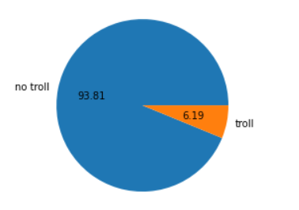
Exploratory Data Analysis
In our training dataset there are no Null values and duplicated rows . The dataset is an unbalanced dataset.
Number of rows: 1000000
Number of Columns :3
Number of non troll questions : 938130
Number of troll questions : 61870

Slide 6
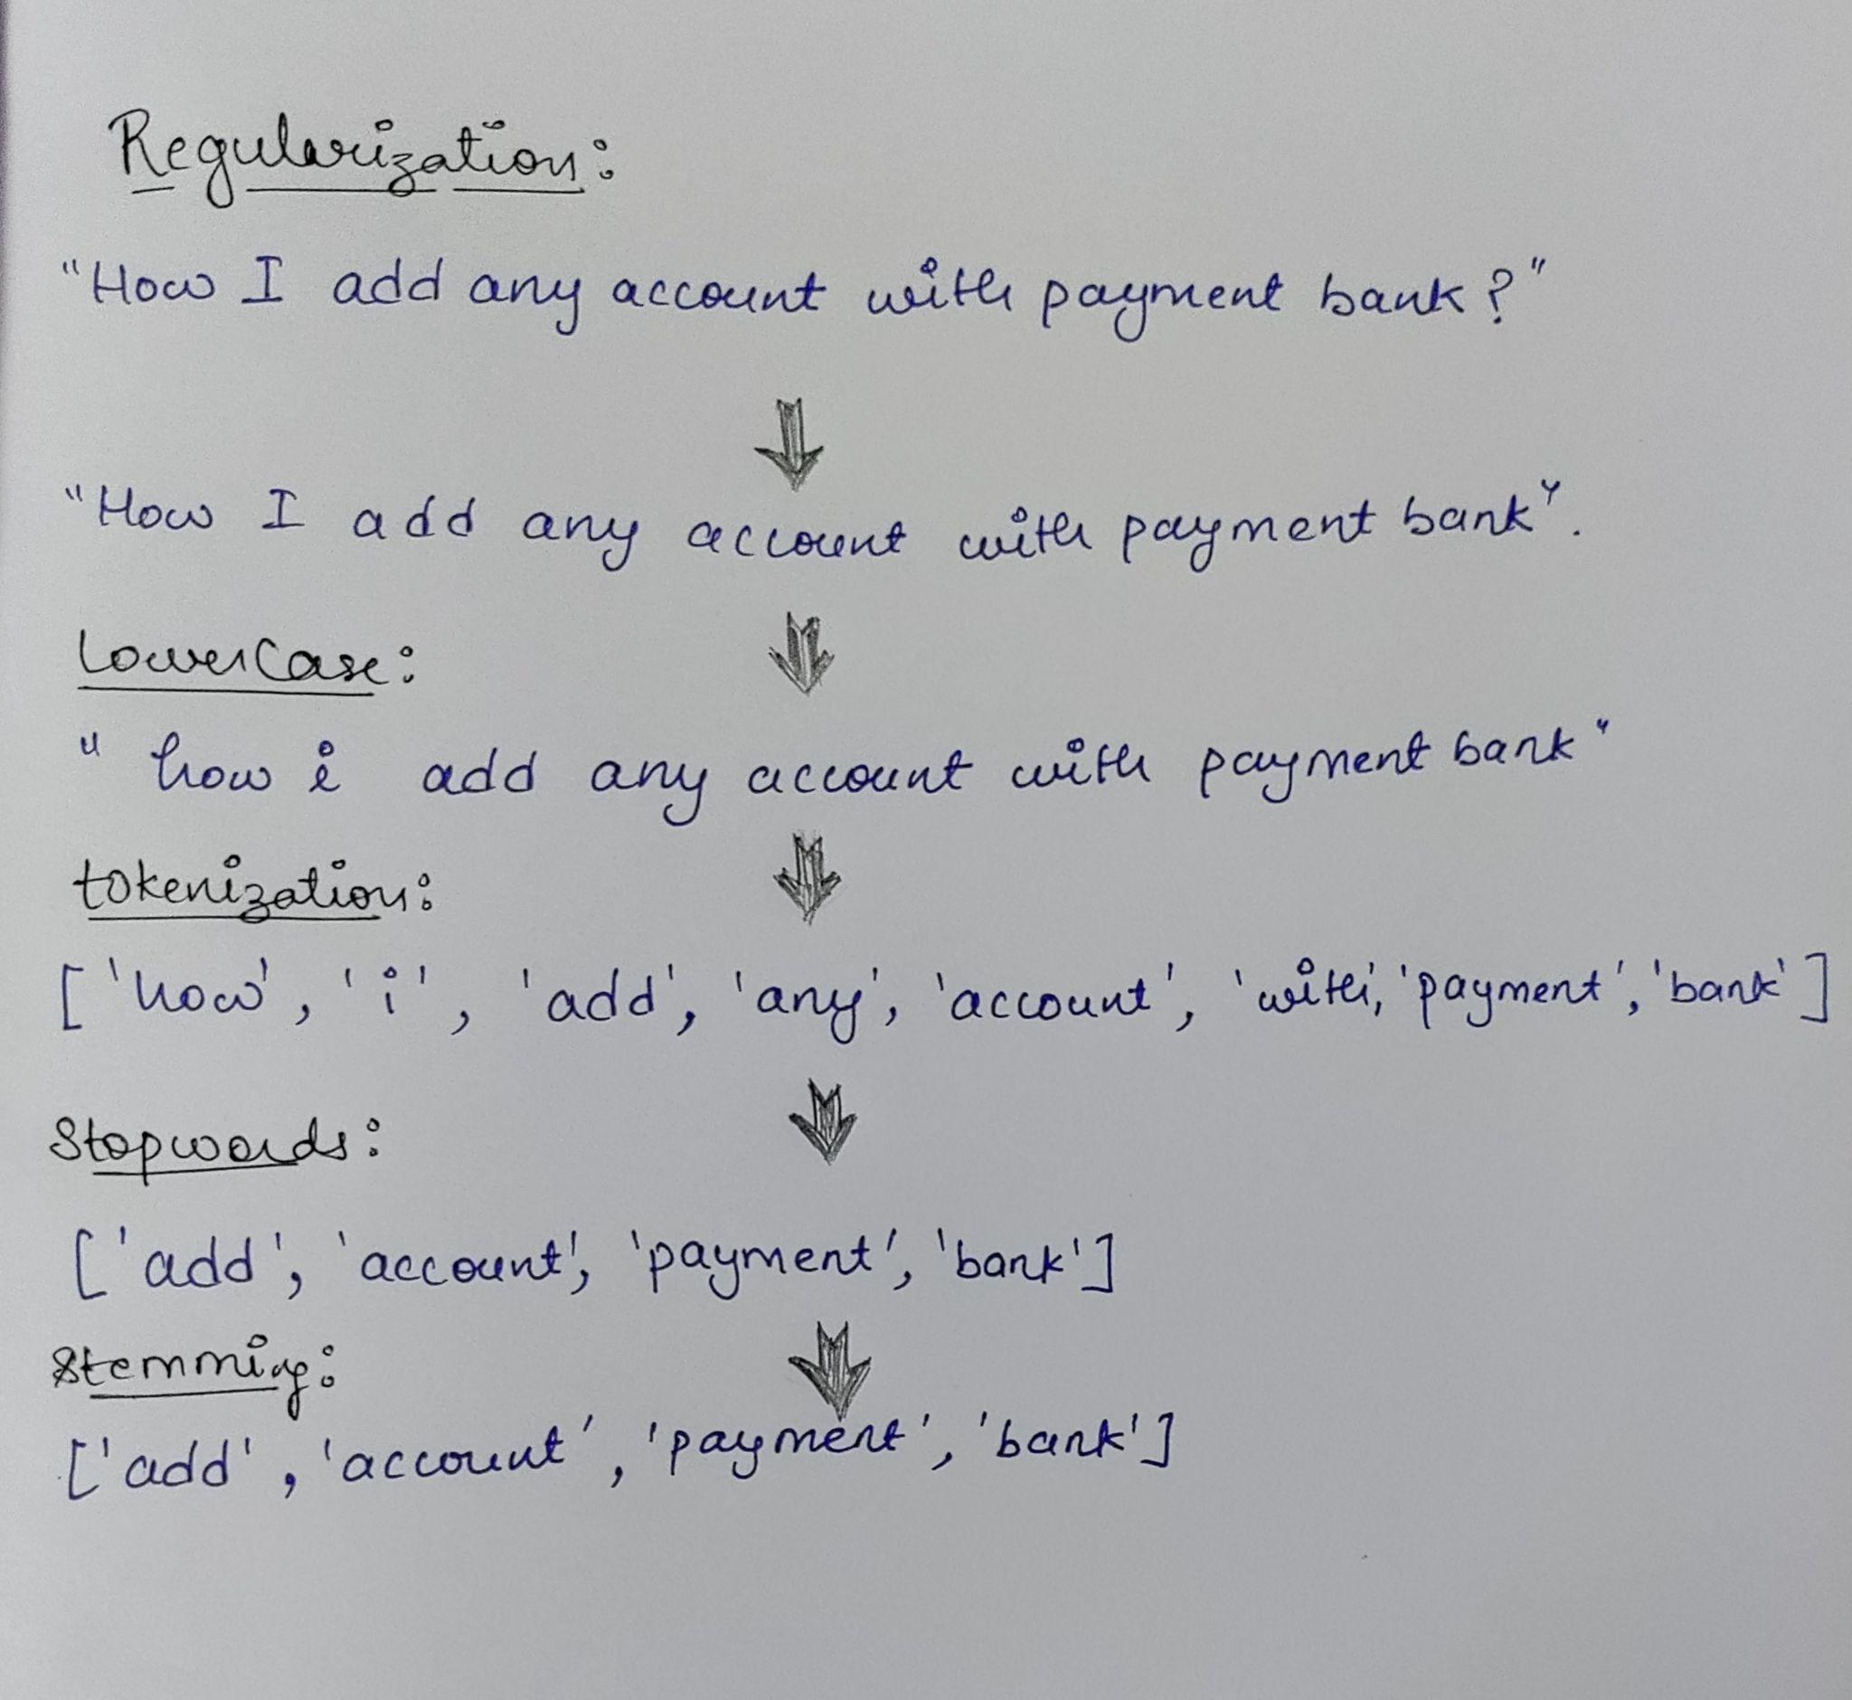
Preprocessing of Text
Ex- “How I add any account with payment bank?”

Slide 7
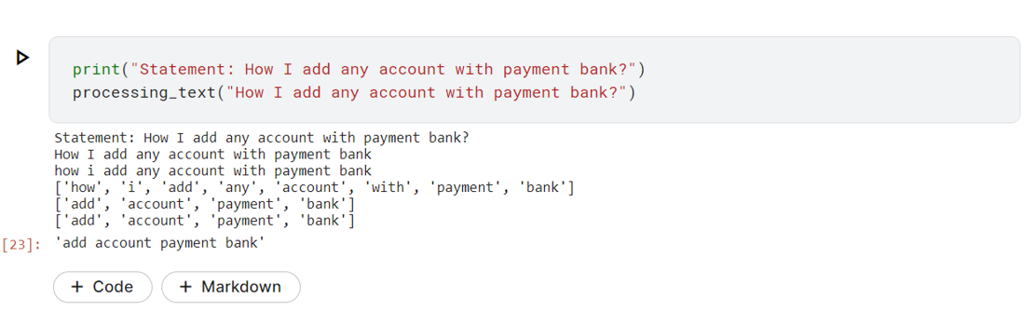

Slide 8
Vectorizers
Countvectorizer - It uses the bag of word model to convert arbitrary text into fixed length vectors by counting how many times each word appears.
TF-IDF Vectorizer - The TF-IDF score for each word is calculated as given below to generate the feature vectors for each sample questions.
The TF-IDF technique is good as it gives importance to
rarely occurring words.

Slide 9
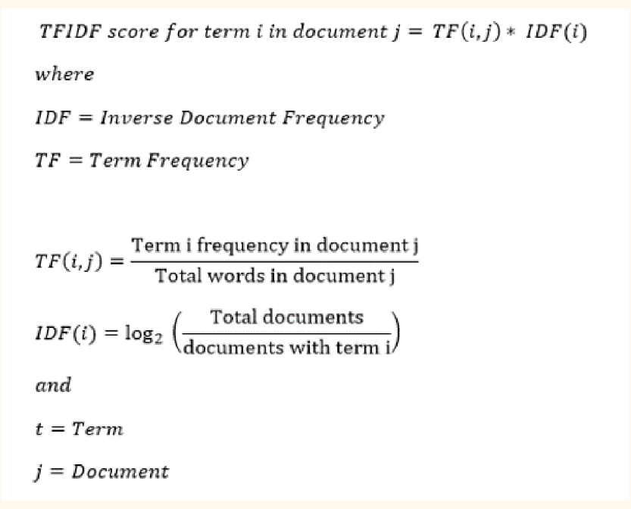

Slide 10
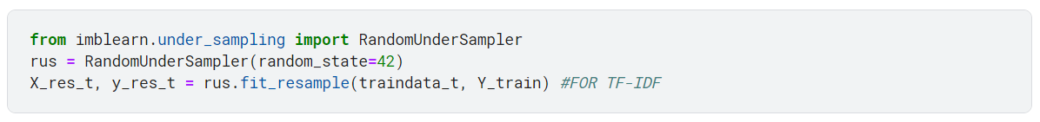
Balancing The Dataset
The random undersampler provided by imblearn was used to balance the dataset as a majority of the samples were of the non troll category.
We can also use oversampling but since data is too much we preferred undersampling.

Slide 11
What we did?
We have separately preprocessed both training and test data set.
Then pickled the preprocessed data and save them into files.
Now merging the preprocessed data set instead of raw dataset .
TF-IDF is used for vectorizations of words. Also Count CountVectorizer.

Slide 12
5. We have limited our features upto 4000 unique words (feature
columns).
6. Again splitting of merged preprocessed dataset as training and
Testing dataset.
Train Data - 1000000 x 4000
Test Data - 306122 x 4000
7. Applying multiple models on preprocessed data.
8. But our accuracy wasn’t improving so we applied models on
dataset without preprocessing.

Slide 13
9. We got satisfactory results from the above
10. We tune the hyper parameters of different models to
check varying accuracy.
11. At the end we also tried to remove URLs and applied
logistic regression model without any other preprocessing
and got some good results.

Slide 14
Models Tried
Logistic Regression
Multinomial Naive Bayes
Gaussian Naive Bayes
Random Forest
Decision Tree
SVM

Slide 15
Model Training (Top 3 Approaches)
Model Name | Description | F1 Score
Logistic Regression (w/o preprocessing) | LR (Countvectorizer) with hyper parameter tuning (alpha-0.0009) | 0.62607
Logistic Regression (w/o preprocessing) | LR (Countvectorizer) with hyper parameter tuning (alpha-0.0008) | 0.62598
Logistic Regression (w/0 preprocessing + only removing URL) | LR (Countvectorizer) with hyper parameter tuning (alpha-0.0001,iteration-1500) | 0.62543

Slide 16
Some Other Approaches
Model Name | Description | F1 Score
Logistic Regression (with preprocessing) | (TF-IDF + Lemmatization) | 0.56182
Logistic Regression (undersampled) | LR with no preprocessing + using bag of words with hyper parameter tuning (max features 500000) | 0.54752
Logistic Regression (with preprocessing) | LR with pre preprocessing (stemming)+ TF-IDF (max features 7000) | 0.48677
Naive Bayes | Multinomial NB (Preprocessed +Undersampled) + using TF-IDF | 0.35487

Slide 17
Model Name | Description | F1 Score
Naive Bayes | Gaussian NB (Preprocessed +Undersampled) + using countvectorizer | 0.19661
Logistic Regression with grid search | LR with pre preprocessing (stemming)+ TF-IDF | 0.45994
Random Forest | RF with pre processed + undersampled data | 0.38528(TF-IDF), 0.21314(CV)
Decision Tree | DT with pre processed + undersampled (countvectorizer) | o.11

Slide 18
Observations -
1.For same model we are getting more accuracy without
preprocessing of data.
2.Tuning the hyperparameters of the model affects the accuracy.
Inference Drawn -
1.Nothing except the very basic Countvectorizer and Logistic Regression (without any preprocessing) worked for us. All other approaches didn’t give us good results.
2.Unbalanced dataset was the biggest problem we faced.
Result- We achieved a f1 score of 0.61928 in private leaderboard and 0.62607 in public leaderboard.

Slide 19
Required Libraries
numpy
pandas
Sklearn
re
nltk
Matplotlib
Imblearn
pickle

