Slide 1
0220 Report
Team G

Slide 2
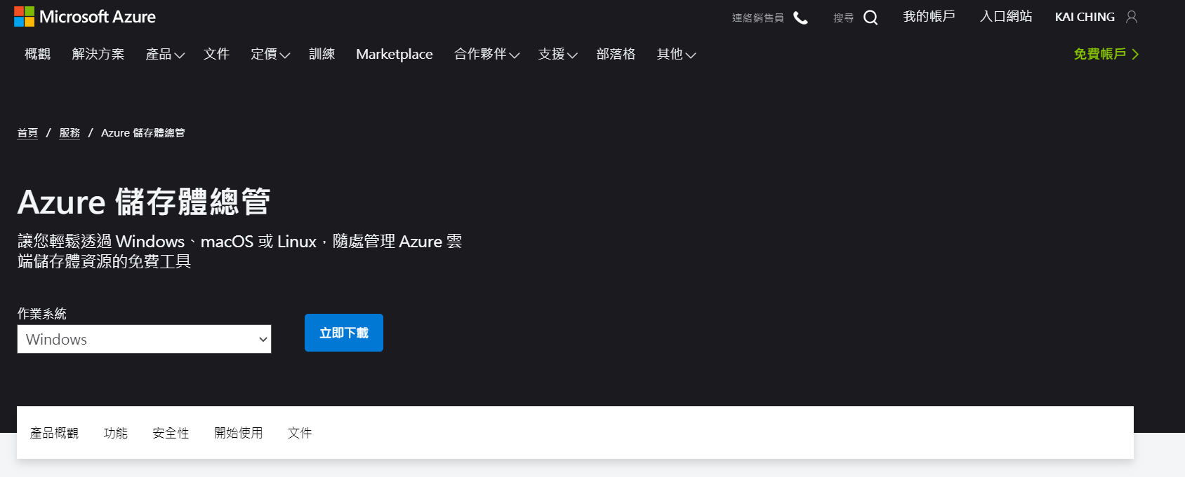
Download Microsoft Azure Storage Explorer

Slide 3
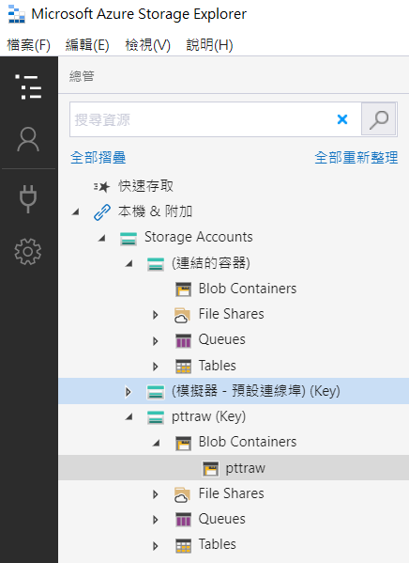
Add Container (named pttraw)

Slide 4

Download .json file

Slide 5
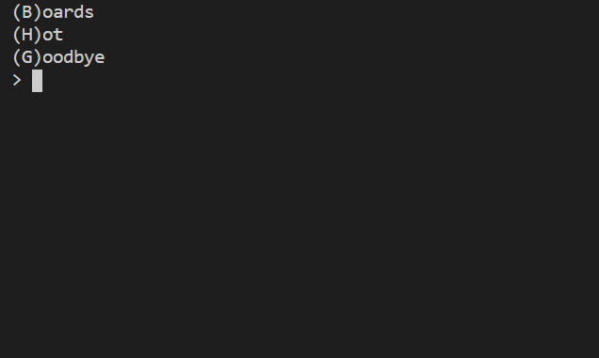
Category

Slide 6
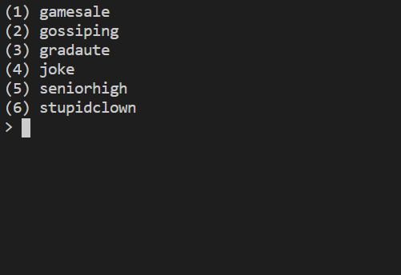

Slide 7
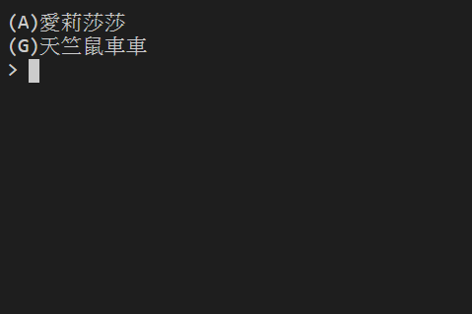

Slide 8
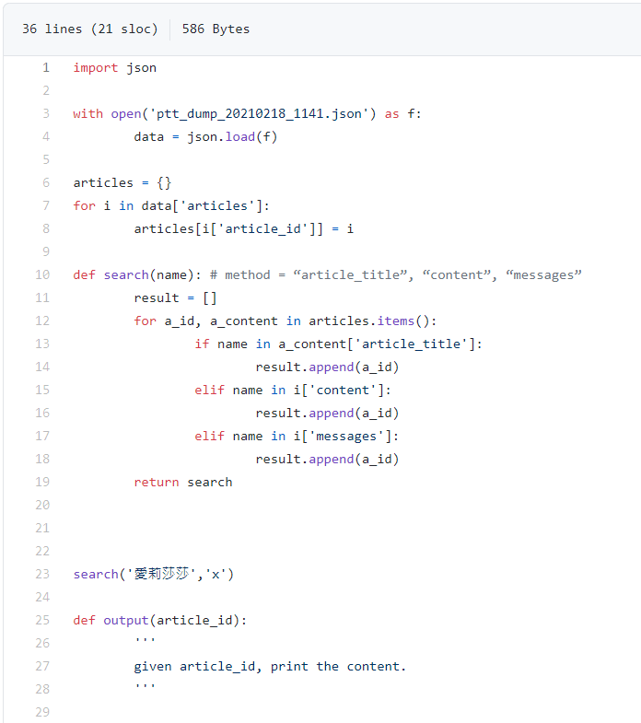
Search function

