Slide 1
E-AUTHENTICATION USING DIFFIE-HELLMAN

Slide 2
INTRODUCTION
growth of the Internet ,an increased awareness and interest in security issues.
minimal attention paid to issues of confidentiality, authentication, and privacy.
daily activities become more and more reliant upon data networks
the importance of an understanding of security issues
cryptographic algorithms (e.g., DES,AES, HMAC)
Manual distribution of keying material is inefficient and complex. This is where the Diffie-Hellman Key Agreement algorithm is useful.

Slide 3
implement the Diffie-Hellman key exchange protocol .
create a web Application
Encipher sensitive data such as user’s email,name,mobile number etc before transporting them from client to server.
the customer accesses the website powered by our simple http server.
The client will communicate with the server by Diffie-Hellman key-exchange protocol
generate the common shared key which is used in the later communication.
After key exchange, both server and client will use the shared key to encipher and decipher the sensitive data using some symmetric protocol.

Slide 4
ABSTRACT
Since directly sending sensitive information over the network is highly dangerous and can lead to privacy related problems and hence we have used diffie-hellman key exchange algorithm to exchange a symmetric key both the client and server side followed by some symmetric key encryption techniques like AES,3DES etc to send data securely over the network.Efficient Extended Diffie-Hellman Key Exchange Protocol we took it as our reference paper.

Slide 5
PROBLEM STATEMENT
E AUTHENTICATION USING MODIFIED DIFFIE HELLMAN ALGORITHM

Slide 6
Literature Survey
1.Efficient Extended Diffie-Hellman Key Exchange Protocol
Author: Arjun Singh Rawat, Maroti Deshmukh
2.Hybrid Algorithm Combining Modified Diffie Hellman and RSA
Author: Junnel E. Avestro , Ariel M. Sison, Ruji P. Medina
3.Prevention of Man-In-The-Middle Attack in Diffie-Hellman Key Exchange Algorithm using Proposed Hash Function
Author: Phyu Phyu Thwe , May Htet
4.Secure Key Exchange Using Enhanced Diffie-Hellman Protocol Based on String Comparison
Author: Ankit Taparia , Saroj Kumar Panigrahy , Sanjay Kumar Jena

Slide 7
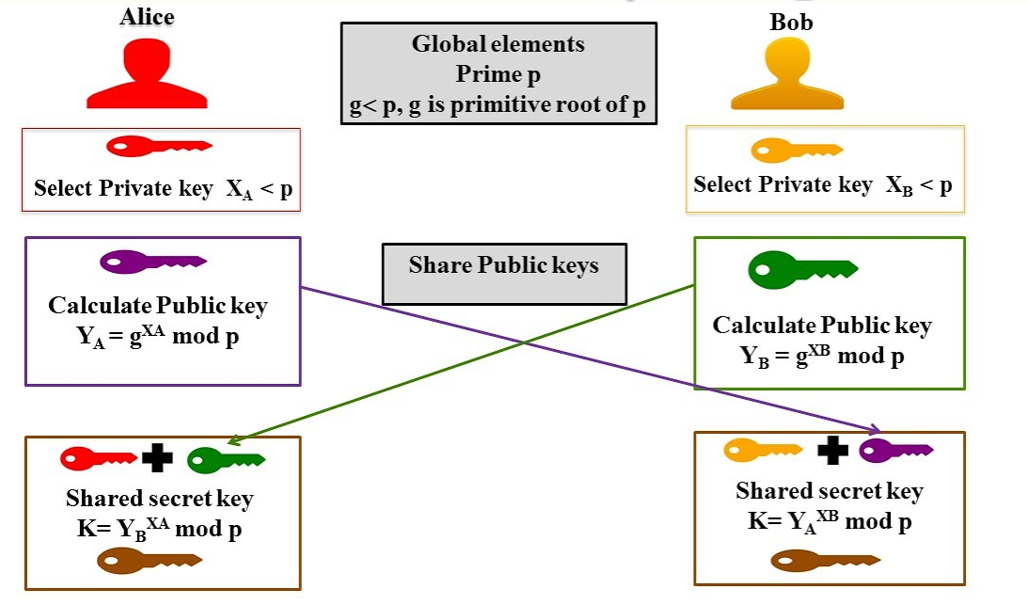
METHODOLOGY

Slide 8
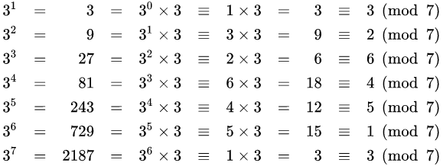
Here , for example
g=3 is primitive root of
p=7.

Slide 9
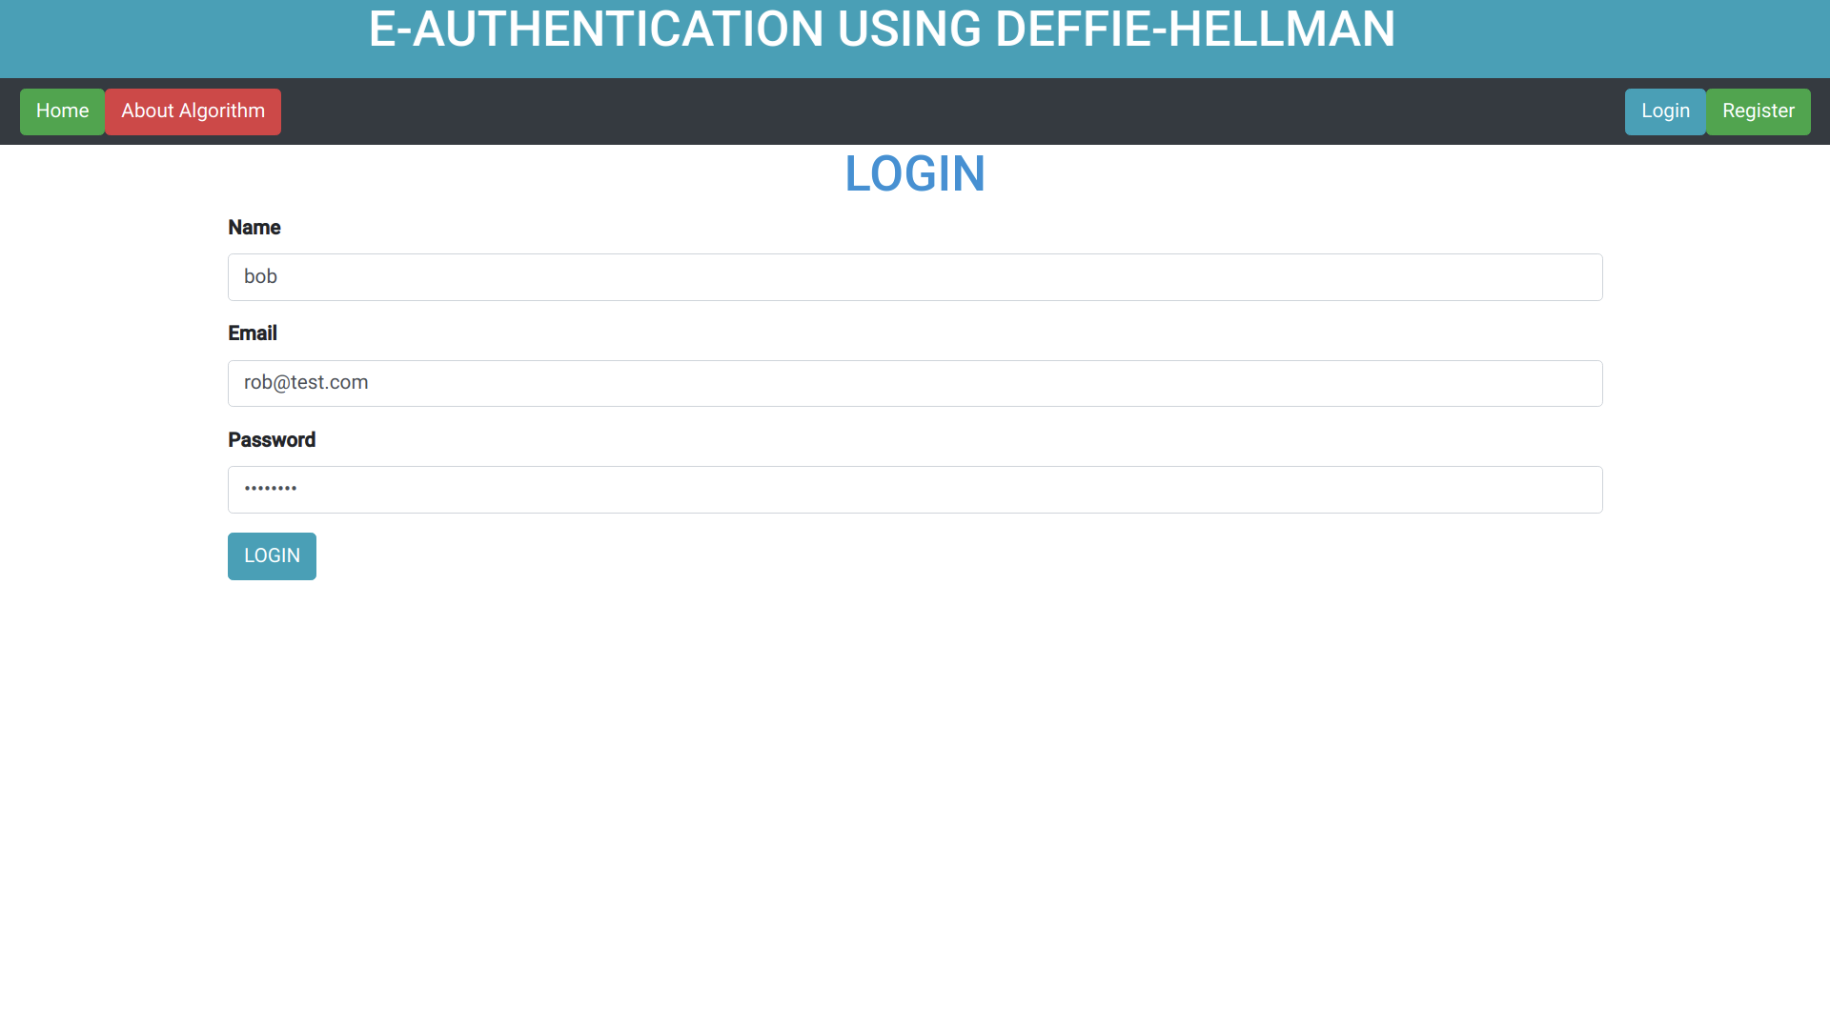

Slide 10
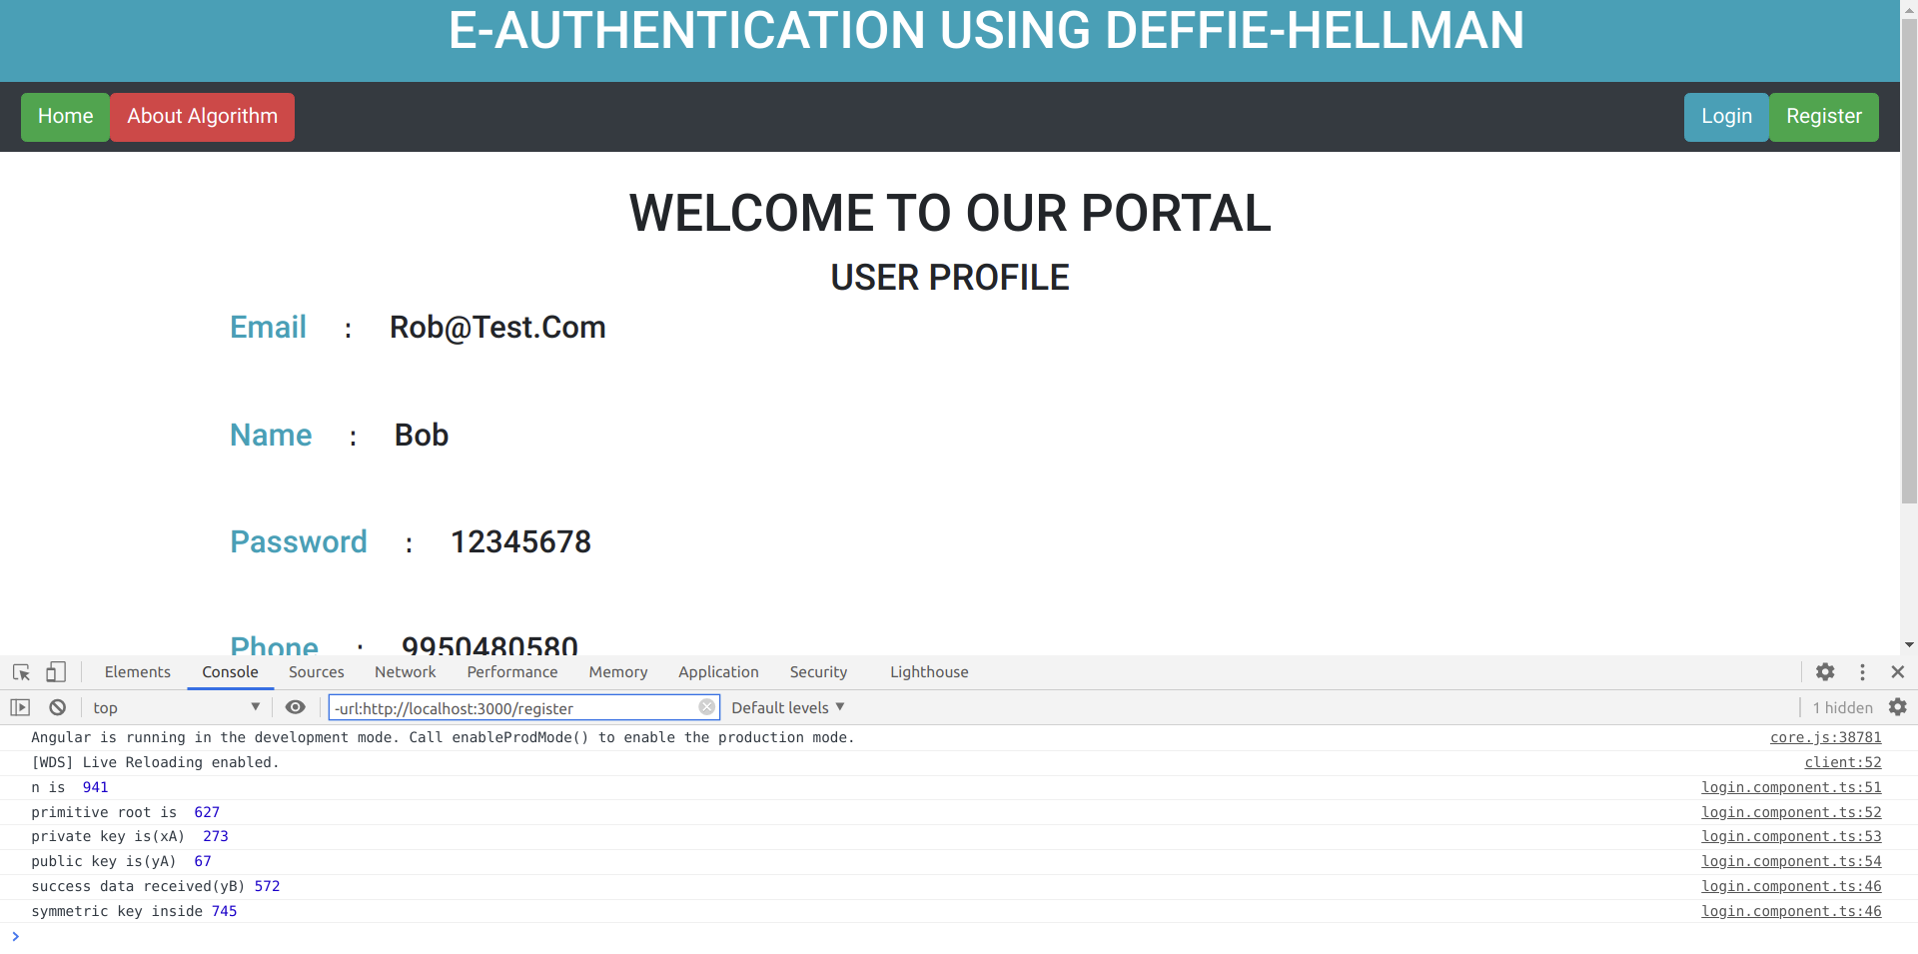
CLIENT SIDE

Slide 11
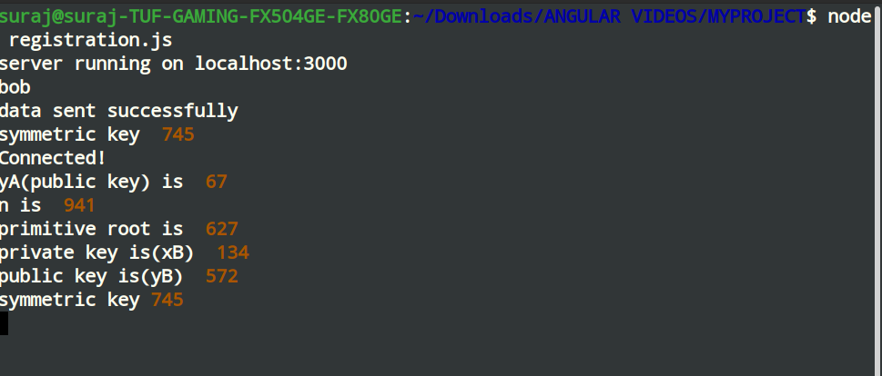
SERVER SIDE

Slide 12
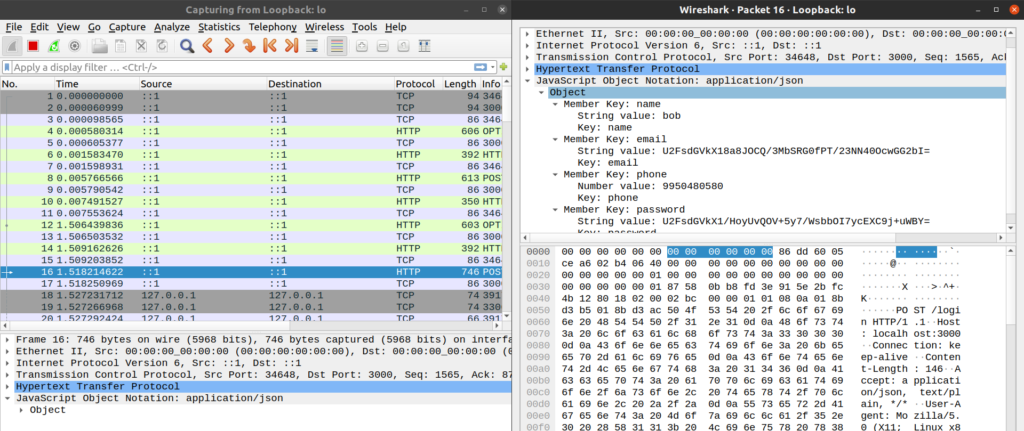
Packet Sniffed In between using Wireshark

Slide 13
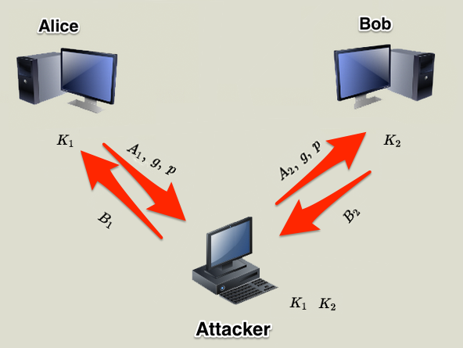
MITM in DIFFIE-HELLMAN

Slide 14
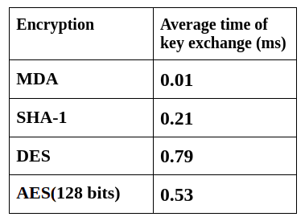
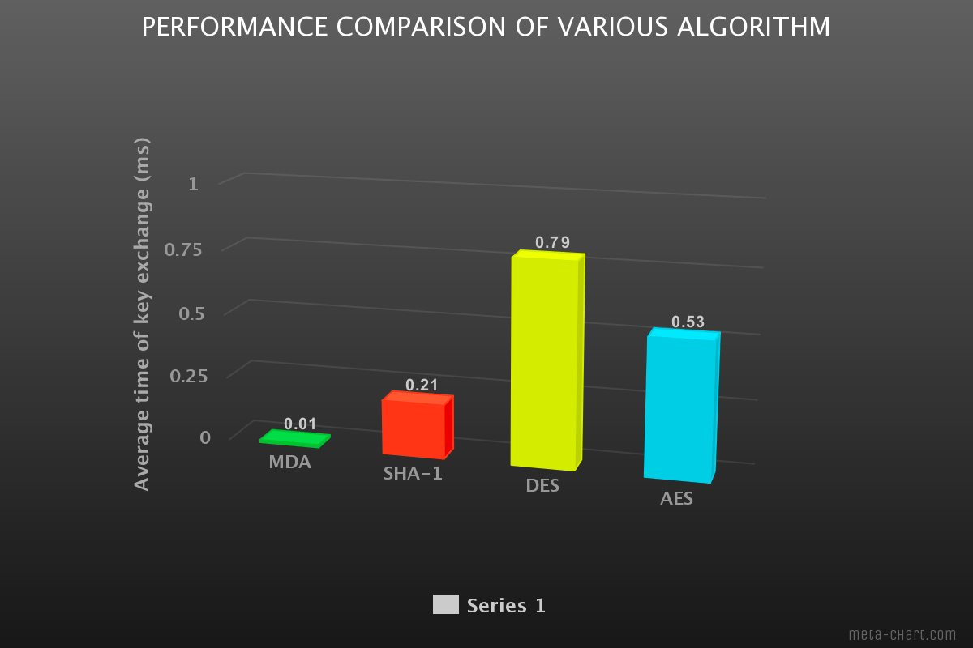
Results and analysis

Slide 15
CONCLUSION
By analyzing the security of the Diffie-Hellman protocol, this paper presents an improved key exchange protocol with an additional security checking. Before applying the diffie hellman key exchange the verification of authority is performed by certificate authority using RSA . Because of the Authentication mechanism, the improved Diffie-Hellman key exchange protocol can resist replay attack, impersonation attack and man-in-the-middle attack. It has a high practical value in building a secure communication channel of symmetric keys. This technique can be used in many web applications which require more security and hence it will be helpful for many e-commerce websites.

