Slide 1
Call Center Performance Project
Created By
Sundram Kumar
sundram_2312res869@iitp.ac.in

Slide 2
Project Overview
The objective of this project was to design an interactive Power BI dashboard to analyze call center performance.
We aimed to:
• Track key performance indicators (KPIs).
• Visualize call trends, agent efficiency, and customer satisfaction.
• Enable interactive analysis using slicers and filters.

Slide 3
Data Preparation
Dataset Source: Provided Call Center Data (Excel)
Steps taken:
• Cleaned and structured the dataset.
• Created DAX measures for KPIs (Total Calls, Answered, Abandoned, CSAT %, FCR %, etc.).
• Ensured consistency in column types and formatting.

Slide 4
Key Performance Indicators
We developed the following KPIs:
• Total Calls Received
• Total Calls Answered
• Total Calls Abandoned
• Average Handling Time (AHT)
• Average Resolution Time
• Customer Satisfaction (CSAT %)
• First Call Resolution (FCR %)
• Service Level (%) – calls answered within X seconds

Slide 5
Dashboard Visuals
The dashboard includes:
• Line Chart – Call Volume Trend by Day
• Bar Chart – Agent Performance
• Donut Chart – Problem Resolved Breakdown
• Column Chart – Average Call Duration by Topic
• Stacked Column Chart – Answered vs Abandoned Calls
• Heatmap (optional) – Calls by Hour & Day
Interactive Slicers: Month, Day, Quarter, Agent Name

Slide 6
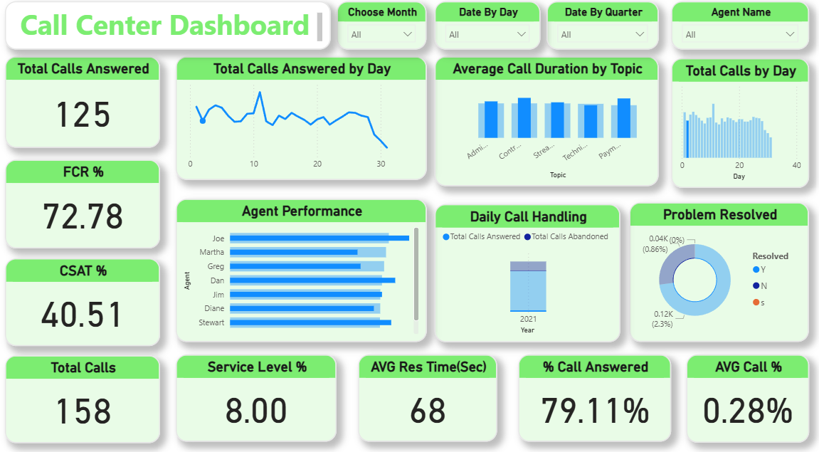
Final Dashboard

Slide 7
💡 Key Insights
• Majority of calls were answered, with a small % abandoned.
• FCR and CSAT % provide insights into service quality.
• Certain agents handle significantly more calls.
• Some topics take longer average duration to resolve.
• Service Level performance requires improvement.

Slide 8
Conclusion
The Power BI Call Center Dashboard successfully provides:
• Real-time monitoring of call center KPIs.
• Insights into agent and customer performance.
• Interactive drill-down capability with slicers.
Created BY SUNDRAM KUMAR

