Slide 1
Restaurant Order Analytics - Project Summary
Restaurant Order Analytics
Created By: Sundram Kumar(Sundram_2312res869@iitp.ac.in)
Tools Used: Power BI, Excel, Python (ETL), DAX
Institution: IIT Patna

Slide 2
Project Overview
This project provides visual insights into restaurant order patterns using a dataset of 500 transactions. The dashboard helps stakeholders understand customer behavior, payment preferences, peak meal times, and overall restaurant performance through interactive charts and KPIs.

Slide 3
ETL Process
Extract:
Source: Two Excel files (Orders.xlsx and Restaurants.xlsx)
Transform:
Cleaned column names and converted date fields
Calculated meal times using DAX in Power BI
Unpivoted food and delivery ratings for comparison
Load:
Exported as Cleaned_Restaurant_Orders.csv
Imported into Power BI for interactive reporting

Slide 4
Key KPIs
- Total Orders: 500
- Total Revenue: 299K
- Total Restaurants: 20
- Total Unique Customers: 21
- Avg. Food Rating: 3.36
- Avg. Delivery Rating: 2.99
- Avg. Delivery Time: 30.54 min

Slide 5
Visual 1 - Top 10 Restaurants by Orders
Type: Bar Chart
Axis: Restaurant Name vs Count of Orders
Insight: "Ellora" and "The Cave Hotel" had the highest order counts.

Slide 6
Visual 2 - Customer Ratings (Food vs Delivery)
Type: Clustered Column Chart
Axis: Rating (1-5) vs Count, Legend: Rating Type
Insight: Food ratings are generally higher than delivery ratings.

Slide 7
Visual 3 - Payment Method Analysis
Type: Pie Chart
Segments: Debit Card, Credit Card, Cash on Delivery
Insight: Credit card was the most used payment method (~36%).

Slide 8
Visual 4 - Revenue by Meal Time
Type: Column Chart
Axis: Meal Time vs Revenue
Insight: Lunch contributes the most to total revenue.

Slide 9
Filters and Interactivity
Filters used:
- Month
- Category (Pro/Ordinary)
- Cuisine Type
- Zone
- Meal Time (DAX-based)

Slide 10
Key Insights
- Dinner hours are busiest, but lunch drives higher revenue
- Delivery ratings are consistently lower than food ratings
- Debit and credit cards are preferred over cash on delivery
- Zone D dominates order volume, especially for South Indian cuisine

Slide 11
Future Scope
- Add trend analysis by date/month
- Predictive model for peak order times
- Geo-mapping zones with delivery heatmap
- Real-time update using APIs and Power Automate

Slide 12
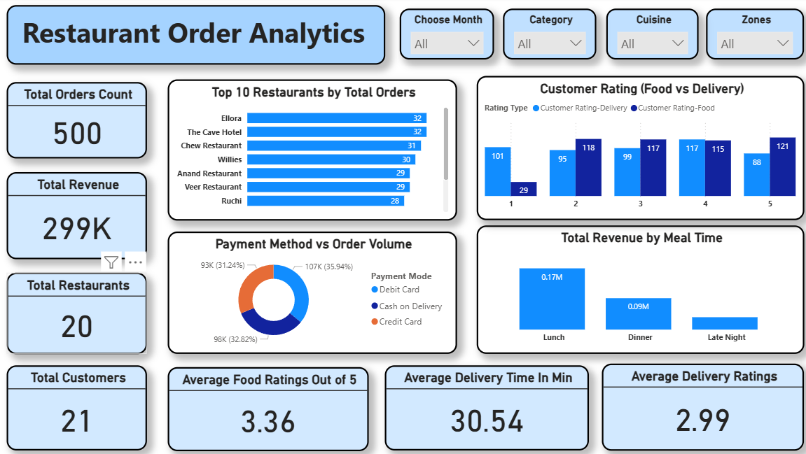
Dashboard

Slide 13
Thank You
Thank you for viewing!
Questions? Reach out at: sundramnld@gmail.com
LinkedIn: www.linkedin.com/in/imsundramk

