Slide 1
Sales Performance Dashboard
Created by: Sundram Kumar
Email: sundram2312res869@iitp.ac.in

Slide 2
Project Overview
• Objective: Visualize product-wise and date-wise sales using Tableau
• Dataset: Small-scale stationery shop sales data
• Tools: Tableau (Data Visualization)
• Metrics: Total Revenue, Units Sold, Top Products, Top Sales Dates

Slide 3
Functional Components
• Connect CSV file to Tableau
• Create calculated field: Total Revenue = Units × Price
• Build Bar Chart: Product vs Revenue
• Build Line Chart: Date vs Units Sold
• Add Filters: Product, Date
• Use Dashboard layout with labels and KPIs

Slide 4
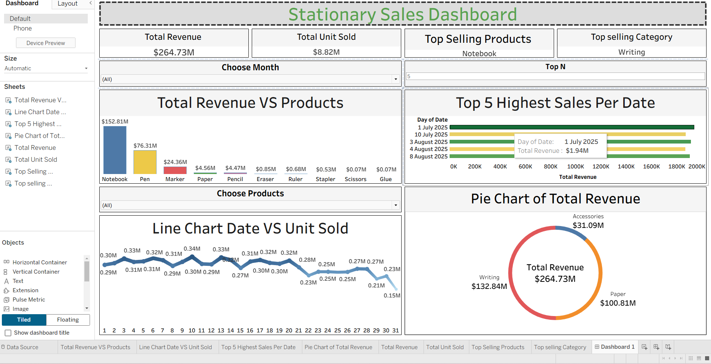
Dashboard Output

Slide 5
Key Insights
• Total Revenue: $264.73M
• Top Selling Product: Notebook ($152.81M)
• Top Selling Category: Writing
• Highest Sales Date: 1 July 2025 ($1.94M)
• Revenue Distribution: Writing (50%), Paper (38%), Accessories (12%)

