Slide 1
INSURANCE · MOTOR · BULK POLICY GENERATION
Motor Portal Application
System Walkthrough, Functional Flow & Data Model
A bulk Excel-to-Policy issuance platform for Motor Class-E / Class-F products — covering upload, validation, premium & GST computation, proposal creation, real-time payment tagging and policy generation.
6
200
3
15
PROCESS STAGES
CASES / BATCH
PRODUCT CLASSES
SCREENS

Slide 2








CONTENTS
What This Deck Covers
Login & Authentication
01
Dashboard Selection
02
Secure entry to the MIBL portal
Product class + process, mandatory both
Excel Upload & Batch
03
Batch Summary & Validation
04
Max 200 cases, unique Batch ID created
Valid / invalid split, processing controls
Proposal & Policy
05
Reports & Search
06
Premium → GST → Proposal → Payment → Policy
Policy issue report export, search & print
Exception Handling
07
Data Model (ER)
08
Invalid record remarks & cleanup
Entities, keys & batch state machine
Motor Portal Application · Bulk Policy Generation
2

Slide 3
01 · SYSTEM OVERVIEW
What the Motor Portal Does
The Motor Portal is an operations console for bulk motor-insurance policy issuance. Operators upload an Excel of vehicle/customer records and the platform drives each record through validation, premium & GST computation, proposal creation, real-time payment tagging and final policy generation — entirely batch-driven.
INDICATIVE TECH CONTEXT
PRESENTATION
Server-rendered web portal (MIBL)
SERVICES
PRODUCTS
PROCESSES
Batch · Validation · Premium · GST
Motor Class-E, Motor Class-F & Eicher Motor — selected per upload session.
Excel Upload · Batch Summary · Report · Search & Print · Policy Cancel Upload.
PROPOSAL
Proposal Service → Proposal No.
PAYMENT
PF Service (real-time tagging)
BATCH LIMIT
CD BALANCE
Each uploaded file carries a maximum of 200 cases for controlled processing.
A side panel checks Cash-Deposit balance against the chosen Master Policy.
POLICY
Policy Service → Policy No. + Cert
DATA
Relational store + audit log
Motor Portal Application · Bulk Policy Generation
3

Slide 4




END-TO-END USER JOURNEY
Six Stages, One Continuous Flow
STAGE 1
STAGE 2
STAGE 3
File Upload
Validation
Premium + GST
Excel ≤200 records validated; unique Batch ID created.
Per-case checks; failures move to Invalid Records.
Base, add-ons, discount, net premium and GST.
STAGE 4
STAGE 5
STAGE 6
Proposal
Payment Tagging
Policy + Print
Proposal No. generated for each valid case.
PF Service tags payment in real time.
Policy No. issued; bulk certificate print enabled.
Batch status advances automatically: UPLOADED → VALIDATED → PREMIUM_CALCULATED → GST_CALCULATED → PROPOSAL_CREATED → PAYMENT_PROCESSED → POLICY_CREATED → PRINTED

Slide 5

01 · AUTHENTICATION
STEP 1
Login — Secure Portal Entry
ON THIS SCREEN
Operator authenticates with Login ID and Password.
“Forgot Password” supports self-service credential reset.
Successful sign-in establishes the session (Welcome: admin) and lands on the Dashboard.
Auth context is reused for every downstream service call.
1_LoginPage.png — operator sign-in
Motor Portal Application · Bulk Policy Generation
5

Slide 6
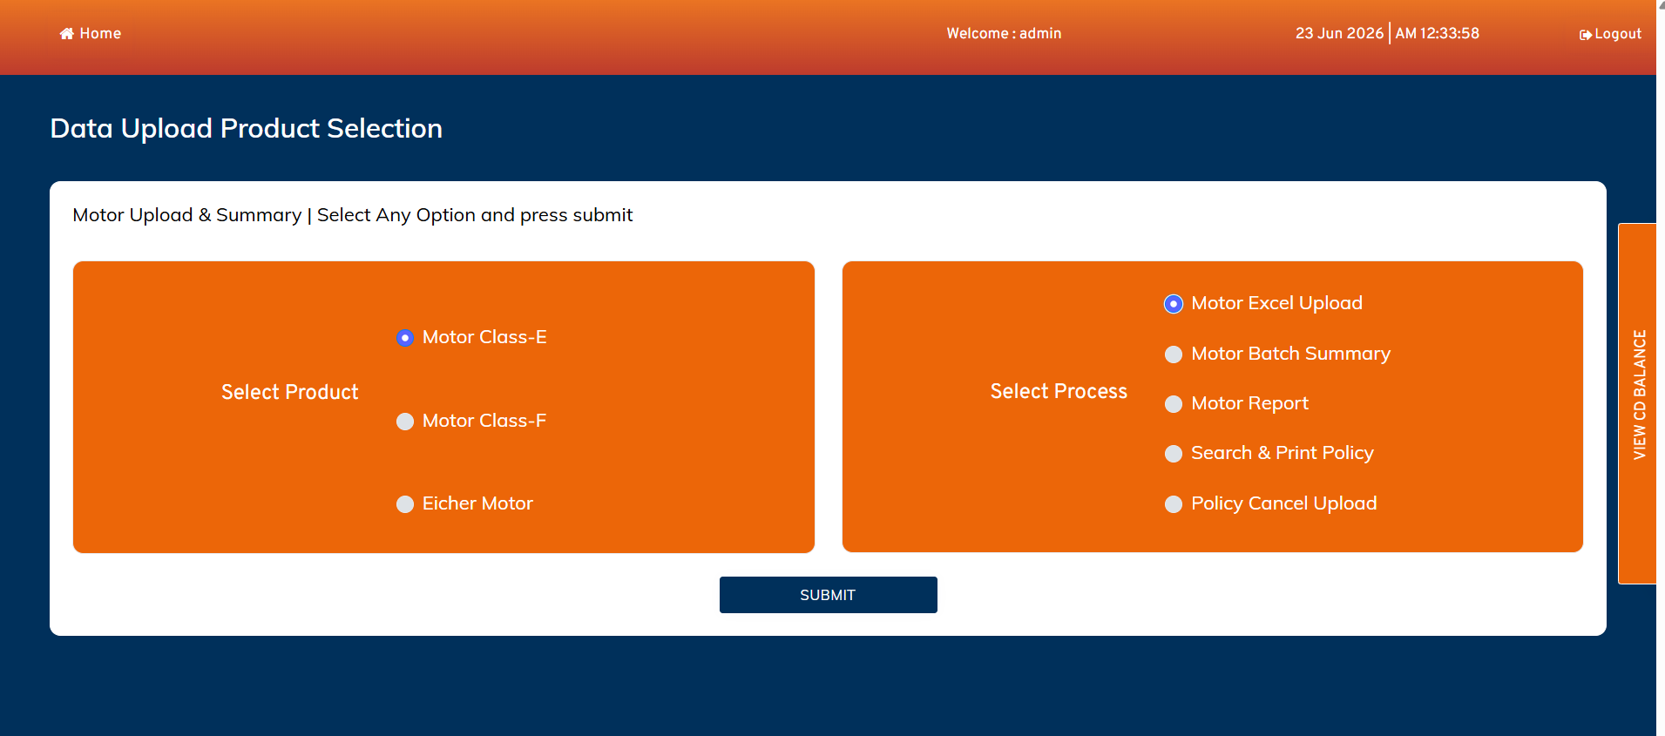
02 · DASHBOARD
STEP 2
Product & Process Selection
ON THIS SCREEN
Left: Select Product — Motor Class-E, Class-F or Eicher Motor.
Right: Select Process — Excel Upload, Batch Summary, Report, Search & Print, Policy Cancel Upload.
Both selections are mandatory before Submit.
Here: Class-E + Motor Excel Upload chosen to begin issuance.
2_Dashboard.png — Data Upload Product Selection
Motor Portal Application · Bulk Policy Generation
6

Slide 7
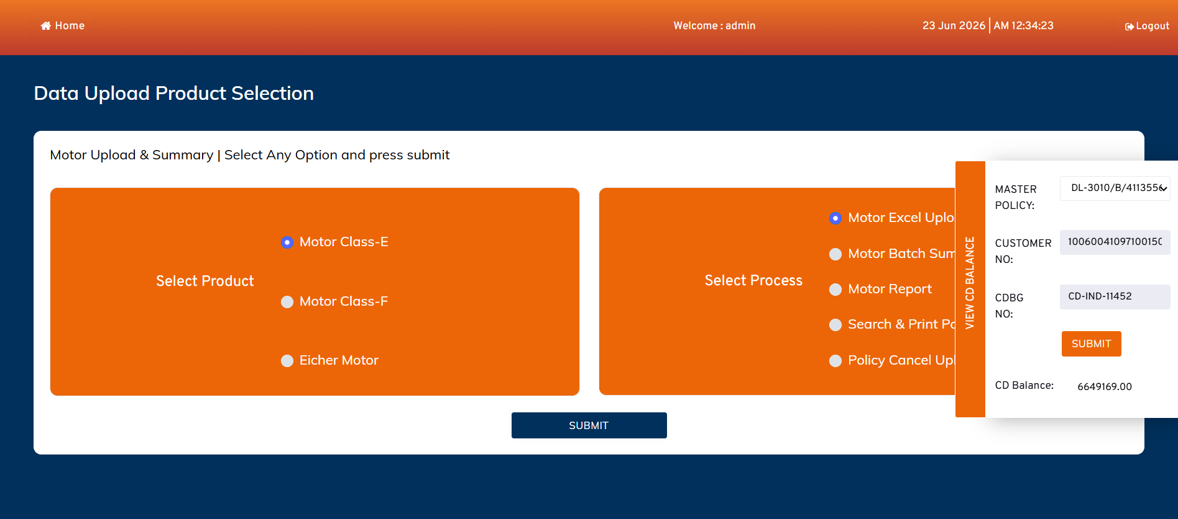
02 · DASHBOARD
UTILITY
CD Balance Check
ON THIS SCREEN
“View CD Balance” side panel opens over the dashboard.
Operator picks a Master Policy and supplies Customer No. / CDBG No.
On Submit the available Cash-Deposit balance is shown (e.g. 6,649,169.00).
Ensures sufficient funds exist before policies consume premium.
3_Check_CD_Balnce_in_Dashboard_login.png — side panel
Motor Portal Application · Bulk Policy Generation
7

Slide 8
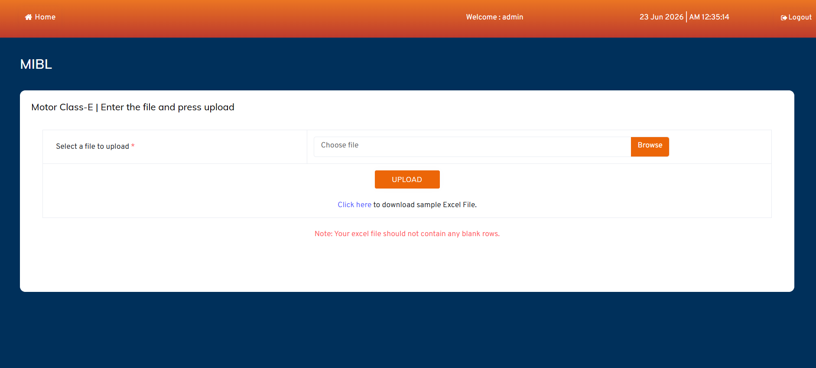
03 · EXCEL UPLOAD
STEP 3
Class-E Upload Page
ON THIS SCREEN
Operator browses and selects the Class-E Excel file, then presses Upload.
A sample Excel template is downloadable to enforce the correct layout.
Note enforced: the file must not contain any blank rows.
Column names, sequence and data types are validated on upload.
4_Class_E_Upload_page.png — file entry
Motor Portal Application · Bulk Policy Generation
8

Slide 9
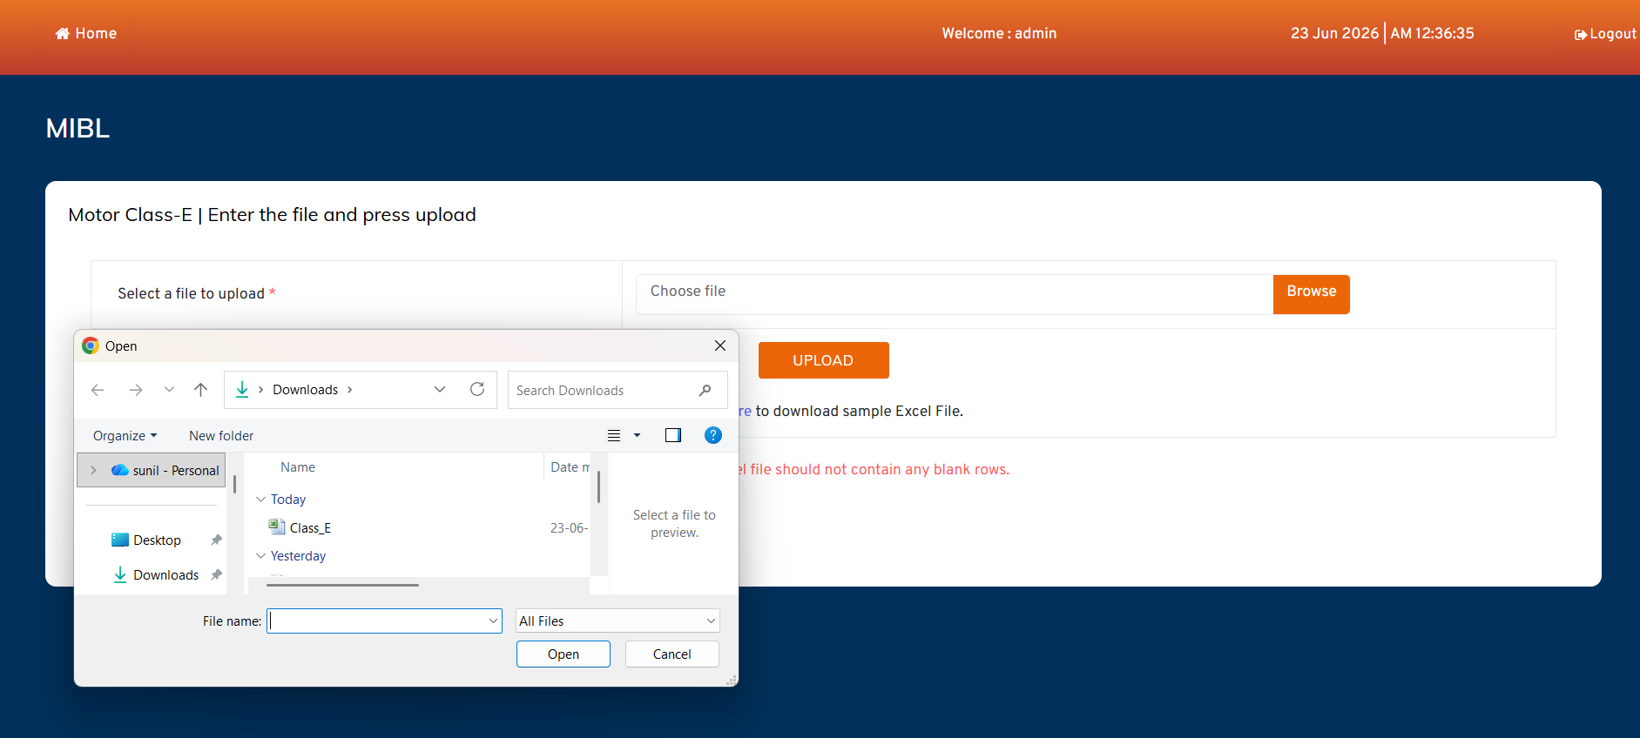
03 · EXCEL UPLOAD
STEP 3
Selecting the Excel File
ON THIS SCREEN
Native file chooser opens for the operator to pick the Class-E workbook.
Only the prepared upload file (e.g. Class_E…) should be chosen.
Selecting and confirming returns the path to the Choose-file field.
Upload then streams the workbook to the server for parsing.
5_Uploader_open_for_upload_class_E_file.png — OS file picker
Motor Portal Application · Bulk Policy Generation
9

Slide 10
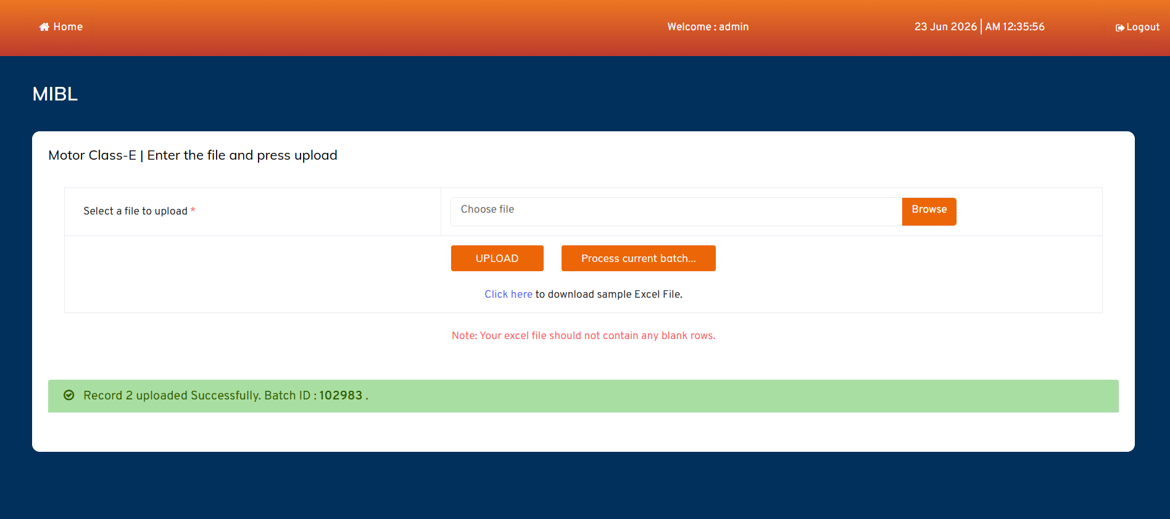
03 · EXCEL UPLOAD
BATCH ID
Upload Success — Batch Created
ON THIS SCREEN
Confirmation: “Record 2 uploaded Successfully. Batch ID: 102983”.
A unique Batch ID groups all records from this file.
Batch status becomes UPLOADED and is now ready to process.
“Process current batch…” lets the operator proceed immediately.
6_File_Uploaded_and_batch_created.png — Batch ID 102983
Motor Portal Application · Bulk Policy Generation
10

Slide 11
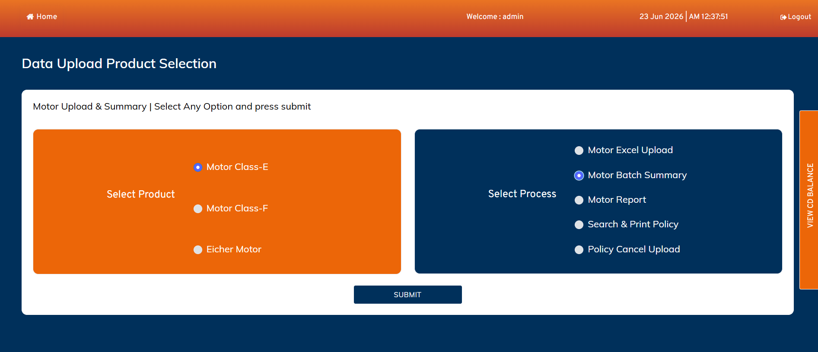
04 · BATCH SUMMARY
STEP 4
Switch to Motor Batch Summary
ON THIS SCREEN
Back on the dashboard the operator selects Motor Batch Summary.
Product stays Class-E; process now targets the batch console.
Submit opens the summary & payment-processing workspace.
This is the control room for validation, proposal and payment.
7_select_Batch_summary_to_process_the_file.png — process selection
Motor Portal Application · Bulk Policy Generation
11

Slide 12
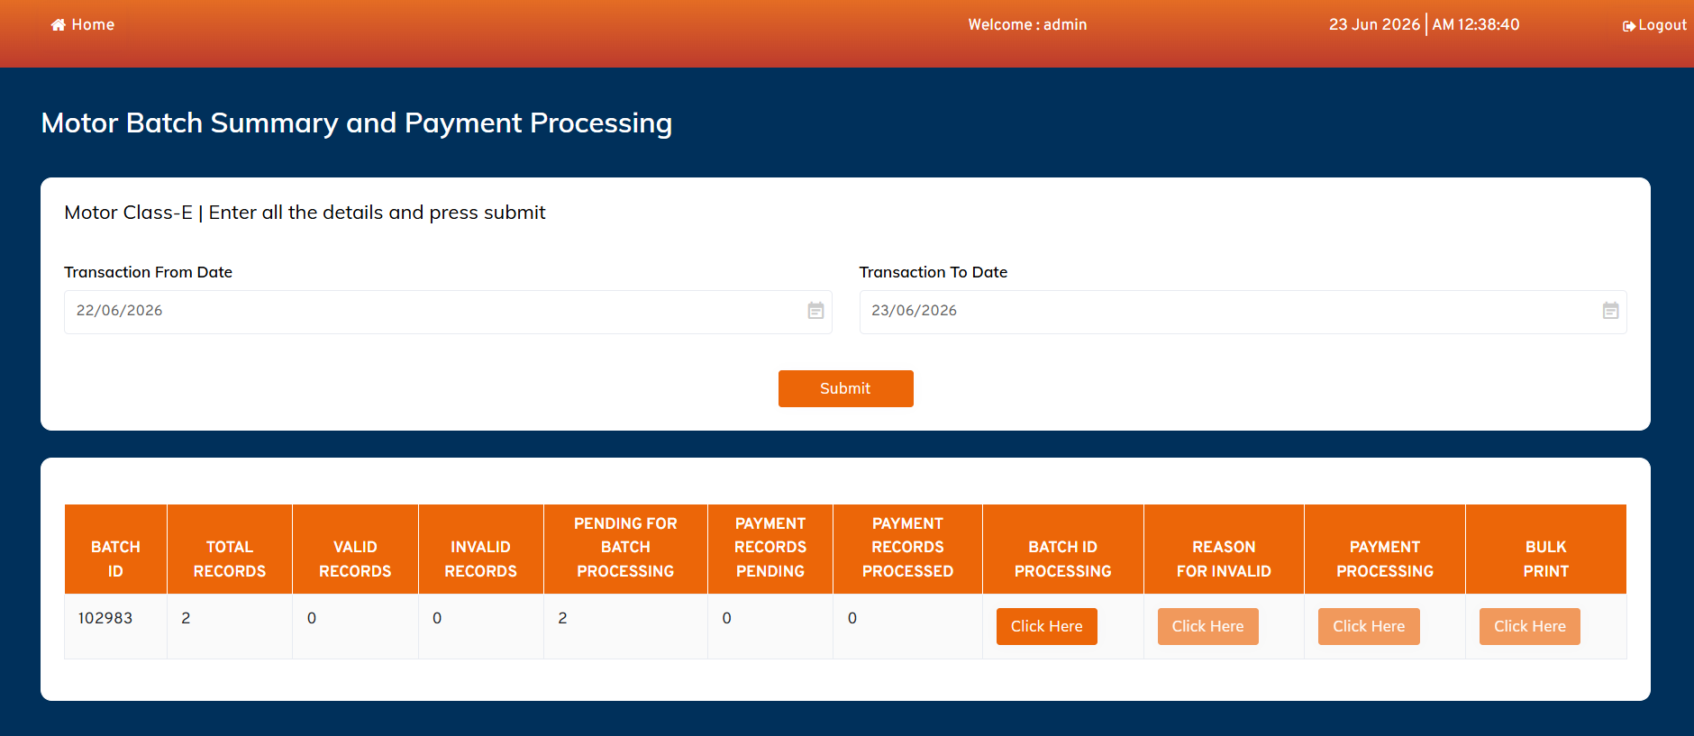
04 · BATCH SUMMARY
CONSOLE
Batch Summary & Counters
ON THIS SCREEN
Filter by Transaction From/To Date to list batches.
Counters: Total, Valid, Invalid, Pending for Batch Processing, Payment Pending / Processed.
Actions per batch: Batch ID Processing, Reason for Invalid, Payment Processing, Bulk Print.
Batch 102983 shows 2 total records, all pending for processing.
9_Batch_Summery_List.png — summary grid with action buttons
Motor Portal Application · Bulk Policy Generation
12

Slide 13
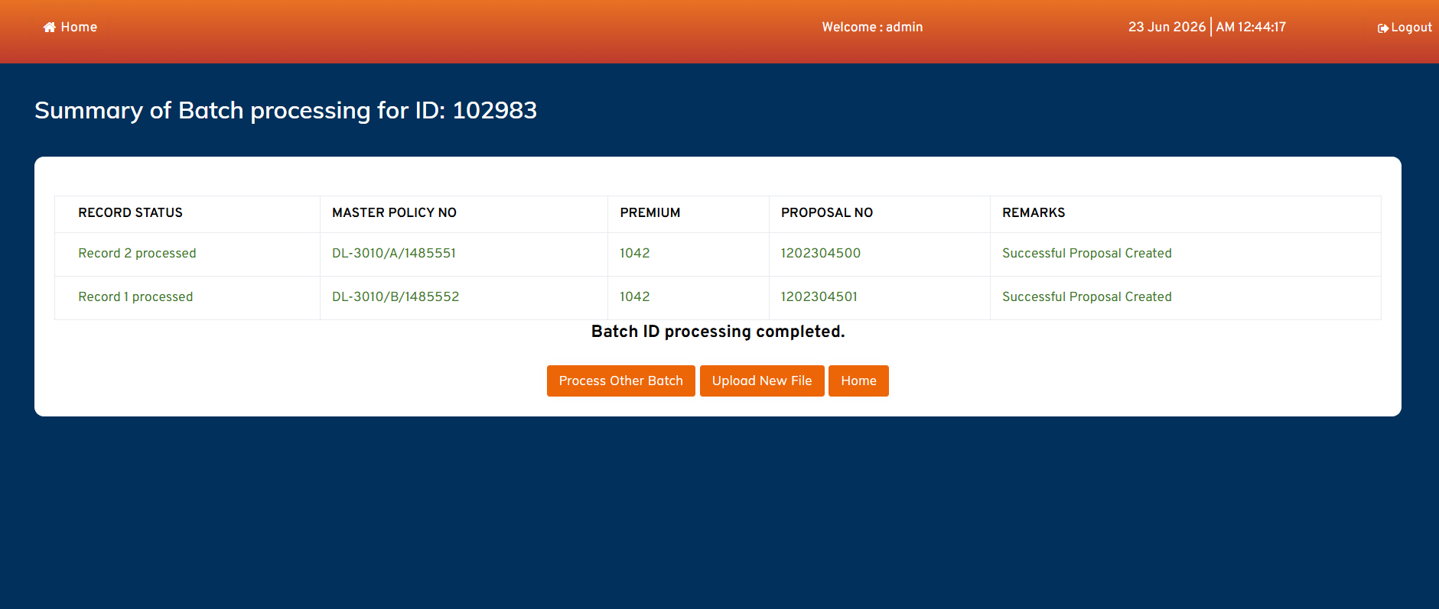
05 · PROPOSAL
PROPOSAL
Batch Processing — Proposals Created
ON THIS SCREEN
“Batch ID Processing” validates each case, then prices it.
Premium computed (Base + Add-ons − Discount, plus GST).
A Proposal No. is generated per record (e.g. 1202304500/01).
Remarks read “Successful Proposal Created”; status → PROPOSAL_CREATED.
10_Successful_proposal_created.png — proposals for Batch 102983
Motor Portal Application · Bulk Policy Generation
13

Slide 14
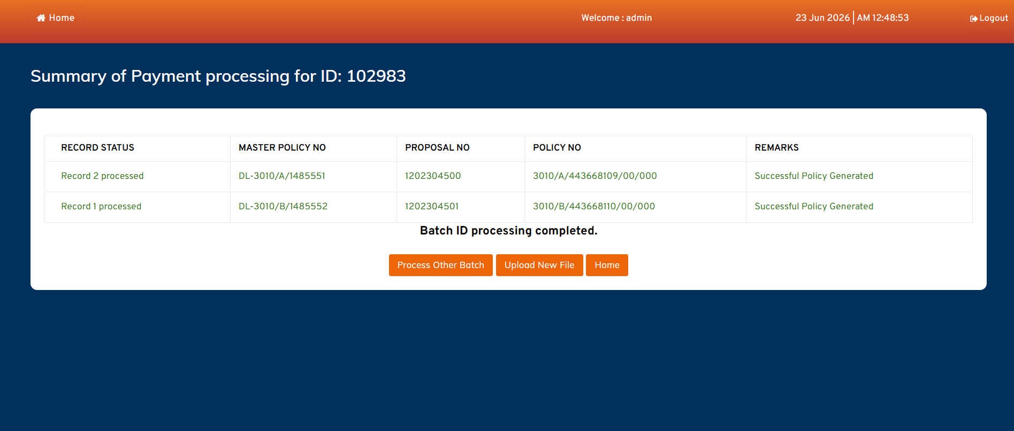
06 · PAYMENT & POLICY
POLICY
Payment Tagging → Policy Generated
ON THIS SCREEN
“Payment Processing” calls the PF Service in real time.
Flow: Proposal No. → Payment Tagging → Policy Generation.
Each case receives a Policy No. (e.g. 3010/A/443668109/00/000).
Remarks: “Successful Policy Generated”; status → POLICY_CREATED; Bulk Print enabled.
11_Successful_Payment_and_Policy_Created.png — policies for Batch 102983
Motor Portal Application · Bulk Policy Generation
14

Slide 15
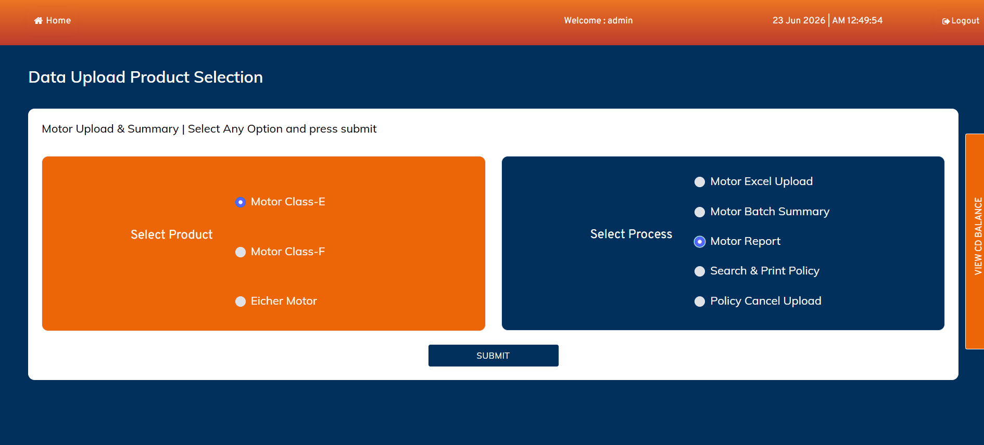
07 · REPORTS
REPORTS
Select Motor Report
ON THIS SCREEN
Operator picks Motor Report on the dashboard.
Used to extract a policy-upload / issuance report.
Product context (Class-E) carries into the report tab.
Submit opens the Motor Report workspace.
12_Policy_Upload_Report.png — process selection
Motor Portal Application · Bulk Policy Generation
15

Slide 16
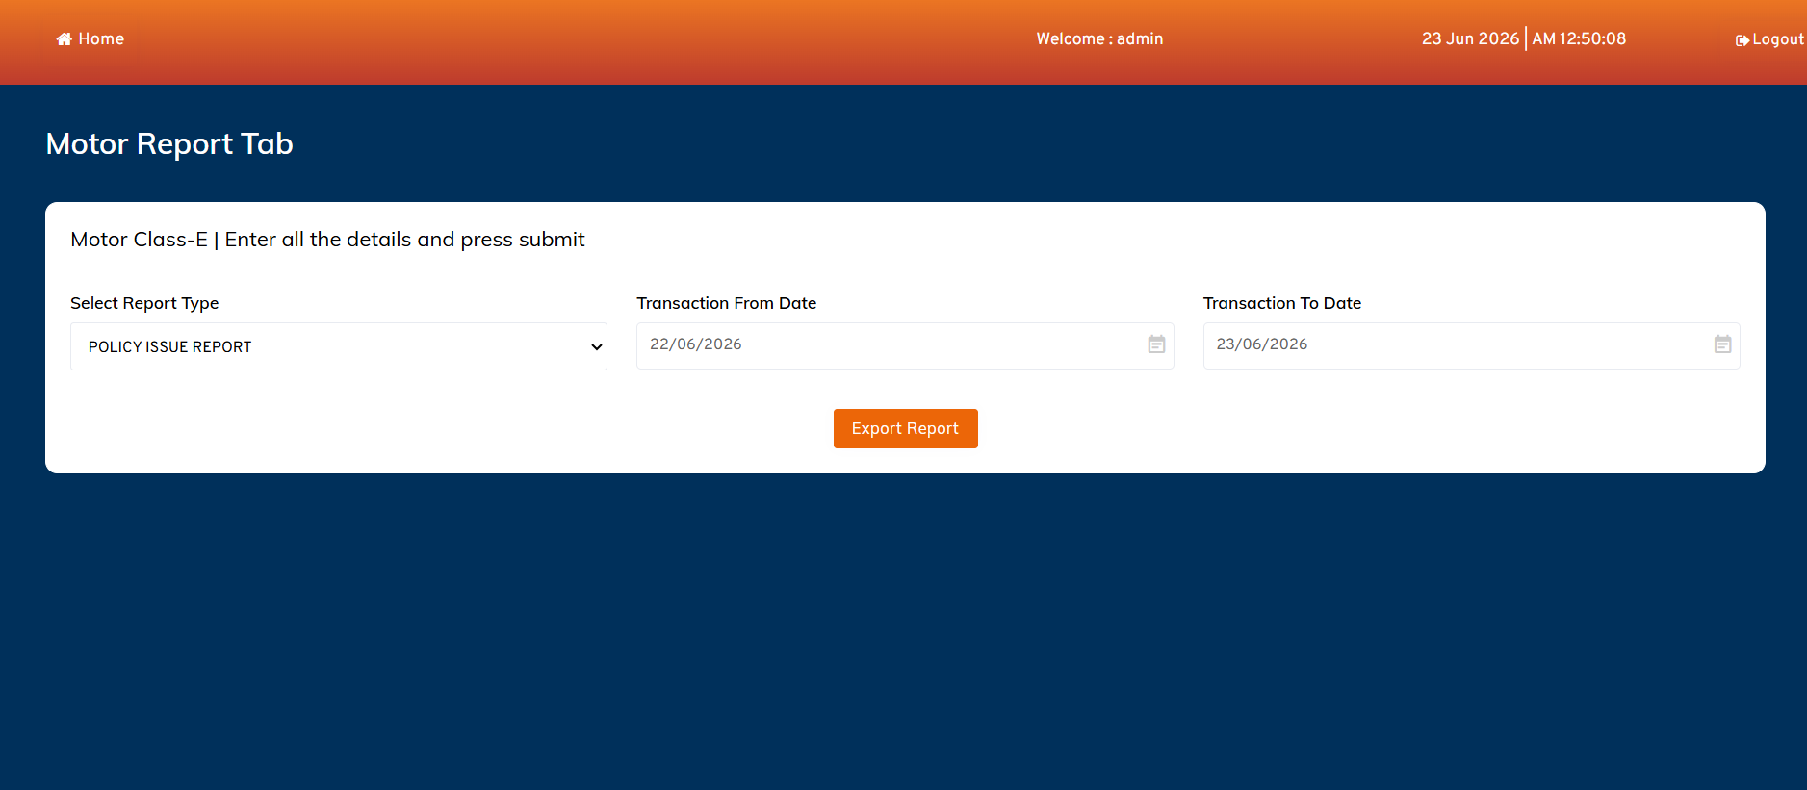
07 · REPORTS
EXPORT
Motor Report — Export
ON THIS SCREEN
Choose Report Type (e.g. Policy Issue Report).
Set Transaction From Date and To Date as the window.
Export Report produces a downloadable Excel.
Supports reconciliation and policy-upload reporting.
13_Policy_Report_page.png — Motor Report Tab
Motor Portal Application · Bulk Policy Generation
16

Slide 17
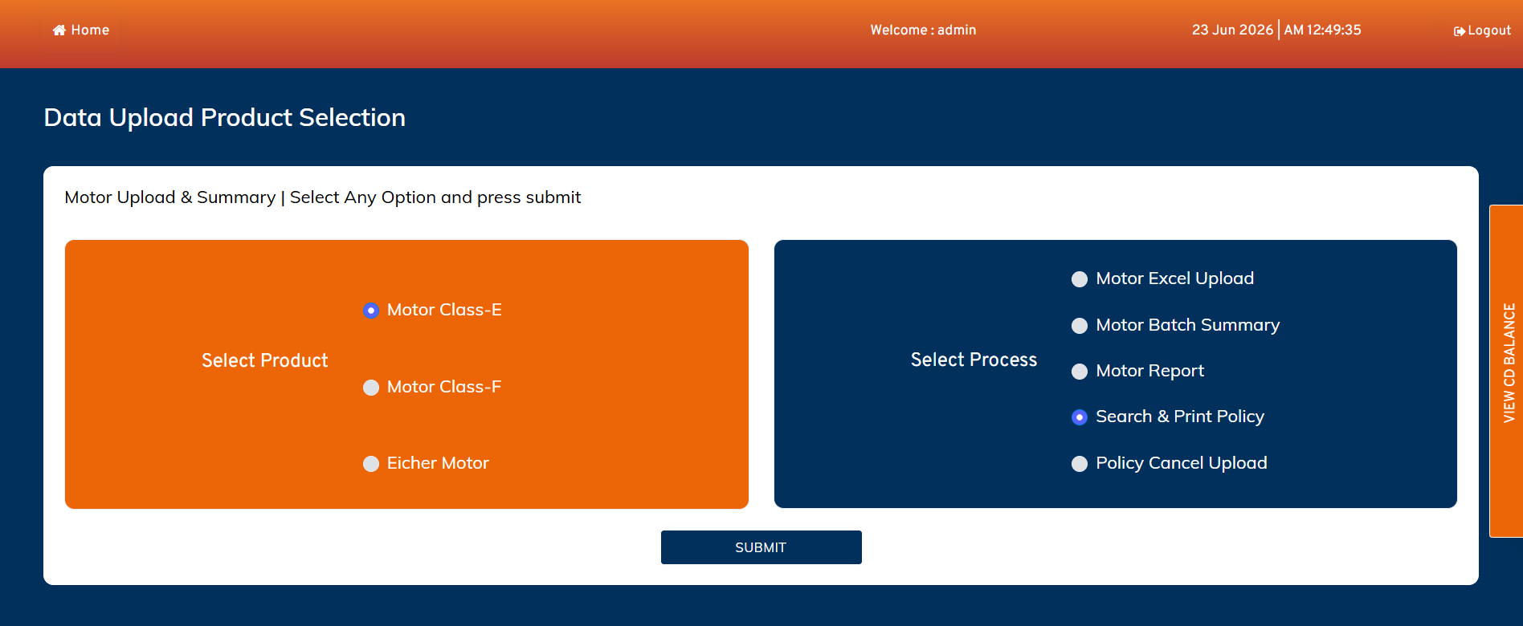
08 · SEARCH & PRINT
SEARCH
Select Search & Print Policy
ON THIS SCREEN
Operator selects Search & Print Policy.
Enables single-policy lookup and certificate print.
Class-E product context is retained.
Submit opens the search & print screen.
14_Policy_Search_Option_in_dashboard.png — process selection
Motor Portal Application · Bulk Policy Generation
17

Slide 18
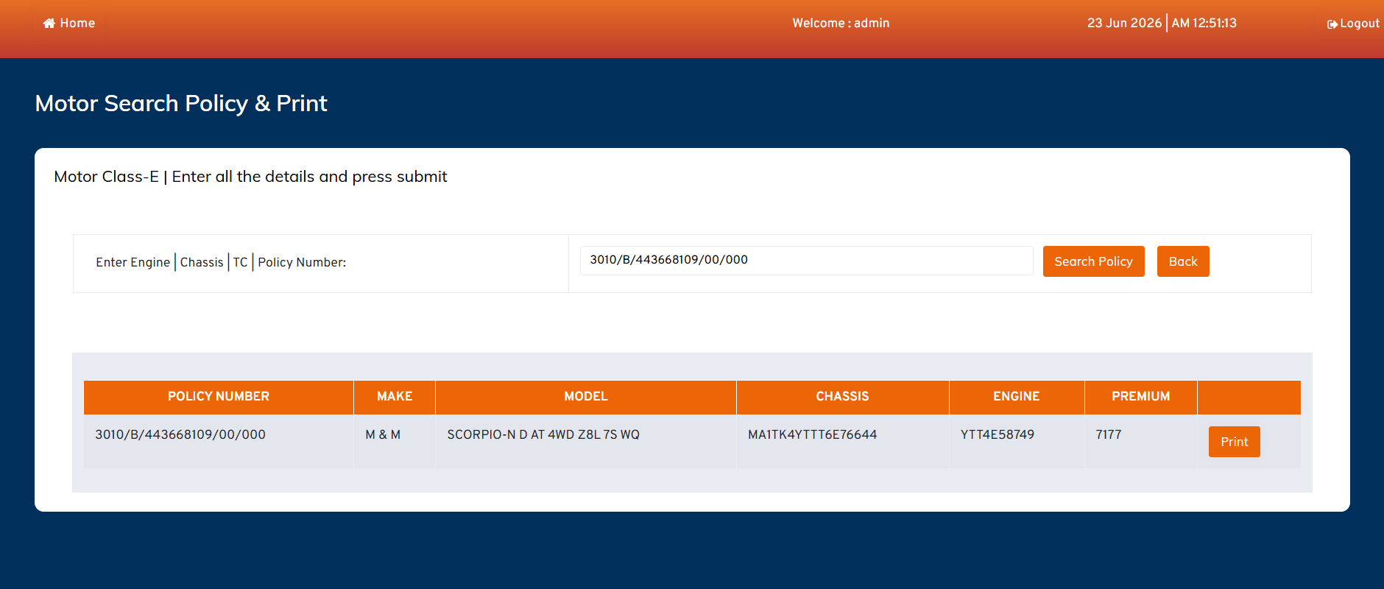
08 · SEARCH & PRINT
PRINT
Search Policy & Print Certificate
ON THIS SCREEN
Search by Engine, Chassis, TC or Policy Number.
Result grid shows Policy No., Make, Model, Chassis, Engine, Premium.
Example: M&M Scorpio-N, premium 7177, Policy 3010/B/443668109…
Print issues the policy certificate for that record.
15_Policy_Search_page.png — Motor Search Policy & Print
Motor Portal Application · Bulk Policy Generation
18

Slide 19
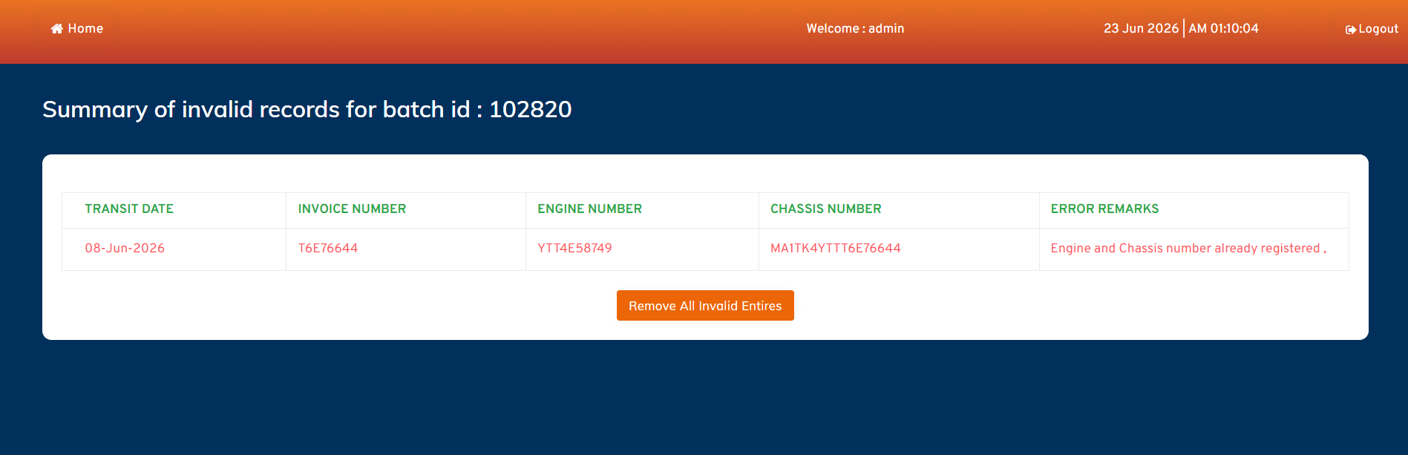
EXCEPTION HANDLING
EXCEPTION
Invalid Records & Remarks
ON THIS SCREEN
“Reason for Invalid” lists failed cases for a batch.
Columns: Transit Date, Invoice No., Engine No., Chassis No., Error Remarks.
Example remark: “Engine and Chassis number already registered”.
“Remove All Invalid Entries” cleans the batch so valid records proceed.
16_Invalid_Records_.png — invalid summary for Batch 102820
Motor Portal Application · Bulk Policy Generation
19

Slide 20
BATCH PROCESSING
Batch State Machine
UPLOADED
VALIDATED
PREMIUM_CALCULATED
1
2
3
GST_CALCULATED
PROPOSAL_CREATED
PAYMENT_PENDING
4
5
6
PAYMENT_PROCESSED
POLICY_CREATED
PRINTED
7
8
9
Validation failures branch records into an INVALID state; they are removed before the remaining valid cases advance to premium, proposal, payment and policy.

Slide 21
10 · VALIDATION RULES
What Every Record Is Checked Against
File / Structure
Field / Datatype
Excel format & extension
Mandatory columns present
Column sequence & names
No blank rows
Maximum 200 cases
Datatype match per column
Mandatory field values
Master Policy Number
Product mapping valid
Vehicle / Duplicate
Financial
Engine Number check
Chassis Number check
Vehicle duplication
Existing policy check
Duplicate transaction
Premium calculation
Add-ons & discount
GST calculation
CD balance sufficiency
Motor Portal Application · Bulk Policy Generation
21

Slide 22
12 · DATA MODEL
Core Entities (Detailed ER in Companion Doc)
USER_MASTER
PRODUCT_MASTER
FUNCTION_MASTER
MASTER_POLICY
BATCH_MASTER
Operators & auth
Class-E / F / Eicher
Process options
Master policy + CD
Batch header & status
BATCH_DETAIL
INVALID_RECORDS
PREMIUM_DETAILS
GST_DETAILS
PROPOSAL_MASTER
Per-case record
Rejected cases
Base / add-on / net
GST over premium
Proposal numbers
PAYMENT_DETAILS
POLICY_MASTER
POLICY_CERTIFICATE
REPORT_LOG
AUDIT_LOG
PF payment tagging
Issued policies
Printable certs
Report exports
Action trail
Relationship spine: USER_MASTER ‖–∞ BATCH_MASTER ‖–∞ BATCH_DETAIL → PREMIUM → GST → PROPOSAL → PAYMENT → POLICY ‖–∞ CERTIFICATE
Motor Portal Application · Bulk Policy Generation
22

Slide 23
ARCHITECTURE
Components & Service Flow
EXPERIENCE
PROCESSING
INTEGRATION & DATA
Portal UI (MIBL)
Validation Service
PF Service (Payment)
Auth / Dashboard
Premium & GST Engine
Policy Service
Upload / Search UI
Proposal Service
Database + Audit
Motor Portal Application · Bulk Policy Generation
23

Slide 24
SUMMARY
One Upload → Validated, Priced & Issued in Bulk
The Motor Portal turns a single Excel batch into issued motor policies through a controlled, auditable pipeline — upload → validation → premium & GST → proposal → real-time payment → policy → print. Invalid cases are isolated with clear remarks so clean records never stall.
Companion deliverable: Motor Portal — ER Diagram & Data Dictionary (Word).

