Slide 1
Data analysis
Exploratory Data Analysis (EDA)
  The role of EDA
  Doing EDA
  Interpreting EDA results

Slide 2
Discover patterns in data
Why is it important to find patterns?
What counts as a pattern?
What techniques can we use to find patterns?
When can such techniques be used?
How should the results be interpreted?

Slide 3
Data analysis
Exploratory Data Analysis
  Summary of the data
  Accidental and unexpected patterns
Data Screening
  check for statistical hiccups
Fit model eg. ANOVA & do specific tests
Exploratory Data Analysis & Data Screening revisited: check residuals

Slide 4
The role of EDA
Exploratory Data Analysis
Explore a data set
Use methods that help you understand the data
- to help you understand the events that generated the data
- to help you see what happened, sometimes in spite of your expectations

Slide 5
Simple example
Class attendance and language learning
Bob: 10 classes; 100 words
Carol: 15 classes 150 words
Dave: 12 classes; 120 words
Ann: 17 classes; 170 words
Steve: 13 classes; 95 words

Slide 6
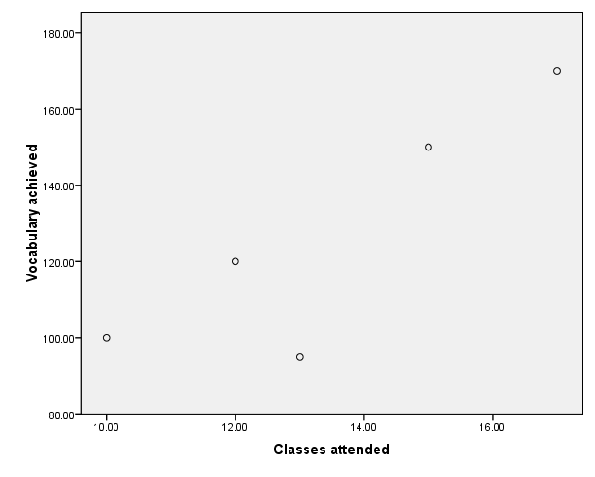

Slide 7
Recognising patterns
EDA supplies statistical techniques
that work in combination with a very powerful pattern recognition device…
Ways to tabulate, summarise, display, reduce …data

Slide 8
Data Analysis (DA)
DA can't be done mechanically
Often there has to be a "creative" element
Conventional DA is in a sense idealistic
Trade-off between
  "ideal" experimentation v. ecological validity
Sometimes questions are tentative
We need data analysis skills that allow data to speak to us despite our expectation

Slide 9
NameVoyager
Variable Method used to represent
Time horizontal axis
No. / billion babies vertical axis
Sex colour hue
Rank in 2007 colour saturation
Name label
Detail pop-up, click thru

Slide 10
Confirmatory vs. exploratory data analysis
Confirmatory data
analysis
Exploratory data
analysis
tests a hypothesis
settles questions
(Inferential statistics)
finds a good description
raises new questions
(Descriptive statistics)

Slide 11
Data reduction – fewer numbers
Summarise proportion
  27 / 48 children in class A are boys
  16 / 23 children in class B are boys
  Re-presented: 56% of class A, 69% of class B are boys
Summarise change
  Before: 112, 134, 121, 97
  After: 116, 132, 140, 108
  Re-presented
  Change: 4, -2, 19, 11

Slide 12
Simpler descriptions are better
"Anything that looks below the previously described surface makes the description
more effective" Tukey (1977)

Slide 13
Revealing patterns
Raw data is hard to understand
EDA provides ways of presenting data that make the data easier to understand
Example of Lord Rayleigh's research on the weight of nitrogen
  used a chemical compound to isolate a fixed amount of nitrogen
  repeated this experiment 15 times
Notes:
…
e.g. table of raw data
…
a representation that the eye finds congenial is of more practical use

Slide 14
Date | Source compound | Extraction method | Weight observed
29.11.93 | NO | hot iron | 2.30143
5.12.93 | NO | hot iron | 2.29816
6.12.93 | NO | hot iron | 2.30182
8.12.93 | NO | hot iron | 2.29890
12.12.93 | Air | hot iron | 2.31017
14.12.93 | Air | hot iron | 2.30986
19.12.93 | Air | hot iron | 2.31010
22.12.93 | Air | hot iron | 2.31001
26.12.93 | N₂O | hot iron | 2.29889
28.12.93 | N₂O | hot iron | 2.29940
9.1.94 | NH₄NO₂ | hot iron | 2.29849
13.1.94 | NH₄NO₂ | hot iron | 2.29889
27.1.94 | Air | ferrous hydrate | 2.31024
30.1.94 | Air | ferrous hydrate | 2.31030
1.2.94 | Air | ferrous hydrate | 2.31028

Slide 15
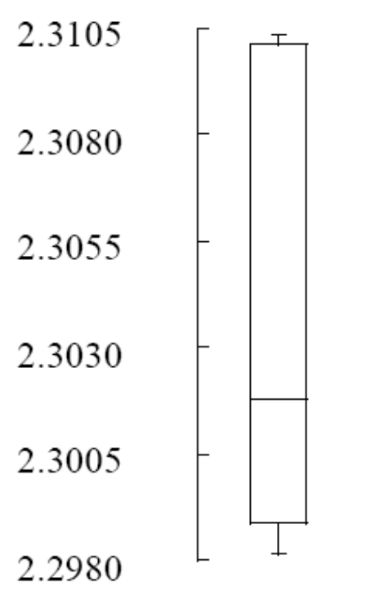
Box & whisker plot

Slide 16
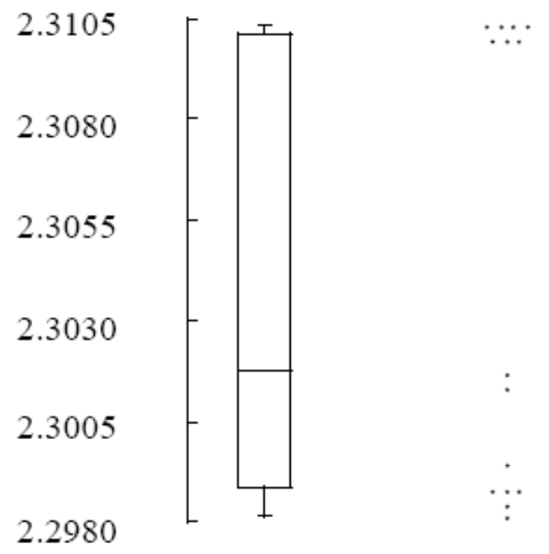
dot plot

Slide 17
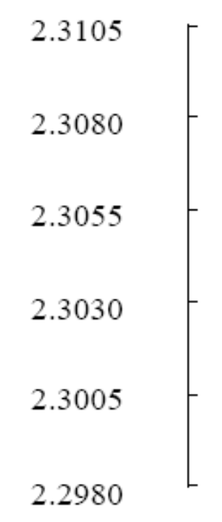
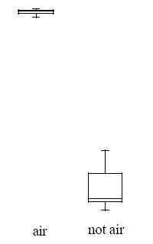
Two separate box & whisker plots

Slide 18
Technique
Find a graph that shows clearly that the data can be divided into two different groups
Appropriate representation depends on your practical goal

Slide 19
Precise descriptions are better
"Most of the key questions in our world sooner or later demand answers to "by how much?" rather than merely to "in which direction?"
(Tukey, 1977)
Hick's Law
    Choice Reaction Time experiment
    RT increases with number of possible response alternatives

Slide 20
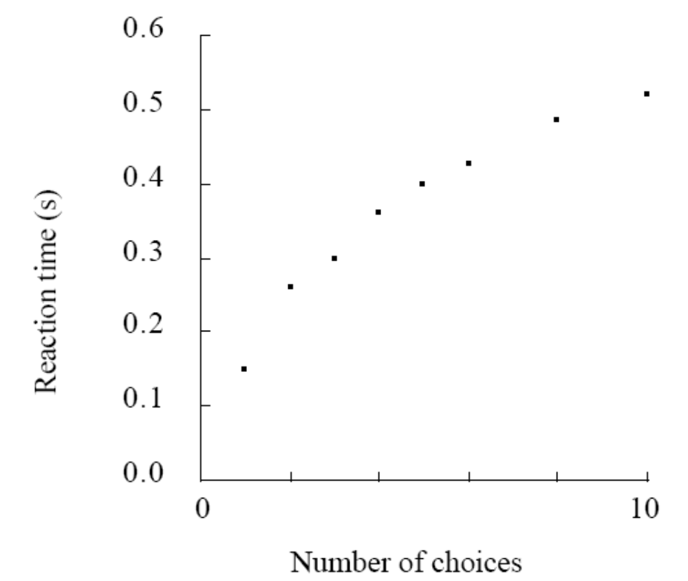
Hick's law

Slide 21
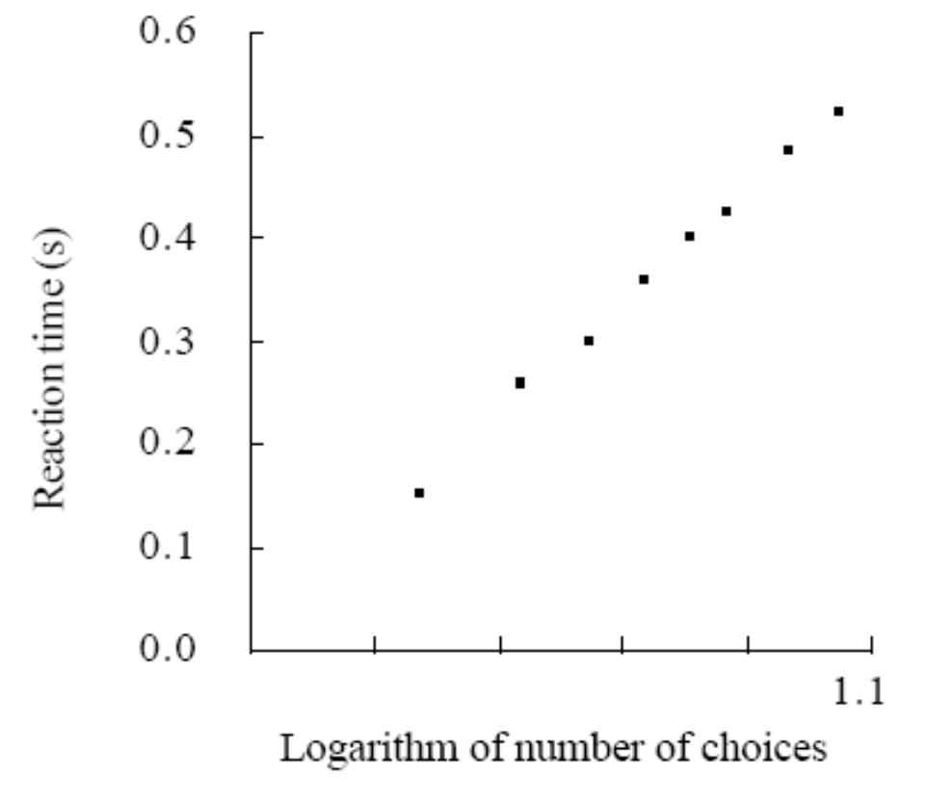
Hick's law

Slide 22
Interpreting EDA
Multiplicity

Slide 23
Interpreting EDA
Summarise the results
Discover unanticipated results
  new line of research, new experiment
  qualify conclusion from the present study
Generate hypotheses
Check assumptions
  qualify conclusion from the present study
  address anomalies
NOT (or, rarely) a definitive conclusion

