Slide 1

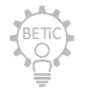


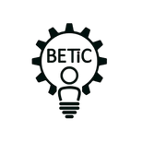






Project Team Formation
MEDHA 2026
Biomedical Engineer
Electronics Engineer
Photo
Full Name
Organization
Age
Location
Mother Tongue
Photo
Full Name
Organization
Age
Location
Mother Tongue
Mechanical Engineer
Computer Engineer
Photo
Full Name
Organization
Age
Location
Mother Tongue
Photo
Full Name
Organization
Age
Location
Mother Tongue
Project Title - “Non-Invasive Jaundice Screening Probe Prototype”
Notes:
1

Slide 2
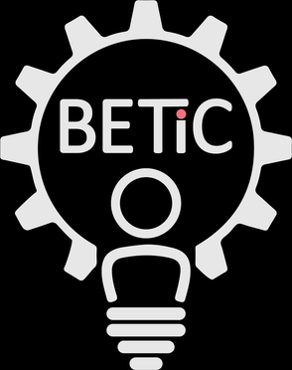
Problem Background
MEDHA 2026
Domain of Proposed Problem | Biomedical Instrumentation / Neonatal Point-of-Care Diagnostics — a non-invasive optical probe to screen newborns for hyperbilirubinemia (neonatal jaundice) without blood sampling.
Physiology of Anatomy in Normal Condition | Red blood cell breakdown releases heme, which is converted to biliverdin and then to unconjugated (indirect) bilirubin. In the liver, the enzyme UDP-glucuronosyltransferase (UGT1A1) conjugates bilirubin, making it water-soluble for excretion via bile into the gut. In healthy newborns, bilirubin production is higher than in adults (shorter RBC lifespan, higher RBC mass) while the liver's conjugating capacity is still maturing, so a mild, self-limiting rise in serum bilirubin (physiological jaundice) is normal in the first days of life and resolves as hepatic enzyme activity matures.
Physiology of Anatomy in Abnormal/diseased Condition | When bilirubin production exceeds the immature liver's conjugation/excretion capacity — due to ABO/Rh blood-group incompatibility, prematurity, cephalohematoma, G6PD deficiency, breastfeeding/breast-milk jaundice or sepsis — unconjugated bilirubin accumulates, depositing in skin and sclera (visible icterus). Because unconjugated bilirubin is lipid-soluble, very high levels can cross the immature neonatal blood-brain barrier and deposit in the basal ganglia, causing acute bilirubin encephalopathy and, if untreated, permanent kernicterus (cerebral palsy, hearing loss, sensory and cognitive impairment).
Notes:
2

Slide 3
Stakeholders Analysis
MEDHA 2026
# | Stakeholders list | Key activities by Stakeholders | Difficulties faced by Stakeholders | Value Additions
 | Neonate (patient) | Undergoes routine jaundice screening before discharge and at follow-up visits | Cannot communicate discomfort; repeated heel-prick blood draws cause pain, bruising and infection risk | Painless, fast, needle-free screening
 | Parents / caregivers | Bring newborn for check-ups; observe skin/eye yellowing at home | Limited clinical knowledge to judge severity; anxiety and travel burden for repeat lab tests | Simple take-home/PHC screening with clear risk indication
 | Neonatologist / Pediatrician | Interprets bilirubin values, decides phototherapy/exchange transfusion per AAP 2022 nomograms | Relies on TSB draws when TcB devices are unavailable or unreliable on darker skin tones | Quick, accurate screening value to guide need for confirmatory TSB test
 | NICU / postnatal nurses | Perform screening measurements each shift; document readings | Existing TcB meters are costly, need calibration, and stock is often shared across wards | Low-cost, rugged, easy-to-operate probe per bed/ward
 | ASHA / community health workers (India) | Conduct home visits and early newborn-care checks in rural areas | No access to bilirubinometers or lab facilities; visual assessment of jaundice is unreliable | Portable, battery-operated device enabling field screening and referral
 | Hospital biomedical/procurement dept. | Purchases, maintains and calibrates diagnostic equipment | High capital cost (~US$2,000–5,000) and service contracts for imported TcB meters | Affordable indigenous device with low maintenance overhead
 | Regulatory bodies (CDSCO, FDA) | Review safety, performance and quality documentation for clearance | Requires evidence of electrical safety, biocompatibility and clinical correlation with TSB | Design aligned with IEC 60601 series, ISO 14971 and 21 CFR 862.1113 from the outset
 | Government health schemes / insurers | Fund newborn-care programs (e.g. India's Rashtriya Bal Swasthya Karyakram) | Budget constraints limit deployment of imported screening devices to primary health centres | Cost-effective device supporting universal predischarge screening at scale
Notes:
3

Slide 4
Prior Art
MEDHA 2026
Existing & Emerging Solutions
Device Name | Brand Name | Website URL | Key Features | Limitations/gaps
Dräger Jaundice Meter JM-105 | Drägerwerk AG | draeger.com | Dual-optical-path reflectance at forehead/sternum; FDA 510(k) Class I (21 CFR 862.1113) | Contact device, ~US$2,500+; underestimates TSB vs. lab reference, especially in preterm/darker-skin infants
BiliCheck | SpectRx / Respironics (Philips) | philips.com | Broadband multi-wavelength spectral reflectance probe; widely used research comparator | Largely discontinued/limited availability; still contact-based and costly
BiliCare | Gerium Medical | geriummedical.com | Ear-based transmission spectroscopy; CE-marked; tissue-thickness compensation (US9173603B2) | Requires precise ear placement; fewer large-scale multi-site validation studies
Bilistick System | Bilimetrix | bilimetrix.com | Point-of-care capillary blood micro-cuvette read on a portable analyzer; low reagent cost | Still requires a heel/finger blood prick; ~10–11% test-failure rate reported in field studies
BiliDx | Academic/Cicada consortium (Malawi study) | - | Low-cost fluorescence-based point-of-care bilirubin assay shown to outperform TcB in accuracy | Still blood-sample based; limited to pilot deployment in a few hospitals
BiliCam | University of Washington (research) | - | Smartphone camera + printed colour-calibration card imaging of sternum skin, ML regression | Needs a calibration card and controlled lighting; not yet a commercial FDA-cleared product
Picterus / neoSCB app | Picterus AS | picterus.com | Smartphone-based sclera/skin chromaticity analysis with ambient-light subtraction | Accuracy still affected by ambient lighting and skin tone; needs multi-ethnic validation
BiliScan | China-based developer | - | Smartphone app estimating bilirubin from skin colour images with self-printed calibration card | Moderate correlation only (r ≈ 0.5–0.6); tends to overestimate TSB, cannot replace lab testing
Notes:
4

Slide 5
Prior Art
MEDHA 2026
Relevant Papers/Publications
# | Title | Authors | Year of Publication | Journal Name | Key Takeaways | Keywords
1 | Use of a Smartphone App to Assess Neonatal Jaundice | Taylor JA, Stout JW, de Greef L, et al. | 2017 | Pediatrics | BiliCam sternum-image analysis performed comparably to transcutaneous bilirubinometers across a multi-ethnic sample of newborns | Smartphone, TSB, screening
2 | Smartphone screening for neonatal jaundice via ambient-subtracted sclera chromaticity | Outlaw F, Nixon M, Odeyemi O, et al. | 2020 | PLOS ONE | Ambient-light-subtracted sclera colour analysis achieved sensitivity/specificity comparable to modern TcB devices | Sclera imaging, chromaticity
3 | Large scale validation of a new non-invasive and non-contact bilirubinometer in neonates with risk factors | Halder A, Adhikari A, Ghosh R, et al. | 2020 | Scientific Reports | Large-cohort validation of a non-contact optical bilirubinometer, supporting feasibility of contactless designs | Non-contact, validation, risk factors
4 | Diagnostic Properties of a Portable Point-of-Care Method to Measure Bilirubin and a Transcutaneous Bilirubinometer | Sampurna MTA, Rani SAD, Sauer PJJ, et al. | 2021 | Neonatology | Compared Bilistick and JM-105 against lab TSB; TcB showed slightly better agreement, Bilistick failed in ~11% of infants | Bilistick, JM-105, point-of-care
5 | Transcutaneous bilirubinometry versus total serum bilirubin measurement for newborns (Cochrane review) | Okwundu CI, Olowoyeye A, Uthman OA, et al. | 2023 | Cochrane Database of Systematic Reviews | Systematic review concluding TcB can reduce the number of blood draws while remaining a reasonable screening proxy for TSB | Systematic review, TcB vs TSB
6 | Measuring transcutaneous bilirubin: a comparative analysis of three devices on a multiracial population | Raimondi F, Lama S, Landolfo F, et al. | 2012 | BMC Pediatrics | BiliCheck and JM-103 showed good correlation with TSB (r=0.86, 0.85) and outperformed BiliMed across a multiracial cohort | Comparative study, multiracial, correlation
7 | Development and Validation of a Smartphone Application for Neonatal Jaundice Screening | Multi-site study group | 2024 | JAMA Network Open (study) | AI/ML app using forehead, sternum and abdomen yellowness indicators reached 100% sensitivity, 70% specificity in a multiethnic cohort | AI/ML, multiethnic, skin tone
8 | Evaluation of BiliCare™ transcutaneous bilirubin device in Japanese newborns | Yamana K, Morioka I, Kurokawa D, et al. | 2017 | Pediatrics International | Validated ear-based spectroscopic TcB device performance against serum bilirubin in an Asian newborn population | Ear probe, spectroscopy, validation
Notes:
5

Slide 6
Prior Art
MEDHA 2026
Relevant Patents
# | Title | Title | Year of Filing | Countries protected | Key Takeaways/Claims | Patent Filing Status
1 | Method and apparatus for optical measurement of bilirubin in tissue (US5353790A) — Jacques SL et al. (Respironics/BiliChek lineage) | Jacques SL et al. (Respironics/BiliChek lineage) | 1993 | United States | Multi-wavelength transcutaneous reflectance spectroscopy to estimate cutaneous bilirubin concentration | Granted (expired)
2 | Non-invasive device and method for measuring bilirubin levels (US9173603B2) — Molcho J, Zmora E; Gerium Medical Ltd | Molcho J, Zmora E — Gerium Medical Ltd | 2011 | United States | Tissue-thickness-compensated multi-wavelength optical probe underlying the BiliCare ear device | Granted, active
3 | System and method for determining bilirubin levels in newborn babies (US9934589B2) — University of Washington (Taylor, Patel et al.) | University of Washington (Taylor, Patel et al.) | 2013 | United States | Smartphone camera + light source/calibration reference used to estimate skin bilirubin concentration (BiliCam) | Granted, active
4 | Electro-optical instrument for non-invasive measurement of bilirubin in skin tissue (US4267844A) — Yamanishi; Minolta | Yamanishi — Minolta | 1979 | United States / Japan | Flash-light source with dual-wavelength optical separation, foundational prior art for transcutaneous bilirubinometers | Granted (expired)
Notes:
6

Slide 7
Applicable Regulatory standards
MEDHA 2026
# | Standard No. | Title of the Standard | Purpose
1 | IEC 60601-1:2020 (IS 13450:2024, India) | Medical electrical equipment — general requirements for basic safety and essential performance | Ensures the probe and its charging base are electrically and mechanically safe for patient and operator use
2 | IEC 60601-1-2:2020 (Ed. 4.1) | Collateral standard — electromagnetic compatibility (EMC) | Confirms the device neither emits nor is disrupted by electromagnetic interference from other hospital equipment
3 | IEC 60601-1-11 | Collateral standard — home healthcare environment | Covers safe operation outside hospitals, relevant for community/PHC and home-visit use
4 | ISO 14971:2019 | Application of risk management to medical devices | Provides the structured hazard-identification and risk-control process followed across the design lifecycle
5 | ISO 10993-1 / -5 / -10 | Biological evaluation of medical devices | Confirms the neonatal skin-contact probe tip is non-cytotoxic and non-irritating
6 | IEC 62304 | Medical device software life-cycle processes | Governs safety classification, verification and documentation of the firmware and bilirubin-estimation algorithm
7 | IEC 62366-1 | Usability engineering for medical devices | Ensures safe, error-resistant operation by nurses and community health workers with minimal training
 | Available Testing Labs | Available Testing Labs | Available Testing Labs
 | NABL/BIS-accredited electrical-safety & EMC labs (e.g. ERTL, STQC, Intertek India, Astute Labs) ISO 10993-accredited biocompatibility & sterilization testing labs | Biocompatibility & sterilization testing labs (ISO 10993-accredited) | Partner NICU/postnatal ward for clinical correlation study vs. laboratory TSB
 | Partner NICU/postnatal ward for clinical correlation study vs. laboratory total serum bilirubin (TSB)
Notes:
7

Slide 8
Need & Market Analysis
MEDHA 2026
# | Market Size
1 | The global bilirubin-meter market was valued at roughly US$1.3 billion in 2024 and is projected to reach about US$1.9 billion by 2030 (~6.8% CAGR); the transcutaneous-bilirubinometer segment alone is growing at ~4.3% CAGR. India registers about 23–24 million births a year, and roughly 60% of term and 80% of preterm newborns develop visible jaundice, creating a large, largely unmet demand for affordable screening at primary health centres and in home-visit settings.
# | Gaps in the Existing Solutions
1 | Existing transcutaneous meters (JM-105, BiliCheck, BiliCare) cost roughly US$2,000–5,000, need periodic calibration and remain confined mostly to hospitals/NICUs. Blood-based point-of-care tools (Bilistick) still require a heel/finger prick and show test-failure rates around 10%. Smartphone-camera apps (BiliCam, Picterus, BiliScan) are promising but depend on printed calibration cards, controlled ambient lighting and further multi-ethnic validation, and none yet combine low cost, full non-contact operation and field-ready robustness for primary-care and community settings.
Notes:
8

Slide 9
Problem Definition and Intended Use
MEDHA 2026
Need Statement | Provide a low-cost, accurate, easy-to-use, non-invasive probe that screens newborns for hyperbilirubinemia at the point of care — including outside tertiary NICUs — without a blood draw.
Who (User of the Device) | Newborns aged 0–14 days at risk of jaundice; operated by nurses, pediatricians, ASHA/community health workers and trained caregivers.
What | A handheld optical probe that measures a reflectance/transmission signal correlated with skin bilirubin and outputs an estimated bilirubin risk value.
When | Within the first week of life — pre-discharge screening, the day 3–5 follow-up visit, and community screening for home births or early-discharge infants.
Where | Postnatal wards, NICUs, primary health centres/rural clinics, and home visits.
Why | To reduce missed or delayed diagnosis of severe hyperbilirubinemia (which can progress to kernicterus), while avoiding painful blood draws and extending screening to resource-limited settings that lack benchtop bilirubinometers.
Intended Use | A screening aid — not a standalone diagnostic — that flags newborns who need a confirmatory total serum bilirubin (TSB) test, consistent with the regulatory framing of existing transcutaneous bilirubinometers (21 CFR 862.1113) and AAP 2022 guidance on universal predischarge screening.
Notes:
9

Slide 10
User & Functional Requirements
MEDHA 2026
# | User Requirements | Functional Requirements | Reference
1 | Painless, non-invasive measurement | Optical LED-photodiode reflectance sensing with no skin puncture | AAP 2022 CPG endorses TcB as a non-invasive screening tool
2 | Fast result at the bedside | On-board signal acquisition and processing delivering a reading in under 10 seconds | Comparable to commercial TcB meters (e.g. JM-105) workflow
3 | Accurate across skin tones | Dual/multi-wavelength optical compensation algorithm correcting for melanin interference | Halder et al. 2020, Sci Rep; AAP 2022 (removed race as a risk factor, mandates universal screening)
4 | Usable by non-specialist health workers | Single-button operation with a simple visual/audio result indicator and minimal training need | IEC 62366-1 usability engineering standard
5 | Portable, field-ready operation | Compact handheld form factor with rechargeable battery for ≥ 8 h continuous use | UNICEF transcutaneous bilirubin meter device specification
6 | Affordable for resource-limited settings | Target bill-of-materials enabling a retail price well below current TcB meters (~US$2,000–5,000) | Bilirubin-meters market reports (IMARC, GII)
7 | Safe for neonatal skin contact | Biocompatible probe-tip materials and low-intensity LED exposure | ISO 10993-1 biological evaluation of medical devices
8 | Reliable data logging | On-device storage with Bluetooth export of each reading, timestamp and patient ID | IEC 60601-1 general requirements; hospital EMR integration practice
9 | Regulatory-compliant design | Electrically safe, EMC-compliant hardware and documented risk file | IEC 60601-1, IEC 60601-1-2; CDSCO Medical Device Rules 2017 / 21 CFR 862.1113
Notes:
10

Slide 11
Potential Concepts
MEDHA 2026
Potential Concepts to Solve the Problem | Potential Concepts to Solve the Problem
1. Contact TcB probe – melanin-compensated | Dual-wavelength (455/575 nm) reflectance probe at sternum/forehead with a skin-tone correction algorithm
2. Non-contact optical imaging probe 3. Smartphone clip-on adapter 4. Ear-clip spectroscopic probe | Camera with multi-LED illumination capturing forehead/sternum images, ambient-light subtraction and on-board ML inference Low-cost optical attachment with a calibration card and companion app for community health workers Transmission-mode measurement through the earlobe for a stable, motion-tolerant reading in low-resource settings
Smartphone clip-on adapter | Low-cost optical attachment with a calibration card and companion app for community health workers
Ear-clip spectroscopic probe | Transmission-mode measurement through the earlobe for a stable, motion-tolerant reading in low-resource settings
# | Key Features of Proposed Device
1 | Dual/multi-wavelength optical sensing (455 nm & 575 nm LEDs) with photodiode detector On-board microcontroller running a melanin-compensation estimation algorithm Illuminated display/indicator showing a bilirubin-correlated value and risk flag Rechargeable Li-ion battery with charging dock, ≥ 8 h runtime Bluetooth Low Energy data export to an EMR/health-worker app Ergonomic single-hand pen-style body with a wipeable, biocompatible probe tip Auto-calibration and self-test routine on power-up
# | Value Propositions for Proposed Device
1 | Eliminates painful blood draws for the majority of screened infants Usable at primary health centres and on home visits, not just in NICUs Lower cost than commercial TcB meters, widening access in resource-limited settings Skin-tone-compensated accuracy, aligned with AAP 2022 removal of race as a risk factor Fast (<10 s) result supporting same-visit clinical decisions Portable, battery-powered and easy to disinfect between patients
Notes:
11

Slide 12
Tentative Development Cost
MEDHA 2026
# | Electronics & Software
1 | Optical sensor module: dual-wavelength LED (455/575 nm) + photodiode, MCU, PCB | 1 | ₹8,000 | ₹8,000
2 | Firmware, calibration algorithm & BLE/app integration | - | - | ₹12,000
# | Mechanical
1 | Enclosure, probe tip & display housing (3D-printed prototype) | 1 set | ₹5,000 | ₹5,000
2 | Battery, charging dock circuit & assembly hardware | 1 set | ₹3,000 | ₹3,000
# | Testing
1 | Bench validation vs. reference TSB/lab bilirubinometer, EMC & electrical-safety pre-check | - | - | ₹6,000
# | Human Resource | - | - | ₹0 (student team, in-kind faculty mentorship)
# | Contingency | - | 10% | ₹3,400
 | Total Project Cost | Total Project Cost | Total Project Cost | ₹37,400
Notes:
12

Slide 13
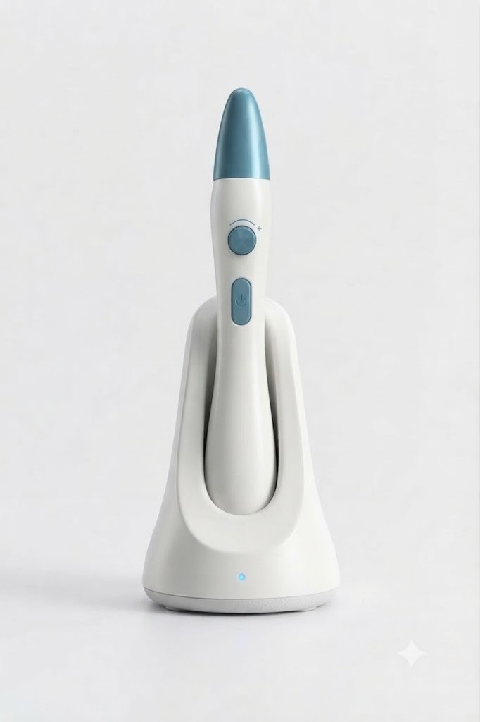
Working Model Video
MEDHA 2026
Proposed Device — Concept Render
Handheld optical probe with charging dock, single-button power control and a rotary intensity/mode dial; teal contact tip houses the dual-wavelength LED and photodiode assembly. Working-model demonstration video to be linked here.
Notes:
13

