Slide 1
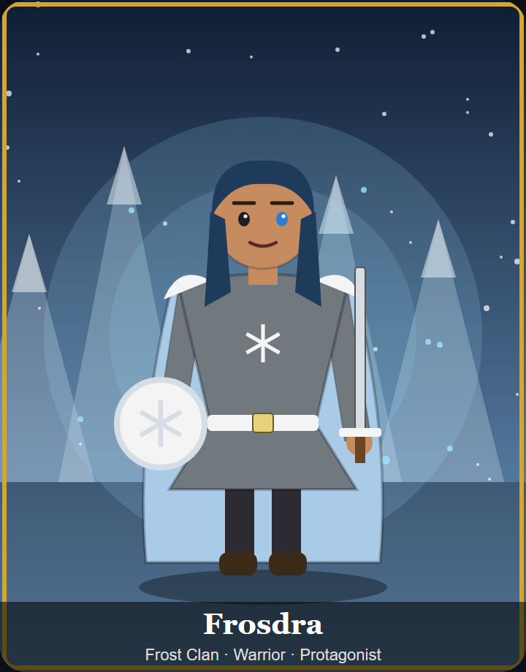
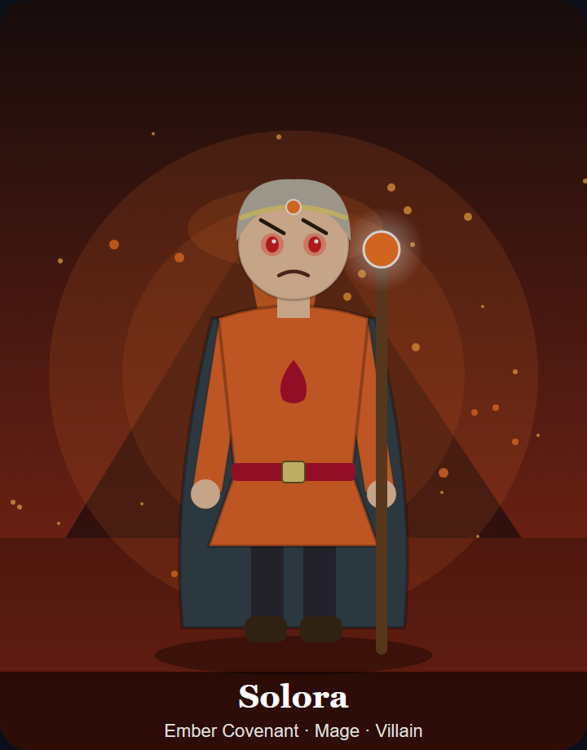
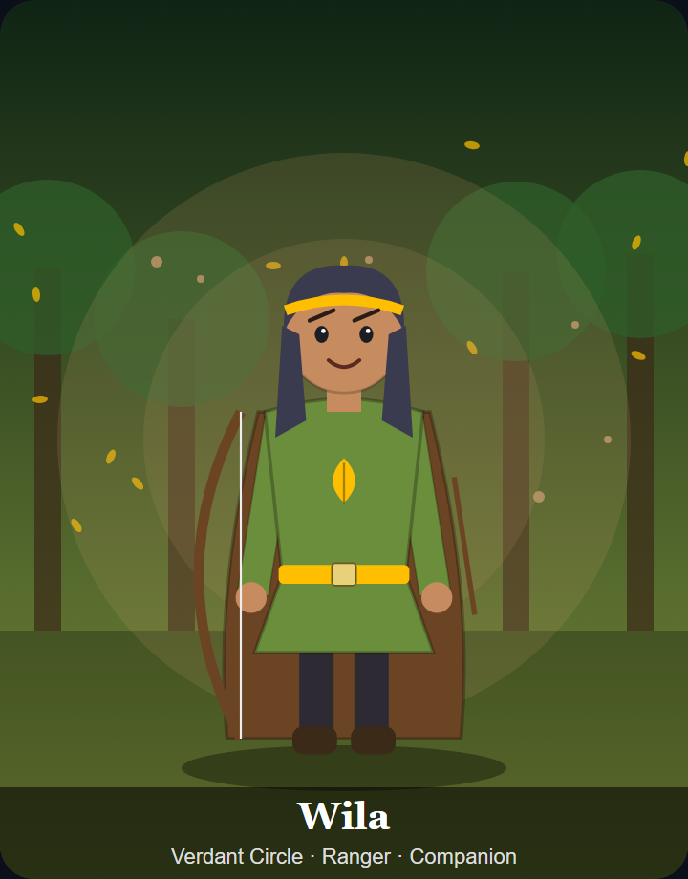
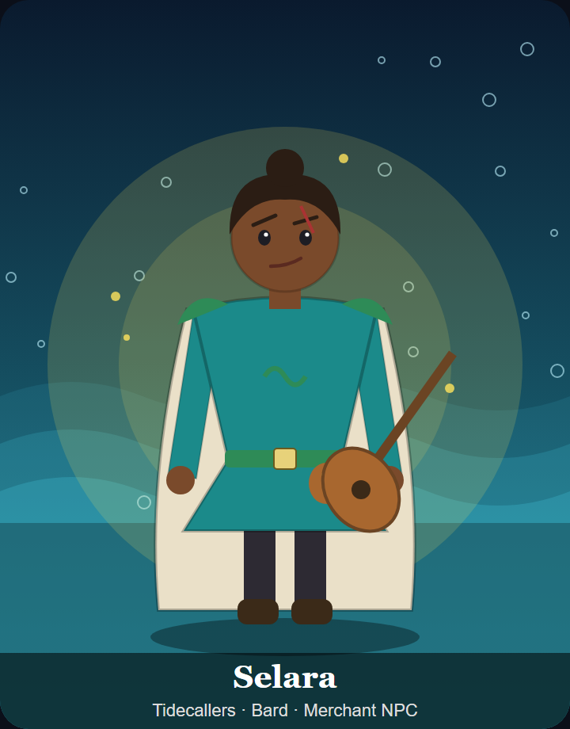
CASE STUDY 65
Character Design Studio
A GenAI workflow that designs video-game characters while keeping them consistent, safe, original, affordable and under human control
Suraj T
USN 1DS23AI058
Notes:
Introduce yourself and the case study. One sentence: this is a working GenAI tool that designs game characters, and keeps the AI inside the game's rules, safe, original, cheap and under the designer's control.

Slide 2
THE PROBLEM
Raw GenAI output isn't ready for a game
1
2
3
4
5
Breaks the rules
Copies others' IP
Unsafe content
Costs add up
Designers lose control
Fire magic for an ice faction, guns in a medieval world, living dragons that should be extinct
Look-alike names (Kratoz, Pikachoo), franchise terms, 'in the style of' a real studio
Gore or adult themes in a PEGI 12 game; prompt injection hidden in a brief
Every call costs tokens; hundreds of NPCs on the largest model gets expensive fast
Unreviewed AI content shipping with no record of who decided what
Goal: keep the speed of GenAI and remove all five risks, which are exactly the constraints set in the case study.
Case Study 65 · GenAI for Video Game Character Design
2
Notes:
Studios want speed from GenAI, but raw output creates five problems. These five map exactly to the constraints in the case study, and the rest of the talk shows how each one is solved.

Slide 3
THE SOLUTION
Wrap the model in a guarded pipeline
Auto-repair loop: errors regenerate only the broken fields
Designer brief
Input guardrail
Cache, budget, routing
Generator
Output guardrail
Consistency check
Human review
Export + provenance
Game Bible rules, lore, factions, banned content
Guardrails
Cost and human control
Grounding
Case Study 65 · GenAI for Video Game Character Design
3
Notes:
The core idea: don't trust the model, wrap it. Walk left to right. Red stages are guardrails, green stages control cost and keep a human in charge. The Game Bible feeds both the generator and the checker, and errors loop back through auto-repair.

Slide 4
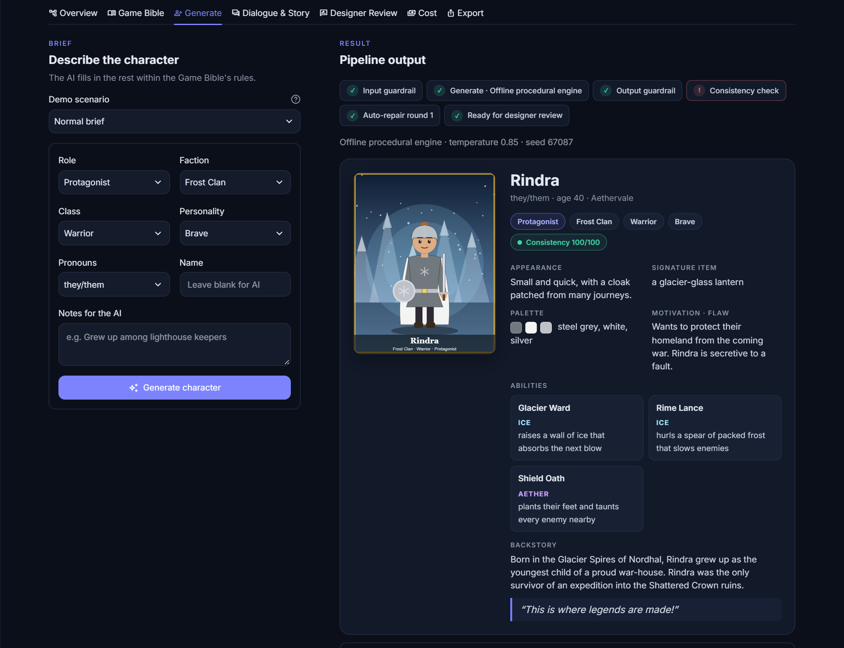
GENERATION
One brief in, a full character package out
1
Step-by-step trace
Every pipeline stage is shown: passed or flagged
2
Full character
Look, palette, abilities, item, backstory, motivation, flaw, catchphrase
3
Concept art
A portrait drawn from the validated data, plus a prompt for any image model
4
Grounded in the Game Bible
4 factions, lore, tech level; 7 rules score every output
Case Study 65 · GenAI for Video Game Character Design
4
Notes:
One click runs the whole pipeline. The step tracker shows every stage; here the consistency check failed on the first draft and auto-repair fixed it. The result is a full character package with generated concept art.

Slide 5
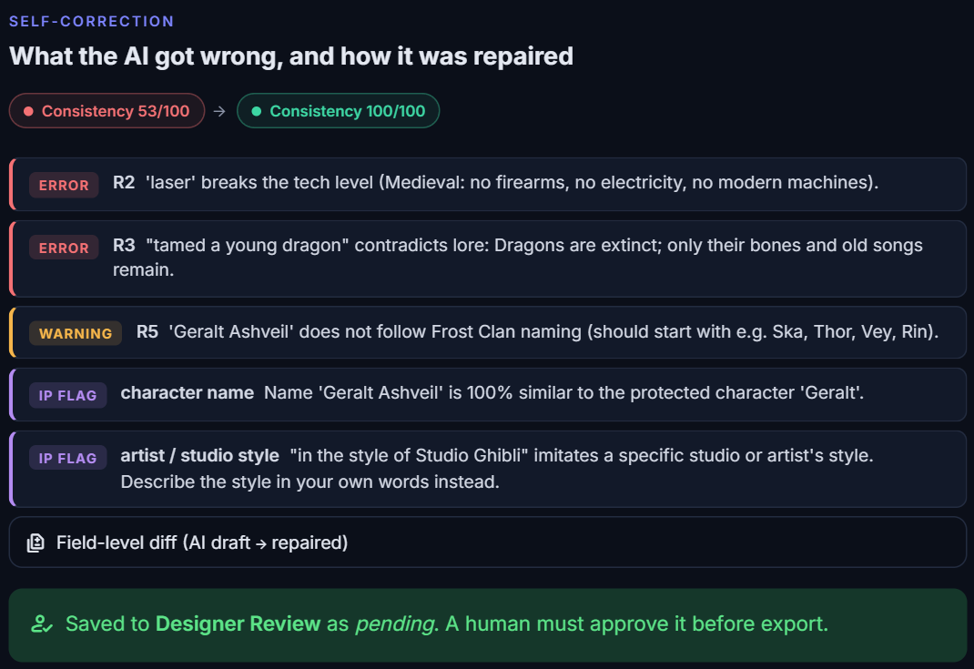
SELF-CORRECTION
The AI makes mistakes. The pipeline catches and fixes them
→
53
100
score of the raw AI draft
after auto-repair
100% → 0%
of characters with rule errors at max creativity, before vs. after repair (60 runs)
Only broken fields are regenerated, so the parts the designer liked are kept and repair costs a fraction of a full regeneration.
Case Study 65 · GenAI for Video Game Character Design
5
Notes:
The most important slide. At high creativity the AI made five mistakes in one character: a laser in a medieval world, a tamed dragon, a name copied from Geralt, and Studio Ghibli's style. The checker caught every one and auto-repair regenerated only the broken fields: 53 to 100. Across the evaluation runs, no repaired character still had an error.

Slide 6
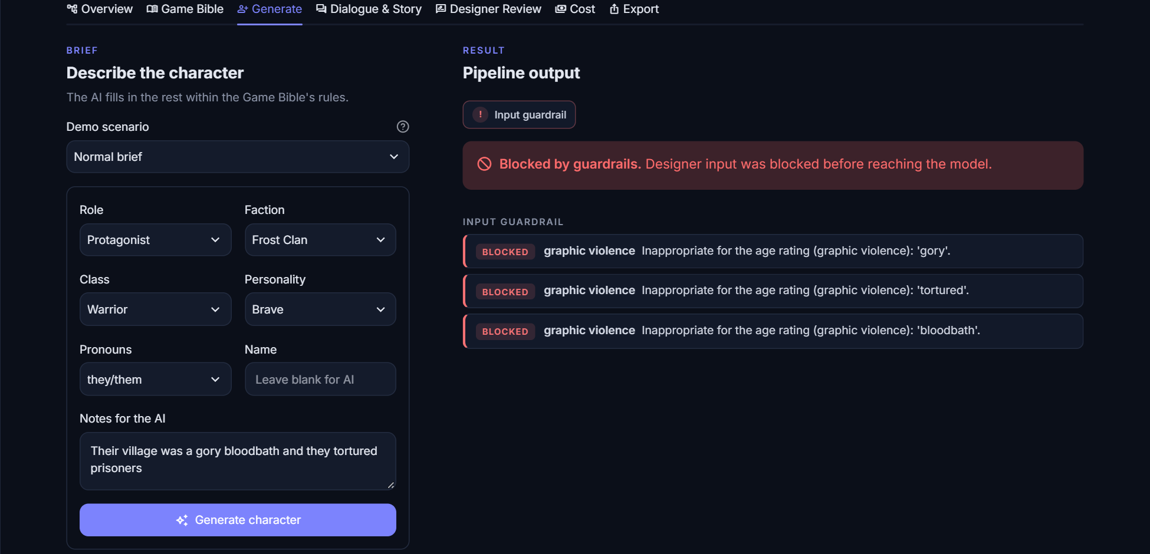
RESPONSIBLE AI
Guardrails for safety and copyright
10/10
0/10
unsafe or injection briefs blocked
safe briefs wrongly blocked
10/10
1/132
copycat names flagged
original names wrongly flagged
Content filter violence, adult, self-harm, drugs, hate, profanity
Injection filter “ignore previous instructions…”
IP detector names, franchises, traits, artist styles
Case Study 65 · GenAI for Video Game Character Design
6
Notes:
Guardrails run on the way in and on the way out. An unsafe brief is blocked before it ever reaches the model. Copyright issues are flagged, not blocked, because a human should judge borderline cases: for example 'Maro' is 89% similar to 'Mario'.

Slide 7
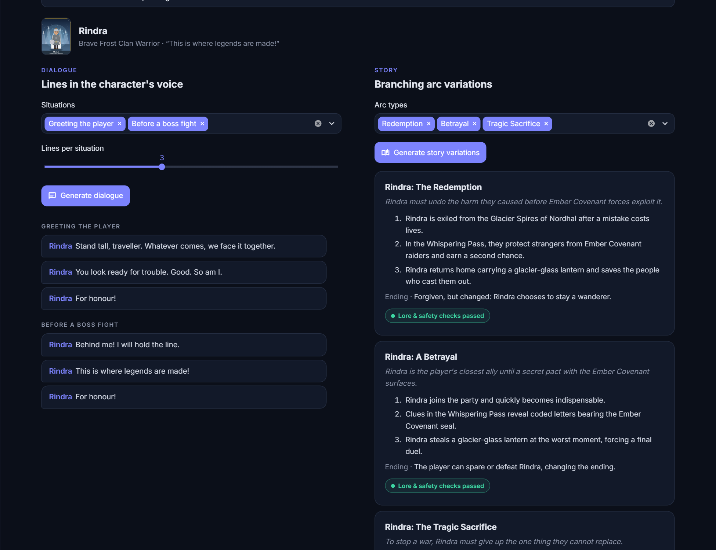
NARRATIVE
Dialogue and branching story variations
1
6 situations
Greeting, boss fight, trading, betrayal, victory, defeat
2
Personality voice
Brave, sarcastic, wise, cunning, gentle or ruthless
3
5 story arcs
Redemption, betrayal, sacrifice, rise to power, hidden heir; each lore-checked
Case Study 65 · GenAI for Video Game Character Design
7
Notes:
The same character gets dialogue in its own voice for different game situations, and several branching story arcs. Every arc is checked against lore and safety rules too.

Slide 8
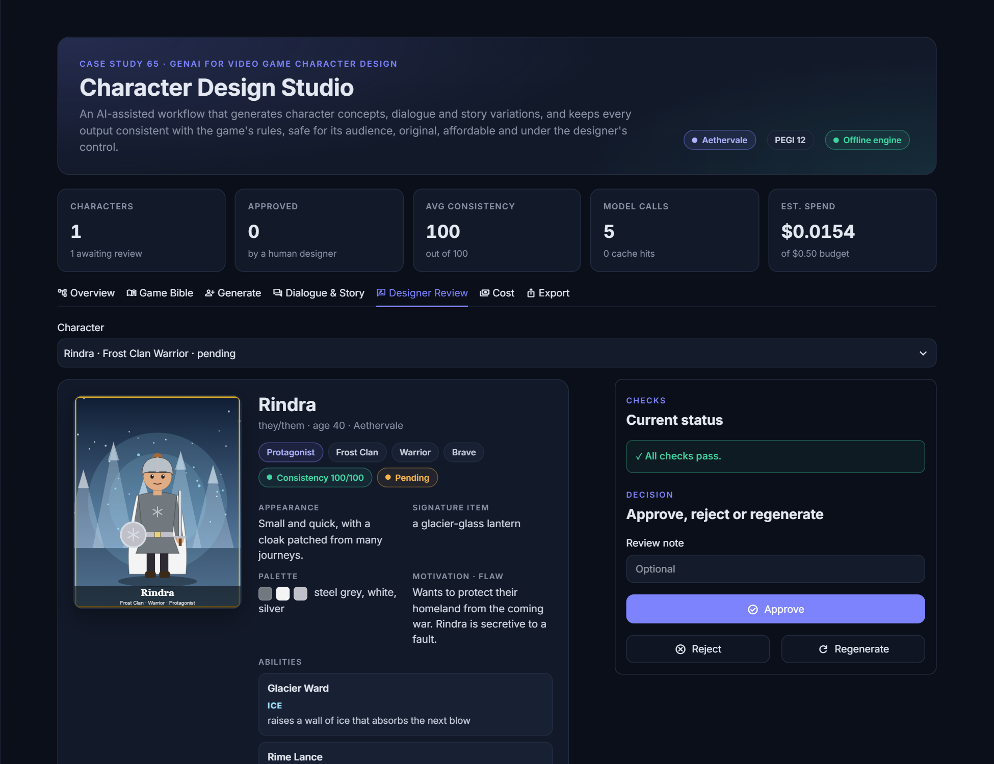
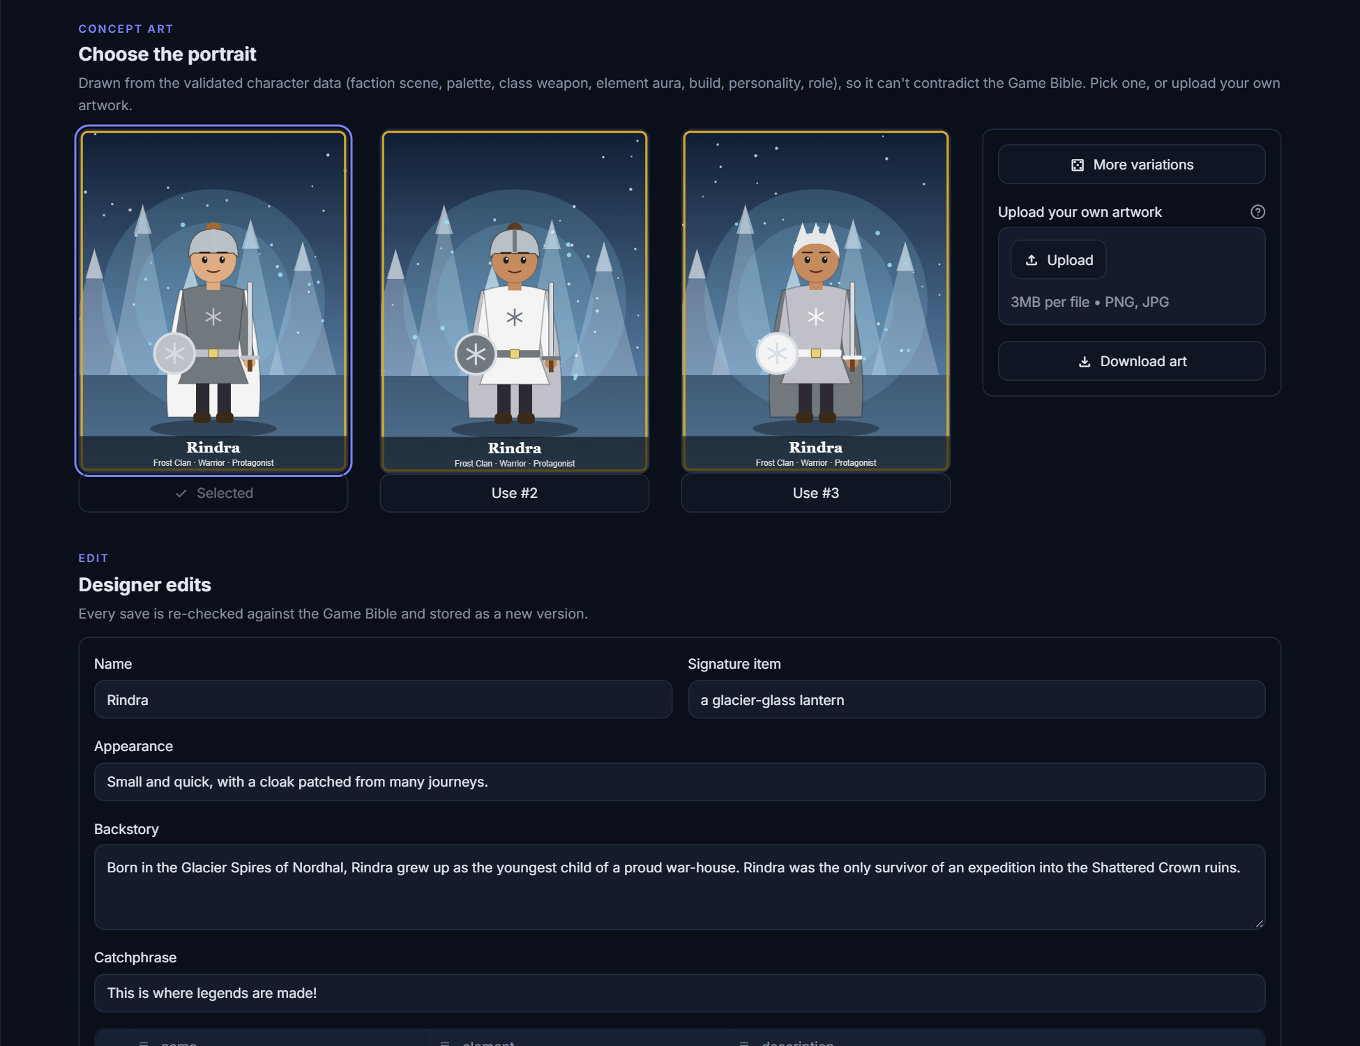
HUMAN IN THE LOOP
The designer always has the final say
Approve · reject · edit · regenerate Edits are re-checked automatically
Pick concept art or upload your own Every choice is logged
Case Study 65 · GenAI for Video Game Character Design
8
Notes:
AI never has the final say. The designer approves, rejects, edits or regenerates; picks one of three concept-art variations or uploads their own; and every action is versioned with author, score and a diff. Only approved characters can be exported.

Slide 9
COMPUTATIONAL COST
About 10× cheaper than using the biggest model for everything
1
Model routing
cheap model for repair and dialogue
2
Response caching
identical requests cost $0
3
Targeted repair
regenerate broken fields only
4
Budget cap
generation stops at the session limit
5
Offline / local engine
$0 for prototyping
Prices are illustrative tiers (editable in the app); token counts use ~4 characters per token.
Case Study 65 · GenAI for Video Game Character Design
9
Notes:
Cost is one of the four required constraints. Every call is metered. Cheap models handle repair and dialogue, the medium model handles creative work, repeats are cached for free, and a budget cap stops overspending. The result is about 10 times cheaper per character than using the biggest model for everything.

Slide 10
CONCLUSION
NEXT STEPS
GenAI speeds up character design when it is wrapped in the right engineering
› Trained moderation model + embedding similarity
› Licensed IP database for copyright checks
› Local image model for concept art
› Multi-role review: writer, art director, legal
1
Consistent grounded in the Game Bible, checked and auto-repaired
2
Safe & original content filters, injection blocking, IP detection
9/9
$0
3
Affordable routing and caching, about 10× cheaper
automated tests pass
offline, no API key
4
Human-led nothing ships without designer approval
Thank you Suraj T · 1DS23AI058
Notes:
Wrap up with the four constraints, then switch to the live demo using docs/DEMO_SCRIPT.md.

