Slide 1
CREDIT CARD FRAUD DETECTION
Sandeep Singh Bisht(15007001037)
Suraj kumar(15007001047)
Project Guide
UMA SINGH

Slide 2
Introduction
Credit Card Fraud
The crime of credit card fraud begins when someone either steals a credit or debit card, or fraudulently obtains the card number and other account information necessary for the card to be used successfully. While the actual physical theft of credit cards does happen, modern technology has seen a steep rise in the incidence of intercepting account information electronically. The owner of the account, the merchant from whom card information was stolen or intercepted, and even the card issuer may be unaware of the compromise until the information is actually used to make purchases.
As online shopping and bill paying has skyrocketed in popularity, there is no longer a need to possess a physical credit card or debit card to make purchases, and it is possible even to open a financial account, and obtain credit cards solely through online transactions. Because of this, criminals able to obtain enough personal information about other individuals may use that information to commit credit card fraud by opening new accounts, or having new cards sent to them on existing accounts.

Slide 3
Aim
To detect credit card fraud using machine learning algorithms.
Local Outlier
Isolation Forest
Logistic Regression

Slide 4
Data Set
The CSV file contains over 2,80,000 entries
The dataset has been taken from the website, Kaggle
The dataset has 31 parameters
28 PCA encrypted values(V1, V2…….V28) and Amount, time and class

Slide 5
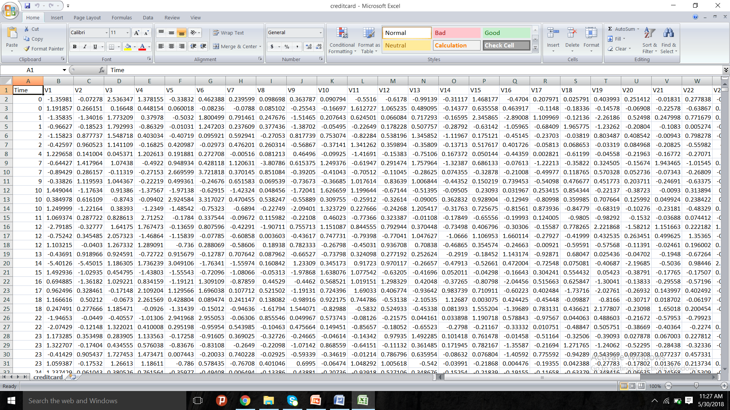
Data Set

Slide 6
Libraries Used
Pandas
pandas.read_csv(filepath_or_buffer )
pandas.describe()
Numpy
numpy.ndarray.shape()
Matplotlib
matplotlib.pyplot.hist

Slide 7
Algorithms used
Logistic Regression
Isolation forest
Local outlier factor

Slide 8
Logistic Regression algorithm
Measures relationship between dependent and independent variables
Used when the dependent variable has only two values
Estimate probabilities using logistic function.

Slide 9
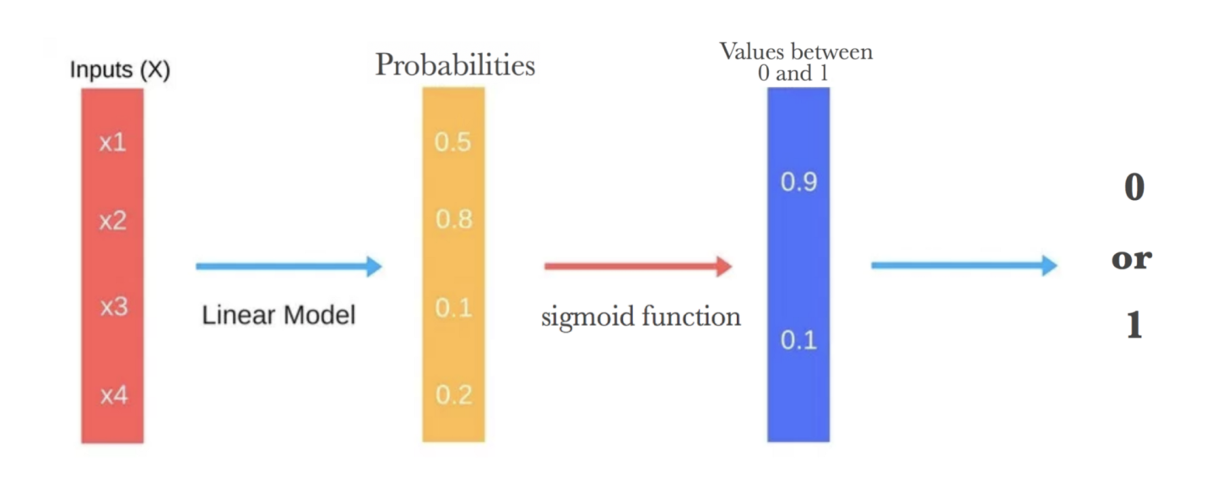
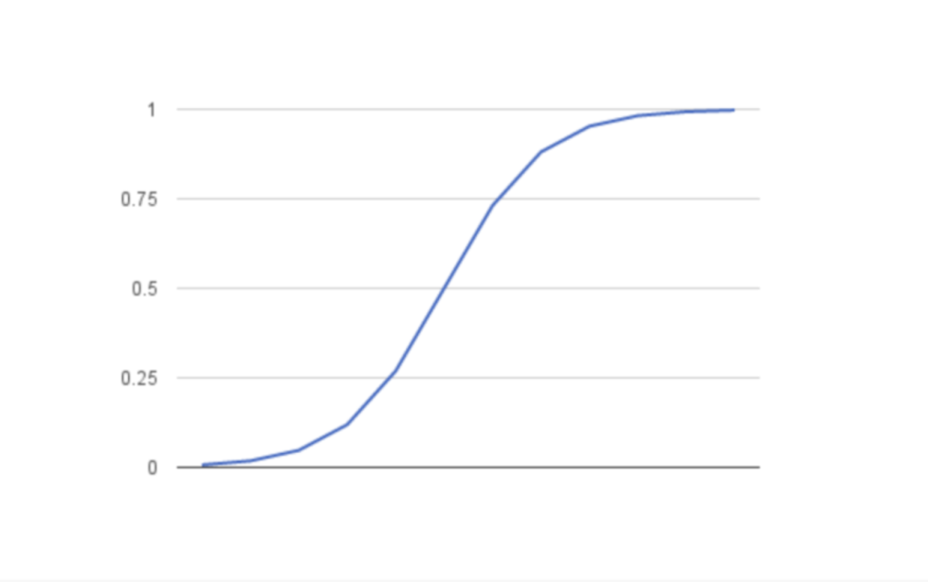
Logistic Regression algorithm

Slide 10
Logistic Regression algorithm
There are two outcomes 0 and 1.
p is the proportion of observations with an outcome of 1.
1-p is the probability of a outcome of 0.
Odds = p/(1-p)
Logit = ln(p/(1-p))

Slide 11

Logistic Regression
Logit(p) = ln(p/1-p) = $B_{0}$+$B_{1}x$
logistic function : p = $\frac{e^{B_{0}^{}B_{1}^{}x}}{1+e^{B_{0}^{}B_{1}^{}x}}$

Slide 12
Isolation forest algorithm
Builds iTrees,
Identify anomalies (short average path lengths on the iTrees) .
‘Isolates’ observations by selecting a feature
then randomly selecting a split value between the maximum and minimum values of the selected feature.

Slide 13
Isolation forest algorithm
First (training) stage: builds isolation trees using subsamples of training set.

Slide 14
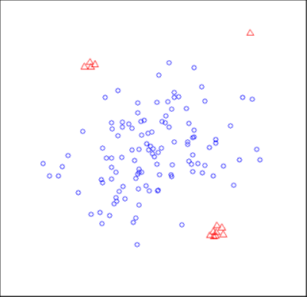
Isolation forest algorithm
Second (testing) stage: passes test instances through isolation trees to obtain an anomaly score for each instance.

Slide 15

Isolation forest algorithm
Path length h(x)
Anomaly score s s(x , n) = $2^{−E(h(x)) / c(n) }$ E(h(x)) average of h(x) c(n)= 2H(n-1) – 2(n-1)/n
If s<0.5, normal instance
If s≈0.5,anomaly

Slide 16
Local outlier factor algorithm
Outliers: patterns in data that do not confirm to the expected behavior
Unsupervised outlier detection method
Computes local density deviation of a given data point with respect to its neighbors.

Slide 17
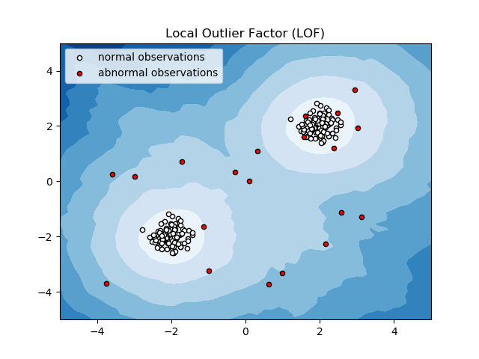
Local outlier factor algorithm

Slide 18
Challenges
Avoid false allegations
Large imbalance between fraudulent and legitimate transaction classes
Requirement an automatic system

Slide 19
Result
Classification report :-
Precision = tp / (tp + fp)
Recall = tp / (tp + fn)
f1-score is harmonic mean of precision and recall

Slide 20
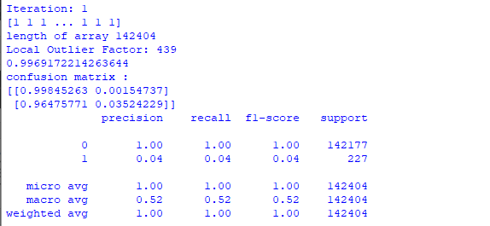
Classification_report for Local Outlier Factor

Slide 21
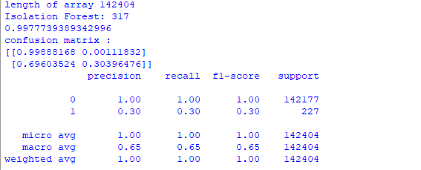
Classification_report for Isolation Forest

Slide 22
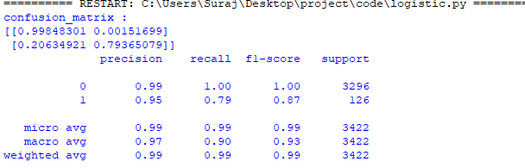
Classification_report for Logistic Regression

Slide 23
Result
Class | Ground Truth | Predicted | Wrongly Predicted | Precision | Recall | F1-score
0 | 3296 | 3263 | 9 | 0.99 | 1.00 | 1.00
1 | 176 | 167 | 33 | 0.95 | 0.79 | 0.87
Avg/total | 3472 | 3430 | 42 | 0.99 | 0.99 | 0.99
Classification report for logistic regression

Slide 24
Result
Class | Ground Truth | Predicted | Wrongly Predicted | Precision | Recall | F1-Score
0 | 142177 | 141949 | 228 | 1.00 | 1.00 | 1.00
1 | 227 | 9 | 218 | 0.04 | 0.04 | 0.04
Avg/total | 142404 | 141958 | 446 | 1.00 | 1.00 | 1.00
Classification report for Local outlier factor

Slide 25
Result
Class | Ground Truth | Predicted | Wrongly Predicted | Precision | Recall | F1-Score
0 | 142177 | 142018 | 159 | 1.00 | 1.00 | 1.00
1 | 227 | 68 | 159 | 0.30 | 0.30 | 0.30
Avg/total | 142404 | 142086 | 318 | 1.00 | 1.00 | 1.00
Classification report for Isolation Forest

Slide 26
Future Scope
Get better fraud detection criteria.
Use cross validation and weighted values of parameters.
Real time prediction before fraud actually occurs.

Slide 27
Conclusion
Credit card fraud detection has traditionally focused on looking for factors such as transaction amount, point of sales, location, etc. available inside the organization. From these basic variables it is possible to compute new aggregate features to model the behavior of the cardholder. Typically, companies use a small sample of historical transactions for each cardholder to build account- level variables. Because it is computationally demanding to compute aggregates, these features are usually calculated offline and then added to the feature vector representing the transaction when it is authorized. Using a small part of the information available may translate into a loss of predictive accuracy. The introduction of big data technologies allows overcoming these issues, i.e. computing aggregates in real time and using a larger set of historical transactions.

Slide 28
References
Andrea Dal Pozzolo, Giacomo Boracchi, Olivier Caelen, Cesare Alippi, and Gianluca Bontempi. Credit Card Fraud Detection with Alert Feedback Interaction. Submitted to IEEE Transactions on Neural Networks and Learning Systems.
Andrea Dal Pozzolo, Olivier Caelen, Yann-Ael Le Borgne, Serge Waterschoot, and Gianluca Bontempi. Learned lessons in credit card fraud detection from a practitioner perspective. Expert Systems with Applications, 41(10):4915-4928, 2014.
Andrea Dal Pozzolo, Olivier Caelen, and Gianluca Bontempi. When is undersampling effective in unbalanced classification tasks. In European Conference on Machine Learning. ECML-KDD, 2015.

Slide 29
References
Andrea Dal Pozzolo, Reid A. Johnson, Olivier Caelen, Serge Waterschoot, Nitesh V Chawla, and Gianluca Bontempi. Using HDDT to avoid instances propagation in unbalanced and evolving data streams. In Neural Networks (IJCNN), The 2014 International Joint Conference on. IEEE, 2014
Andrea Dal Pozzolo, Olivier Caelen, Serge Waterschoot, Gianluca Bontempi, Racing for unbalanced methods selection. Proceedings of the 14th International Conference on Intelligent Data Engineering and Automated Learning (IDEAL), IEEE, 2013

Slide 30
THANK YOU

