Slide 1

Capstone supervisor allocation portal for LPU students using python
School of Computer Science and Engineering
INT 213
Submitted To Pooja Rana (Faculty INT 231) On 10-Nov-2021 by
NAME | REG NO | ROLL NO | Section
Garapati Mahendra Siva Sai Satya Venkat | 12014364 | RK20TSB75 | K20TS

Slide 2
Index
1.Title
2.Index
3.Acknowledgement
4.Summary
5.Tabel Of Figures
6.Introduction
7.Basic Module Division
8.Reference
9.Result
Acknowledgement
I Garapati Mahendra Siva Sai Satya Venkat alone worked hard to complete this project. However, it would not have been possible without the kind support and help of my professor Pooja Rana(Faculty INT-213).
I would like to extend my sincere thanks to all those who helped regarding the project & also for their support in completing the project. This project helped me to hone my Python programming skills and helped me gain grip on GUI
(Graphical User Interface).

Slide 3
SUMARRY :
This project takes use of GUI to create a portal that enables Students to request Supervisor for their capstone project and Supervisors to select the students whom they wish to supervise.
INTRODUCTION
In this project I made a Capstone Supervisor Allocation Portal, the technology that we have used is sole Python Tkinter and MySQL . Tkinter is the standard GUI (Graphical User Interface) library for Python. Python when combined with Tkinter provides a fast and easy way to create GUI applications. Tkinter provides a powerful object-oriented interface to the Tk GUI toolkit. MySQL is an open-source relational database management system. With MySQL commands we can use it together with Tkinter, which allows to create and manipulate databases and tables in the GUI.
This project has been divided into two segments: -
Student Segment :
which helps new students register for the supervisor allocation and pre-registered students to login and check the name of their supervisor and their basic details.
Supervisor Segment :
which helps new supervisors to register for his availability and pre-registered supervisors to check the name of allocated students under them and their basic details.

Slide 4
Table of Figures
Fig No | Name
1 | Portal/Main page
1.1 | Student Login
1.2 | Student Register
1.3 | Supervisor Login
1.4 | Supervisor Register
2 | Request Supervisor
2.1 | Table with Supervisor Details
2.2 | Request via UID
3 | Select Students
3.1 | Table with Student Details
3.2 | Table of Requests

Slide 5
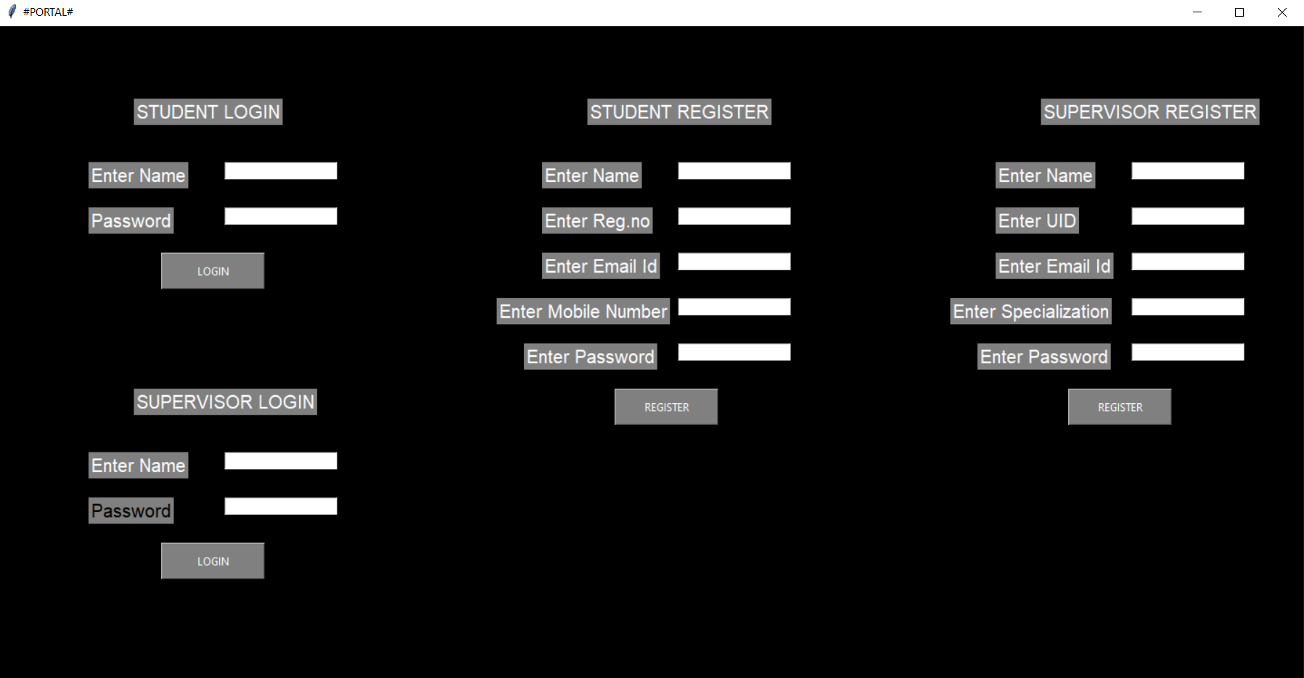
FIG 1
This is the Main page where you choose to Login as a student if you already registered or Register if you are a new user and
Supervisors can login as Supervisor if already registered or Register if you are a new user.

Slide 6
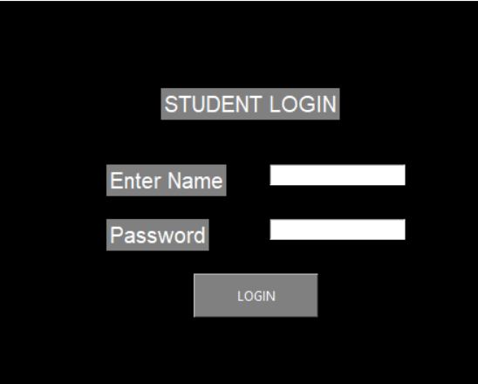
FIG 1.1
Existing user can login using student login if they are students. Usernames are their Registration numbers and passwords are those entered by them in Registration. Their details are stored in database using MySQL, So their Password must match their Registration number to Login Successfully.

Slide 7
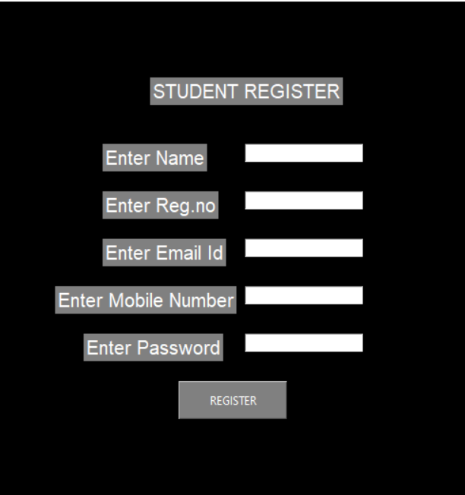
FIG 1.2
New Students can Register here by entering their Name, Registration Number, Email Id ,Mobile Number, Password. All fields must be filled and Registration number must be a number and Mobile number must be number of length 10 or else error will be shown.

Slide 8
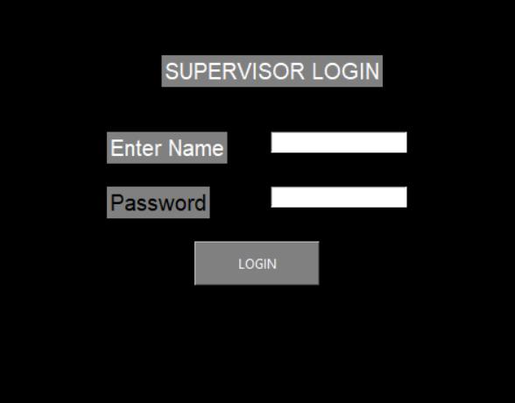
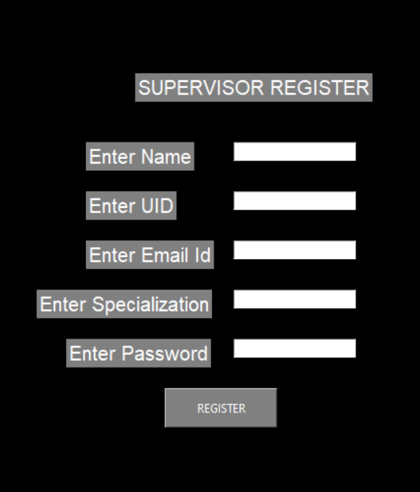
FIG 1.3
Similar to Student login, here username is UID
FIG 1.4
Similar to Student Register but fields are different

Slide 9
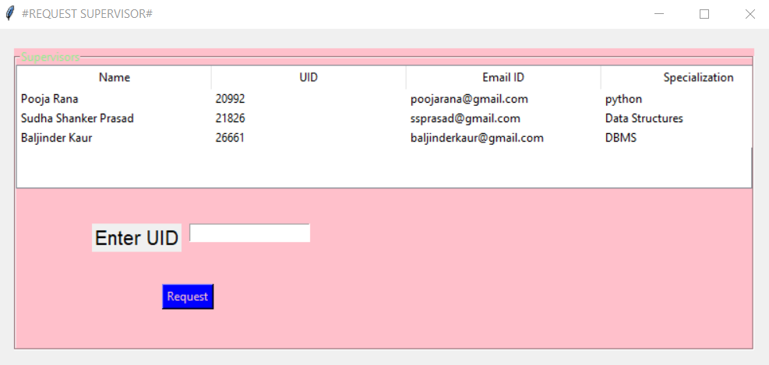
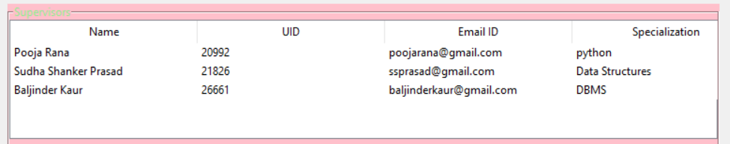
FIG 2
After login successfully this window opens, REQUEST SUPERVISOR
FIG 2.1
We can see the details of available Supervisors using MySQL and Tkinter Treeview

Slide 10
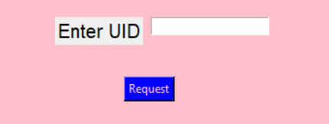
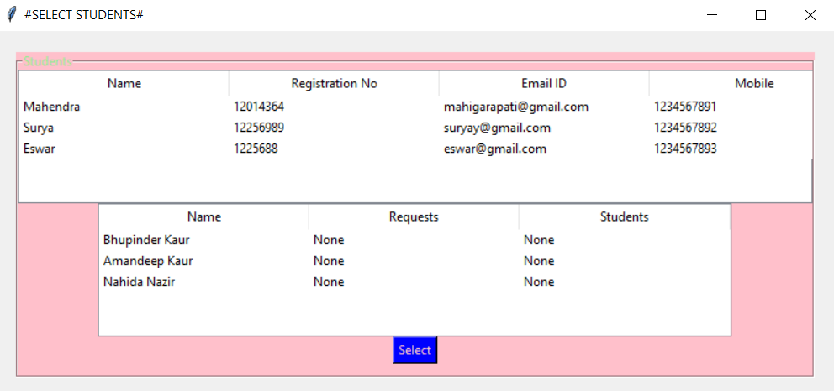
FIG 2.3
Here enter the UID of your preferred to send a request to the supervisor
FIG 3
After Supervisor login this window appears, SELECT STUDENTS

Slide 11
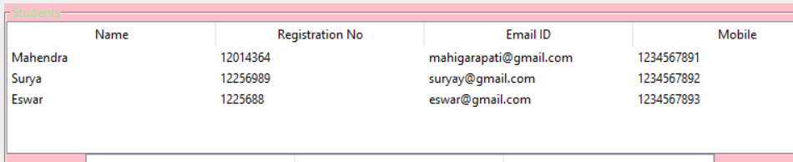
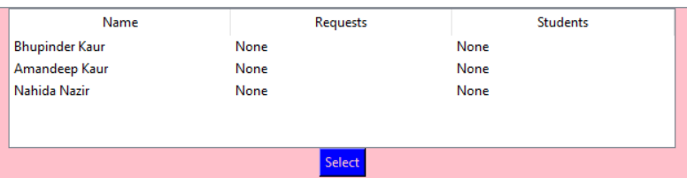
FIG 3.1
The Supervisors can see the details of the students here using MySQL and Tkinter Treeview
FIG 3.2
Supervisors can see the requests and selected students in this table and can select the students

Slide 12
References:
https://stackoverflow.com/
https://www.geeksforgeeks.org/
With all the information above and guidance by my faculty I was able to complete my project.
Github link:

