Slide 1

Lookup Table Based Design of High PSRR LDO and Automation of its MOSFET Sizing
VL804 Analog Power IC Design
Anwit Suhas Damale IMT2020532
Nalamothu Sai Sampath MT2023525

Slide 2
Outline
Limitations of Square Law
gm/Id Methodology
LDO
Specification Table
Circuit Diagram
Design Flow
Limitations of gm/Id Methodology
Automation Design Flow
Results
Next Steps
References

Slide 3
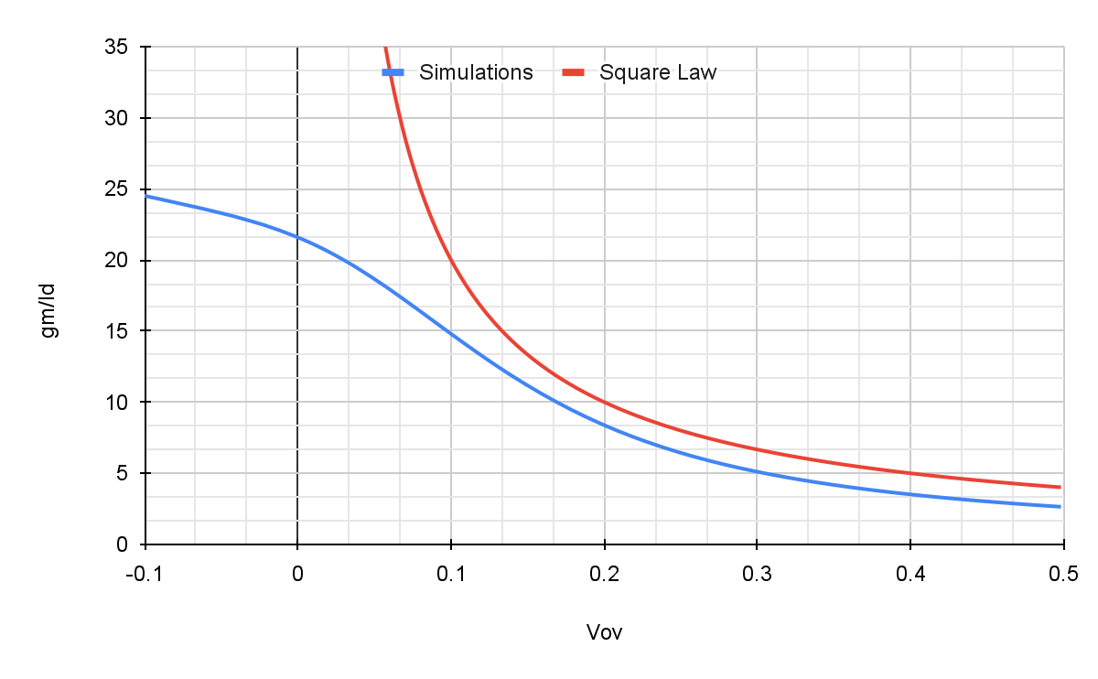
Limitations of Square Law
The square law fails to describe the weak inversion (sub-threshold) region.​
The square law fails to describe strong inversion (saturation) region when short channel effects are taken into consideration.​
Since there is a difference between an actual transistor behavior and the simple square law model, any square-law driven design optimization will be far off from simulation results​

Slide 4
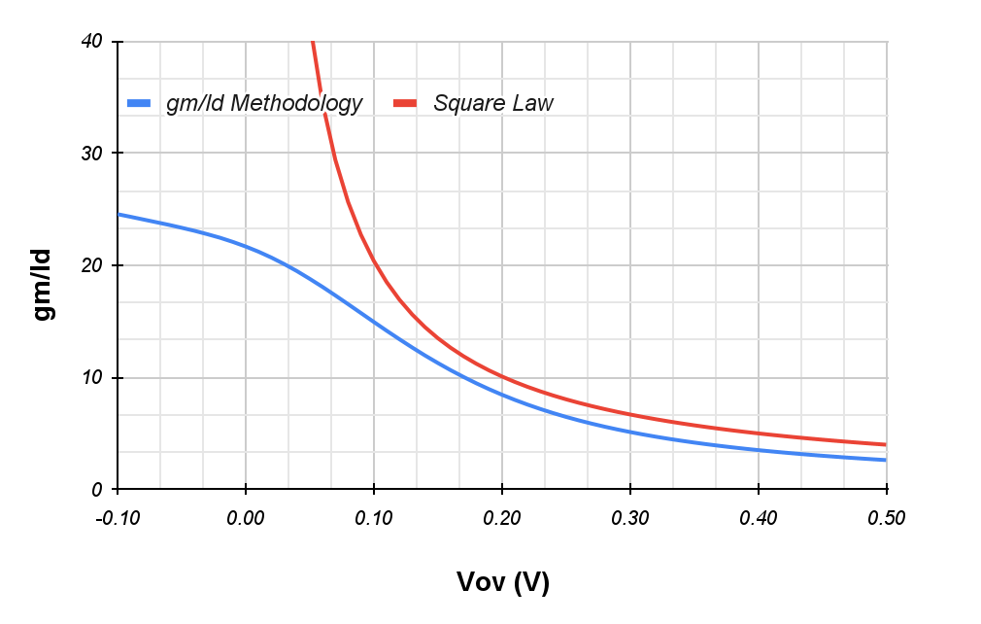
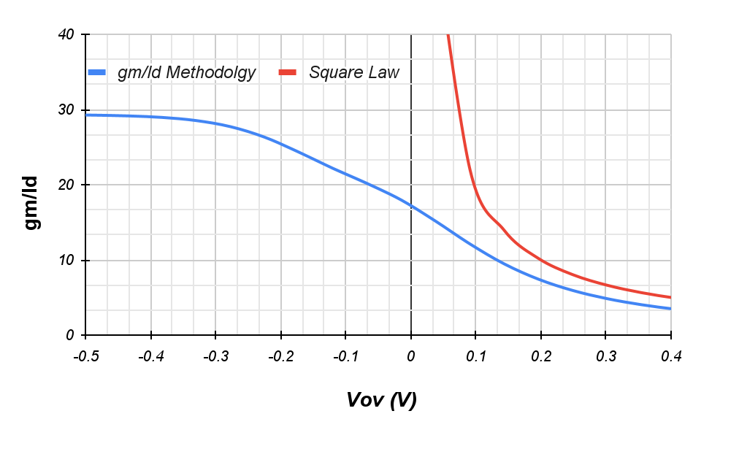
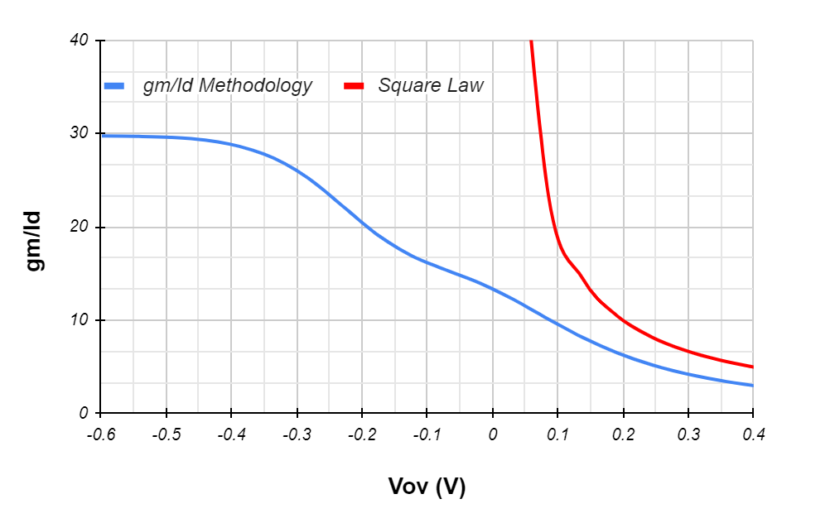
gm/Id v/s Vov plot comparison for different technology nodes for their minimum lengths
180nm technology node
Lmin = 180nm
110 nm technology node
Lmin = 110nm
45nm technology node
Lmin = 45nm
For a lower technology node of its respective minimum length the difference between gm/Id methodology and square is very large

Slide 5
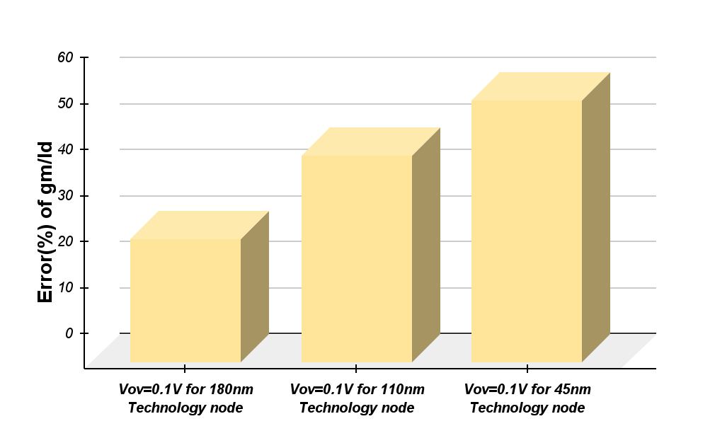
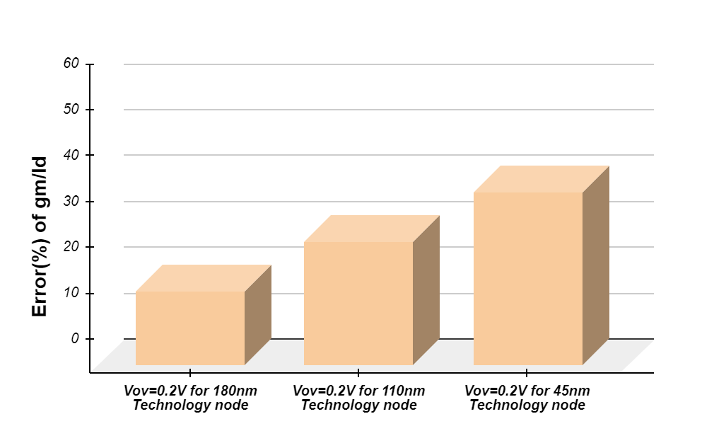
Comparison of Error (%) of gm/Id v/s Vov for different technology nodes
For a lesser Vov value, the error (%) of gm/Id value of gm/Id methodology and Square Law is very high

Slide 6
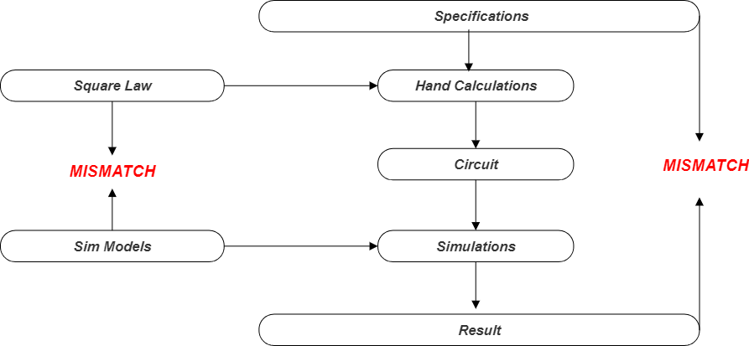
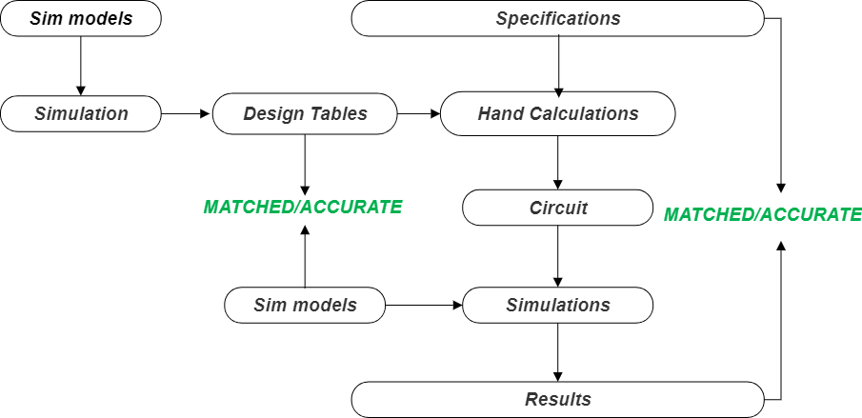
Square Law based Design
gm/Id methodology based Design
gm/Id methodology gives more accurate results than Square Law

Slide 7
gm/Id Methodology
gm/Id is a measure of the efficiency to translate current (i.e., power) into gm (i.e., gain). The greater gm/Id, the greater gm is for a fixed Id. gm/Id is interpreted as a measure of the “gm enhancement efficiency”.​
It is strongly related to the performances of analog circuits.​
It describes about the device region of operation.​
It provides a tool for calculating the transistors dimensions.​
The method exploits the transconductance over dc drain current ratio ( gm/Id) relationship versus the normalized current [Id/(W/L)].

Slide 8
Advantages of gm/Id Methodology
gm/id curve is generated from SPICE simulation, which is linked to the actual measurement data​
- Better match to the fabricated one​
gm/id value does not rely on any model equation​
- Avoid the design uncertainties​
gm/id Value has fixed shape regardless of transistor length​.
gm/id curve is valid all over the transistor operating range​.
gm/id method can reduce the design and optimization effort a lot​.
Once selecting one point from gm/id curve, with another design parameter the third parameter can be easily determined.

Slide 9
Figure of merits (or) Performance metrics
1.Trans-conductor Efficiency: (Should be high)​
It is the efficiency of the MOS transistor to translate given current into an equivalent​ transconductance.​
TE = gm/Id​
2. Intrinsic Gain: gm*ro​
3.Transit Frequency (or Unity Gain Frequency):​
WT=gm/Cgg​
It is the maximum frequency beyond which MOS transistor will not act as amplifier.
​
All the above mentioned FOM's and Id/W are independent of widths.

Slide 10
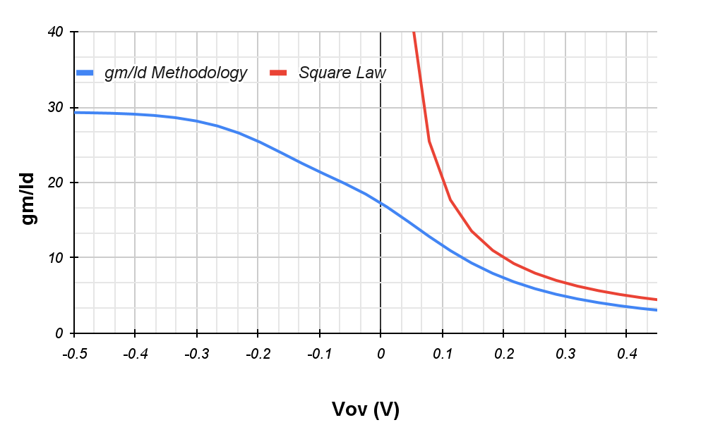
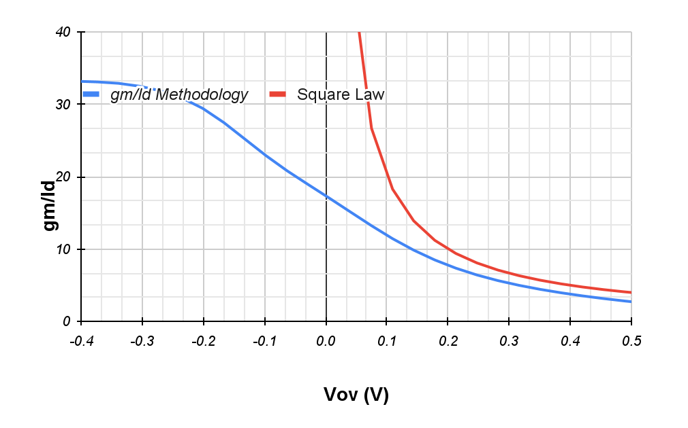
gm/Id plot comparison for different technology nodes of same length = 180nm
180nm technology node
110 nm technology node
45nm technology node
For any technology node if length increases the narrowness between gm/Id methodology and Square law gets decreased

Slide 11
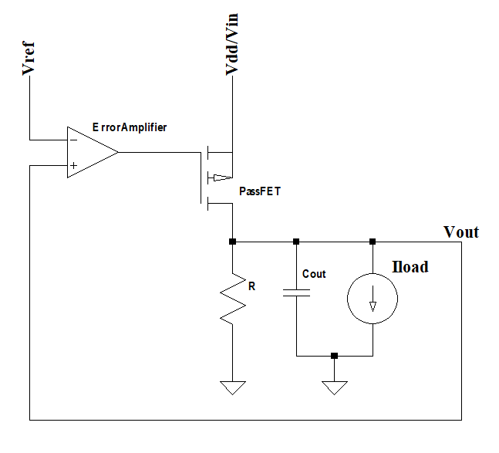
LDO
A voltage regulator with a small difference in voltage between input and output is called an LDO regulator. LDO stands for low dropout; an LDO regulator is a type of linear regulator with a low input-output voltage differential.
Linear regulator with unity feedback

Slide 12
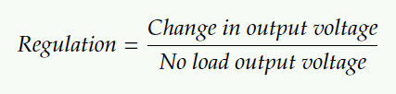
Regulator Performance Parameters
DC Regulation:
It is measure of an error in output voltage.
For good dc regulation high gain error amplifier, low offset error amplifier and a constant vref w.r.t. process, voltage and temperature is required.

Slide 13
Line regulation:
It is a measure of error in output voltage due to change in the input supply (line)
Line Regulation = ΔVout / Δvin (at low freq)
Load regulation:
It is a measure of error in output voltage with change in load current.
Load Regulation = ΔVout / ΔIout
Cumulative high gain of error amplifier and passfet is desired for the good load regulation i.e less change in vout with change in load current.

Slide 14
Line transient:
When there is up and down step change in line supply, it result in over and undershoot respectively in the vout of regulator. The reason is the feedback doesn’t respond quickly.
Line Transient = ΔVout / Δvin (step change)
For a good regulator, ΔVout because of line transient should be less than 5% of Vout and tsettle will be calculated when it will reach to 1% of Vout.
For a good line transient generally a large capacitor at output is used. Also feed forward from line is taken with feedback to decide the gate control of passfet and high bandwidth regulator is made for loop to respond faster.

Slide 15
Load transient:
It is a measure of error in output voltage with step change in load current.
Load Transient = ΔVout / Iload (step change)
When there is up and down step change in load, it result in under and overshoot respectively in the vout of regulator.
The reason is the feedback doesn’t respond quickly and the capacitor draws and gets respectively the extra current.
Large capacitor and high bandwidth regulator is useful in less load transient.
Large Capacitor will act as transient filter because any fast change at output will be filtered out by it.

Slide 16
Power supply rejection ratio (PSRR):
It is the ability to reject any change in vout w.r.t. ac change in vin.
PSRR = ΔVout/ΔVin
Large output capacitor value will allow less ripple to go at load. It is calculated in dB. A large –ve dB PSRR value is good.
Efficiency:
Efficiency w.r.t. Power = Pout/(Pout+Ploss)
Quiescent Current:
It is an internal current consumption of the regulator at no load condition. It should be as low as possible for better current efficiency.
Iq should be as minimum as possible from the design along with correct operation
Efficiency w.r.t. Current = Iout/(Iout+ Iq)

Slide 17
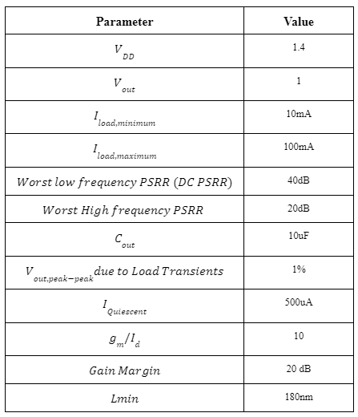
Specification Table

Slide 18
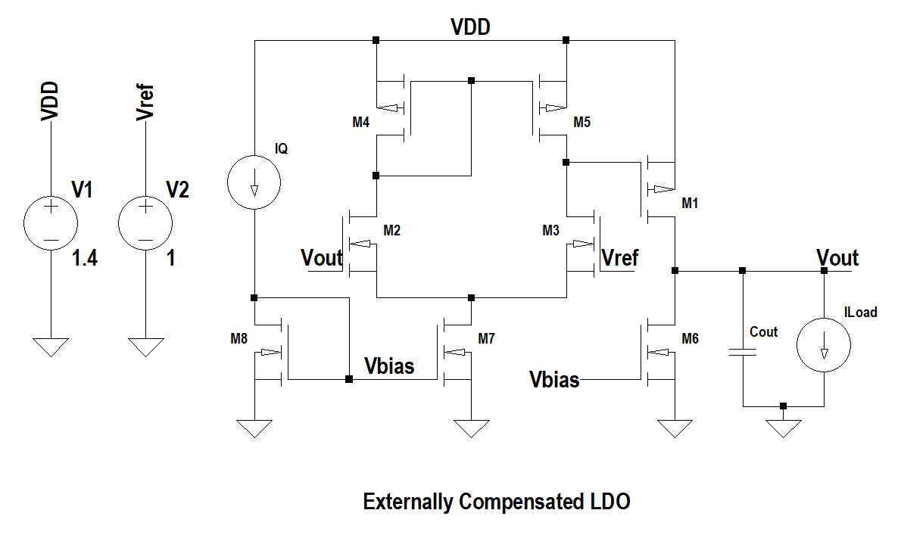
Circuit Diagram

Slide 19
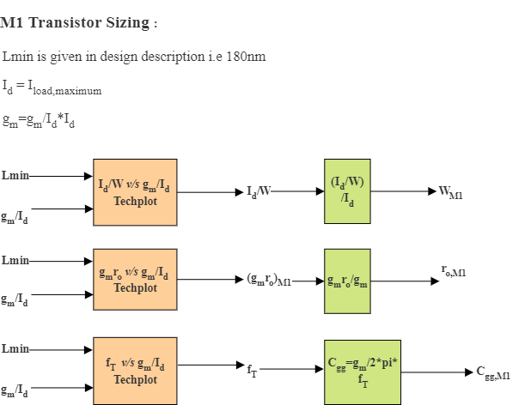
Design Flow

Slide 20
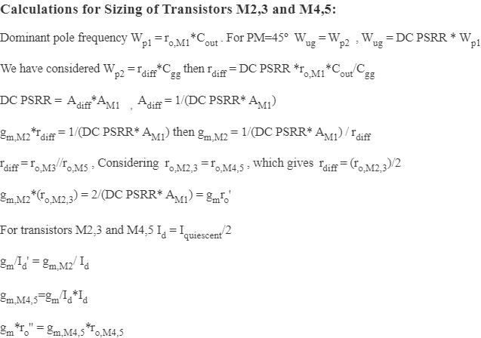

Slide 21
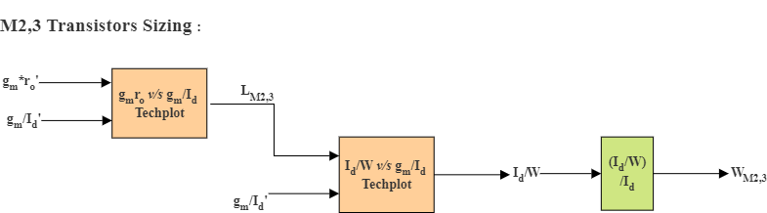
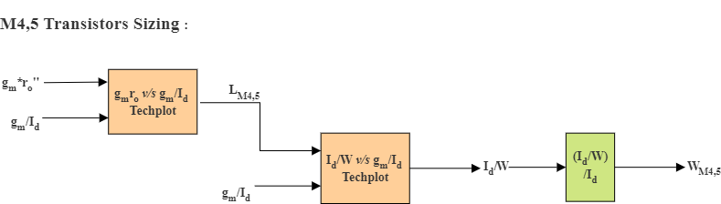

Slide 22
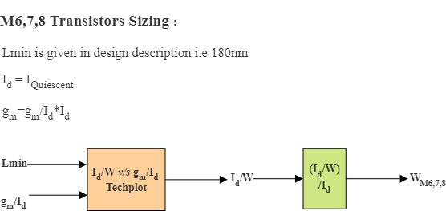

Slide 23
Limitations of gm/Id Methodology
If we go for lower technology nodes the dependency of width comes into the picture where in general the parameters (FOM’S) are independent of width .
We are fixing the value of Vds for a certain value which in turn leads Vds mismatch in device and tech-plots.

Slide 24
Automation Design Flow
We are using the TechPlot_Sim_Data_180nm_VDS_0p4V.xlsx file as our tech-plot file.
As of now we need to change the format of this file for our inputs to the automated Python script.
The exact .csv format files and directories can be seen in the flow below.

Slide 25
Format of Saving plots
Directories
Directories
csv files
M1 plot
Gm by Id vs gmro
L = 180 nm
M2 plot
Gm by Id vs Id by W
Tech-plot
Gm by Id vs gmro
L = 360 nm
M1 to M8
Gm by Id vs Id by W
For all Lengths

Slide 26
Block Diagram of the Script
Script
Tech-plot
Optimal Lengths and Widths of M1 to M8 Transistors
Specifications
Look-up table

Slide 27
Automation Design Flow - Script Sequence
The sequence in which the code works is :-
First M1 Width, inputs are specification value gm by Id = 10.
Second will be getting Width and Length of M2 and M3. The input will be both Gm_diff/I_diff and Gm_diff*ron_diff.

Slide 28
Automation Design Flow - Script Sequence
The sequence in which the code works is :-
Input will be gm/I_diff and gm*ron, then we will get the most suitable length.
Then input gm/i_diff will give us Id/W as output. Now use specification table and get W.

Slide 29
Automation Design Flow - Script Sequence
The sequence in which the code works is :-
Similarly we get Width and Length of M4 and M5.
We get Width of M6, M7 and M8 the same way we got M1 Width.

Slide 30
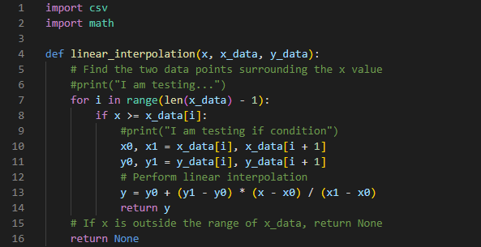
Automation Design Flow - Code Functions
This function performs linear interpolation to estimate the y-value corresponding to a given x-value within a set of data points (x_data, y_data) provided in CSV format.

Slide 31
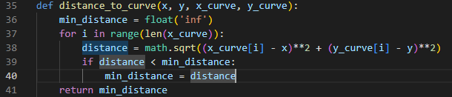
Automation Design Flow - Code Functions
This function calculates the minimum Euclidean distance between a point (x, y) and a curve defined by a set of points (x_curve, y_curve).

Slide 32
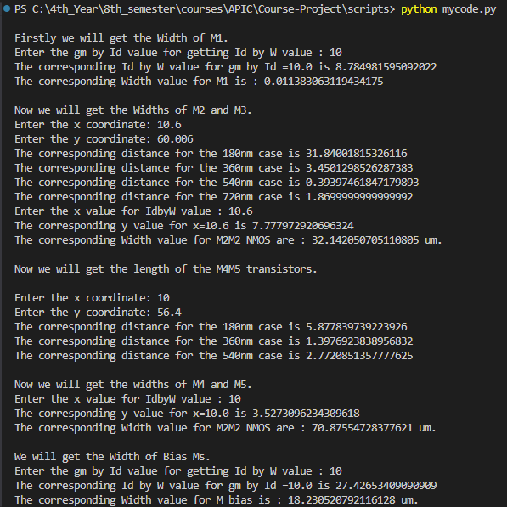
Automation Design Flow - Example
Use Specification table for giving inputs at every step and the look-up table for the formulae based calculations.

Slide 33
Limitations of the Script
The format of the tech plot needs to be manually changed.
The inputs should be looked up for in the specifications table instead of getting them automatically.
The intermediate formulae based calculations are not yet put in the code.

Slide 34
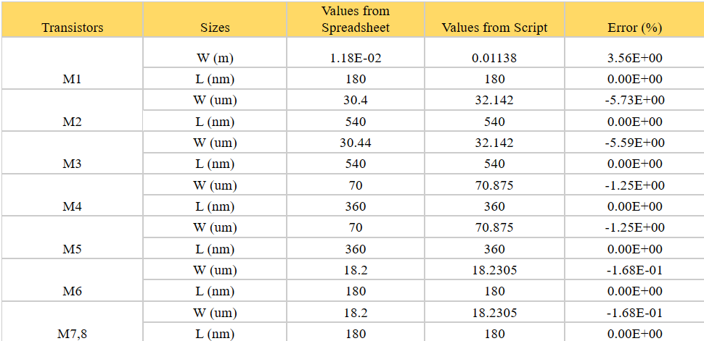
Results
Transistor Sizing Comparison

Slide 35
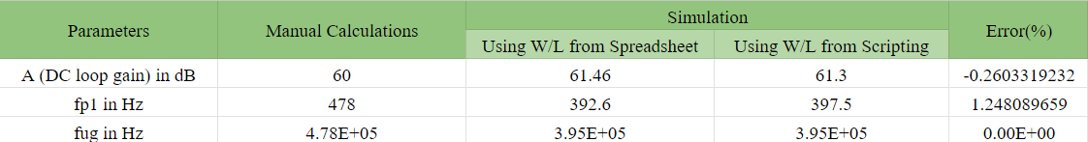
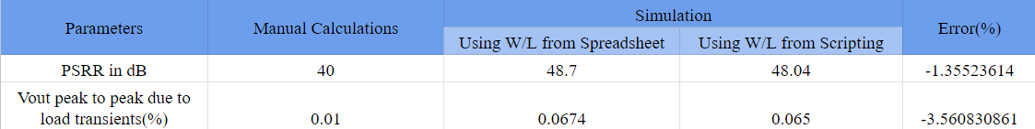
Comparison of values generated from spreadsheet and scripting

Slide 36
Next Step
Making the script more automated with including formulae based calculations coded in it.
Interpreting the tech plot format internally in the code itself.
Taking inputs from specification table automatically.
Making the entire process open source.

Slide 37
References
F. Silveira et al. "A gm/ID based methodology for the design of CMOS analog circuits and its application to the synthesis of a silicon-on insulator micropower OTA," IEEE J. Solid-State Circuits, Sep. 1996, pp.1314-1319.

