Slide 1
NLP Chatbot Developmt Using dialogflow

Slide 2
My Introduction
I am Imtanan Ahnaf, full-time student of BSSE from Multan and presenting you here my Final Year Project.
Group ID: F24PROJECT9A4A9
Student ID: BC200401263

Slide 3
INTRODUCTION OF PROJECT
This project aims to develop an intelligent chatbot using Dialogflow that automates and enhances customer support for a training company. The chatbot will handle tasks like answering course-related queries, managing student registrations, and providing timely information about schedules and services. By integrating Natural Language Processing (NLP), the system offers human-like interaction, improves user experience, and reduces the manual workload of administrative staff.

Slide 4
PROJECT’s Requirements
1. Student Inquiry Handling
Answers FAQs about courses, fees, schedules, and trainers
Provides details on course content & certifications
2. Course Registration
Displays available courses for easy registration
Sends confirmation messages upon successful signup
3. Schedule Management
Provides class schedules & batch timings
Allows users to check upcoming & ongoing classes
4. Resource Distribution
Enables students to download brochures & training materials
5. Personalized Interaction
Recommends courses based on user interests & history
6. Management Tasks (Admin Panel)
Manage Course Catalog – Add, update, or remove course details

Slide 5
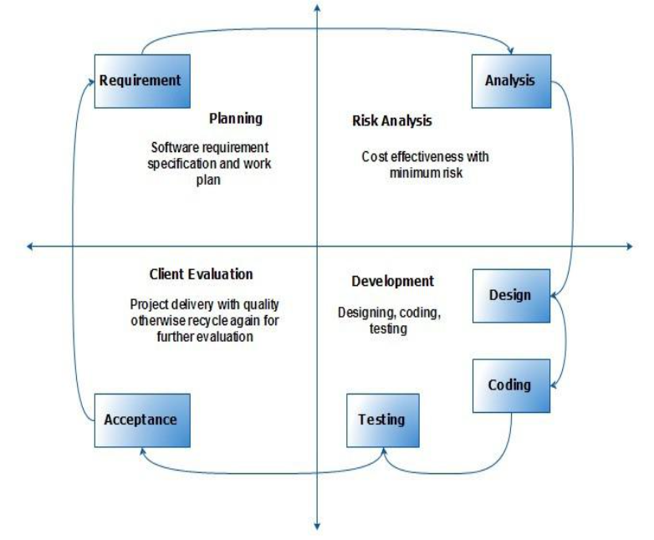
VU Process Model

Slide 6
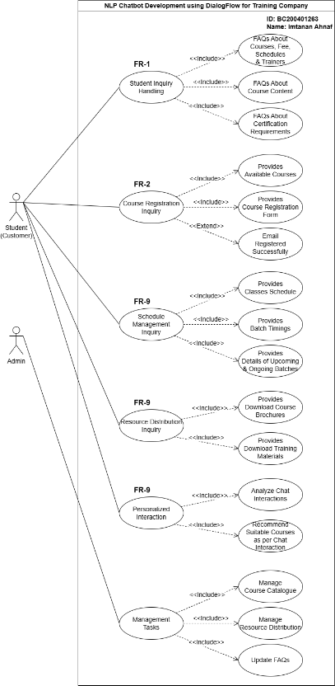
Use Case Diagram

Slide 7
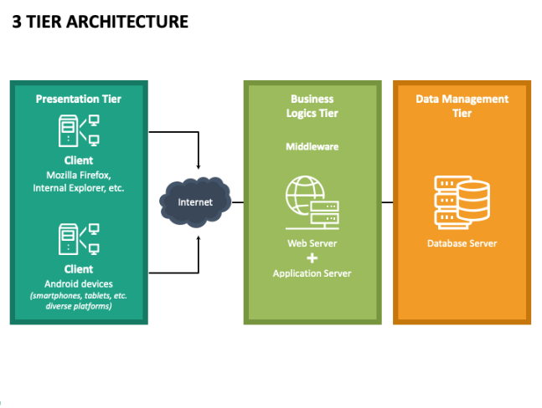
Architectural Design

Slide 8
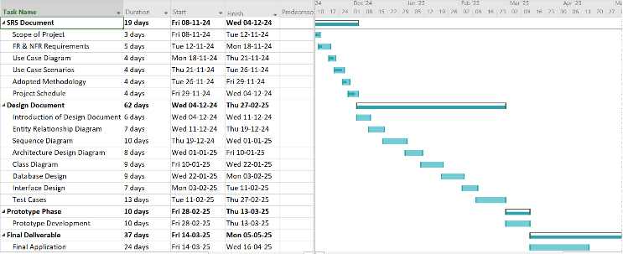
Project Schedule

Slide 9
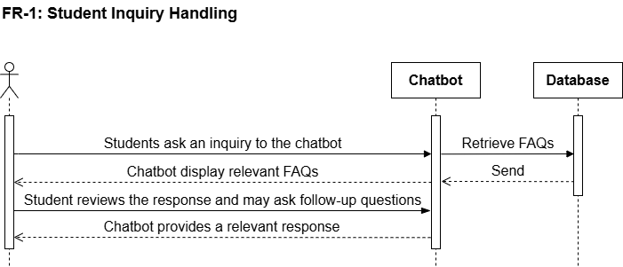
Sequence Diagrams

Slide 10
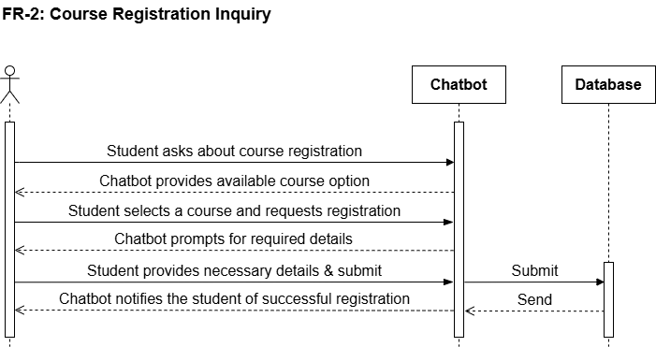
Sequence Diagrams

Slide 11
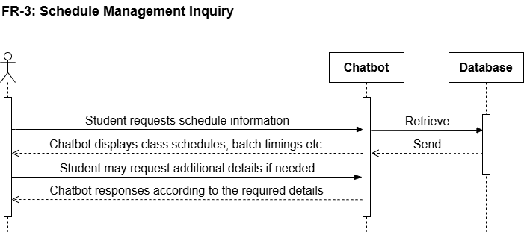
Sequence Diagrams

Slide 12
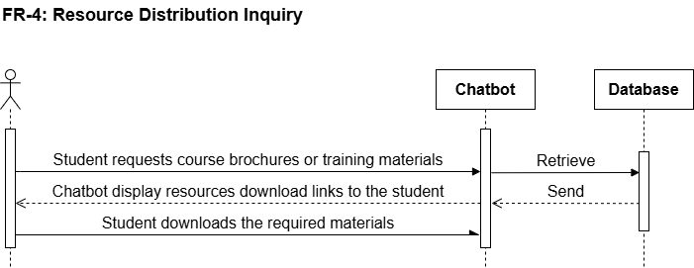
Sequence Diagrams

Slide 13
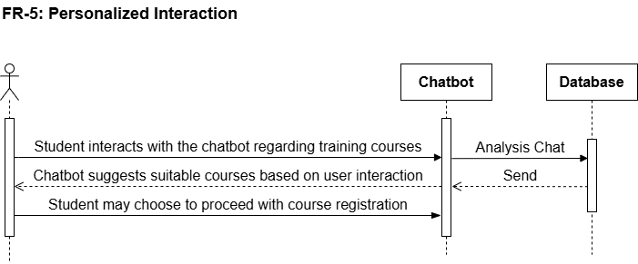
Sequence Diagrams

Slide 14
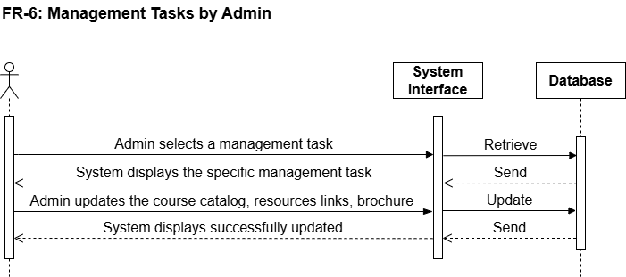
Sequence Diagrams

Slide 15
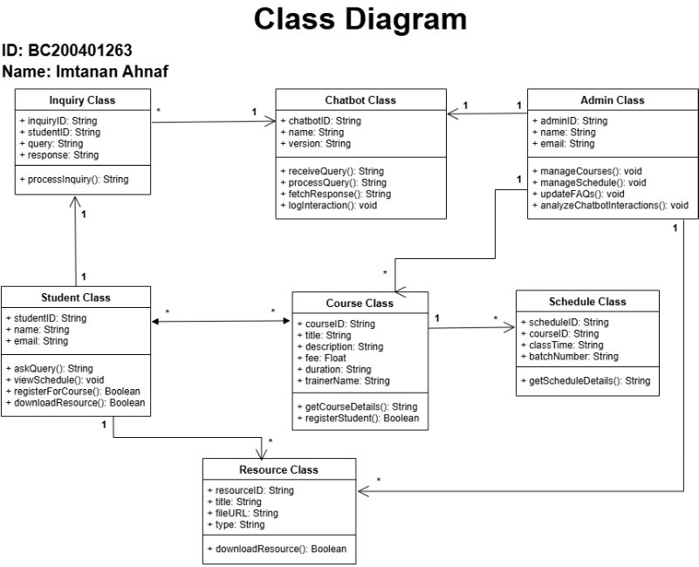
Logical Model/Class Diagram

Slide 16
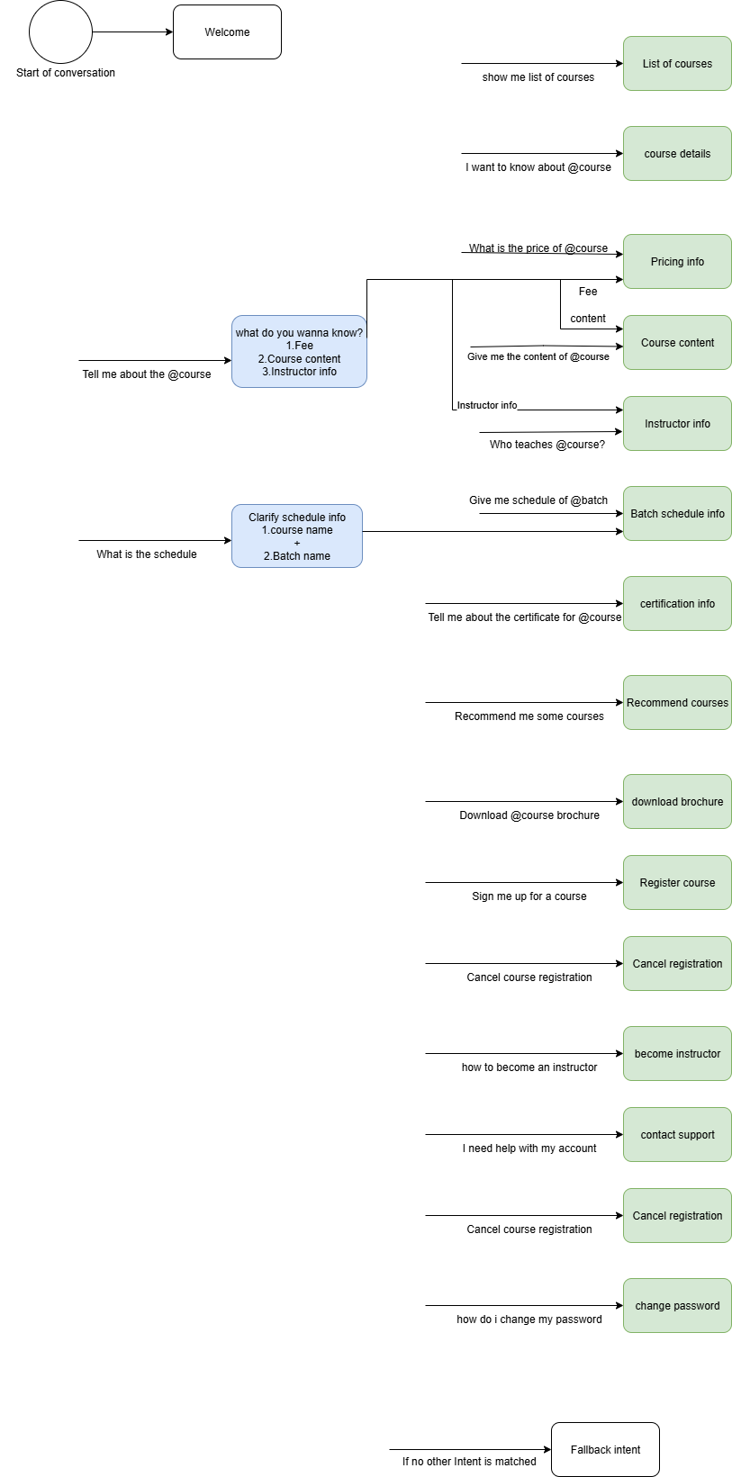
Intent-Entity Diagram

Slide 17
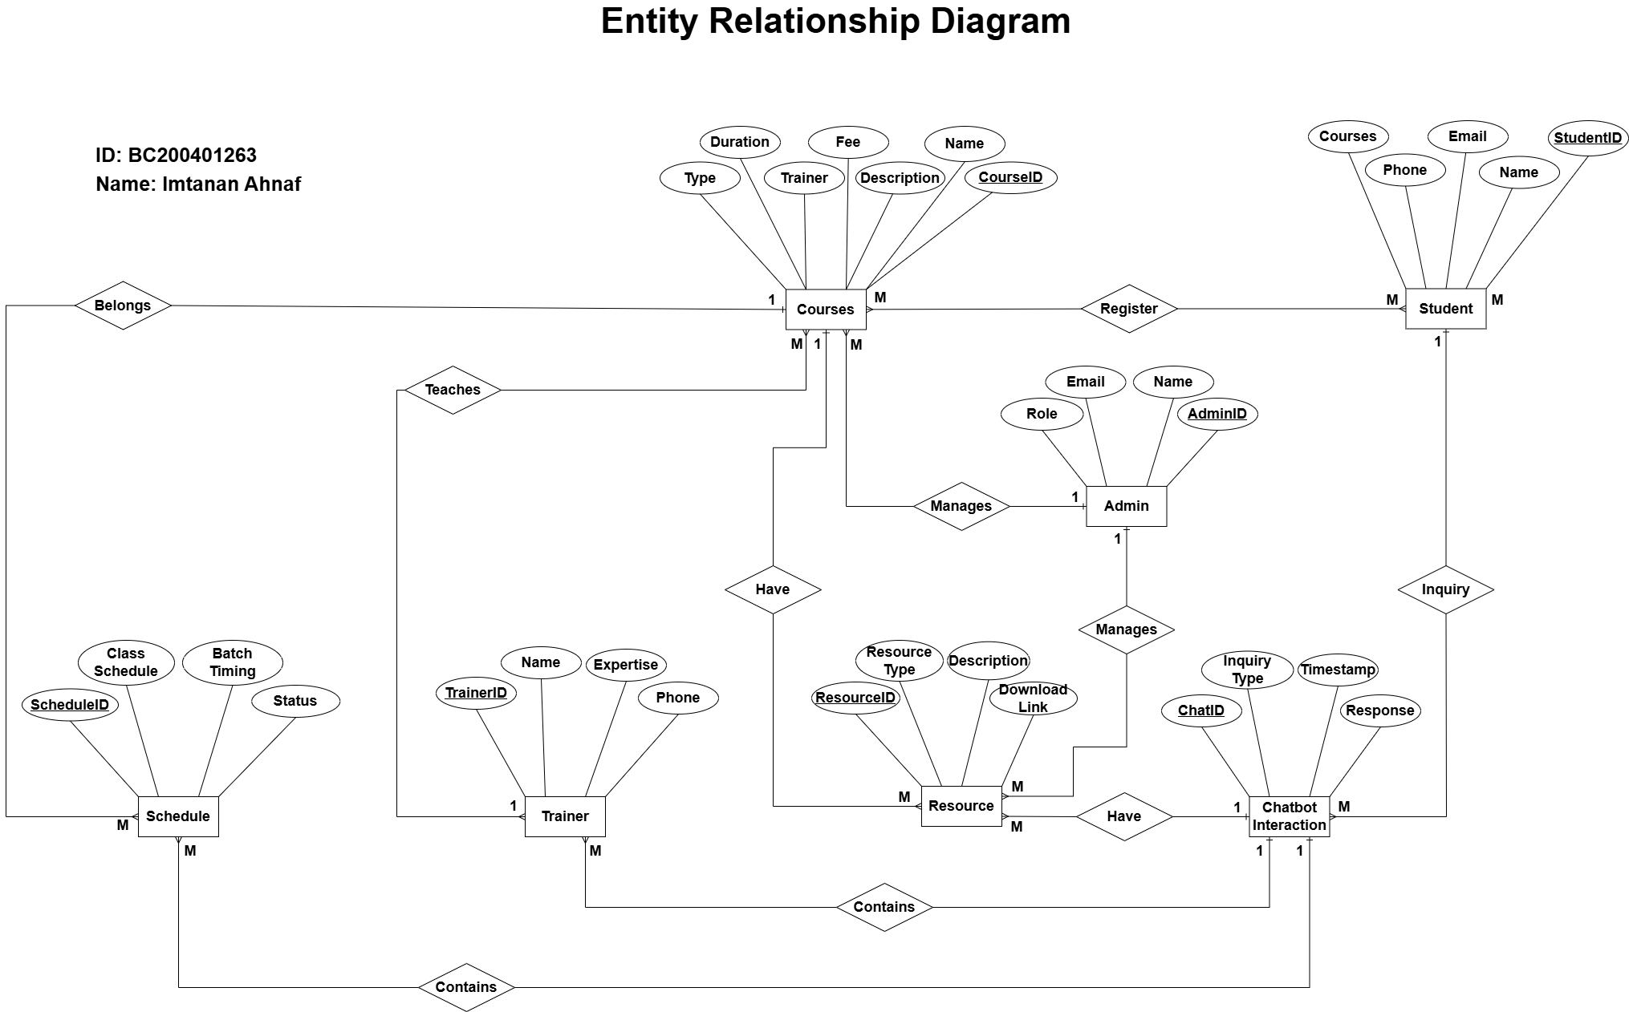
Entity-Relationship Diagram

Slide 18
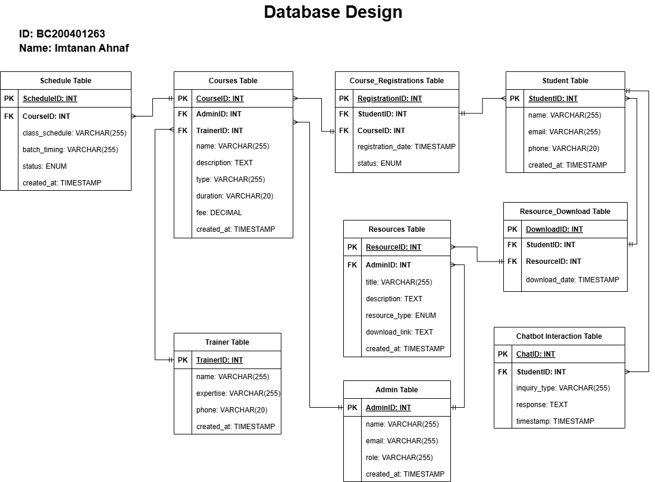
Database Diagram

Slide 19
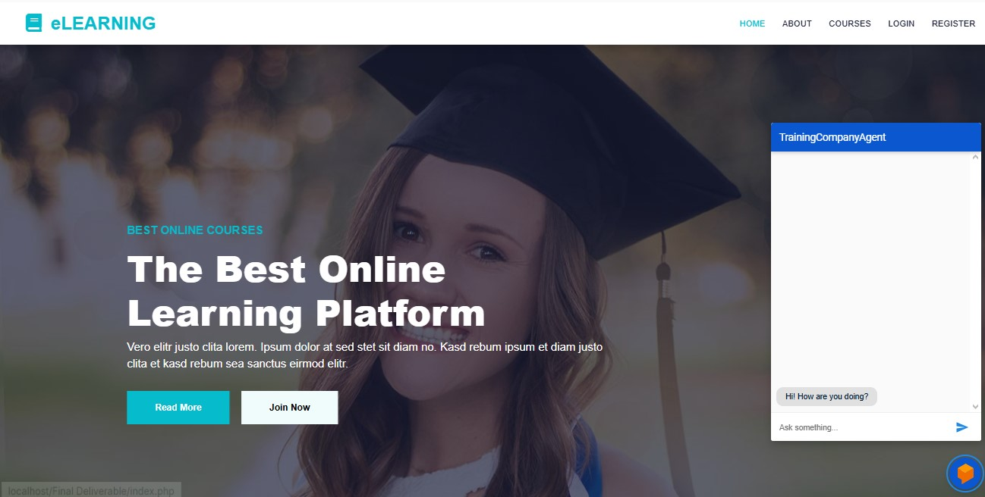
User Interfaces

Slide 20
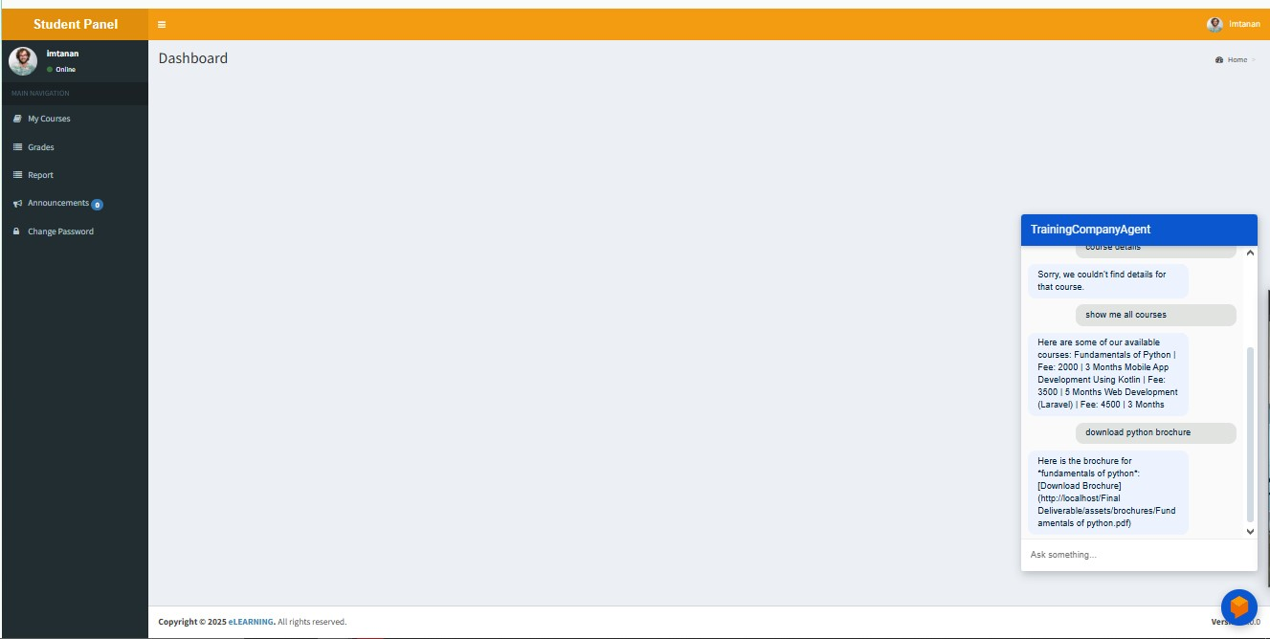
User Interfaces

Slide 21
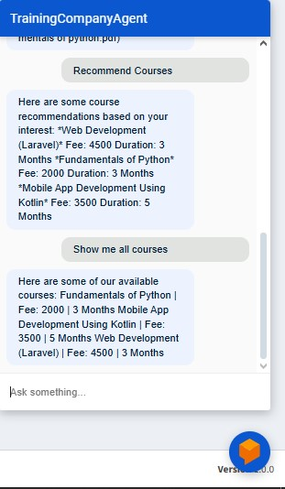
User
Interfaces

Slide 22
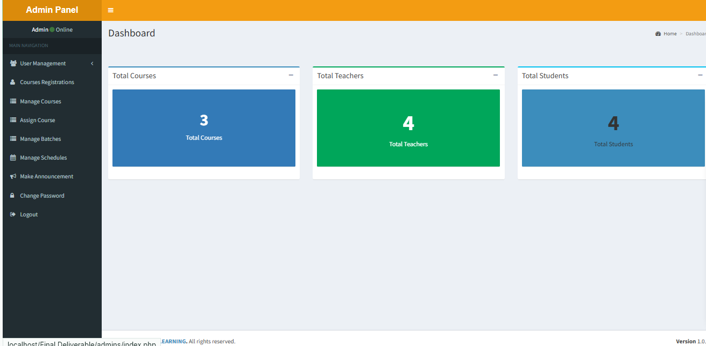
User Interfaces

Slide 23
Tools
Development & NLP Tools
Dialogflow – For designing and training the NLP chatbot
PHP – Backend scripting and server-side logic
HTML/CSS/JavaScript – Frontend development
MySQL – Database management
VS Code – Code editor/IDE
XAMPP – Local server environment for PHP and MySQL
Admin LTE templates
Dialogflow Testing Console – To simulate and test user interactions

