Slide 1

#LifeKoKaroLift
Android

Slide 2


Course : Android
Lecture On : Fragments & UIComponents
Instructor : Rohit Jain

Slide 3
In Last Class, we covered….
Intents
Navigation
Implicit Intent
Explicit Intent
Serializable

Slide 4
Today’s Agenda
Fragments
Custom Toast
Snackbars
List Type Views & Adapters

Slide 5
Fragments
Defining a Fragment
A fragment, like an activity, has an XML layout file and a Java class that represents the Fragment controller.
<?xml version="1.0" encoding="utf-8"?> <LinearLayout xmlns:android="http://schemas.android.com/apk/res/android" android:layout_width="match_parent" android:layout_height="match_parent" android:orientation="vertical" > <TextView android:id="@+id/textView1" android:layout_width="wrap_content" android:layout_height="wrap_content" android:text="TextView" /> <Button android:id="@+id/button1" android:layout_width="wrap_content" android:layout_height="wrap_content" android:text="Button" /> </LinearLayout>

Slide 6
Fragments
The Java controller for a fragment looks like:
import android.support.v4.app.Fragment; public class FooFragment extends Fragment { // The onCreateView method is called when Fragment should create its View object hierarchy, // either dynamically or via XML layout inflation. @Override public View onCreateView(LayoutInflater inflater, ViewGroup parent, Bundle savedInstanceState) { // Defines the xml file for the fragment return inflater.inflate(R.layout.fragment_foo, parent, false); } // This event is triggered soon after onCreateView(). // Any view setup should occur here. E.g., view lookups and attaching view listeners. @Override public void onViewCreated(View view, Bundle savedInstanceState) { // Setup any handles to view objects here // EditText etFoo = (EditText) view.findViewById(R.id.etFoo); } }

Slide 7
Adding a Fragment to Activity
There are two ways to add a fragment to an activity
dynamically using Java
statically using XML
<?xml version="1.0" encoding="utf-8"?> <LinearLayout xmlns:android="http://schemas.android.com/apk/res/android" android:layout_width="match_parent" android:layout_height="match_parent" android:orientation="vertical" > <fragment android:name="com.example.android.FooFragment" android:id="@+id/fooFragment" android:layout_width="match_parent" android:layout_height="match_parent" /> </LinearLayout>

Slide 8
Demo Fragments

Slide 9
Custom Toast
You can also create a Toast that uses a custom XML layout rather than just displaying plain text. First, simply define the XML view in res/layout in a file such as toast_layout.xml:
<LinearLayout xmlns:android="http://schemas.android.com/apk/res/android" android:id="@+id/toast_layout_root"> <ImageView android:src="@drawable/droid" android:layout_width="wrap_content" android:layout_height="wrap_content" android:layout_marginRight="8dp" /> <TextView android:id="@+id/text" android:layout_width="wrap_content" android:layout_height="wrap_content" android:textColor="#FFF" /> </LinearLayout>

Slide 10
Custom Toast
Notice that the ID of the LinearLayout element is "toast_layout_root". You must use this ID to inflate the layout from the XML:
private void displayToast(String message) { // Inflate toast XML layout View layout = getLayoutInflater().inflate(R.layout.toast_layout, (ViewGroup) findViewById(R.id.toast_layout_root)); // Fill in the message into the textview TextView text = (TextView) layout.findViewById(R.id.text); text.setText(message); // Construct the toast, set the view and display Toast toast = new Toast(getApplicationContext()); toast.setView(layout); toast.show(); }

Slide 11
SnackBar
Snackbars are shown on the bottom of the screen and contain text with an optional single action. They automatically fade out after enough time similar to a toast. Snackbars can be swiped away by the user or contain other actions making them more powerful than simple toasts.
Snackbar.make(parentView, R.string.snackbar_text, Snackbar.LENGTH_LONG) .setAction(R.string.snackbar_action, myOnClickListener) .show();
// Don’t forget to show!

Slide 12
SnackBar
Action Click Listener
The setAction method accepts a String resource id and a View.OnClickListener defined and used
// Define the click listener as a member View.OnClickListener myOnClickListener = new View.OnClickListener() { @Override public void onClick(View v) { // Do something here } }); // Pass in the click listener when displaying the Snackbar Snackbar.make(parentView, R.string.snackbar_text, Snackbar.LENGTH_LONG) .setAction(R.string.snackbar_action, myOnClickListener) .show(); // Don’t forget to show!

Slide 13
Demo SnackBar

Slide 14
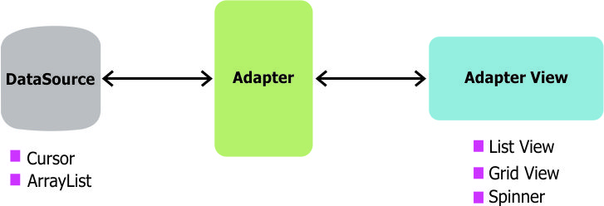
ListView & Adapter
In Android development, any time we want to show a vertical list of scrollable items we will use a ListView which has data populated using an Adapter. The simplest adapter to use is called an ArrayAdapter because the adapter converts an ArrayList of objects into View items loaded into the ListView container.

Slide 15
Types of Adapters
Base Adapter
Array Adapter
Simple Adapter
Cursor Adapter

Slide 16
Demo ListView

Slide 17
#LifeKoKaroLift
Thank You!

