Slide 1

#LifeKoKaroLift
Android

Slide 2


Course : Android
Lecture On : Data Storage I
Instructor : Rohit Jain

Slide 3
In the last class we covered…
Broadcast Receivers
Services

Slide 4
Today’s Agenda
Database Sql lite
Using a library for Data Storage

Slide 5
Persisting Data
The Android framework offers several options and strategies for persistence:
Shared Preferences - Easily save basic data as key-value pairs in a private persisted dictionary.
Local Files - Save arbitrary files to internal or external device storage.
SQLite Database - Persist data in tables within an application specific database.
ORM - Describe and persist model objects using a higher level query/update syntax.

Slide 6
Use Cases
Each storage option has typical associated use cases as follows:
Shared Preferences - Used for app preferences, keys and session information.
Local Files - Often used for blob data or data file caches (i.e disk image cache)
SQLite Database - Used for complex local data manipulation or for raw speed
ORM - Used to store simple relational data locally to reduce SQL boilerplate

Slide 7
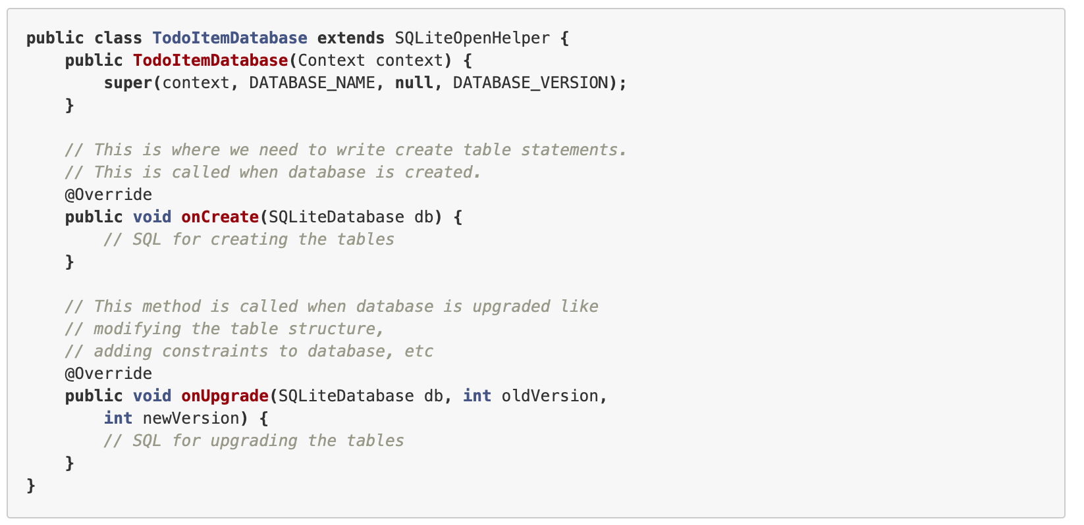
SQL Lite

Slide 8
Demo SQL Lite

Slide 9
#LifeKoKaroLift
Thank You!

