Slide 1

FINAL RESEARCH PRESENTATION
Dependable Radar Sensing & Trust-Aware
Fusion for UAV Swarms
Modeling, injecting, and measuring realistic sensing, tracking, and communication faults across 62 scenarios and 1,240 Monte-Carlo trials
RESEARCH TEAM
SUPERVISOR
LAB HEAD
Imtishal Haq
Abdullah Sarwar Mirza
Dr. Atif Aftab Jilani
Saad Bin Waqas
Dependability Research Lab
Notes:
1

Slide 2
THE PROBLEM
Real sensors and links fail — swarm logic rarely admits it
Imperfect perception
Unreliable links
Radars miss real targets (low P_D), invent phantom ones (false alarms), and add range/bearing noise — a UAV never sees ground truth, only a corrupted measurement of it.
Packet loss, limited range, latency, and staleness mean cross-UAV fusion cannot assume every peer's track arrives, arrives on time, or arrives uncorrupted.
Faulty confidence
Untested failure modes
A miscalibrated or overconfident sensor can poison naive fusion — the swarm may trust the wrong source precisely when it should trust it least.
Most swarm-coordination work assumes clean sensing; how safety and mission success degrade — and where they collapse outright — is rarely characterized systematically.
Radar-Fusion UAV Swarm Simulation
2
Notes:
2

Slide 3
RESEARCH GAP
What the literature leaves open
A structured review of ~43 papers across radar/sensor detection, fusion methods, and swarm coordination surfaced a recurring pattern:
Fault realism
Perception faults are usually a single flat noise term — not independently modeled P_D, P_FA/clutter, latency, and dropout with per-channel measurement covariance.
Fusion breadth
Papers typically compare one or two fusion schemes; few place naive, confidence-weighted, trust-weighted, covariance-weighted, and covariance-intersection fusion side by side under identical faults.
Trust dynamics
Static, self-reported confidence is common; adaptive trust that revises itself from cross-UAV disagreement over time is rarely benchmarked against it under an actively faulty sensor.
Reproducible failure envelopes
Few frameworks report exactly where a swarm crosses from safe → degraded → mission failure → safety failure as a function of a swept parameter, with seeds and provenance for replication.
Ground-truth discipline
It is rarely explicit or audited whether the perception/fusion pipeline is inadvertently reading ground truth to make a decision it wouldn't have in the real world.
Radar-Fusion UAV Swarm Simulation
3
Notes:
3

Slide 4
OBJECTIVE
Four questions this simulation answers
Q1
How much do detection errors, measurement noise, latency, dropout, and confidence miscalibration each degrade swarm safety and mission metrics relative to a clean baseline?
Q2
Does cross-UAV track fusion — naive, confidence-, trust-, covariance-weighted, or covariance-intersection — improve those metrics, and which mode is most robust when a sensor is actively faulty or overconfident?
Q3
Does dynamic, cross-step trust adaptation outperform static trust derived only from a sensor's own self-reported confidence?
Q4
How does the communication link itself — packet loss, range limits, latency, corruption, outage — affect a distributed fusion architecture versus a centralized one?
Constraint: nothing in the sensing → tracking → fusion → trust pipeline is allowed to read ground truth to make a decision — only what a real UAV would actually have on hand. Checked by an independent leakage audit — partial pass, open corrective actions remain (see Limitations).
Radar-Fusion UAV Swarm Simulation
4
Notes:
4

Slide 5
SYSTEM ARCHITECTURE
A layered, non-invasive pipeline
simple_swarm_sim.py
Core 4-UAV kinematic simulation — motion, obstacle/target avoidance, goal-seeking, formation keeping.
▼
radar_like_model.py
Monkey-patches Perception + Simulation to layer P_D / P_FA / clutter / noise / latency / dropout on top — zero edits to the core file.
▼
radar_track_model.py
Per-UAV constant-velocity Kalman filter + Mahalanobis-gated nearest-neighbor tracking (tentative → confirmed → coasting → lost).
▼
fusion_model.py
Cross-UAV track-to-track association + 6 fusion modes, centralized or distributed, with optional dynamic trust.
▼
communication_model.py
CommunicationChannel: packet loss, range gating, latency, staleness rejection, confidence corruption — used by the distributed path.
Supporting infrastructure: metrics_analysis.py (canonical metric definitions) · build_experiment_matrix.py · run_final_simulations.py · generate_final_result_package.py · per-stage *_validation.py correctness suites.
Radar-Fusion UAV Swarm Simulation
5
Notes:
5

Slide 6
PERCEPTION LAYER
Radar model: five independent fault mechanisms
Probability of detection
BASELINE RADAR PARAMETERS
Independent Bernoulli gate per real detection — a low P_D genuinely removes it from what the UAV acts on.
Max range
15 units
False alarms / clutter
Field of view
360°
Poisson-distributed clutter candidates per step, positioned in their own range annulus, injected into the same stream the UAV steers on.
Update rate
5 Hz
P_D
1.0
Measurement uncertainty
P_FA
0.0
Every measurement carries an explicit per-channel variance and a 3×3 covariance — not one flat noise std applied uniformly.
Range-noise σ
0.3 m
Radial-vel. noise σ
0.1 units/s
Latency & dropout
Configurable per-radar delay in steps plus Bernoulli/duration-based blackout windows.
Latency / dropout
0 (clean reference)
Every degraded scenario is a delta from this clean-sensor reference.
Radar-Fusion UAV Swarm Simulation
6
Notes:
6

Slide 7
PERCEPTION LAYER
Tracking: gated Kalman filtering per radar
1. Predict
2. Gate & associate
3. Update
4. Age / delete
5. Spawn
Every existing track predicts forward under a constant-velocity motion model (Kalman predict).
Matched to this step's detections by nearest neighbor, gated on Mahalanobis distance using the track's own innovation covariance — the gate tightens or loosens with current uncertainty.
Matched tracks run a Kalman update, reset missed_count, and raise existence_probability.
Unmatched tracks decay: missed_count increments, existence_probability falls; enough consecutive misses moves a track lost → deleted.
Unmatched detections spawn tentative tracks, confirmed after CONFIRM_HITS consecutive matches.
Each track carries: filtered position/velocity, full 4×4 state covariance, confidence from the most recent matched detection, age, hit/missed counts, existence probability, and status.
Validated independently: 40/40 deterministic tracker-logic checks pass — including exact filter convergence to true position on a clean constant-velocity target.
Radar-Fusion UAV Swarm Simulation
7
Notes:
7

Slide 8
FUSION LAYER
Six fusion modes, one reliability model
no_fusion
Each UAV's own track stands alone (control).
naive_fusion
Unweighted average across UAVs agreeing on the same object.
confidence_weighted_fusion
Weight = track's own reported confidence.
trust_weighted_fusion
Weight = confidence × status reliability × composite reliability (age, latency, dropout, optional dynamic trust).
covariance_weighted_fusion
Information-filter (inverse-covariance) fusion; optimal only under independent source errors.
covariance_intersection_fusion
Covariance Intersection — consistent even when source errors are correlated in an unknown way.
Fusion never reads ground truth — every weight comes from a track's own confidence, status, covariance, staleness, and static config-known sensor characteristics.
Radar-Fusion UAV Swarm Simulation
8
Notes:
8

Slide 9
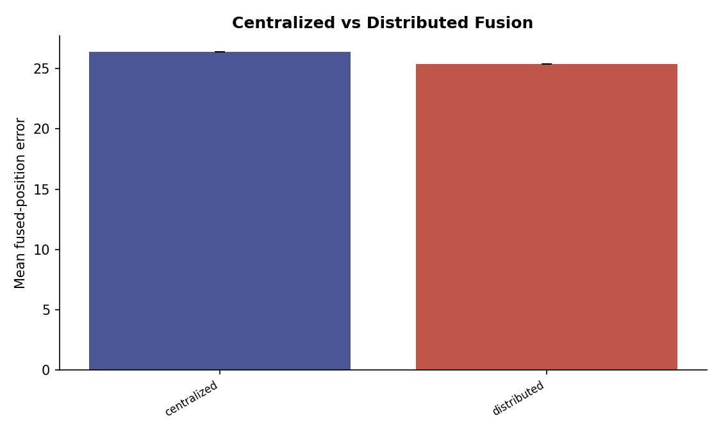
FUSION ARCHITECTURE
Centralized vs. distributed fusion
Centralized
Distributed
Every UAV's track goes to one central node, which clusters + fuses once and broadcasts a single shared result — at the cost of an uplink-then-downlink round trip before anything is usable.
No central node; each UAV broadcasts a lightweight summary to peers and fuses locally over its own track plus whatever peer summaries arrived that step. Delivery isn't uniform, so UAVs can hold slightly different local estimates.
DEPENDABILITY FINDING (40% PACKET LOSS)
0.267 m
distributed mean fused-position error (n=10)
0.271 m
centralized mean fused-position error (n=10)
Distributed fusion held up marginally better under heavy packet loss for this metric — a small, single-scenario result, not a general claim.
Radar-Fusion UAV Swarm Simulation
9
Notes:
9

Slide 10
LINK MODEL
Communication uncertainty: CommunicationChannel
packet_loss_probability
Per-message chance of outright loss.
comm_range
Maximum distance a message can travel; out-of-range pairs simply can't hear each other.
base_latency_steps
Fixed delay added on top of the sender's own sensor latency.
max_staleness_steps
A message older than this (by measurement age) is rejected outright, regardless of delivery.
corruption_probability
Per-message chance the confidence/reliability value arrives scaled by a random factor — modeling bit errors, not loss.
Verified Communication Degradation
Six dedicated scenarios were built to sweep the channel model — perfect communication, low/high packet loss, short range, delayed sharing, full outage. The data correctly demonstrates the impact of these variables, such as fused sources dropping significantly under high packet loss.
Radar-Fusion UAV Swarm Simulation
10
Notes:
10

Slide 11
TRUST LAYER
Dynamic trust vs. static, self-reported trust
TrustTracker adds a slow-moving persistent_trust score per UAV that accumulates across steps — decaying on repeated disagreement, dropout, or staleness; recovering (more slowly) as the source re-agrees with its cluster.
Fusion mode (faulty sensor present)
Mission success
Collisions (mean)
Position RMSE (m)
naive_fusion
0.90
0.30
1.83
confidence_weighted
0.90
0.65
1.81
trust_weighted (fixed)
0.80
0.80
1.81
trust_weighted (dynamic)
0.80
1.20
1.80
covariance_weighted
0.80
0.95
1.83
None of these pairwise differences reached significance at N=20 (Welch's t-test, all p > 0.11). Dynamic trust did not outperform fixed trust here — its collision mean was numerically higher, and a separate dependability comparison found fixed trust marginally lower fused-position error (1.947 m vs 1.952 m) on the same overconfident-sensor scenario.
Radar-Fusion UAV Swarm Simulation
11
Notes:
11

Slide 12
METHODOLOGY
62 scenarios × 20 trials = 1,240 Monte-Carlo runs
62
20
1,240
18/18
scenarios
trials / scenario
total runs
QA checks passed
World & swarm
100×100 world · 4 UAVs clustered at (5,5)–(15,15) · rally target (90,90) · static obstacle at (50,50), r=5 · speed 2.0 · formation spacing 8.0 · safety distance 2.0
Time base
dt = 0.2 s · max 600 steps (120 s simulated) · fusion update 5 Hz · master seed 42 with per-trial derived seeds for full reproducibility
Two-tier trial plan
Every scenario: ≥20 trials by design. A 50-trial bump was planned for fusion-comparison scenarios via a timed warm-up check, but the budget check fell back to 20 for every scenario in this run — the final package is a uniform 20 trials/scenario, not a mix
Every trial records: per-trial seed, exact hashed config, full step-level raw log, PASS/FAIL execution status (kept separate from mission_success), and wall-clock runtime.
Radar-Fusion UAV Swarm Simulation
12
Notes:
12

Slide 13
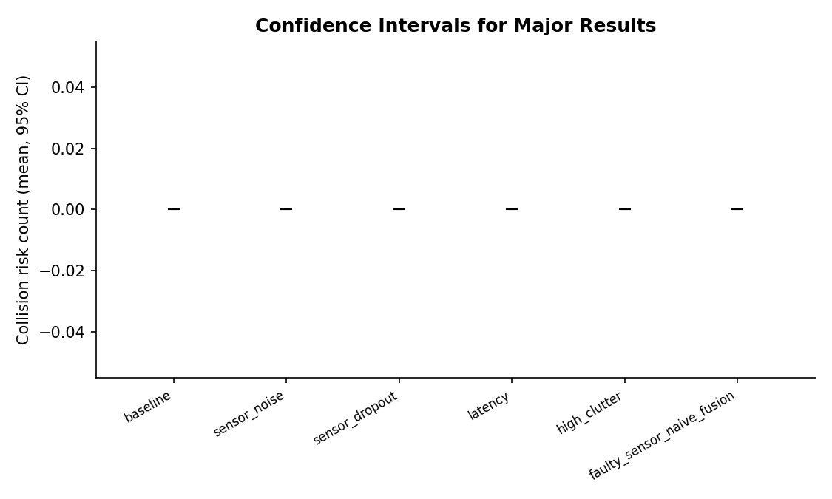
RESULTS
Main quantitative results
SELECTED SIGNIFICANT FINDINGS (p < 0.05, Welch's t)
false_positive: worst single-factor perception scenario for position RMSE (Δ = +0.014 m vs baseline, p = 0.0006); sensor_noise is second (Δ = +0.010 m, p = 0.0011)
very_low_P_D (P_D=0.1): mission success collapses to 0%, +47.95 mean collisions (p < 0.001)
high_latency (20 steps): +55.85 mean collisions, response time +8.0 s (p < 0.001)
simultaneous_sensor_failures: +154.45 mean collisions, response time +25.0 s (p < 0.001)
Fusion-mode differences (naive vs. trust-weighted vs. no-fusion) on collision risk / mission success: not significant at N=20
In an earlier, separate single-factor sweep (not this 62-scenario package), noise_level correlated most strongly with collision risk (r ≈ 0.954); the final package's sensor_noise scenario shows no measurable collision effect (p = 1.0)
Radar-Fusion UAV Swarm Simulation
13
Notes:
13

Slide 14
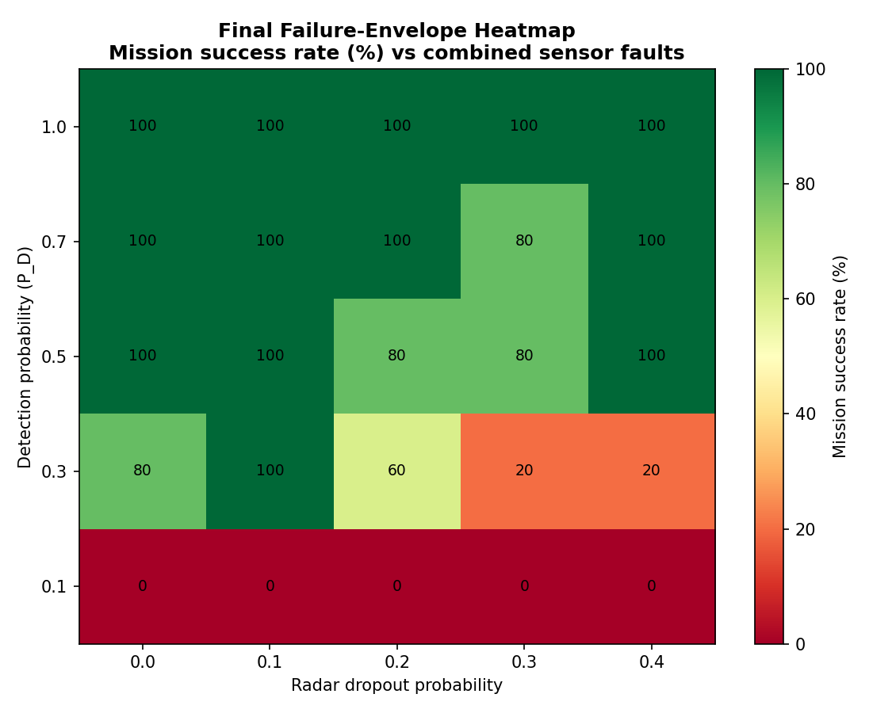
STRESS TESTS
Where the swarm actually breaks
0%
0%
0%
0%
very_low_P_D
high_dropout
simultaneous_failures
N ≥ 5 UAVs (600-step budget)
MSR · 47.95 collisions
MSR · 118.2 collisions
MSR · 154.45 collisions
MSR · overhead-bound, not collisions
FAILURE ENVELOPE — WHAT FLIPS THE SWARM UNSAFE
P_D ≤ 0.1 → safety failure (0.3 still degraded-but-functional, not failed)
Calibration error ≥ 0.2 → mission failure (no safety failure observed up to 0.5)
Covariance magnitude ≥ 3.0 → safety failure (2.0 still degraded-but-functional)
Sensor disagreement = 4.0 → mission failure (not a safety failure)
Combined faults: latency + rapidly-moving obstacle was the only paired-fault SAFETY FAILURE (19 collisions/run); low-P_D+clutter, ghost-returns+crossing, and corrupted-confidence+delay each hit MISSION FAILURE without collisions.
Radar-Fusion UAV Swarm Simulation
14
Notes:
14

Slide 15
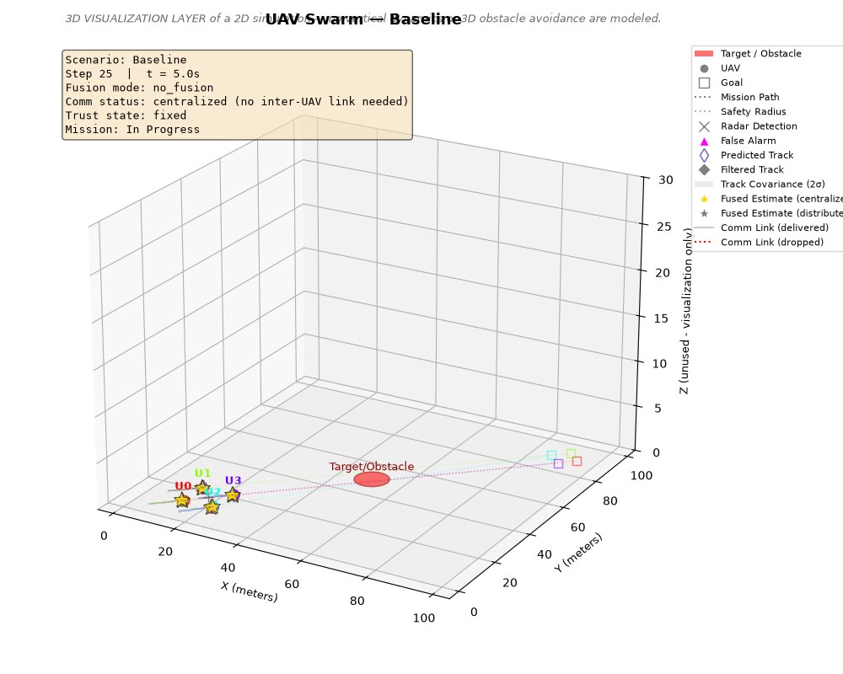
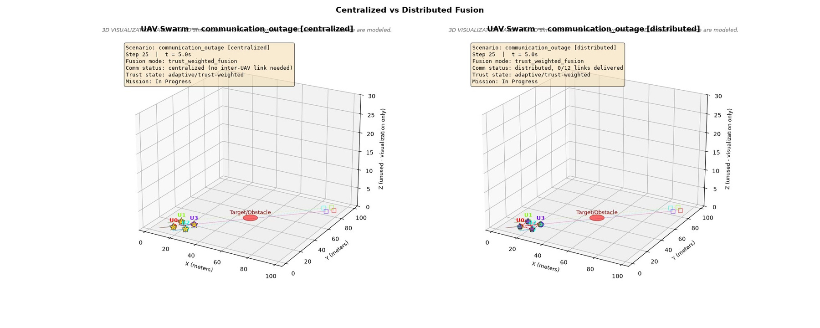
DEMONSTRATION
3D mission playback
Baseline mission trajectory
Centralized vs. distributed fusion (3D)
Frames captured from simulation_visualizer.py's rendered flight replays. Full animated .mp4 demonstrations (baseline, fixed-vs-dynamic trust, faulty-sensor, communication-outage, and 13 more) accompany the project repository.
Radar-Fusion UAV Swarm Simulation
15
Notes:
15

Slide 16
CONTRIBUTIONS
What this project built
1
A non-invasive radar fault-injection layer (P_D, P_FA/clutter, per-channel noise, latency, dropout) wrapped around the core swarm simulation with zero source edits
2
A Mahalanobis-gated Kalman tracker with full track lifecycle management (tentative → confirmed → coasting → lost → deleted)
3
Six cross-UAV fusion modes under both centralized and distributed architectures, sharing one composite reliability model
4
A dynamic, cross-step TrustTracker that adapts trust from observed disagreement rather than a sensor's own self-report
5
A communication channel model (packet loss, range, latency, staleness, corruption) for realistic distributed fusion
6
A 12-parameter failure-envelope sweep and 8 paired combined-fault scenarios classifying SAFE → DEGRADED → MISSION FAILURE → SAFETY FAILURE
7
A reproducible 62-scenario × 1,240-run Monte-Carlo package with full seed/config provenance and an automated 18/18 sanity check
Independent correctness verification: 393/393 deterministic checks pass across radar (99), tracker (40), fusion (29), calibration (24), communication (28), dynamic trust (13), metrics (32), handoff (57), and quality-monitor (71) validation suites.
Radar-Fusion UAV Swarm Simulation
16
Notes:
16

Slide 17
LIMITATIONS
Where this result package still falls short
Non-significant fusion comparisons
At N = 20 trials, no pairwise fusion-mode comparison (naive vs. trust-weighted vs. covariance-weighted, fixed vs. dynamic trust) reached statistical significance — differences are numerically present but not yet distinguishable from noise.
Dynamic trust did not clearly win
Dynamic trust's collision mean under a faulty sensor was numerically higher than fixed trust, and a separate dependability comparison favored fixed trust — the adaptive mechanism needs more targeted scenarios or trials to show a clear benefit.
Scalability ceiling
Mission success falls to 0% for swarms of 5+ UAVs within the 600-step budget — driven by formation/avoidance overhead, not collisions, so this reflects a time-budget limit more than a safety failure.
Vision/LiDAR stacks incomplete
Comparison sensor models exist in the codebase for future multi-sensor work but are not part of this radar-centric final result package, and their own leakage audits are rated mixed/neutral (not a clean pass), with open corrective actions (e.g. detecting obstacles at runtime rather than from known positions).
Radar-Fusion UAV Swarm Simulation
17
Notes:
17

Slide 18
CONCLUSION
A reproducible dependability lens on swarm fusion
Across 1,240 Monte-Carlo trials over 62 scenarios, the swarm's collision-avoidance and mission success stayed robust to individual perception faults, but collapsed sharply — 0% mission success — once detection probability, latency, or dropout crossed identifiable thresholds, or when multiple faults combined.
No fusion mode dominated — at conventional trial counts — naive fusion was numerically strongest, but not significantly better than trust- or covariance-weighted fusion.
Dynamic trust is promising, not yet proven — it did not clearly beat static, self-reported trust in this data — a direction for more targeted experiments.
Failure is threshold-shaped — safety failure appears at specific, now-documented parameter thresholds (P_D ≤ 0.1, covariance ≥ 3.0); calibration-error and sensor-disagreement faults drive mission failure rather than outright safety failure — not a smooth degradation.
The pipeline itself is verified — 393/393 independent correctness checks pass; the ground-truth-leakage audit found a mixed result — open corrective actions on goal-position and vision/LiDAR ground-truth use, and no completed audit yet for the fusion-weighting/trust-update code path.
Radar-Fusion UAV Swarm Simulation
18
Notes:
18

