Slide 1
World Cup Performance Visualization and Analysis
Steven Zulim & Aaron Burke
(with support from Tara Fathinejad)

Slide 2

The World Cup is here!
Let’s look at historical performance records
Which teams have been best?
What teams over/underperform
Map and graph results
World Cup Performance Analysis
Steven Zulim and Aaron Burke

Slide 3
Full-Stack Web App:
SQLite
Flask
GeoJson
Leaflet
d3
Bootstrap
Interactive Choropleth map
D3 scatterplot
Select Year
World Cup Performance Analysis
Steven Zulim and Aaron Burke

Slide 4
Steven content - databse

Slide 5
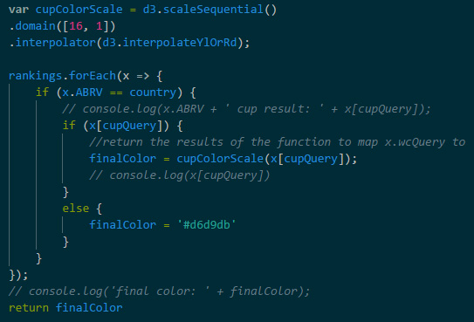
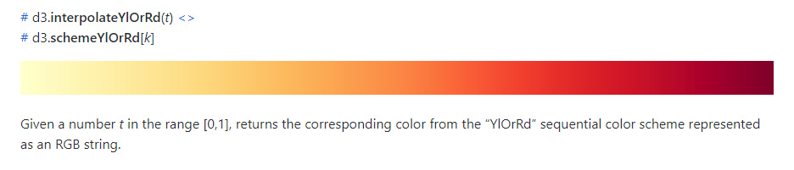
Map Design
Challenges:
Make only 1 layer active
Make borders always show and be top layer
Connect GeoJson data to database data
Flexible color scale
d3-scale-chromatic
World Cup Performance Analysis
Steven Zulim and Aaron Burke

Slide 6
Steven content - scatterplot

