Slide 1


Slide 2
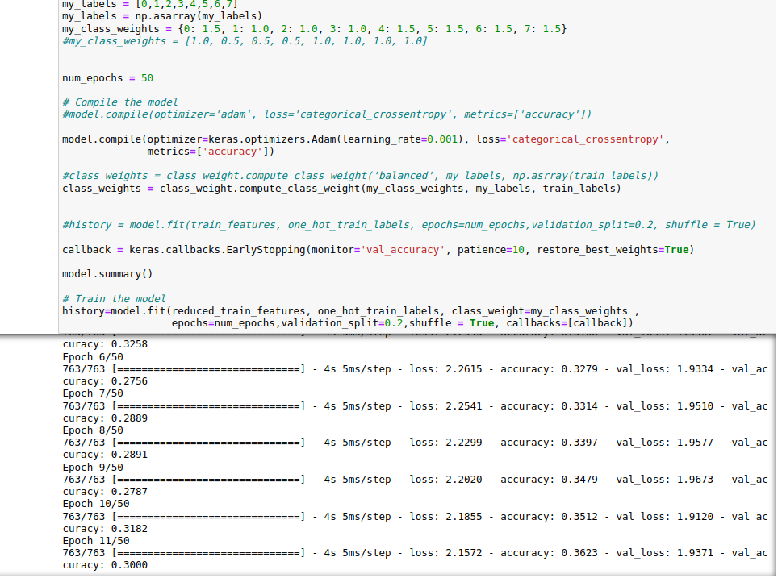
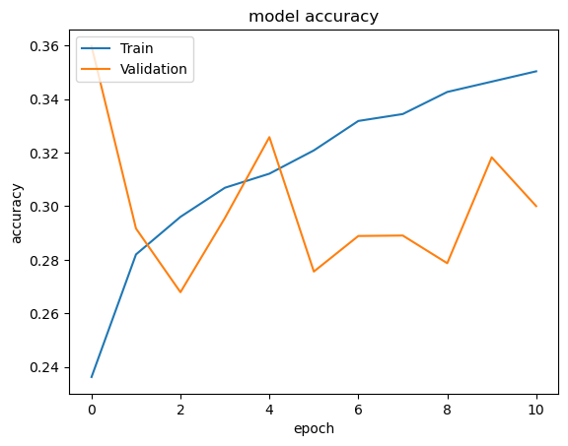
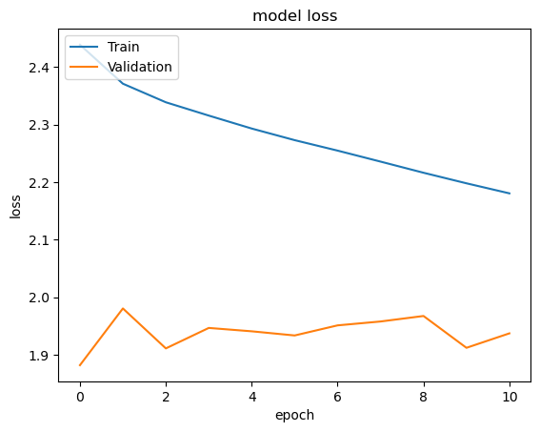

Slide 3

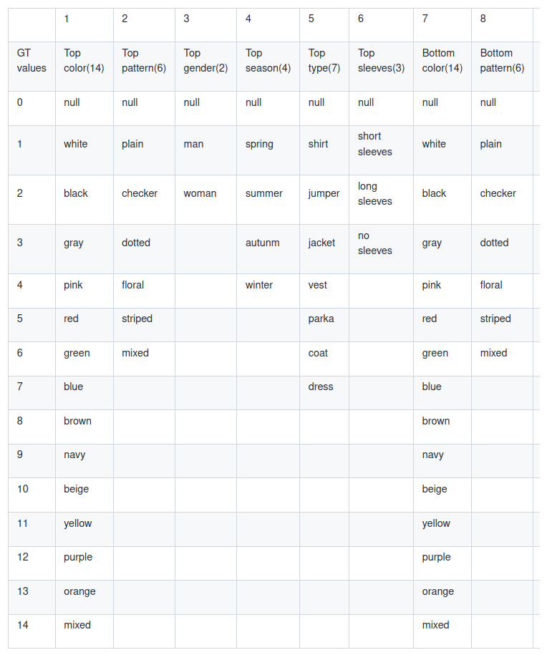
AIR-Clothing-MA(Multi Attributes)

Slide 4
SentenceTransformers is a Python framework for state-of-the-art sentence, text and image embeddings

