Slide 1
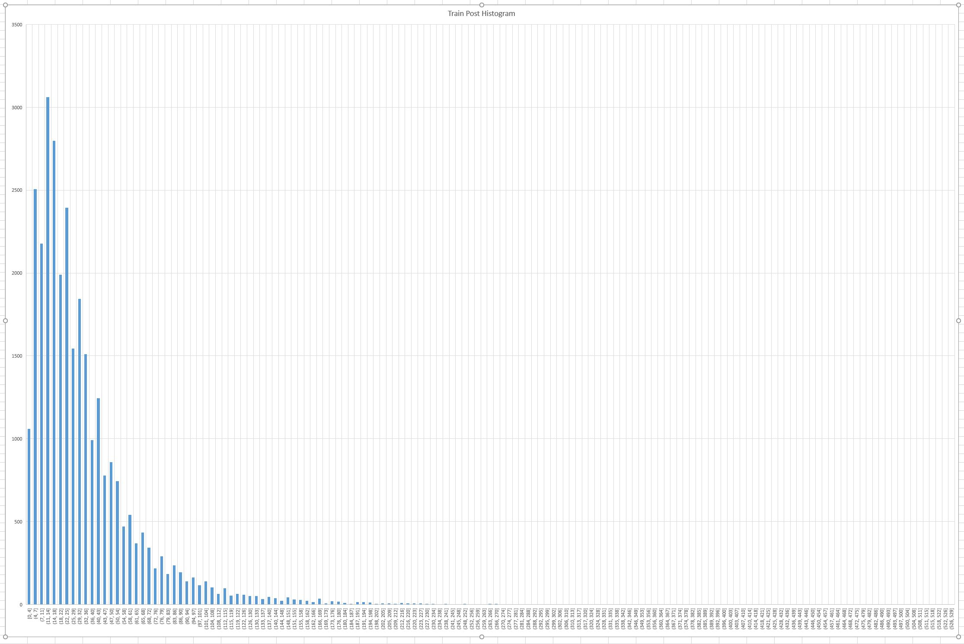

Slide 2
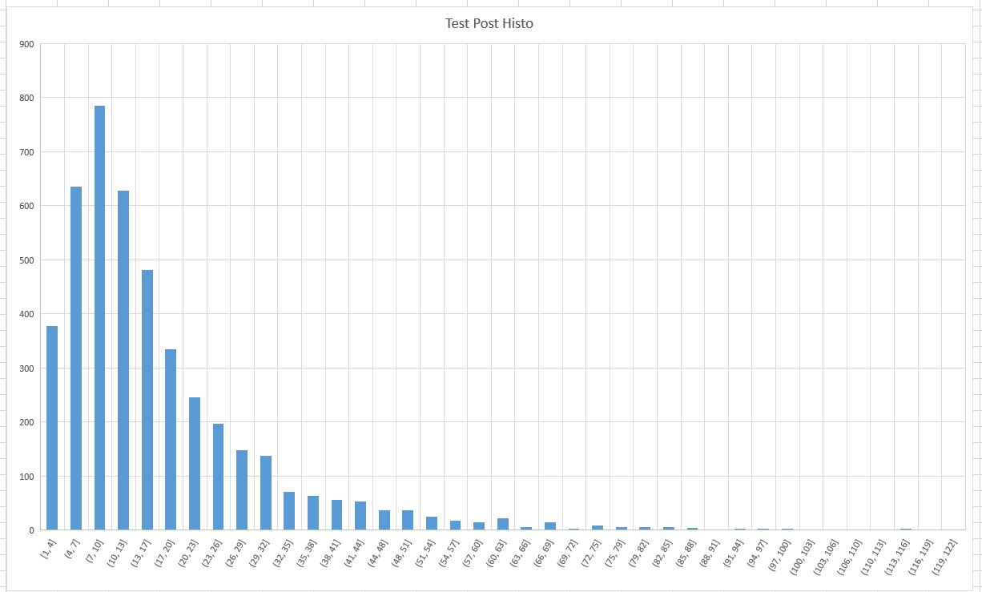

Slide 3
bins = [0,4,18,25,29,43,50,65,600]
labels = [0,1,2,3,4,5,6,7]
from sentence_transformers import SentenceTransformer
import numpy as np
model = SentenceTransformer('all-MiniLM-L6-v2')

Slide 4
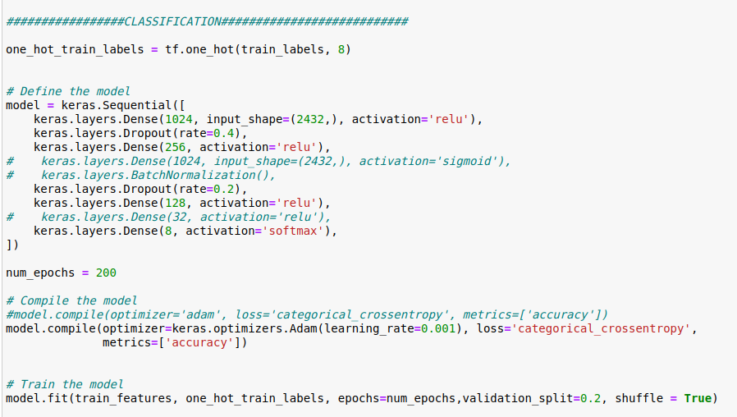

Slide 5
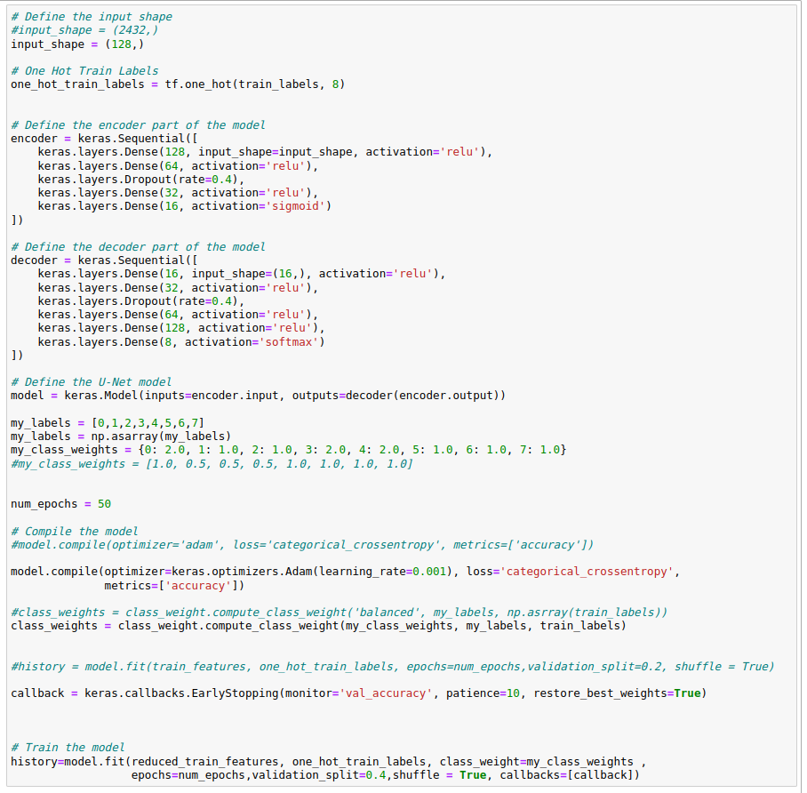
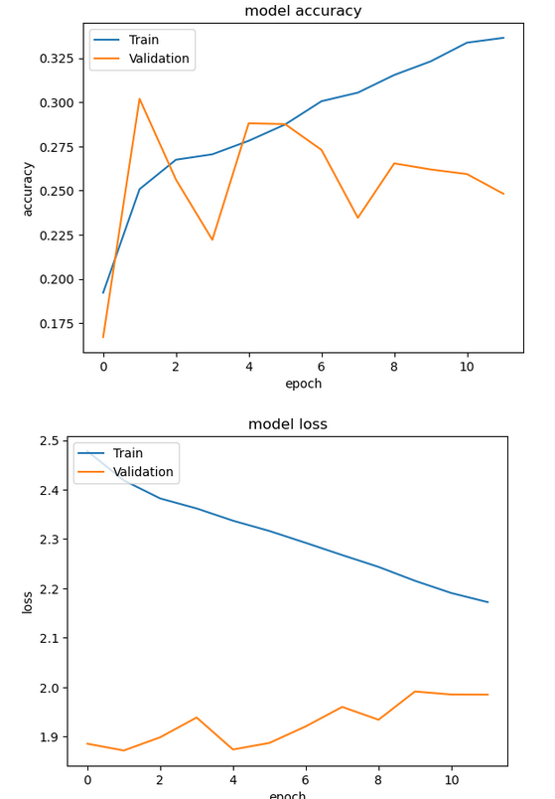
UNet

Slide 6
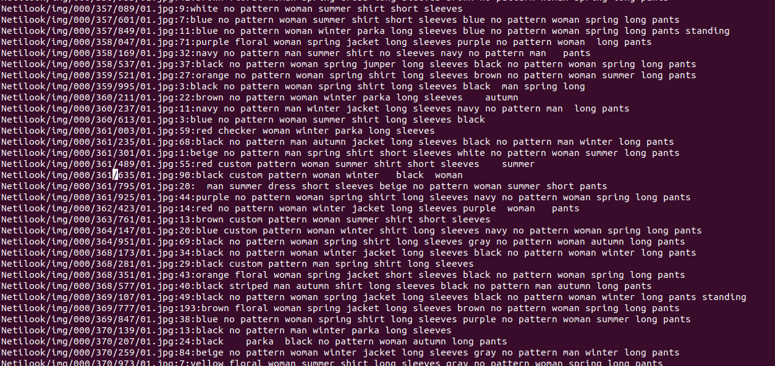

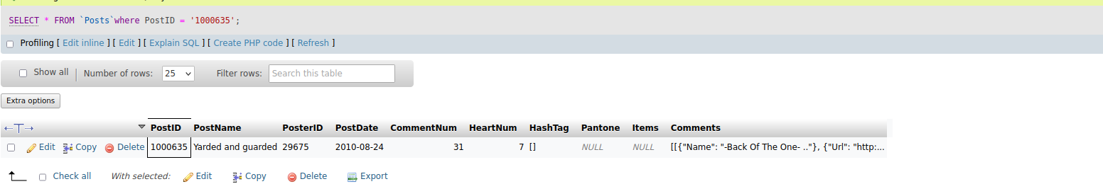
Air Clothing
brown no pattern woman summer dress short sleeves woman
Netilook/img/001/000/635/01.jpg
>=1

Slide 7
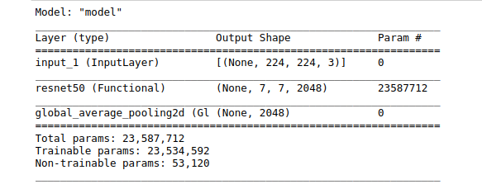
Image Features
Netilook/img/001/000/635/01.jpg
Test&Train Features
Sentence Transformer
Embeddings

Slide 8

0
1
2
3
4
5
6
7

Slide 10
Data Sanitazing
From Texts:
Remove man/woman
Remove double spaces
Remove tabs
TOTAL:
30491 Train
4464 Test
Input Features: 2432
Labels: 8

Slide 11
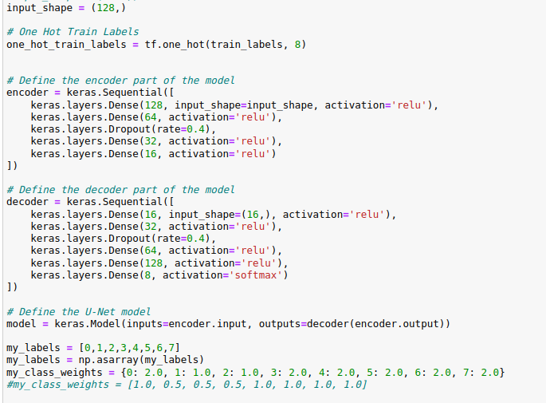
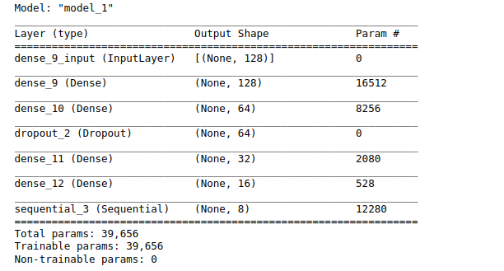
THE MODEL
Features reduced with PCA
For
Overfitting
U-Net
Modified Weights

Slide 12
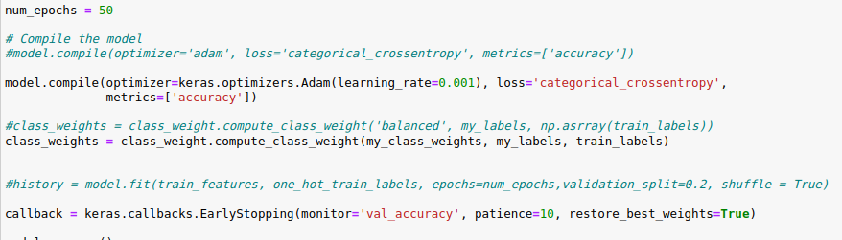
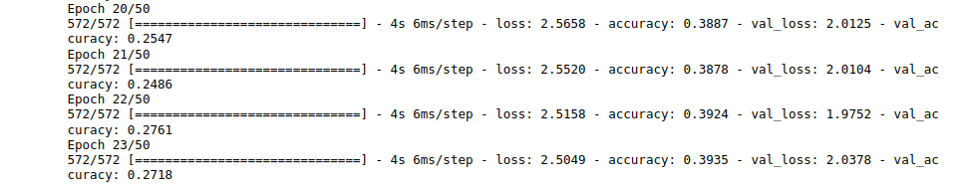
Adam Optimizer
Early Stop

Slide 13
