Slide 1
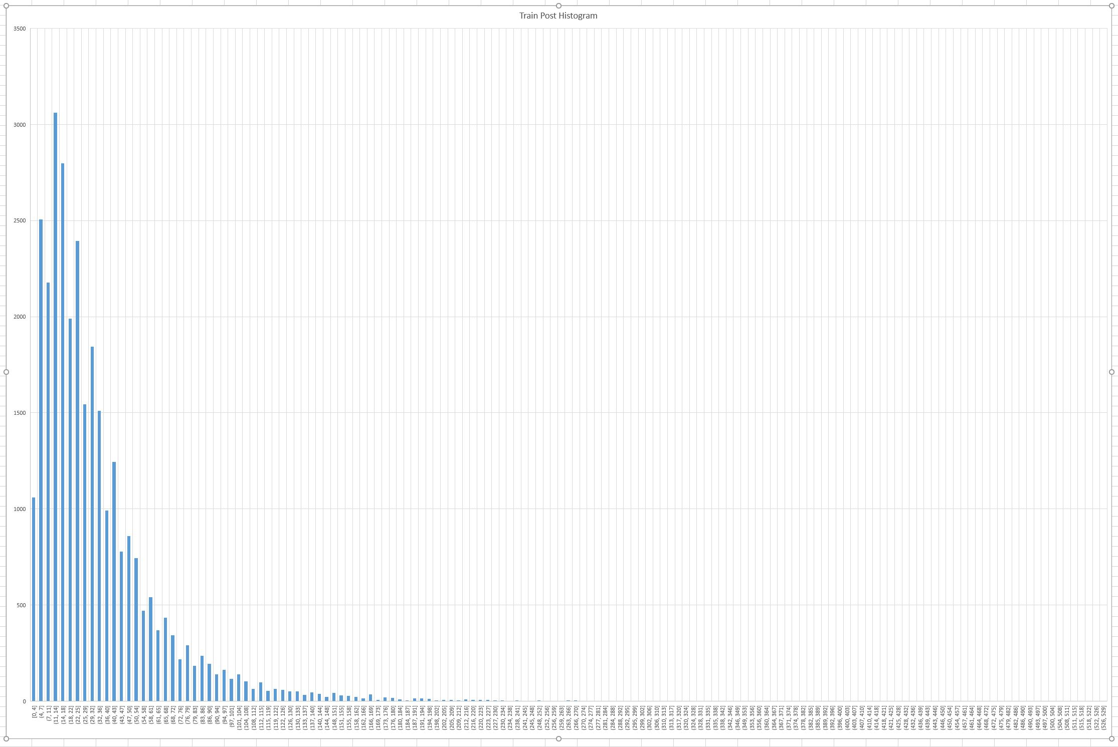

Slide 2
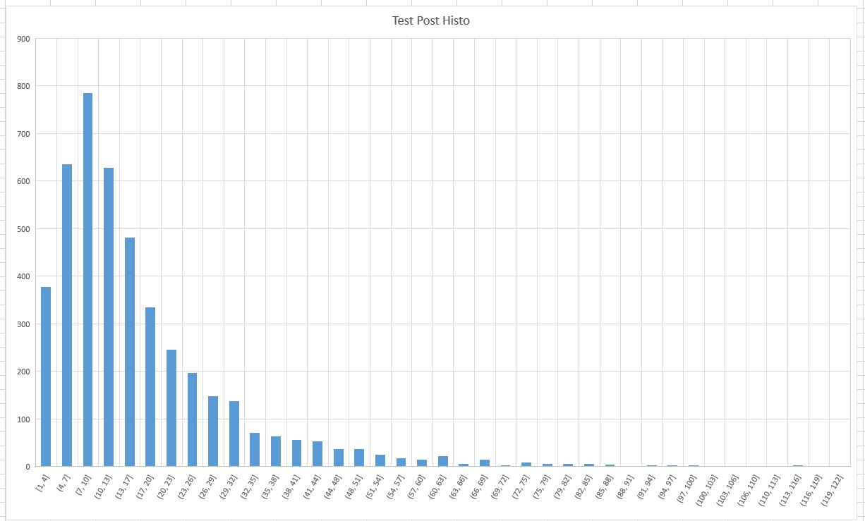

Slide 3
Performed Operations
Filtered broken images
Texturized the images via Airxxxx code
Select >= one hearted images
Sanitaze the textures
Convert tabs to spaces
Remove man-woman definitions
Remove double spaces
Remove spaces at the start
Query the one hearted pictures comment numbers
Create test and train data groups
Create histogram of the test and train datasets according to the comment numbers
Tune bins according to the distribution of the num. of comments data
Extract features of the images (2048)
Exctract vector embeddings of the captures (384)
Combine features and vector embeddings (2432)
Generate labes according to the refined bins of comments
Create a model
Regression model tested
Classification model tested
Unet Classification
Tune operations
L2 regression (???) Kontrol edilecek
Dropout
Num of layer
PCA Feature reduction
Manual Class weight
Early Stop
Validation
Optimizer selection
Adam
SGD
Model Performance (Yazılacak)

Slide 4
bins = [0,4,18,25,29,43,50,65,600]
labels = [0,1,2,3,4,5,6,7]
from sentence_transformers import SentenceTransformer
import numpy as np
model = SentenceTransformer('all-MiniLM-L6-v2')

Slide 5
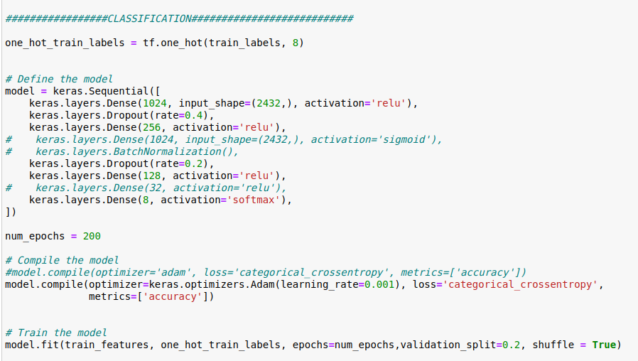

Slide 6
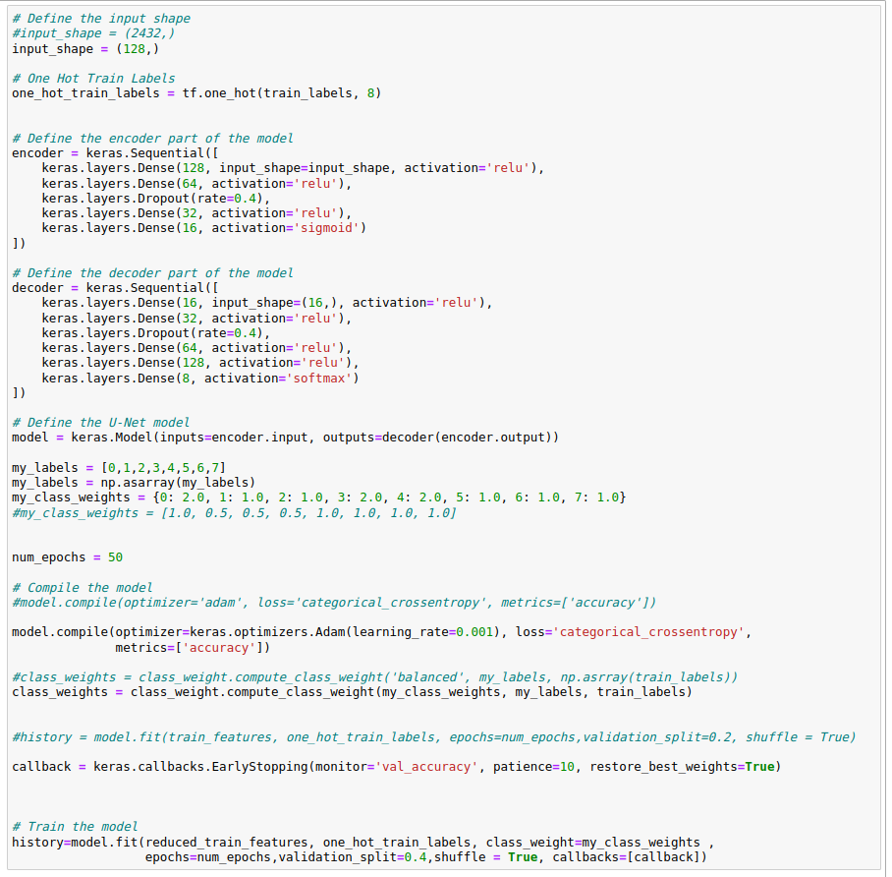
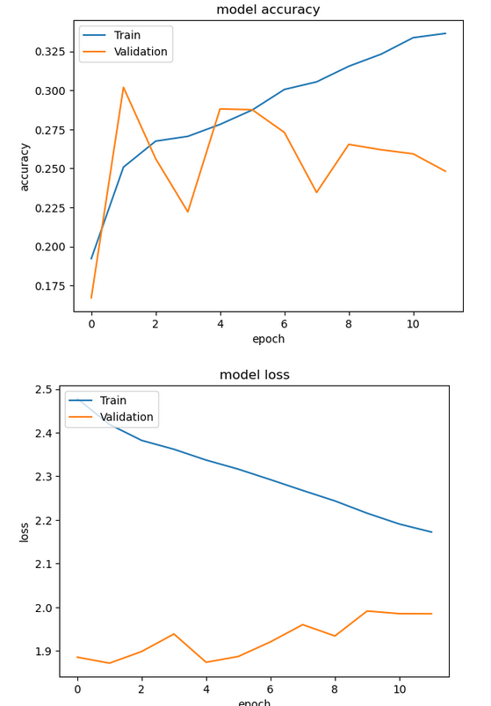
UNet

