Slide 1
Lending Club Case Study
By:
Imthiyaz
Ishita

Slide 2
Problem Statement
In this case study we are going to analyze the past loan data and then create a model profiles who are likely to default the loan.
Based on the given understanding there are two types of risks associated with the bank’s decision of giving a loan.
If the applicant is likely to repay the loan, then not approving the loan results in a loss of business to the company
If the applicant is not likely to repay the loan, i.e. he/she is likely to default, then approving the loan may lead to a financial loss for the company
In this case study we will compare the available data to provide insight which type of borrowers are most likely to default and are high risk to revenue of the organization.

Slide 3
Analysis Approach
Our approach for solving this problem will be as follows
Understanding the data
Data Cleanup
Data Analysis
Univariate Analysis
Segmented Univariate Analysis
Bivariate Analysis
Inference & Recommendations

Slide 4
Understanding the Data
The Current Data Set has information on loans issued for the year 2023.
We have 111 columns and 39717 rows in the dataset.
We have information about the borrower like borrower annual income, home ownership, debt to income ratio, employment title, employment length in years, no.of open credit lines, public record of bankruptcies etc.
We also have details on the loan like purpose of loan, loan term, loan grade, funded amount, interest rate, issued date etc.
We also have certain variables like mths_since_last_delinq, which we will have data only after the loan is sanctioned but not at the time of approving the loan.
We also observed that there are many columns which have null values or same value in all rows of the columns.

Slide 5
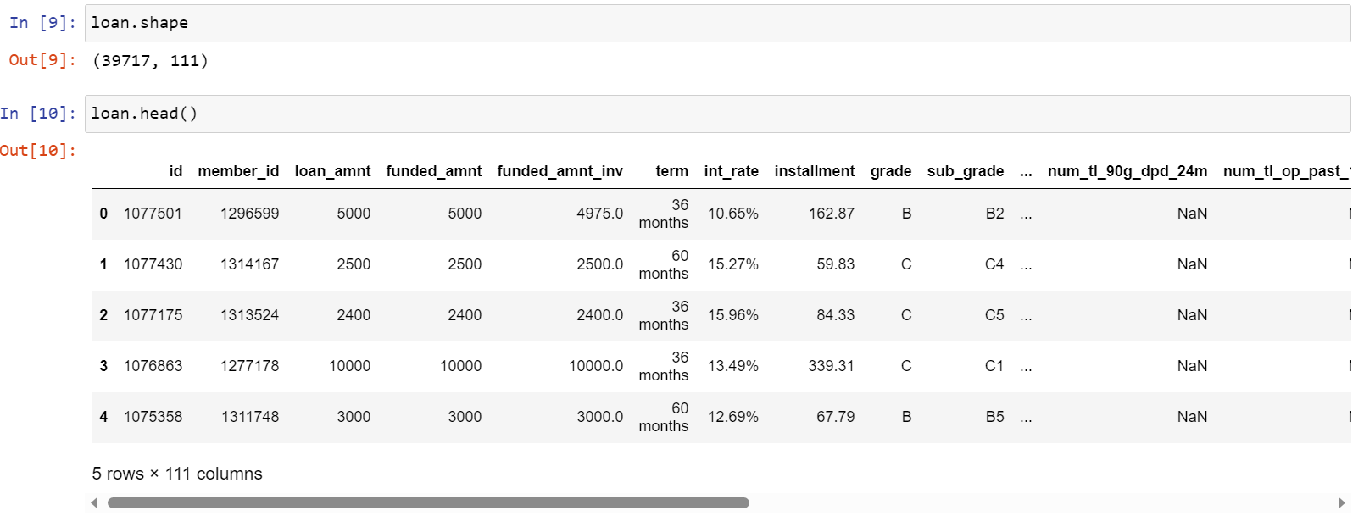
Understanding the Data

Slide 6
Data Cleanup and Sorting
Data Cleanup:
We will drop columns which satisfy below criteria:
Columns which have more than 90% of null values.
Columns which contain free text.
Columns which have only a same value in all the rows.
Columns which contains unique identifiers like loan application id or borrower id.
Columns which are either masked or have redundant information.
Columns which contain customer behaviour information are not available at the time of loan application
Certain numeric columns are stored as string. We will clean them and convert them into numeric format.
Interest Rate column has ‘%’ at the end.
Employment Length.

Slide 7
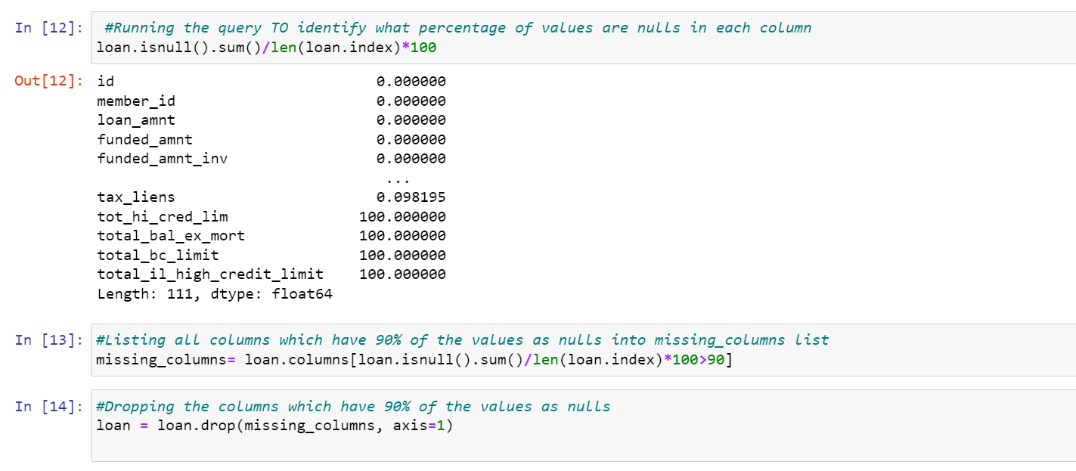
Data Cleanup and Sorting

Slide 8
Data Analysis
Our Objective is to identify predictors of default so that at the time of loan application, we can use those variables for approval/rejection of the loan.
There are broadly three types of variables in our dataset-
Those which are related to the applicant (demographic variables such as age, occupation, employment details etc.)
Loan characteristics (amount of loan, interest rate, purpose of loan etc.)
Customer behaviour variables (those which are generated after the loan is approved such as delinquent 2 years, revolving balance, next payment date etc.).
The customer behaviour variables are not available at the time of loan application, and thus they cannot be used as predictors for credit approval, so we have removed them during our Data Cleanup Step.
Loans which are in ‘Current’ Status are ongoing and are neither defaulted nor fully paid. Hence they cannot help us in predicting defaulters, so we will filter them off.
We will convert Loan Status to numeric. Fully Paid Loans will be represented by 0 and Loan Default by 1.

Slide 9
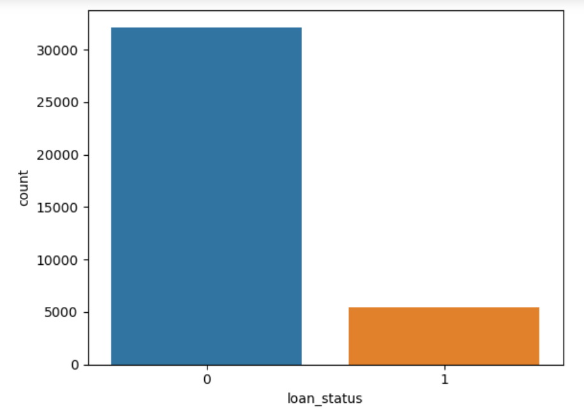
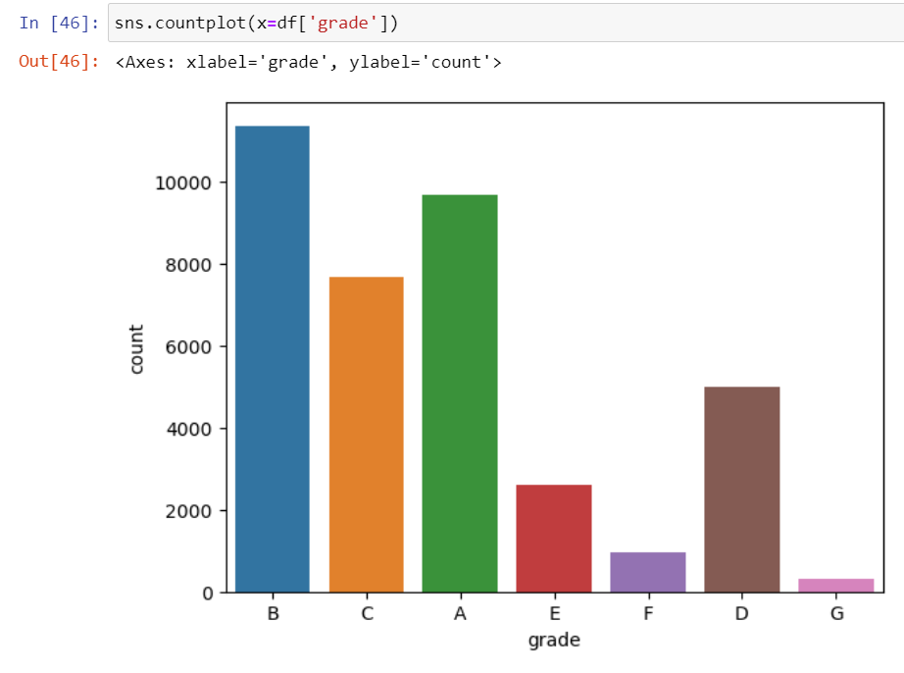
Univariate Analysis
Fig. 1
Fig. 2
We compared the percentage of defaults compared to fully paid loan.
We find that around 14% loan defaults, which is relatively low compared to fully paid loans.
In the fig.1, shows Loan Status count.
In Fig.2, We compared the count of loans in each grade.
We find that count of Garde B loans is higher followed by Grade A , Grade C and Grade D etc.

Slide 10
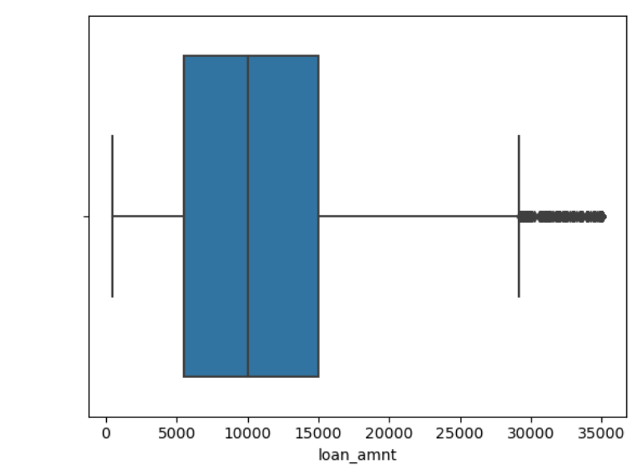
Loan Amount
From Fig.3 box plot for the loan amount, we find that most of loan amounts lie in the range 5000 to 15000.
Most common loan amount is 10000.
Fig. 3

Slide 11
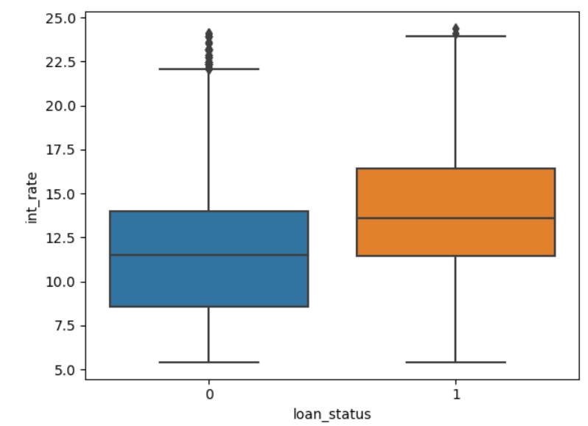
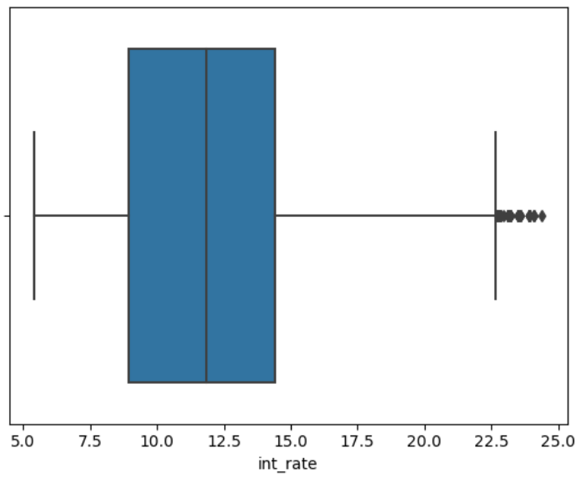
Loan Amount and Interest Rate
Fig. 4
Fig. 5
From Fig. 4, for the interest rate, we find that top and bottom quartiles of interest rates belong to range 9% and 14% and the median lies at 12%.
From Fig. 5, we find that higher interest rate leads to more probability for defaulting of loan.
We find that median, first and third quartiles are higher for defaulters.

Slide 12
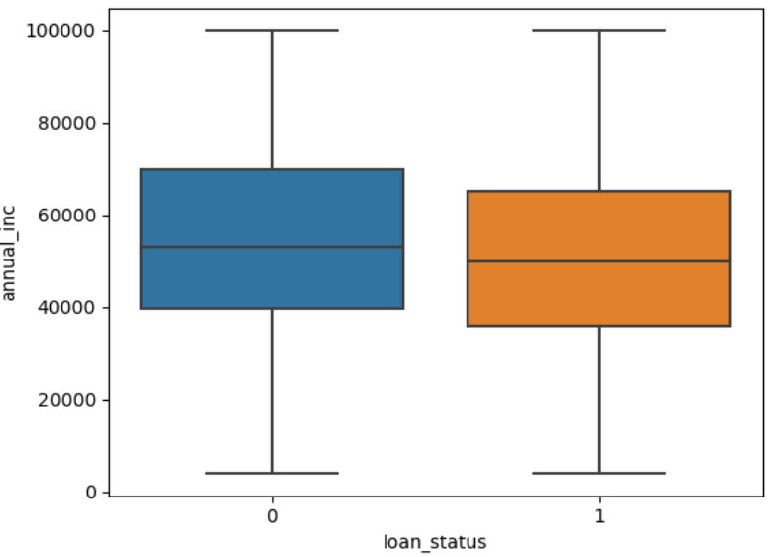
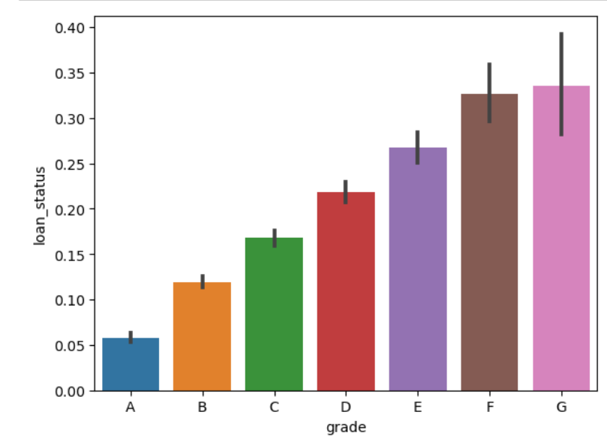
Annual Income & Loan Grade
Fig. 6
Fig. 7
From Fig. 7, we can infer that the probability of a loan default increases with grade of loan from grade A to grade G.
This is expected because the grade of loan is given based on the riskiness of the loan by Lending Club.
From Fig. 6, for the loan amount, we find that top and bottom quartiles of loan amount belong to range 5000 and 15000 and the median lies at 10000.

Slide 13
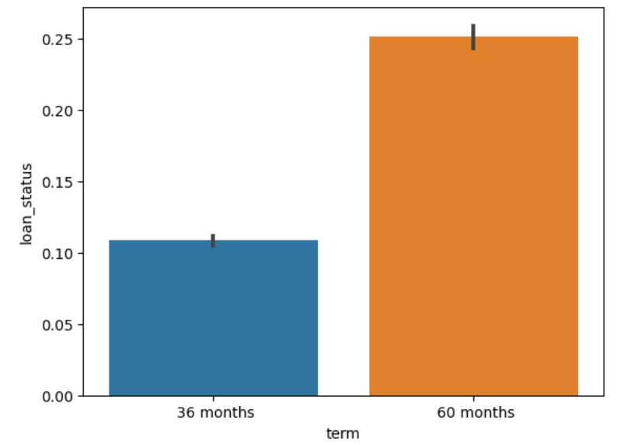
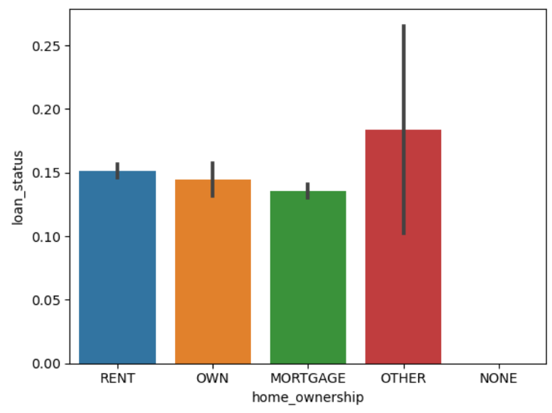
Term and Home Ownership
Fig. 9
Fig. 8
From Fig. 8, we can see that loans with 60 months term have a higher chance of defaulting than 36 months.
From Fig. 9, Home ownership is not a major discriminator in pointing to defaulting

Slide 14
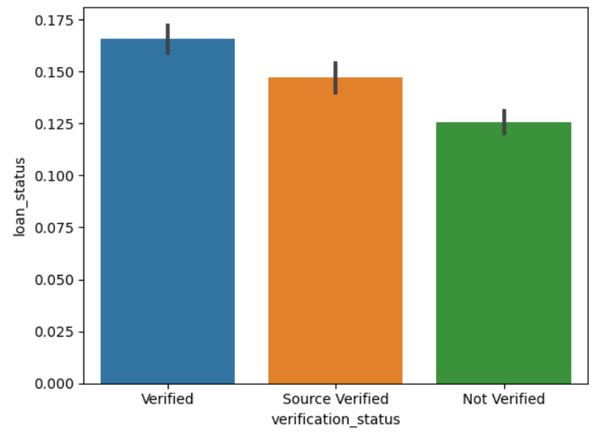
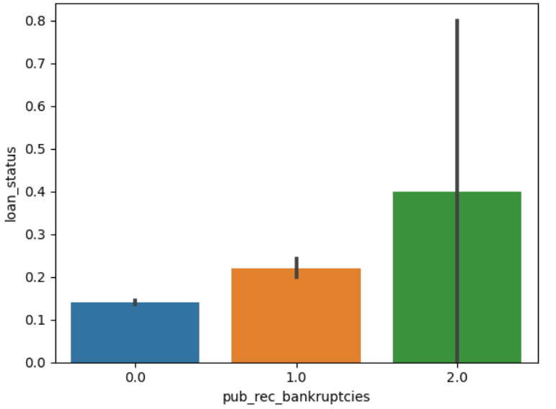
Verification Status and Bankruptcies
Fig. 11
Fig. 10
From Fig. 10, shows that Verified loans have a higher probability of default compared to other verification status.
From Fig. 11, shows that Higher Public Record of Bankruptcies have a higher probability of default.

Slide 15
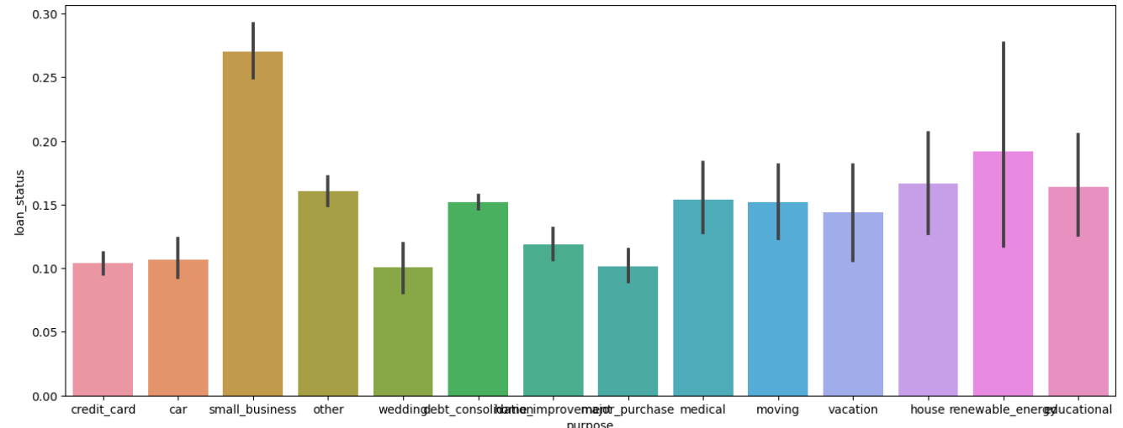
Purpose of Loan
From Fig. 12, shows that small business loans have a higher chance default followed by renewable energy and education compared to others
Fig. 12
Fig. 8
Fig. 9

Slide 16
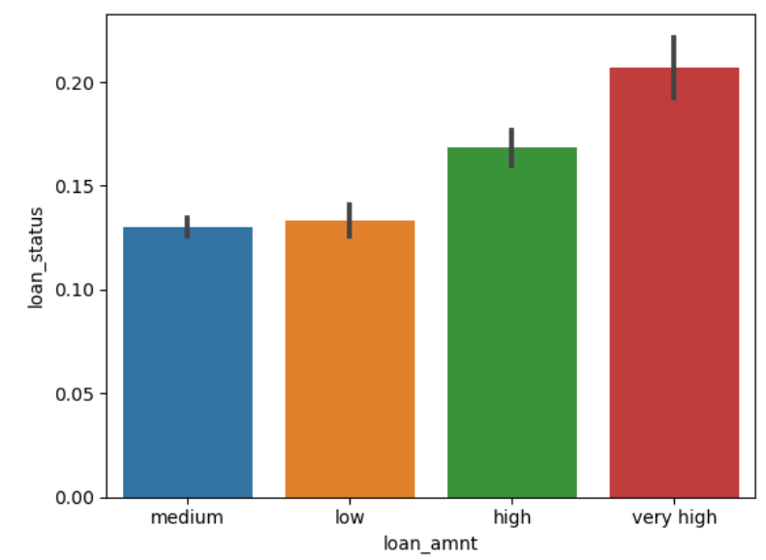
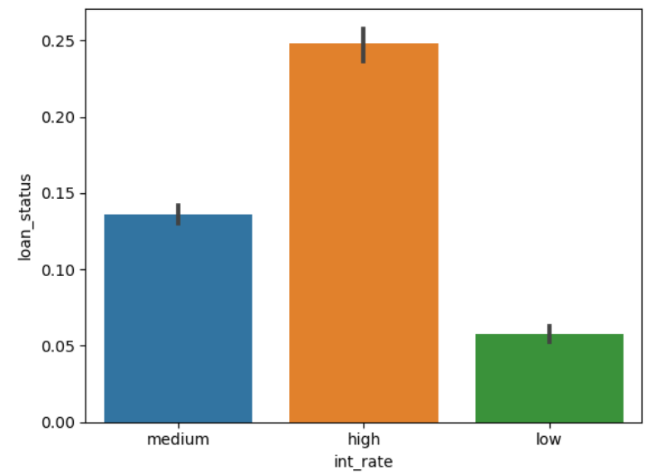
Loan Amount & Interest Rate
Fig. 13
Fig. 14
We have grouped the loan amounts into bins and analyzed loan status for different bins.
From Fig. 13, shows that loan default raises directly with loan amount.
We have grouped the interest rates into bins and analyzed loan status for different bins.
From Fig. 14, shows that loan default raises directly with interest rate.

Slide 17
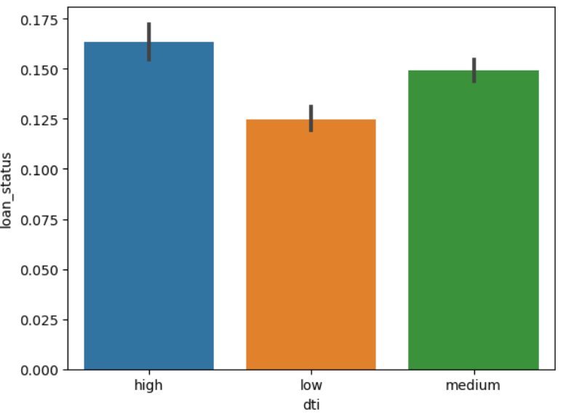
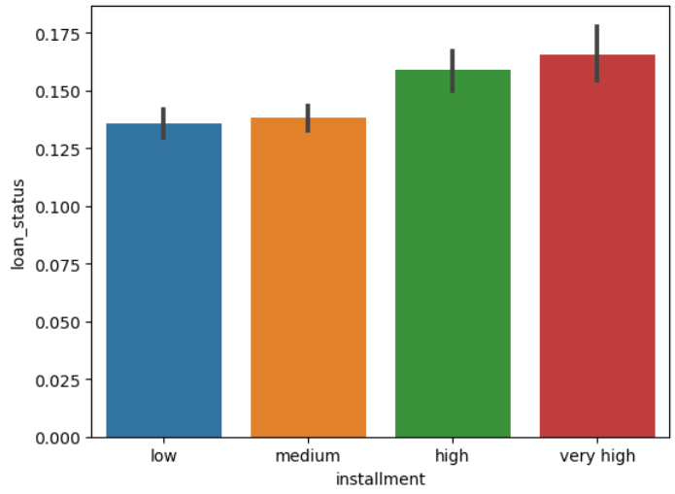
Debt to Interest Ratio & Installment Amount
Fig. 15
Fig. 16
We have grouped the debt to interest ratio into bins and analyzed loan status for different bins.
From Fig. 15, shows that loan default raises with increase in debt to interest ratio.
We have grouped the Installment amounts into bins and analyzed loan status for different bins.
From Fig. 16, shows that loan default raises directly with installment amount.

Slide 18
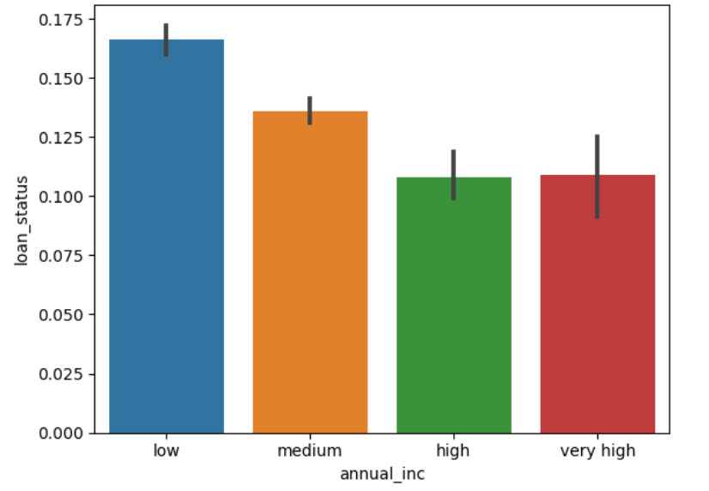
Annual Income
We have grouped the annual income into bins.
From Fig. 17, shows that loan default raises with decrease in annual income.
Fig. 17

Slide 19
Segmented Univariate Analysis

Slide 20
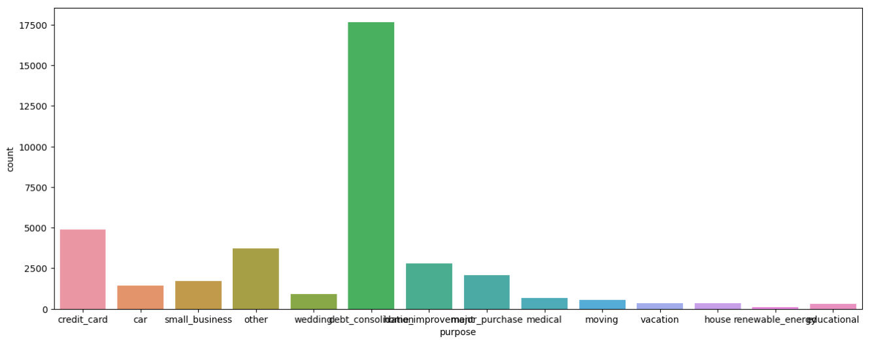
Segmented based on Purpose of loan
Fig. 18
We counted the number of loans for each purpose. For analysis purpose we have selected the top 4 common loan purposes and used them for Segmented Univariate Analysis
From Fig. 18, we have selected ‘debt consolidation’, ‘credit card’, ‘home improvement’ and ‘major purchase’ for our analysis.

Slide 21
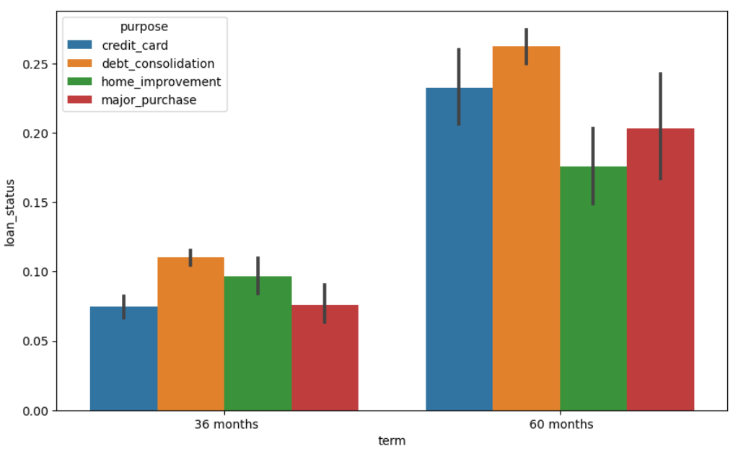
Term of loan
Fig. 19 shows the analysis of loan default status for term of loan by segmenting the data on purpose of loan.
We find that debt consolidation loan type is highly probable to default.
Fig. 19

Slide 22
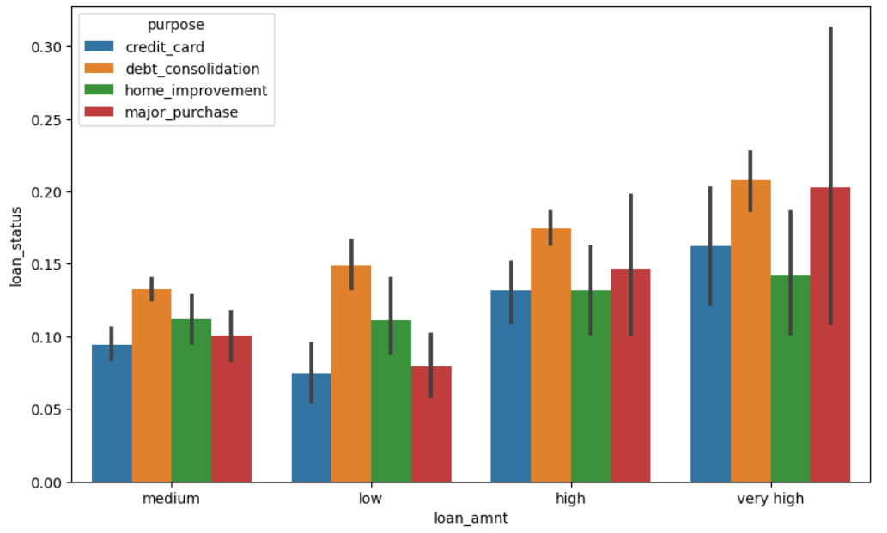
Loan Amount
Fig. 20 shows the analysis of the loan default status for loan amounts by segmenting the data on purpose of loan.
We find that debt consolidation loan type is highly probable to default for various loan amounts.
Fig. 20

Slide 23
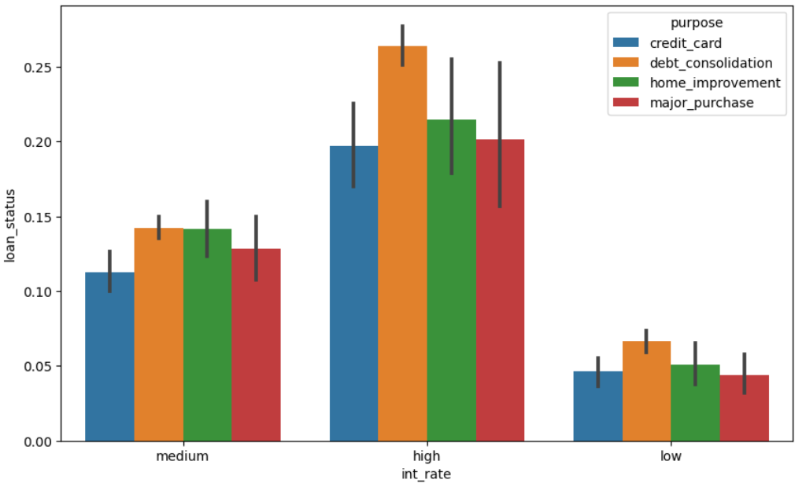
Loan Interest Rate
Fig. 21 shows the analysis of the loan default status for interest rates by segmenting the data on purpose of loan.
We find that debt consolidation loan type is highly probable to default for various loan interest rate groups.
Fig. 21

Slide 24
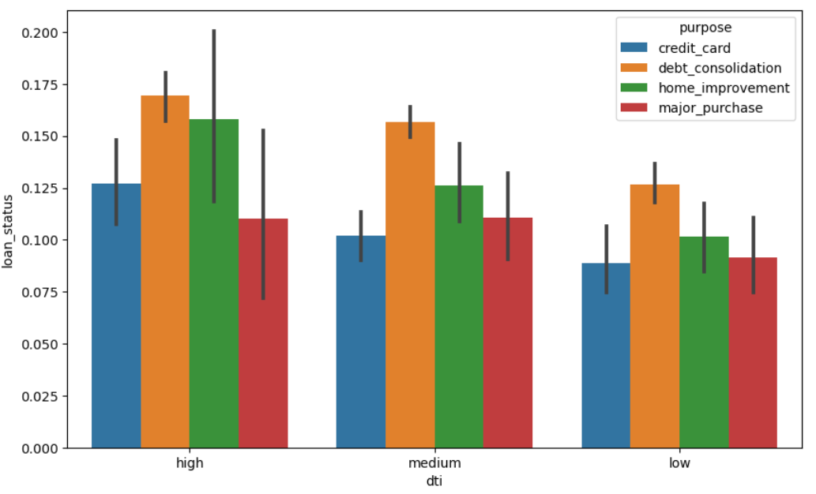
Debt to Interest Ratio
Fig. 19 shows the analysis of the loan default status for debt to interest ration by segmenting the data on purpose of loan.
We find that debt consolidation loan type is highly probable to default for various dti ratios.
Fig. 22

Slide 25
Bivariate Analysis

Slide 26
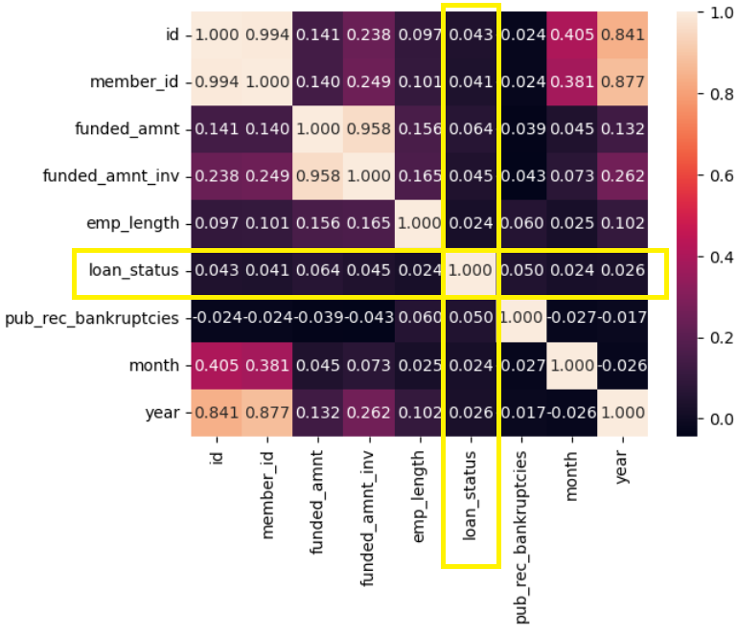
Correlation of variables
Fig. 23 shows the correlation for various variables with each other.
We find that loan status is not highly correlated with any variable directly.
We can assume that the effect on loan default is a combined effect of multiple variables but not a direct impact of any single variable.
Among all, funded amount has relatively higher correlation with loan status compared to others
Fig. 23

Slide 27
Inferences & Recommendations

Slide 28
Inferences
Based on the analysis, we found the following inferences
The total percentage of loan defaults is around 15% to total loans.
Loan default probability increases with increase in
loan amount,
interest rate
loan term
debt to interest ratio,
Installment amount
loan grade from Grade A to Grade G
History of Bankurptcies
Loan default probability increases with decrease in
Annual Income
Loans for purpose of Debt consolidation are more to default compared to other types of loans.
Loans which are verified status are more probable to default than unverified loans.

Slide 29
Recommendations
Loans which are verified status are more probable to default than unverified loans. So it is recommended to Background Verification to be performed well.
Lending agency can use caution while approving high risk purpose loans.
Lending agency can try to provide short term loans for borrowers with better debt to income ratio, or higher income and with moderate interest rate to avoid defaults.

Slide 30
THANK YOU

