Slide 1

JAVA Part-2
Salman Rahmn
Sr. Software Engineer
Cefalo

Slide 2
Ternary Operator / Short Hand if else
Without if else How can you solve this question?
public static void main(String[] args) { int age=18; String isVoter= (age>=18)?"Voter":"not voter"; System.out.println(isVoter); }

Slide 3
Ternary Operator ( multiple conditions)
public class MaxOfThree {
public static void main(String[] args) {
int num1 = 10;
int num2 = 20;
int num3 = 15;
int max = (num1 > num2)
? (num1 > num3 ? num1 : num3)
: (num2 > num3 ? num2 : num3);
System.out.println("The maximum of the three numbers is: " + max);
}
}

Slide 4
CONDITIONAL STATEMENT PRACTICES
Write a program to get a number from the user and print whether it is positive or negative.
Take three numbers from the user and print the greatest number
Write a program that takes a year from user and print whether that year is a leap year or not
Write a program to check if inputted letter is small or capital
Write a program to calculate GPA and find grade
Write a program to check balance and withdraw money from ATM booth using if else or switch case

Slide 5
FOR LOOP SYNTAX
for(init; condition; inc/dec){
statement
}
Decreace number in for loop ( print 10 to 1)

Slide 6
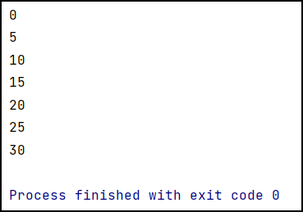
FOR LOOP EXAMPLE

Slide 7
FOR LOOP PRACTICES
write a program to print 1 to 100
Write a program to print only even numbers
Write a program to calculate sum of first 100 even numbers
Write a program to sum of numbers which only divisible by 5 from 1 to 100
Write a program to find the factorial of a given number
Write a program to check a number if it is prime or not
Write a program to print prime numbers from 2 to n

Slide 8
CHECK A NUMBER IF PRIME OR NOT
package loop; import java.util.Scanner; public class Check_Prime_Number { public static void main(String[] args) { int num = 26; boolean flag = true;
for (int i = 2; i <num/2; i++) { if (num % i == 0) { flag = false; break; } } if (flag==true) System.out.println(num + " is a prime number."); else System.out.println(num + " is not a prime number."); } }

Slide 9
Nested For Loop Basic program
for (int i = 1; i <= 3; i++) { // Outer loop
for (int j = 1; j <= 3; j++) { // Inner loop
System.out.print(i + "," + j + " ");
}
System.out.println(); // Moves to the next line
}

Slide 10
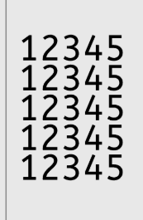
Nested For Loop
int rows = 5; // Number of rows in the pattern
int cols = 5; // Number of columns in the pattern
for (int i = 1; i <= rows; i++) {
for (int j = 1; j <= cols; j++) {
System.out.print(j); // Print the number
}
System.out.println();
}

Slide 11
Nested For Loop
Print * pattern
public static void main(String[] args) { for(int i=1;i<=5;i++){ for(int j=1;j<=i;j++){ System.out.print("*"); } System.out.println(); } }
*
**
***
****
*****

Slide 12
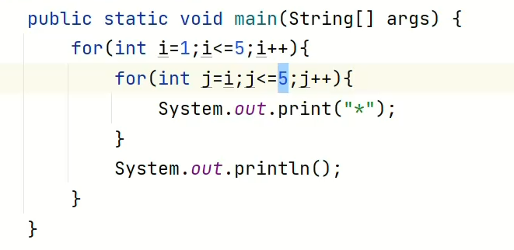
What is this solution?
*****
****
***
**
*

Slide 13
WHILE LOOP SYNTAX
Init;
While(condition){
Statement;
Inc/dec;
}

Slide 14
WHILE LOOP PRACTICES
Write a program to reverse a number.
Write a program to generate 2 random numbers which will not be shown to the user. Take a user input and match it with any of the random numbers. If correct give it 1 point and if incorrect, do not give it any point. Finally, repeat this for 10 times and count the point user achieved.

Slide 15

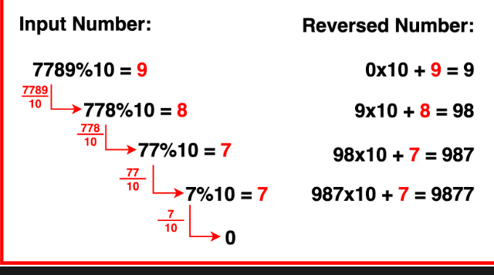
REVERSE A NUMBER

Slide 16
REVERSE A NUMBER
public static void main(String[] args) { int number=7789, reverse=0; while(number!=0){ int rem=number%10; number=number/10;
reverse=reverse*10+rem; } System.out.println(reverse); }

Slide 17
SUM OF USER INPUTS UNTIL USER PRESS -1 FROM KEYBOARD
int sum=0;
System.out.println("Input a number");
Scanner scanner = new Scanner(System.in);
while (true){
int num=scanner.nextInt();
if(num == -1){
System.out.println("You stopped the process");
break;
}
sum+=num;
System.out.println("Sum Till Now : "+sum);
}

Slide 18
DO WHILE LOOP EXAMPLE
public static void main(String[] args) { int sum=0; char ch; System.out.println("Input a number"); Scanner input=new Scanner(System.in); do{ sum+=input.nextInt(); System.out.println(sum); System.out.println("Do you want to continue?"); ch=input.next().charAt(0); } while (ch!=‘q'); }

Slide 19
DO WHILE LOOP PROGRAMS
Write a program to sum of user input until users input ‘q’ from keyboard
Write a program to enter the numbers till the user wants and at the end the program should display the largest and smallest numbers entered.

Slide 20
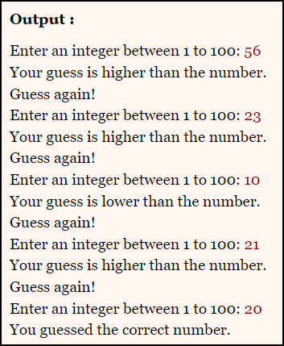
DO-WHILE PRACTICE-Simple Game!
Write a program according to the output.
Here you have already storead a random value inside a variable. And then trying to guess that.

