Slide 1

JAVA Part-1
Salman Rahmn
Sr. Software Engineer
Cefalo

Slide 2
CONTENTS
Introduction to Java
Setup JDK, Intellij IDEA and Gradle
Java Variables
Rules of variable writing
Escape sequence
Data Types
Type Casting
Operators
Math Functions
User Input

Slide 3
CONTENTS
11. Conditional Statement
If-Else
Switch case
12. Break
13. Continue
14. Loop
For Loop
While Loop
Do While Loop

Slide 4
INTRODUCTION TO JAVA
Java is a programming language and a platform. Java is a high level, robust, object-oriented and secure programming language.
Java was developed by Sun Microsystems (which is now the subsidiary of Oracle) in the year 1995. James Gosling is known as the father of Java.

Slide 5
Why Java
Complex to learn.
Huge community in testing
OOP concepts
Learning selenium.

Slide 6
SETUP JDK AND INSTALL INTELLIJ IDEA
JDK 17
IntelIJ Community Edition

Slide 7
FIRST PROGRAM
public static void main(String[] args) { System.out.println(“Hello Java!");
String MyString=“Hello Java”;
System.out.println(MyString); }
* Explanation of main method overall structure in java.
* To increase font site : Go to settings -> search “font” -> goto “font” section -> Increase the size -> Apply -> Ok
* Always Create a new file inside the main folder , for normal java coding

Slide 8
JAVA VARIABLES
Local Variables - local variables used only in a local scope [Like inside loop , method]
Instance Variables - Instance variable can only be accessed by Object of the class
Static Variables - shared by all instances of the class

Slide 9
package basic; public class JavaVariables { public static void purchase(String brand, String model) { String name = "Mr. Zahid"; //local variable System.out.println(name + " wants to buy a " + brand + " " + model + " car"); } } class Car { //instance variable String brand; String model; static int wheel=4; //static variable }

Slide 10
VARIABLE NAMING CONVENTION
A variable name can consist of Capital letters A-Z, lowercase letters a-z, digits 0-9, and two special characters such as underscore and dollar Sign.
The first character must be a letter.
Blank spaces cannot be used in variable names.
Java keywords cannot be used as variable names.
Variable names are case-sensitive.

Slide 11
ESCAPE SEQUENCE
Escape Sequence | Description
\t | Inserts a tab in the text at this point.
\n | Inserts a newline in the text at this point.
\" | Inserts a double quote character in the text at this point.
\\ | Inserts a backslash character in the text at this point.

Slide 12
DATA TYPES
Primitive Data Types
Non-Primitive Data Types

Slide 13
PRIMITIVE DATA TYPES
Data type | Size | Description
byte | 1 byte | Stores whole numbers from -128 to 127
short | 2 byte | Stores whole numbers from -32,768 to 32,767
int | 4 byte | Stores whole numbers from -2,147,483,648 to 2,147,483,647
long | 8 byte | Stores whole numbers from -9,223,372,036,854,775,808 to 9,223,372,036,854,775,807. (Add L at the end. Exp 213321212L)
float | 4 byte | Stores fractional numbers. Sufficient for storing 6 to 7 decimal digits. (Add f at the end. Exp 23.23422f )
double | 8 byte | Stores fractional numbers. Sufficient for storing 15 decimal digits
boolean | 1 byte | Stores true or false values
char | 2 byte | Stores a single character/letter or ASCII values

Slide 14
NON-PRIMITIVE DATA TYPES
Class
Object
Array
String
Interface
There are 5 types of non-primitive data types:

Slide 15
TYPE CASTING
Widening casting: [ long a = 12]
byte -> short -> char -> int -> long -> float -> double
Example : int a = 10; double d = a;
Narrowing casting:
double -> float -> long -> int -> char -> short -> byte
Example: double d = 10.5 ; int a = d;

Slide 16
Parsing
Converting into completely different data type. Specially used for string. This can only be done when your string contains only digits.
Example :
* String a = "100";
int b = a;
int b = Integer.parseInt(a);
System.out.println(b);
* String a = "100.63";
double b = Double.parseDouble(a);

Slide 17
Converting int to String
int a = 10;
String b = a;
String b = String.valueOf(a);

Slide 18
OPERATORS
Arithmetic operators (+, -, *, /, %, ++, --)
Assignment operators (=, +=, -=, *=, /=)
Comparison operators (==,>,<,>=,<=,!=)
Logical operators (&&, ||, !)
Bitwise operators(<<, >>)

Slide 19
MATH FUNCTIONS
Math.max(val1,val2)
Math.min(val1,val2)
Math.sqrt(val)
Math.pow(val,power)
Math.abs(x)
Math.random() [Returns value between 0 to 1]
Math.round()
Math.ceil()
Math.floor()

Slide 20
GENERATE RANDOM NUMBER
min + Math.random()*(max-min)
Example:
int maxRange , minRange;
minRange = 10;
maxRange = 1000;
double a = Math.random();
int randomNumber = (int) (min + a * (maxRange - minRange) );
System.out.println(randomNumber);
To organize your syntax look: ctrl + alt + l

Slide 21
Generate Rabdom Phone Number
int maxRange, minRange;
minRange = 10000000;
maxRange = 99999999;
double a = Math.random();
int randomNumber = (int) (minRange + a * (maxRange - minRange));
//String concatination
String phoneNum = "017" + randomNumber;
System.out.println(phoneNum);

Slide 22
USER INPUT
public static void main(String[] args) { Scanner input = new Scanner(System.in); System.out.println("Enter first number:"); int number1 = input.nextInt(); System.out.println("Enter second number:"); int number2 = input.nextInt(); int sum=number1+number2; System.out.println("Sum is "+sum); }
// double b = input.nextDouble
// String str = input.next();
// String str = input.nextLine();

Slide 23
EXCEPTION HANDLING
try{
}
Catch(exception e){ }
Finally{ }

Slide 24
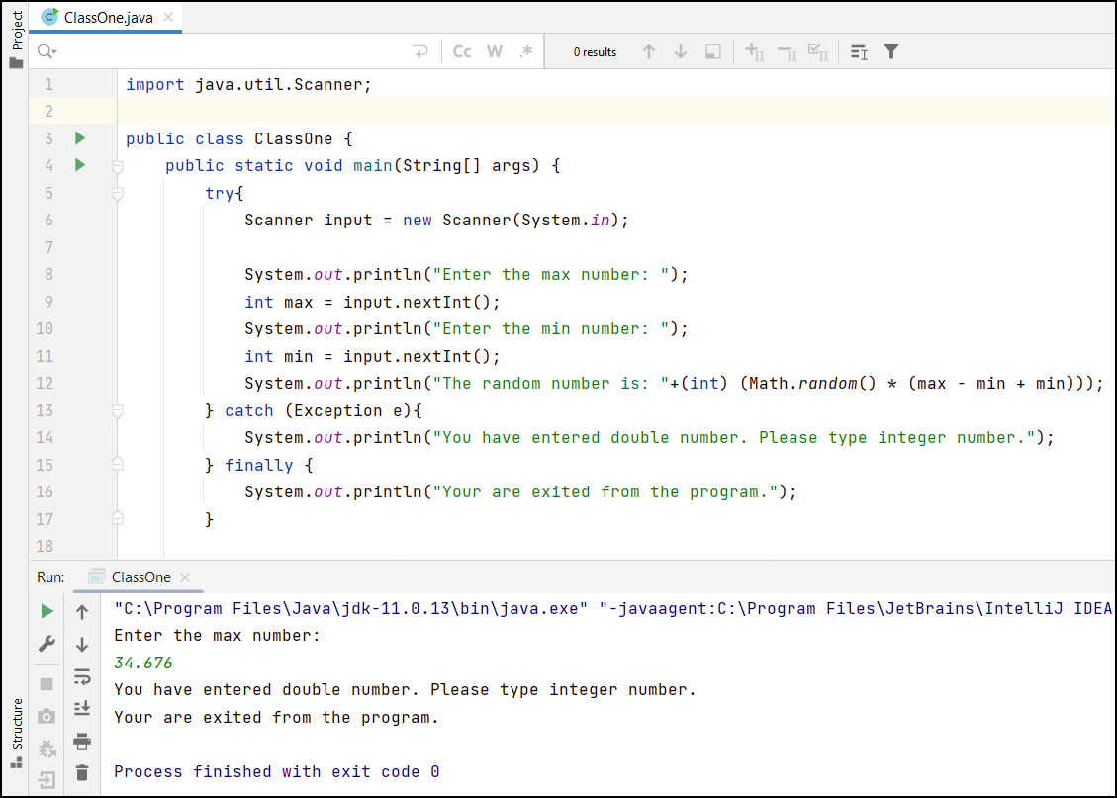

Slide 25
Another example of exception Handling
try{
double ans = 5/0;
}
catch(Exception e){
System.out.println("You can not divide any number by zero.");
System.out.println( e );
}
finally {
System.out.println("Please correct your error");
}

Slide 26
IF ELSE SYNTAX
If(condition){
statement
}
Else if(condition){
statement
}
Else{
statement
}

Slide 27
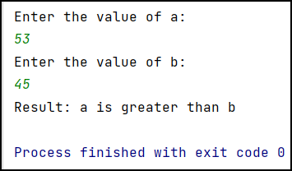
IF ELSE EXAMPLE

Slide 28
SWITCH CASE SYNTAX
Switch(expression){
Case 1:
Statement
Break;
Case 2:
Statement
Break;
default:
Statement
}

Slide 29
Switch case Example
Scanner scanner = new Scanner(System.in); System.out.println("Enter a number (1-3): "); int choice = scanner.nextInt(); switch (choice) { case 1: System.out.println("You selected Option 1"); break; case 2: System.out.println("You selected Option 2"); break; case 3: System.out.println("You selected Option 3"); break; default: System.out.println("Invalid choice!."); }

Slide 30
CONTINUE
Continue the loop without executing the next lines.
public class ContinueExample {
public static void main(String args[]){
for (int i = 0; i <= 10; i++)
{
if (i == 5)
{
continue;
}
System.out.println(i);
}
}
}

Slide 31
BREAK
Brings you out of the loop.
public class BreakExample1 {
public static void main(String args[]){
for (int i = 0; i <= 10; i++)
{
if (i == 5)
{
break;
}
System.out.println(i);
}
}

Slide 32
CONDITIONAL STATEMENT PRACTICES
Write a program to get a number from the user and print whether it is positive or negative.
Take three numbers from the user and print the greatest number
Write a program that takes a year from user and print whether that year is a leap year or not
Write a program to check if inputted letter is small or capital
Write a program to calculate GPA and find grade
Write a program to check balance and withdraw money from ATM booth using if else or switch case

