Slide 1
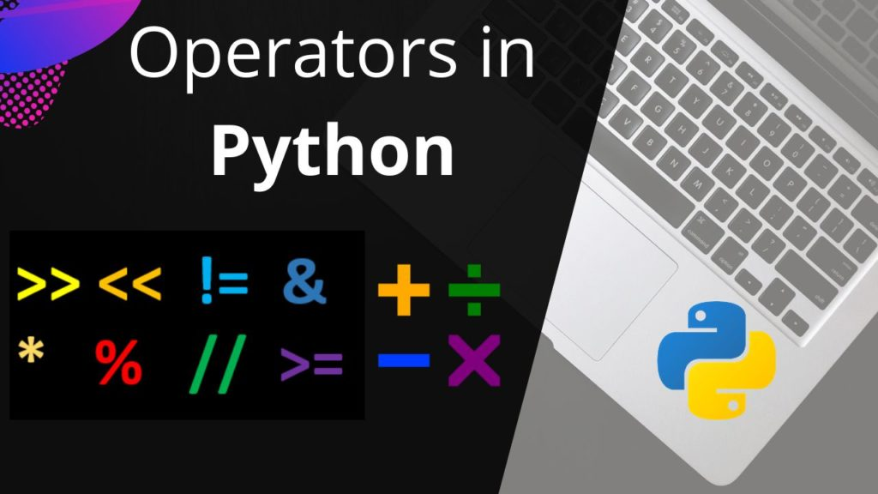

Slide 2
Previous Session
Introduction to Script
Introduction to Python
History of Python
Features of Python
Input/Output
Variables
DataType

Slide 3
Agenda
Operators
Problem Solving
Python

Slide 4

Operators in python
Arithmetic
Operators
Comparison Operators
Assignment Operator
Logical Operators
Membership Operators
Identity Operators

Slide 5
Arithmetic Operator
Operator | Description
+ (Addition) | It is used to add two operands. For example, if a = 20, b = 10 => a+b = 30
- (Subtraction) | It is used to subtract the second operand from the first operand. If the first operand is less than the second operand, the value results negative. For example, if a = 20, b = 10 => a - b = 10
/ (divide) | It returns the quotient after dividing the first operand by the second operand. For example, if a = 20, b = 10 => a/b = 2.0
* (Multiplication) | It is used to multiply one operand with the other. For example, if a = 20, b = 10 => a * b = 200
% (reminder) | It returns the reminder after dividing the first operand by the second operand. For example, if a = 20, b = 10 => a%b = 0
** (Exponent) | It is an exponent operator represented as it calculates the first operand power to the second operand.
// (Floor division) | It gives the floor value of the quotient produced by dividing the two operands.

Slide 6
Comparison Operator
Operator | Description
== | If the value of two operands is equal, then the condition becomes true.
!= | If the value of two operands is not equal, then the condition becomes true.
<= | If the first operand is less than or equal to the second operand, then the condition becomes true.
>= | If the first operand is greater than or equal to the second operand, then the condition becomes true.
> | If the first operand is greater than the second operand, then the condition becomes true.
< | If the first operand is less than the second operand, then the condition becomes true.

Slide 7
Assignment Operator
Operator | Description
= | It assigns the value of the right expression to the left operand.
+= | It increases the value of the left operand by the value of the right operand and assigns the modified value back to left operand. For example, if a = 10, b = 20 => a+ = b will be equal to a = a+ b and therefore, a = 30.
-= | It decreases the value of the left operand by the value of the right operand and assigns the modified value back to left operand. For example, if a = 20, b = 10 => a- = b will be equal to a = a- b and therefore, a = 10.
*= | It multiplies the value of the left operand by the value of the right operand and assigns the modified value back to then the left operand. For example, if a = 10, b = 20 => a* = b will be equal to a = a* b and therefore, a = 200.
%= | It divides the value of the left operand by the value of the right operand and assigns the reminder back to the left operand. For example, if a = 20, b = 10 => a % = b will be equal to a = a % b and therefore, a = 0.
**= | a**=b will be equal to a=a**b, for example, if a = 4, b =2, a**=b will assign 4**2 = 16 to a.
//= | A//=b will be equal to a = a// b, for example, if a = 4, b = 3, a//=b will assign 4//3 = 1 to a.

Slide 8
Bitswise Operator
Operator | Description
& (binary and) | If both the bits at the same place in two operands are 1, then 1 is copied to the result. Otherwise, 0 is copied.
| (binary or) | The resulting bit will be 0 if both the bits are zero; otherwise, the resulting bit will be 1.
^ (binary xor) | The resulting bit will be 1 if both the bits are different; otherwise, the resulting bit will be 0.
~ (negation) | It calculates the negation of each bit of the operand, i.e., if the bit is 0, the resulting bit will be 1 and vice versa.
<< (left shift) | The left operand value is moved left by the number of bits present in the right operand.
>> (right shift) | The left operand is moved right by the number of bits present in the right operand.

Slide 9
Logical Operator
Operator | Description
and | If both the expression are true, then the condition will be true. If a and b are the two expressions, a → true, b → true => a and b → true.
or | If one of the expressions is true, then the condition will be true. If a and b are the two expressions, a → true, b → false => a or b → true.
not | If an expression a is true, then not (a) will be false and vice versa.

Slide 10
Membership Operator
Membership operators are used to determine whether the iterator or the value given is present in the sequence.
Such operator types often return values in either the TRUE or FALSE format.
If the value is contained in a set, the operator returns TRUE, otherwise it returns FALSE.
Operator | Description
in | It is evaluated to be true if the first operand is found in the second operand (list, tuple, or dictionary).
not in | It is evaluated to be true if the first operand is not found in the second operand (list, tuple, or dictionary).

Slide 11
Identity Operator
In the Python programming language, identity operators are used to check if both values, variables,
or constants are not only the same, but also have the same memory location.
To compare and check the exact match of values between two objects, these types of operators are used.
Operator | Description
is | It is evaluated to be true if the reference present at both sides point to the same object.
is not | It is evaluated to be true if the reference present at both sides do not point to the same object.

Slide 12
Operator Precedence
Operator | Description
** | The exponent operator is given priority over all the others used in the expression.
~ + - | The negation, unary plus, and minus.
* / % // | The multiplication, divide, modules, reminder, and floor division.
+ - | Binary plus, and minus
>> << | Left shift. and right shift
& | Binary and.
^ | | Binary xor, and or

Slide 13
Operator Precedence
Operator | Description
<= < > >= | Comparison operators (less than, less than equal to, greater than, greater then equal to).
<> == != | Equality operators.
= %= /= //= -= += *= **= | Assignment operators
is is not | Identity operators
in not in | Membership operators
not or and | Logical operators

Slide 14
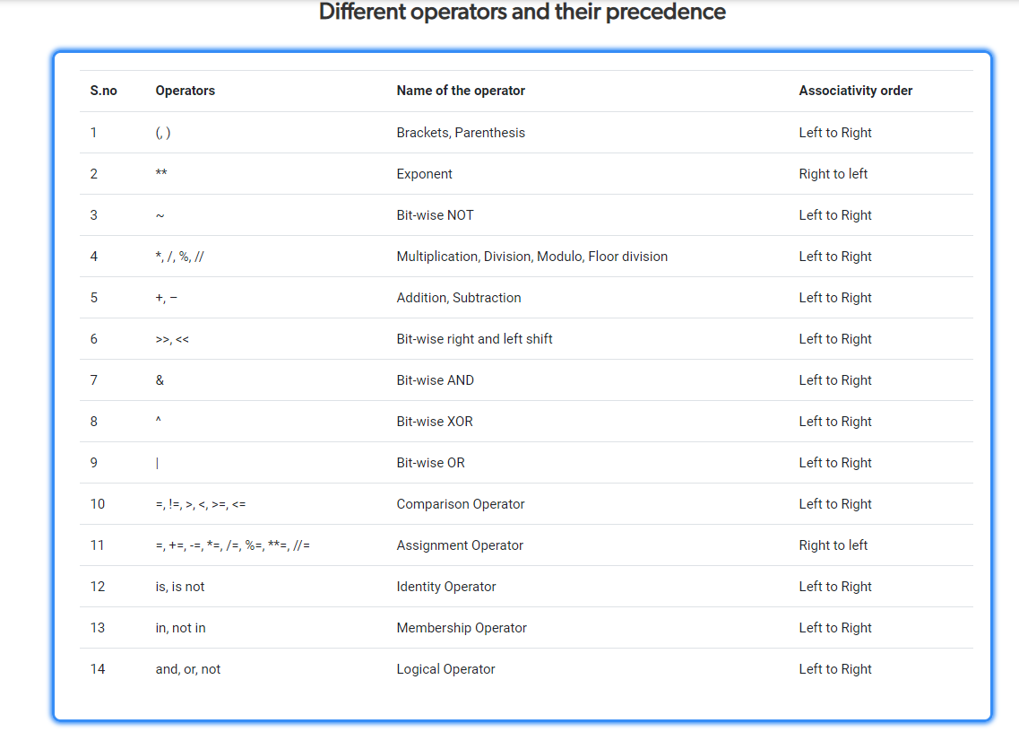

Slide 15

Let’s Start Coding…

Slide 16
Problem Statement-1
John given task to smith to write a logic by following requirement:
Test for a given number is greater than 4^4 and which is 4 mod 34 or not.
Input Format:
Take input as integer value.
Output Format:
Print True | False dependents on problem.

Slide 17
Test Case
Sample Input | Sample Output | Explanation
X:922 | True | 922>256 is True and 922 module 34 is 4.
X:914 | False | 914>256 is True but 914 module 34 is 30.

Slide 18
Solution
def testNum(num):
return num % 34 ==4 and num>4**4
x=int(input('X:'))
print(testNum(x))

Slide 19
Problem Statement-2
John this time asked smith to write the logic by using following requirement:
Round in int value up to the next multiple of 10 if it’s rightmost digit is 5 or more i.e. is 15 round to 20.
Round down to the previous multiple of 10 if it's rightmost digit is less than 5 i.e. is 12 round to 10.
Input Format:
Take 3 input as integer value.
Output Format:
Print round sum of 3 integer value.

Slide 20
Test Case
Sample Input | Sample Output | Explanation
X:16 Y:17 Z:18 | 60 | Round(16)+Round(17)+Round(18)
X:12 Y:13 Z:11 | 30 | Round(12)+Round(13)+Round(11)

Slide 21
Solution
def test1(x,y,z):
return round10(x)+round10(y)+round10(z)
def round10(num):
if num%10>=5:
return num + (10 - num%10)
return num - (num%10)
x=int(input("X:"))
y=int(input("Y:"))
z=int(input("Z:"))
print(test1(x,y,z))

Slide 22
Problem Statement-3
Smith given task to John to solve the below problem:
You and your date are trying to get a table at a restaurant. The parameter "you" is the stylishness of your clothes, in the range 0..10, and "date" is the stylishness of your date's clothes. The result getting the table is encoded as an int value with 0=no, 1=maybe, 2=yes. If either of you is very stylish, 8 or more, then the result is 2 (yes). With the exception that if either of you has style of 2 or less, then the result is 0 (no). Otherwise the result is 1 (maybe).
Notes:
Hint: One solution uses the patternif xxx: return 0 elif yyy: return 2 else: return 1 where xxx and yyy compute with <=, >= if the you/date numbers get that result. The order of the if statements is significant -- the 0 result case takes precedence over the other cases, so that if statement comes first.

Slide 23
Problem Statement-3
Input Format:
Read 2 values
Output Format:
Print the integer

Slide 24
Test Case
Sample Input | Sample Output | Explanation
you: 5 date:10 | 2 | You is less then 8 or date is greater then 8.
you: 5 date: 2 | 0 | You is greater then 2 or date is less then 2.

Slide 25
Solution
# date_fashion(5, 10) → 2
# date_fashion(5, 2) → 0
# date_fashion(5, 5) → 1
def date_fashion(you, date):
if you <= 2 or date <= 2:
return 0
elif you >= 8 or date >= 8:
return 2
return 1
you = int(input('you:'))
dat = int(input('date:'))
print(date_fashion(you,dat))

Slide 26
Problem Statement-4
Given 2 ints, a and b, return their sum. However, sums in the range 10..19 inclusive, are forbidden, so in that case just return 20.
Input Format:
Read 2 values
Output Format:
Print the value.

Slide 27
Test Case
Sample Input | Sample Output | Explanation
X : 3 Y :4 | 7 | 3+4=7 and totalsum is not between 10 and 19.
X:9 Y:4 | 20 | 9+4=13 and totalSum is Between 10 and 19.

Slide 28
Solution
def sorta_sum(you, date):
totalSum = you+date
if 10<=totalSum<=19:
return 20
return totalSum
you = int(input('you:'))
dat = int(input('date:'))
print(sorta_sum(you,dat))

Slide 29


