Slide 1
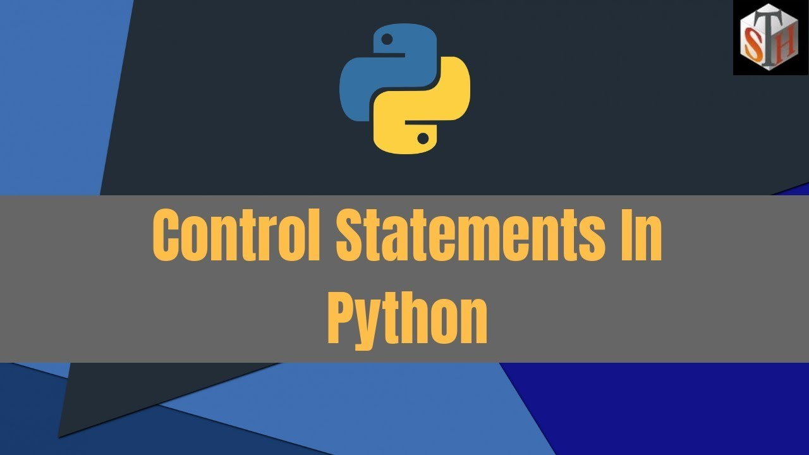

Slide 2
Previous Session
Operators
Problem Solving

Slide 3
Agenda
Control Statement
Problem Solving
Python

Slide 4

Control Statement in python
Conditional Statement
Transfer Statement
Iterative Statement
If
If-elif
If-elif-else
break
Continue
pass
for
while

Slide 5

Let’s Start Coding…

Slide 6
Problem Statement-1
John can manipulate at most X number of guards with the apple of Eden.
Given that there are Y number of guards, predict if he can safely manipulate all of them.
Input Format
First line will contain T number of test cases. Then the test cases follow.
Each test case contains of a single line of input, two integers X and Y.
Output Format
For each test case, print YES if it is possible for John to manipulate all the guards. Otherwise, print NO
Constraints
1<=T<=100
1<=X,Y<=100

Slide 7
Test Case
Sample Input | Sample Output | Explanation
1 5 7 | No | John can manipulate at most 5 guards. Since there are 7 guards, he cannot manipulate all of them.
1 6 6 | Yes | John can manipulate at most 6 guards. Since there are 6 guards, he can manipulate all of them.

Slide 8
Solution
nt=int(input())
for i in range(nt):
x,y = map(int,input().split())
if(x>=y):
print('Yes')
else:
print('No')

Slide 9
Problem Statement-2
To access CRED programs, one needs to have a credit score of 750 or more. Given that the present credit score is X, determine if one can access CRED programs or not.
If it is possible to access CRED programs, output YES, otherwise output NO.
Input Format
The first and only line of input contains a single integer. X, the credit score.
Output Format
Print YES if it is possible to access CRED programs, otherwise print NO.
Constraints
0<=X<=1000

Slide 10
Test Case
Sample Input | Sample Output | Explanation
823 | YES | Since 823>=750, it is possible to access CRED program.
251 | NO | Since 251<750, it is not possible to access CRED program.

Slide 11
Solution
x = int(input())
if(x>=750):
print('Yes’)
else:
print('No')

Slide 12
Problem Statement-3
There is a group of N friends who wish to enroll in a course together. The course has a maximum capacity of M students that can register for it. If there are K other students who have already enrolled in the course, determine if it will still be possible for all the N friends to do so or not.
Input Format
The first line contains a single integer T i.e. no of test cases.
Each test cases consists of a single line containing 3 integer i.e. N,M and K the size
of the friend group, the capacity of the course and the no of students already registered for the course.
Output Format
For each test case, output YES if it will be possible for all the N friends to register for the
course. Otherwise , output NO
Constraints
0<=X<=1000

Slide 13
Problem Statement-3
1≤T≤1000
1≤N≤M≤100
0≤K≤M

Slide 14
Test Case
Sample Input | Sample Output | Explanation
1 2 50 27 | YES | The 2 friends can enroll in the course as it has enough seats to accommodate them and the 27 other students at the same time.
1 5 40 38 | NO | The course does not have enough seats to accommodate the 5 friends and the 38 other students at the same time.

Slide 15
Solution
nt= int(input())
for i in range(nt):
N,M,K = map(int,input().split(" "))
if N<=(M-K):
print("Yes")
else:
print("No")

Slide 16
Problem Statement-4
A study has shown that playing a musical instrument helps in increasing one's IQ by 7 points. Chef knows he can't beat Einstein in physics, but he wants to try to beat him in an IQ competition.
You know that Einstein had an IQ of 170, and Chef currently has an IQ of X.
Determine if, after learning to play a musical instrument, Chef's IQ will become strictly greater than Einstein's.
Print "Yes" if it is possible for Chef to beat Einstein, else print "No" (without quotes).
Input Format
The first and only line of input will contain a single integer X, the current IQ of Chef.
Output Format
For each testcase, output in a single line "Yes" or "No“
Constraints
100<=X<=169

Slide 17
Test Case
Sample Input | Sample Output | Explanation
165 | YES | After learning a musical instrument, Chef's final IQ will be 165+7=172. Since 172 >170, Chef can beat Einstein.

Slide 18
Solution
iq =int(input())
if (iq+7)>170:
print("Yes")
else:
print("No")

Slide 19
Problem Statement-5
The Chef has reached the finals of the Annual Inter-school Declamation contest.
For the finals, students were asked to prepare 10 topics. However, Chef was only able to prepare three topics, numbered A, B and C - he is totally blank about the other topics. This means Chef can only win the contest if he gets the topics A, B or C to speak about. On the contest day, Chef gets topic X. Determine whether Chef has any chances of winning the competition. Print "Yes" if it is possible for Chef to win the contest, else print "No".
Input Format
The first and only line of input will contain a single line containing four space-separated integers A, B, C, and X - the three topics Chef has prepared and the topic that was given to him on contest day.
Output Format
For each testcase, output in a single line "Yes" or "No".
Constraints
1<=A,B,C,X<=10
A,B,C are distinct.

Slide 20
Test Case
Sample Input | Sample Output | Explanation
2 3 7 3 | YES | Chef had prepared the topics: 2, 3, 7. Chef gets to speak on the topic: 3. Since Chef had already prepared this, there is a chance that he can win the contest
4 6 8 5 | NO | Chef had prepared the topics: 4, 6, 8. Chef gets to speak on the topic: 5. Since Chef didn't prepare this topic, there is no chance that he can win the contest.

Slide 21
Solution
A,B,C,TOPIC = map(int,input().split())
if A==TOPIC or B==TOPIC or C==TOPIC:
print("Yes")
else:
print("No")

Slide 22
Problem Statement-6
Chef has N empty bottles where each bottle has a capacity of X liters.
There is a water tank in Chef land having K liters of water. Chef wants to fill the empty bottles using the water in the tank. Assuming that Chef does not spill any water while filling the bottles, find out the maximum number of bottles Chef can fill completely.
Input Format
First line will contain T, number of test cases. Then the test cases follow.
Each test case contains of a single line of input, three integers N, X, and K.
Output Format
For each test case, output in a single line answer, the maximum number of bottles Chef can fill completely.
Constraints
1<=T<=100
1<=N,X<=10^5
0<=K<=10^5

Slide 23
Test Case
Sample Input | Sample Output | Explanation
1 5 2 8 | 4 | The amount of water in the tank is 8 liters. The capacity of each bottle is 2 liters. Hence, 4 water bottles can be filled completely.
1 3 1 4 | 3 | The amount of water in the tank is 4 liters. The capacity of each bottle is 1liters. Chef has 3 bottles available. He can fill all these bottles completely using 3 liters of water.

Slide 24
Solution
from math import floor
nt= int(input())
for i in range(nt):
N,X,K = map(int,input().split())
res = floor(abs(K/X))
if(res>N):
print(abs(N))
else:
print(res)

Slide 25
Problem Statement-7
You are given the height H (in metres) and mass M (in kilograms) of Chef.
The Body Mass Index (BMI) of a person is computed as : M/H^2.
Report the category into which Chef falls, based on his BMI:
Category 1: Underweight if BMI <=18
Category 2: Normal weight if BMI {19,20,…24}
Category 3: Overweight if BMI {25,26…,29}
Category 4: Obesity if BMI >=30
Input Format:
The first line of input will contain an integer, T, which denotes the number of testcases. Then the testcases follow.
Each testcase contains a single line of input, with two space separated integers, M, H which denote the mass and height of Chef respectively.
Output Format:
For each testcase, output in a single line, 1, 2, 3 or 4, based on the category in which Chef falls.

Slide 26
Problem Statement-7
Constraints:
1<=T<=2*10^4
1<=M<=10^4
1<=H<=10^2

Slide 27
Test Case
Sample Input | Sample Output | Explanation
1 72 2 | 1 | Since M/H^2 = 72/2^2= 18. therefore person falls in category 1.
1 80 2 | 2 | Since M/H^2=80/2^2=20. therefore person falls in category 2.

Slide 28
Solution
nt =int(input())
for _ in range(nt):
M,H=map(int,input().split())
#HR=H**2
HR=pow(H,2)
res=M/HR
if res<=18:
print(1)
elif res>=19 and res<=24:
print(2)
elif res>=25 and res<=29:
print(3)
else:
print(4)

Slide 29
Problem Statement-8
People in Chef land have three different eye colors, namely brown, blue, and green. green is the rarest of the eye colors whereas brown is most common. The eye color of the child of two people is most likely to be the most common eye color between them.
You are given two characters denoting the eye colors of two people in Chef land. The character R denotes Brown color, B denotes Blue color, and G denotes Green color. Determine the most likely eye color of their child. (Print R, B or G denoting R Brown, B Blue and G Green respectively).
Input Format
The first (and only) line of input contains two space-separated characters, the eye colors of the parents.
Output Format
Print a single character denoting the most likely eye color of the child. (Print R, B or G denoting brown, blue or green respectively).
Constraints
The input contains two space-separated characters
Each character in the input is one among {R, B, G}.

Slide 30
Test Case
Sample Input | Sample Output | Explanation
R B | R | The two people have brown and blue eyes and brown is the most common. Therefore, their child will most likely have brown eyes.
B B | B | Both parents have blue eyes, therefore their child will most likely have blue eyes
G B | B | The parents have green and blue eyes, out of which blue is more common than green, therefore the child will most likely have blue eyes.

Slide 31
Try
Chef is watching TV. The current volume of the TV is XX. Pressing the volume up button of the TV remote increases the volume by 11 while pressing the volume down button decreases the volume by 11. Chef wants to change the volume from XX to YY. Find the minimum number of button presses required to do so.
Input Format
The first line contains a single integer TT - the number of test cases. Then the test cases follow.
The first and only line of each test case contains two integers XX and YY - the initial volume and final volume of the TV.
Output Format
For each test case, output the minimum number of times Chef has to press a button to change the volume from XX to YY.

Slide 32
Try
Constraints
1≤T≤100
1≤X,Y≤100

Slide 33
Test Case
Sample Input | Sample Output | Explanation
1 50 54 12 10 | 4 | Chef can press the volume up button 4 times to increase the volume from 50 to 54
1 12 10 | 2 | Chef can press the volume up button 2 times to decrease the volume from 12 to 10.

Slide 34
Solution
notestcase=int(input())
for i in range(notestcase):
x,y = map(int,input().split())
print(abs(y-x))

Slide 35


