Slide 1
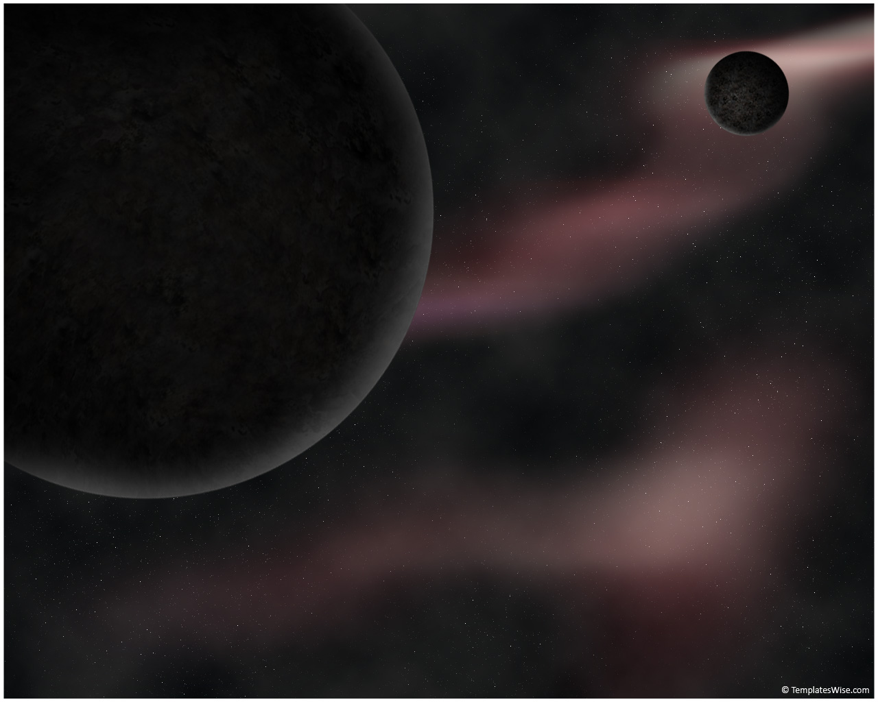
Morphological Analysis of Galaxies From High-Resolution Simulations Using Automated Detection
Ian Tibbetts
Ariunjargal Bat-Erdene

Slide 2

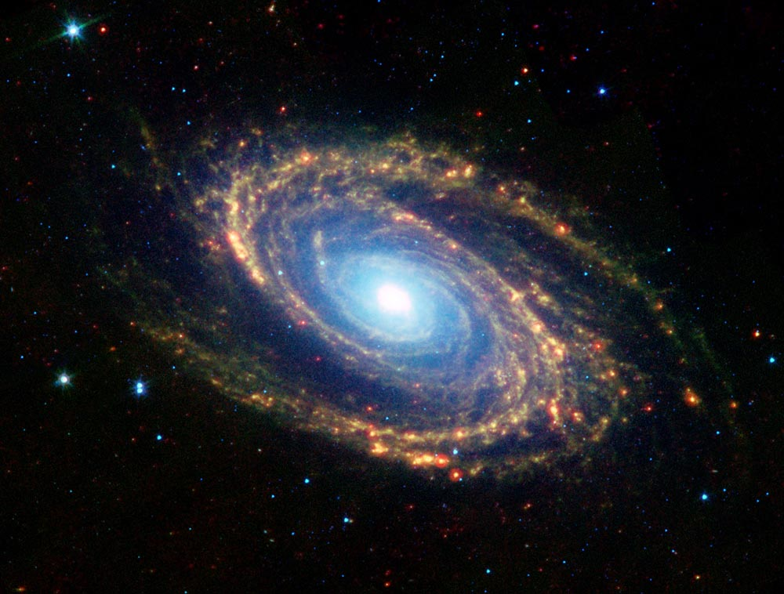
Why we care
Space is cool and there is lot to explore
The Big Bang: Our cosmic origin (how did we get here)
Part of emerging collaborations between observers and theorists in the field
Interdisciplinary: CS and Physics/Astronomy
Notes:
Space is cool – Explain why knowing more about space and our cosmic origins is important and interesting, famous movie quote
Collaborations between observational and theoretical astronomers – cooperation between these two parts of astronomy is a key step towards understanding more about galaxy morphology and our cosmic origins
Interdisciplinary – Python used to automate tools used by astronomers

Slide 3
Title

Slide 4

Title

Slide 5
Title

