Slide 1
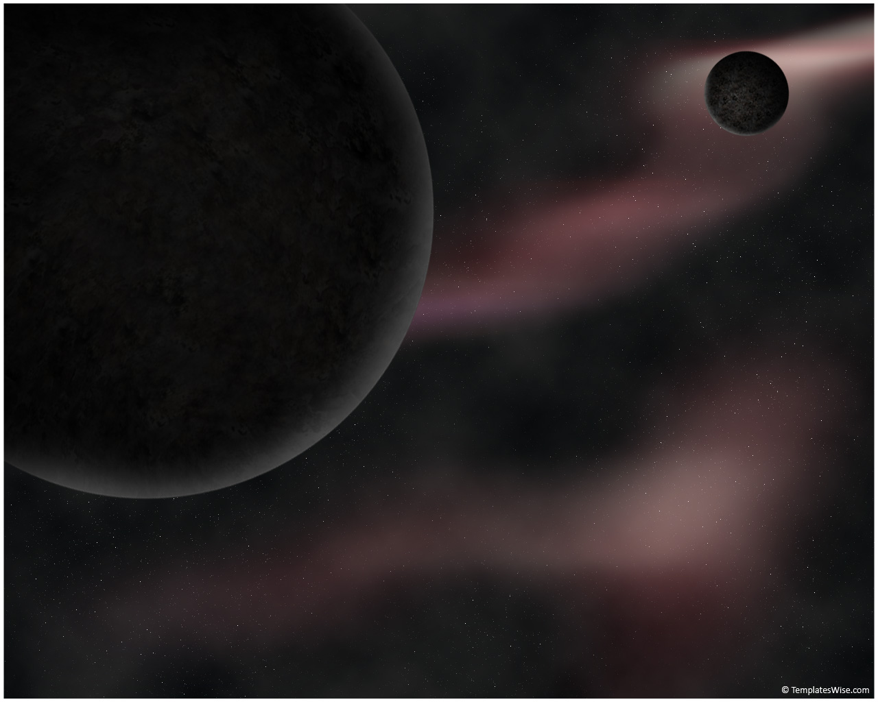
Morphological Analysis of Galaxies From High-Resolution Simulations Using Automated Detection
Ian Tibbetts
Ariunjargal Bat-Erdene

Slide 2

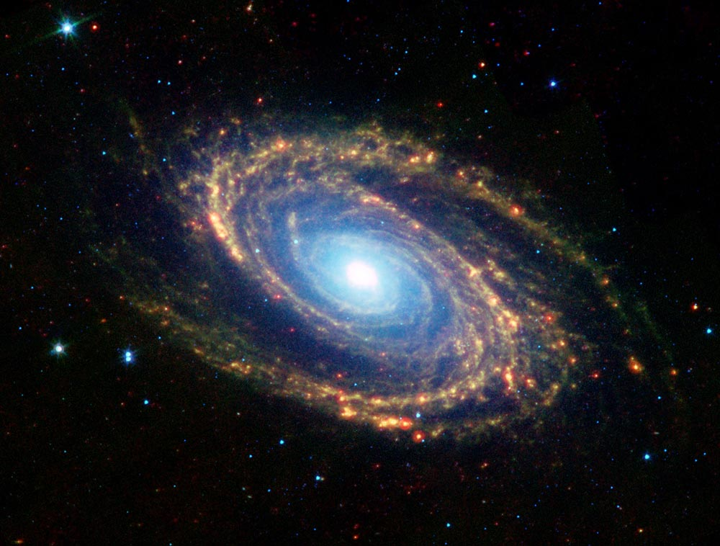
Why we care
Space is cool and there is a lot to explore
The Big Bang: Our cosmic origin (how did we get here)
Part of emerging collaborations between observers and theorists in the field
Interdisciplinary: CS and Physics/Astronomy
Notes:
Space is cool – Explain why knowing more about space is important and interesting – a famous movie quote?
Big Bang – Age of the universe, where we came from and how it evolved to today, our cosmic origins
Observational and theoretical astronomers – cooperation between these two parts of astronomy is a key step towards understanding more about galaxy morphology and our cosmic origins
Interdisciplinary – Python used to automate tools used by astronomers

Slide 3
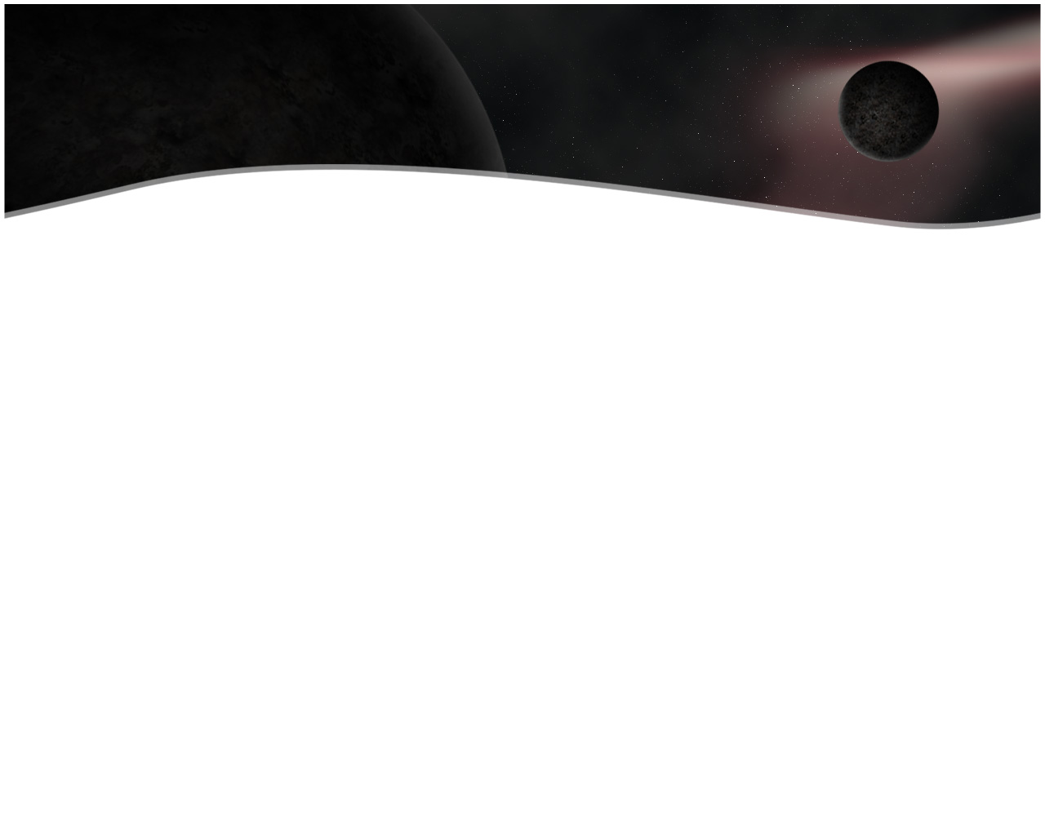
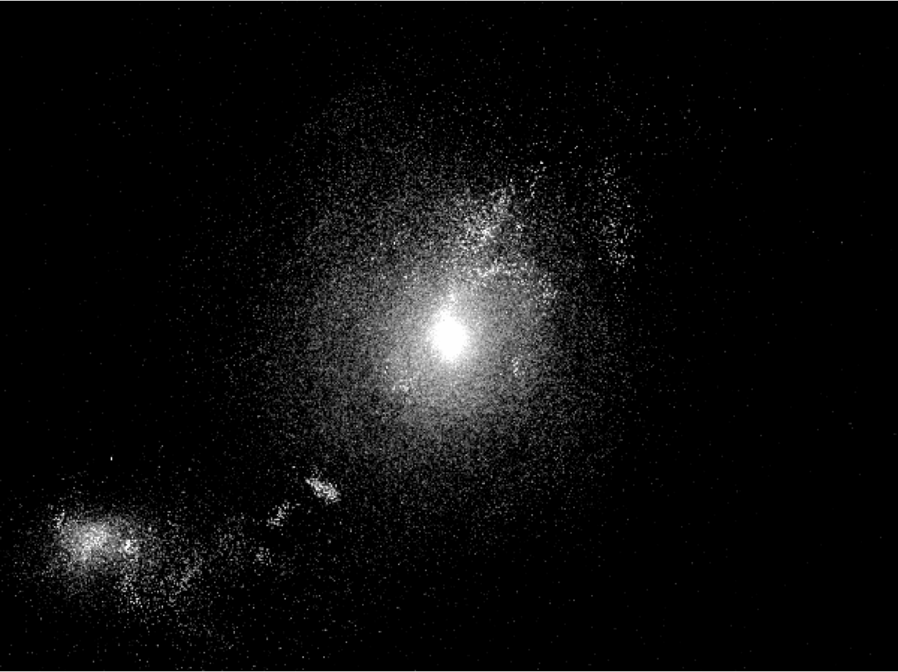
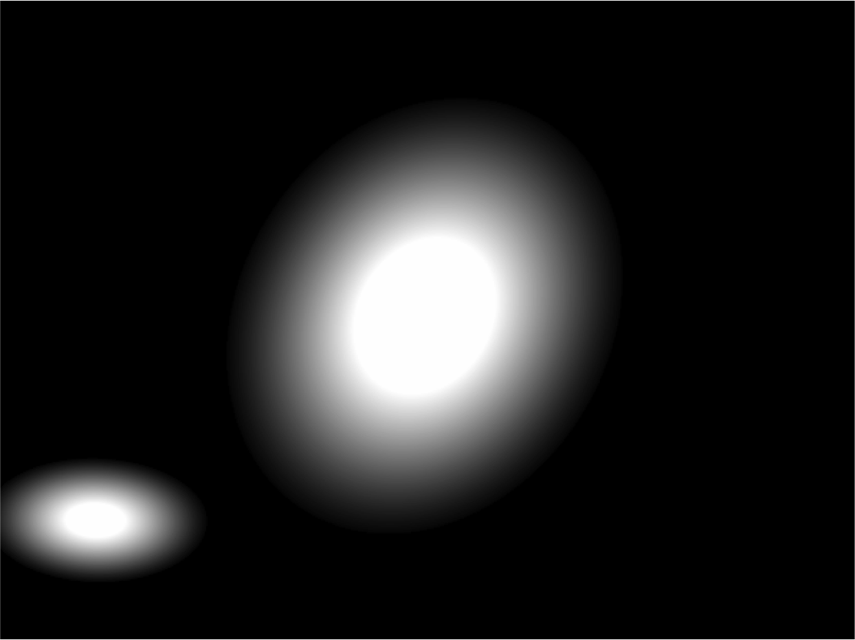
What we’re doing
High-resolution simulations
Hundreds of images for each galaxy
Automated fitting of elliptical models
Notes:
High-resolution simulations – images produced from fully cosmological mass simulations of evolving universe
# images – time steps over billions of years, multiple camera and angles and filters
Automated fitting – use elliptical models to get info about galaxies that can be compared with observable parameters

Slide 4
How we’re doing it
Source-Extractor
Identifies all of the galaxies in the image and guesses their properties
Galfit
Refines the guesses and outputs an image of the model and residual
Python
Program to run the above on a list of images and organize the outputs
Notes:
Sextractor – we set up the configuration file to work with our images, yields location and initial guesses for all galaxies in the image
Galfit – Use Sextractor output to write the parameter file to feed Galfit, yields a refined eliptical model and an image of the model and the residual with the original
Python – to mediate passing information between the above and to organize the at least to 6 output files for each image

Slide 5
Title

Slide 6
Title

Slide 7
Title

