Slide 1
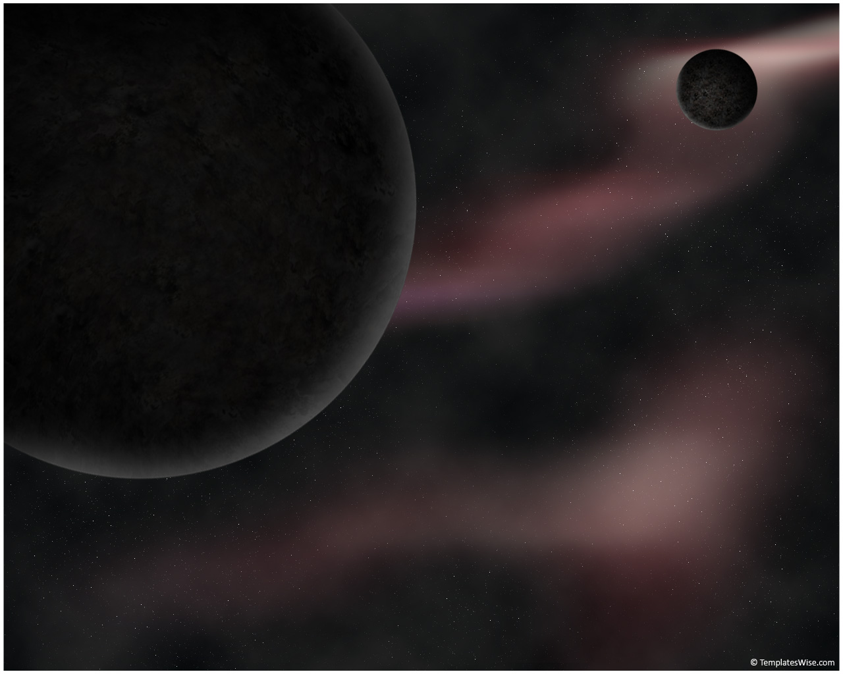
Morphological Analysis of Galaxies From High-Resolution Simulations Using Automated Detection
Ian Tibbetts
Ariunjargal Bat-Erdene

Slide 2
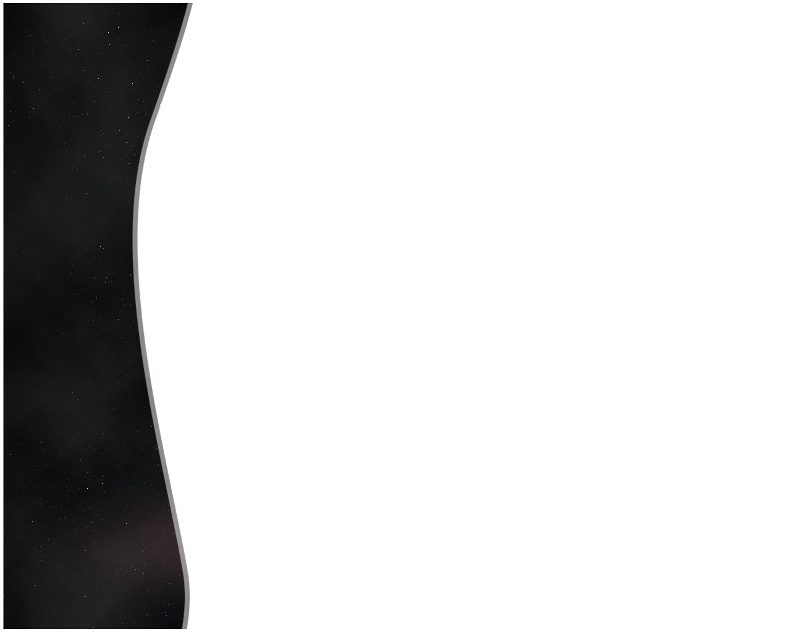
Title

Slide 3
Title

Slide 4
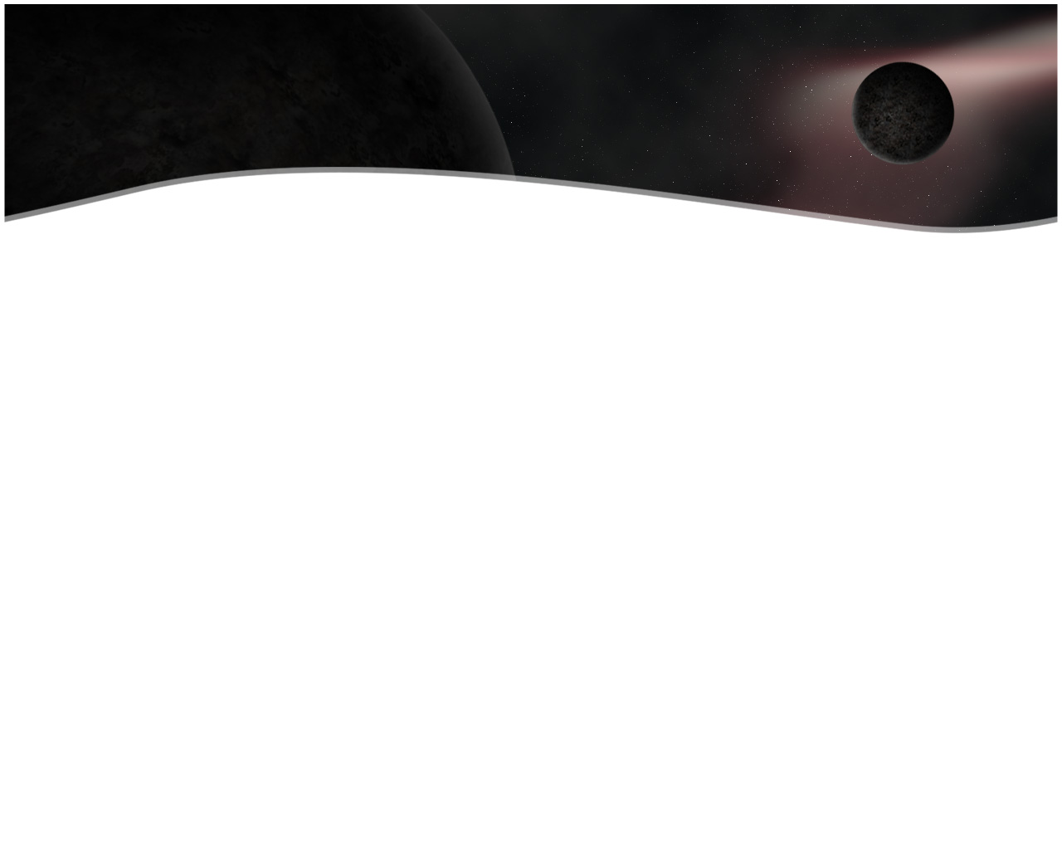
Title

Slide 5
Title

