Slide 1
STL Microsoft Fabric & Power BI Meetup
Write-Back in Power BI Is Finally Here!
How to Build Translytical Task Flows
with Multi-Row CRUD
Tony Kain | Senior Data Consultant
Tuatara Consulting | January 15, 2026

Slide 2
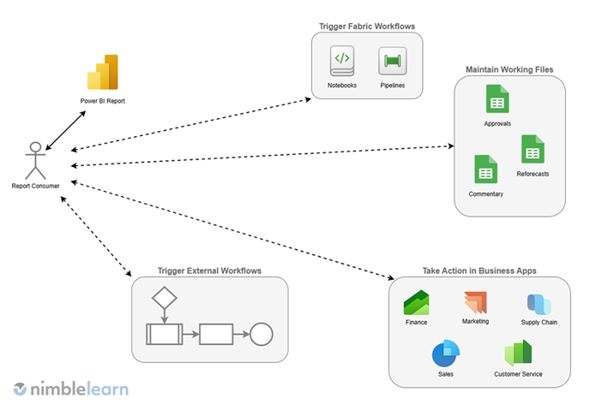

Today's loop:
Bob in accounting sees a report and notices some values need to be updated
He updates the values in one place
Bothers you and half the data team for some updates
You don't get it updated in PROD within 5 minutes of Bob's Teams messages, so he CCs the CTO
You make Bob's updates
He realizes he needs more
Round and round we go
Data team ☹
https://www.nimblelearn.com/blog/6-things-you-should-know-about-translytical-task-flows-in-microsoft-fabric/

Slide 3
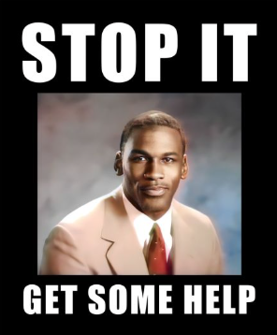
When it comes to updating data outside your source systems…
🛠️ Are you a Power App dev?
📤 Do you like Excel-round trips to export, edit, and re-import?
  Don't forget, Excel is a database!
💾 How about manually running UPDATE statements?
📓 Anyone for hardcoding in Notebooks?
📤 Ever have issues with source control in this chaos?
Do your users finally see the update they gave you and then
immediately need a new change, starting the cycle all over?

Slide 4
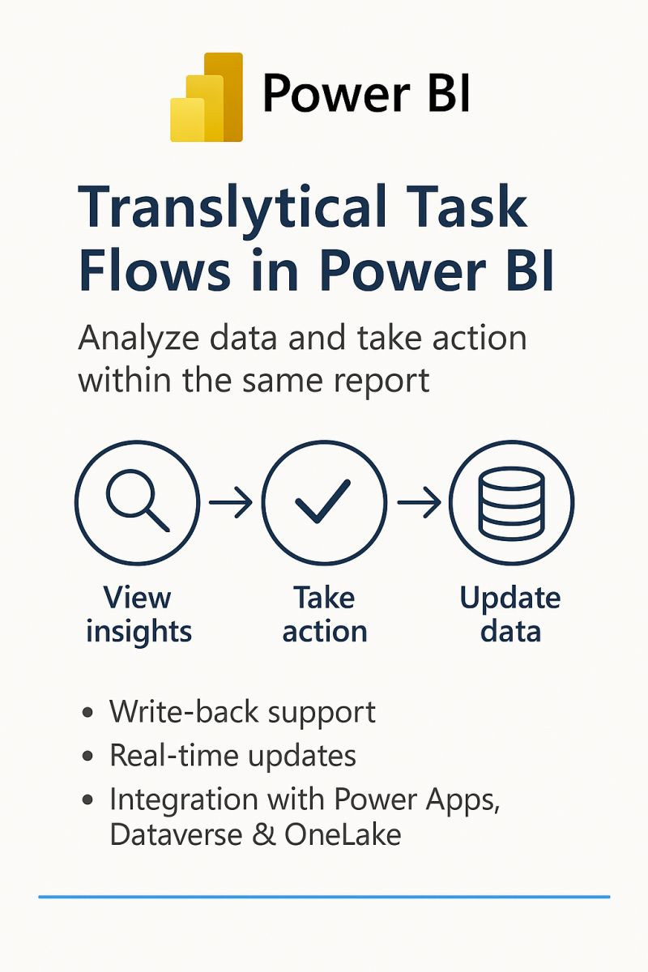
What Is a Translytical Task Flow?
Analyze → Select → Input → Commit → See Changes
Transaction + Analytical = Translytical
Traditional BI is read-only. You analyze data, but if you need to change something, you leave the report and go somewhere else.
Translytical closes that loop: the analytical tool becomes the transactional interface.
The user never leaves Power BI. No export. No separate app. No waiting for a refresh. The report is both the dashboard and the data entry form.

Slide 5
With Translytical Task Flows…
👤 Users update their own data — No more "hey can you change this for me?"
📊 Never leave Power BI — Select rows, enter value, click button, done
🔄 Instant feedback — DirectQuery refresh shows changes immediately
📝 Built-in audit trail — CDC history tracks who changed what and when
🔒 Governed access — Role-based permissions control who can edit

Slide 6
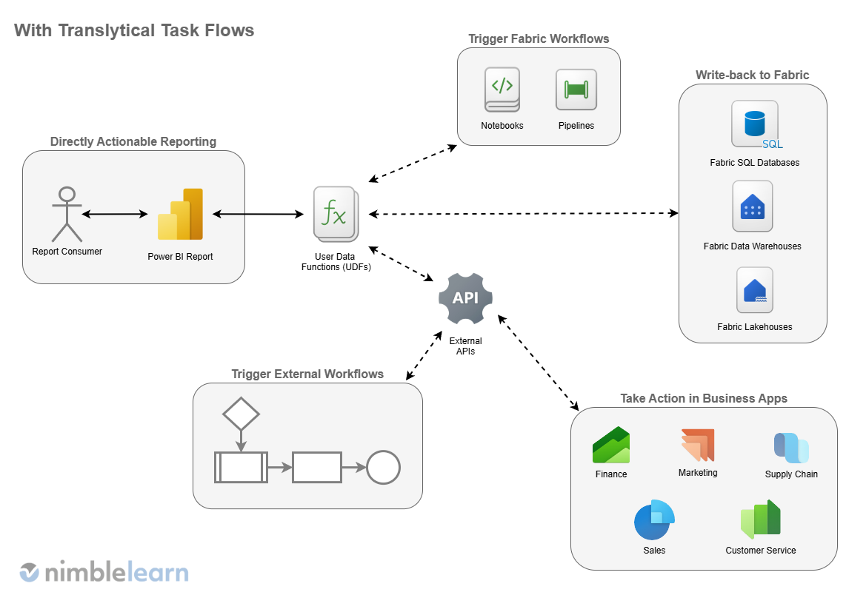
https://www.nimblelearn.com/blog/6-things-you-should-know-about-translytical-task-flows-in-microsoft-fabric/

Slide 7
Use Cases I've Actually Implemented
💰 Pricing / Rate Ops — batch update prices for selected SKUs
📈 Sales Pipeline — mass-update stage, owner, probability
📊 Forecasting — adjust forecasts for multiple rows
✅ Data Quality — fix flags, categories, statuses
⚙️ Config Management — update control tables from PBI
Coming later: Examples from others + theoretical possibilities
What would YOU use this for?

Slide 8

AI-Assisted Development
Full Disclosure: This project was AI-assisted
Code development, documentation, and even this presentation
🤖 Strong Opinion: Claude is the best for coding
Actually follows directions
Tells you when it doesn't know things
Doesn't make things up (AKA lie and send you down a rabbit hole)
📦 What's in the Repo
Heavily commented code (explains the "why")
PBIP file for config examination
github.com/imtkain/Fabric-Redux

Slide 9
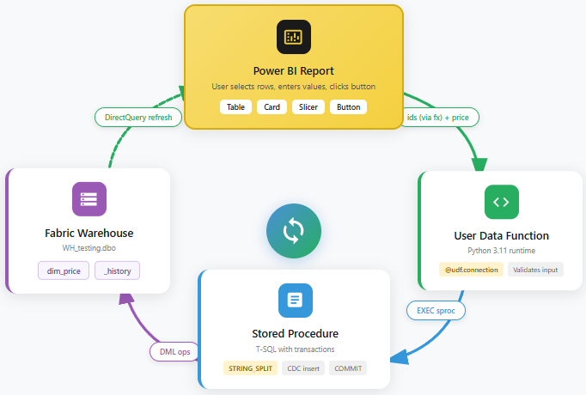

Slide 10
Test Environment
Workspace: Tuatara Sandbox
Warehouse: WH_testing
Tables: dim_price, dim_price_history
Sprocs: usp_insert/update/delete/reactivate_price
UDF Item: udf_testing
✅ Supported: Fabric Warehouse, Fabric SQL Database
⚠️ NOT Supported: Lakehouse
SQL analytics endpoint is read-only by design (we'll cover why later)

Slide 11
🎬
Live Demo
Let's see it in action
Table Visual • Card Visuals • Text Slicer • Button + UDF • CDC History

Slide 12
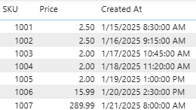
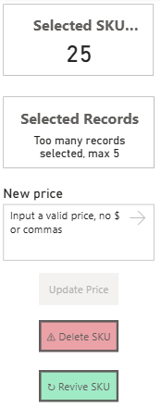
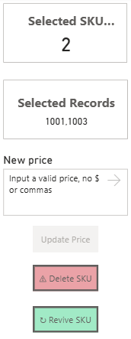
PBI Visual Checklist
📊 Table Visual — User selects rows
🔢 Card: Selected Row Count — Shows count of selected rows (COUNTROWS(VALUES(...)))
🔗 Card: Concatenated IDs — Displays the comma-delimited ID string (your Selected Records measure)
✏️ Slicer(s) — One Text slicer for each field you're updating (price, status, etc.)
🔘 Button(s) — One per operation (Update, Delete, Reactivate, etc.)
  Action type: Run function
  ids param: bind via fx to your concatenated IDs measure
  Other params: bind to slicers
  ⚠️ Only executable when all necessary slicers populated!

Slide 13
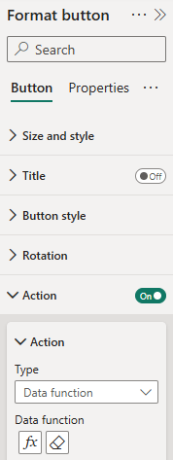
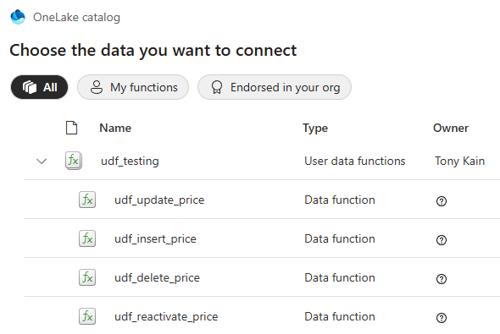
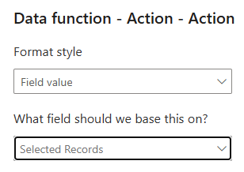

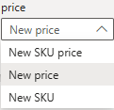

🔴 Critical: Button Wiring
This is where some people get stuck!
The dropdown for parameters in Format → Action only shows slicers.
You MUST click the fx button to bind a measure.
Parameters automatically become visible after selecting the function
⚠️ ids parameter — Click fx → Select "Selected Records" measure
✅ price parameter — Select Text slicer from dropdown (works normally)
✅ Recommend these ON
  "Refresh the report" – requeries to refresh visuals
  "Auto clear" – clears your slicers

Slide 14
DAX Measures & Guardrails
Selected Records =
VAR t_ids = VALUES( dim_price[sku] )
VAR id_count = [Selected ID Count]
RETURN IF(
id_count > 5,
"Too many records selected, max 5"
CONCATENATEX( t_ids, dim_price[sku], "," )
)
💡 The 5-row guardrail prevents "update all" accidents
Adjust to your org's risk tolerance — but HAVE one. Users WILL make mistakes.

Slide 15

🔴 UDF: Connection Setup
1. Fabric Portal: Edit → Manage connections → Create alias (e.g., "demo")
2. Decorator Stack:
@udf.connection("demo")
@udf.context(argName="ctx")
@udf.function()
def udf_update_price(demo, ctx, ids, price):
Note: Python 3.11 runtime (NOT PySpark) • Parameters cannot use snake_case

Slide 16
UDF: Calling the Stored Procedure
# Three-part naming REQUIRED
sql = """
EXEC WH_testing.dbo.usp_update_price
@id_list = ?, @price = ?, @user_name = ?;
"""
cur.execute(sql, (ids, price, user_name))
conn.commit() # REQUIRED!
💡 Three-part naming required for EXEC: Database.Schema.Object
💡 Parameters are positional (?) — order matters!
⚠️ conn.commit() is mandatory — without it, transaction rolls back!

Slide 17
Stored Procedure: STRING_SPLIT
WITH cte_sku_list AS (
SELECT CAST(value AS BIGINT) AS sku
FROM STRING_SPLIT(@id_list, ',')
WHERE RTRIM(LTRIM(value)) <> ''
)
UPDATE t SET
t.price = @price, t.updated_at = @timestamp...
FROM dim_price t
INNER JOIN cte_sku_list c ON t.sku = c.sku
💡 This is the T-SQL half of the CONCATENATEX + STRING_SPLIT pattern
Transaction pattern: BEGIN TRAN / TRY-CATCH / COMMIT / ROLLBACK

Slide 18
CDC: History Table & Restore Points
Every operation writes to dim_price_history:
Full row state at time of operation
operation_type: INSERT, UPDATE, DELETE, REACTIVATE
operation_timestamp, updated_by (user who made change)
vw_dim_price_history — composite key for restore points:
sku_version: "1001 (3)" — SKU 1001, version 3
💡 DBAs may demand audit trails. Build CDC in from day one.

Slide 19
🔴 DirectQuery Datetime Gotcha
The problem I hit when initially conceiving this idea:
Some row selections worked, others silently failed. No error — just BLANK.
Root Cause:
datetime2(6) retains sub-second precision in DAX
DirectQuery SQL truncates to seconds
Equality comparison fails → silent cross-filter failure
✅ Solution:
[created_at] [datetime2(0)] -- NOT datetime2(6)
⚠️ Undocumented silent failure. Fabric doesn't support datetime — use datetime2(0).

Slide 20
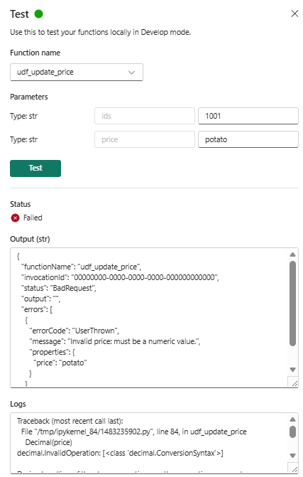

UDF Technical Constraints and Testing
Execution timeout: 240 seconds
Response size: 30 MB
Request payload: 4 MB
Authentication: User context only
⚠️ No SPN, no managed identity, no workspace identity
User's permissions apply to everything — including Key Vault
Testing and Debugging
Note that you can test from within the Fabric UDF UI
Hover over the function and click the flask
Enter the values you want to test – good detail on errors
Shows success/failure of custom error messages, too

Slide 21
The Art of the Possible
UDFs run on Python 3.11 — any HTTP-accessible service becomes a potential integration point.
Demonstrated by Others:
Azure OpenAI — AI suggestions from button click
Microsoft Graph — Teams posts, emails, M365 workflows
External REST APIs — Any HTTP endpoint via requests library
Data Activator — Event-driven UDF triggers
Theoretical (No PoC Yet):
Power Automate via HTTP triggers
Fabric REST API orchestration (trigger pipelines from UDF)
Links to TTF Gallery in repo README

Slide 22
🟡 Key Vault Credential Warning
Key Vault integration exists, BUT...
The invoking user must have Key Vault access
(Get permission on secrets)
❌ Not a service identity — UDFs run in user context only
⚠️ Each button-clicker needs Key Vault permissions

Slide 23
Why Not Lakehouse?
SQL analytics endpoint is READ-ONLY by design
"DML statements are not supported for this table type"
This is architectural, not a temporary limitation.
Workarounds Exist But Add Complexity:
delta-rs, Polars — require service principal auth
No V-ORDER optimization
Manual or scheduled VACUUM/OPTIMIZE maintenance
✅ Recommendation: Use Warehouse or SQL Database for TTF write-back

Slide 24
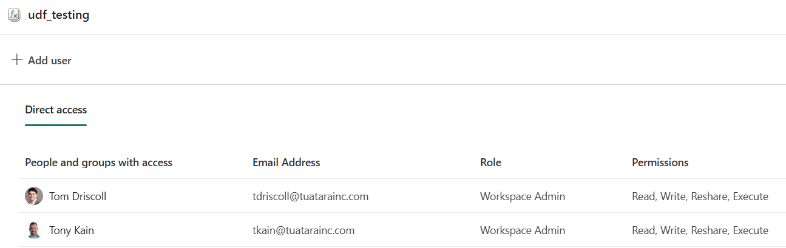
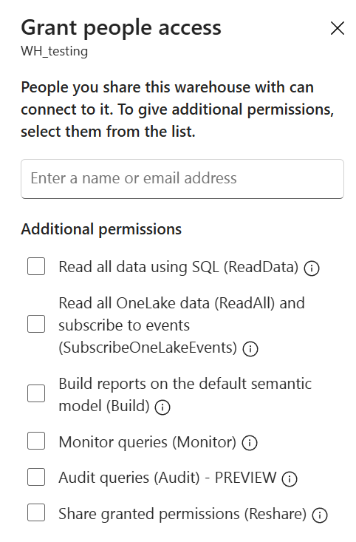
Access Control
UDF Permissions:
Add user groups to function's accessibility settings
Database Permissions:
CREATE ROLE price_editors;
GRANT INSERT, UPDATE, DELETE ON dbo.dim_price TO price_editors;
💡 Principle of Least Privilege:
Share with user group (click ... on warehouse) → uncheck all "additional permissions"
⚠️ Test both successful execution AND denied access

Slide 25
Resources
📦 GitHub: github.com/imtkain/Fabric-Redux
📚 Microsoft TTF Docs, UDF Docs, Service Limits
🎨 TTF Gallery (community examples)
📝 LinkedIn Article: "Multi-row Translytical Task Flows in Microsoft Fabric"
Alternative Approach Worth Reading, probably better for APIs:
evaluationcontext.github.io/posts/translytical-rows/
All links available in the repo README

Slide 26
❓
Questions?
Let's discuss
Tony Kain
Senior Data Consultant | Tuatara Consulting
github.com/imtkain/Fabric-Redux

