Slide 1
POINT CLOUD WORKSHOP
Natapong Intarasuk
6770312121
Chulalongkorn University
Int.natapong@gmail.com

Slide 2
Agenda: what are we gonna talk today.
What is actually point cloud
Why its difficult to understand than images
What is features of 3D Point clouds?
3D Data Analysis
Deep Learning for 3D Point cloud
Where did I find this knowledge (EXTRA !!!)

Slide 3
What point cloud actually is ?
A point cloud is a collection (set) of 3D points, representing as a 2D array with shape (N, 3) where N is the number of points and 3 represents the X, Y, Z coordinates.
Beyond just “where” a point is, sensors often capture “what” the point is like i.e. Intensity, RGB Color, Timestamp.

Slide 4

File I/O Operations
ASCII Format
Extension: .xyz, .txt, .csv
Pros: universally compatible, human readable
Cons: Large files, don’t have metadata
LAS Format
Extension: .las, .laz
Pros: Can store metadata,standardize, fast, compressed
Cons: can’t readable, can store only point cloud
BINARY Format
Extension: .ply, .e57, .obj
Pros: can store 3D mesh, even 2D images, flexible, fast
Cons: Some software don’t support

Slide 5
Why its difficult to analyze than 2D image
Unstructured Data: Unlike a digital photo, points are scattered. There is no inherent “neighbor” relationship between point A and point B.
Permutation Invariance: The data doesn’t care about order. If you have 1M points, you can shuffle the list, and the shape remains exactly the same.
Scale Invariance: A point cloud of a coffee cup and a point cloud of skyscraper can look identical in structure; only the coordinate values tell you the actual size.

Slide 6
The Neighborhood Concept
💡 Why This Matters: Feature extraction is the bridge between raw 3D data and intelligence. These geometric descriptors enable machine learning models to distinguish walls from trees, roads from roofs, and structures from clutter.
A single point’s coordinates tell us nothing about its context. But analyzing its neighbors reveals whether it’s part of a line (pole), plane (wall), or volume (vegetation).

Slide 7
Spatial Queries with KD-Trees
K-Nearest Neighbors (KNN)
Find the K closest points to each query point.
Pros: Fixed number, consistent density
Cons: Ignores physical scale
Typical K: 10-50 points
Radius Search
Find all points within a fixed radius
Pros: Physically meaningful scale
Cons: Variable neighbor count
Typical Radius: 0.1 – 1.0 meters

Slide 8
Computing Geometric Features
Once we have neighborhoods, we apply Principal Component Analysis (PCA) to extract shape descriptors.
Feature | Formula | Detects | Range
Linearity | (λ₁ – λ₂) / λ₁ | Cables, poles, edges | 0 (not linear) to 1 (perfect line)
Planarity | (λ₂ – λ₃) / λ₁ | Walls, ground, roofs | 0 (not planar) to 1 (perfect plane)
Sphericity | λ₃ / λ₁ | Vegetation, clutter | 0 (flat) to 1 (spherical)
Verticality | 1 – |N_z| | Vertical surfaces (facades) | 0 (horizontal) to 1 (vertical)
Omnivariance | (λ₁·λ₂·λ₃)^(1/3) | Local roughness/noise | Higher = more scattered

Slide 9
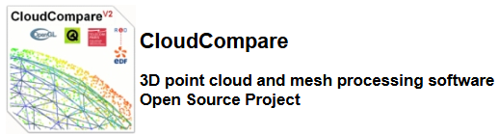
Cloud Compare Hands on
Import, Cleaning, Subsampling.
Compute Geometric Features.
Export to CSV, using for ML.

Slide 10
Machine Learning
https://medium.com/data-science/3d-machine-learning-course-point-cloud-semantic-segmentation-9b32618ca5df
https://github.com/uav4geo/OpenPointClass
https://arxiv.org/pdf/1705.08374

Slide 11
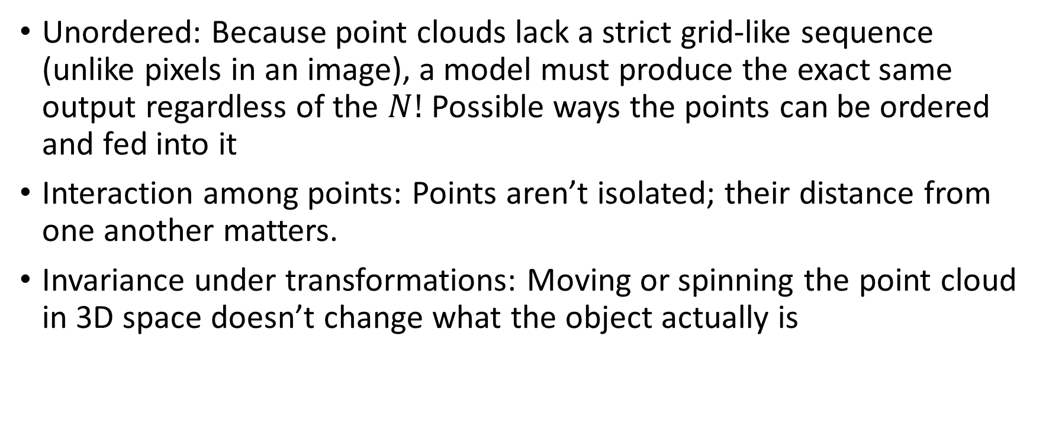
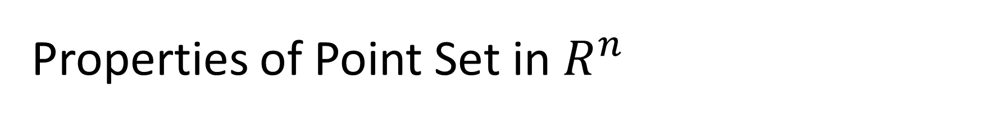
Properties of Point Set in $R^{n}$
Unordered: Because point clouds lack a strict grid-like sequence (unlike pixels in an image), a model must produce the exact same output regardless of the $N!$ Possible ways the points can be ordered and fed into it
Interaction among points: Points aren’t isolated; their distance from one another matters.
Invariance under transformations: Moving or spinning the point cloud in 3D space doesn’t change what the object actually is

Slide 12
PointNet
https://colab.research.google.com/drive/12RQDCV7krZtfjwJ0B4bOEBnvnDHTu-k2?usp=sharing
https://datascienceub.medium.com/pointnet-implementation-explained-visually-c7e300139698
https://medium.com/@itberrios6/introduction-to-point-net-d23f43aa87d2

Slide 13
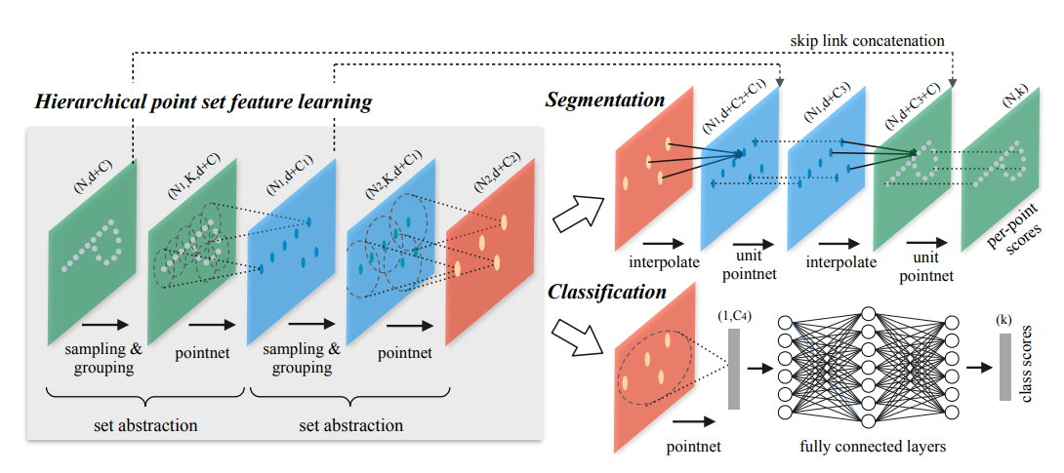
PointNet++
https://colab.research.google.com/drive/18zkBVxE_yPiiUyWWTiMz59cvo8jUjvvG?usp=sharing

Slide 14
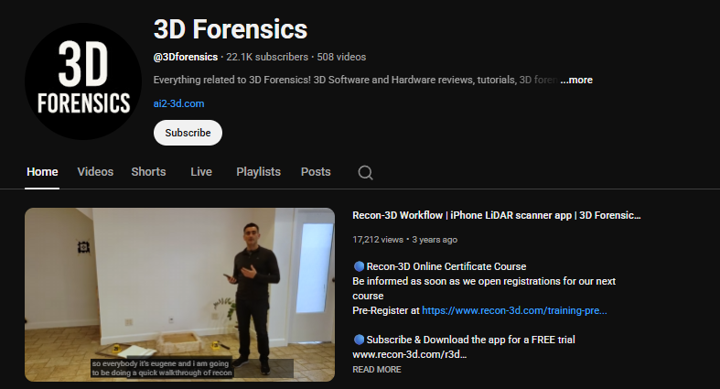
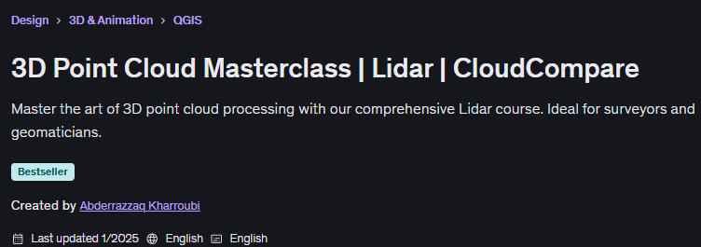


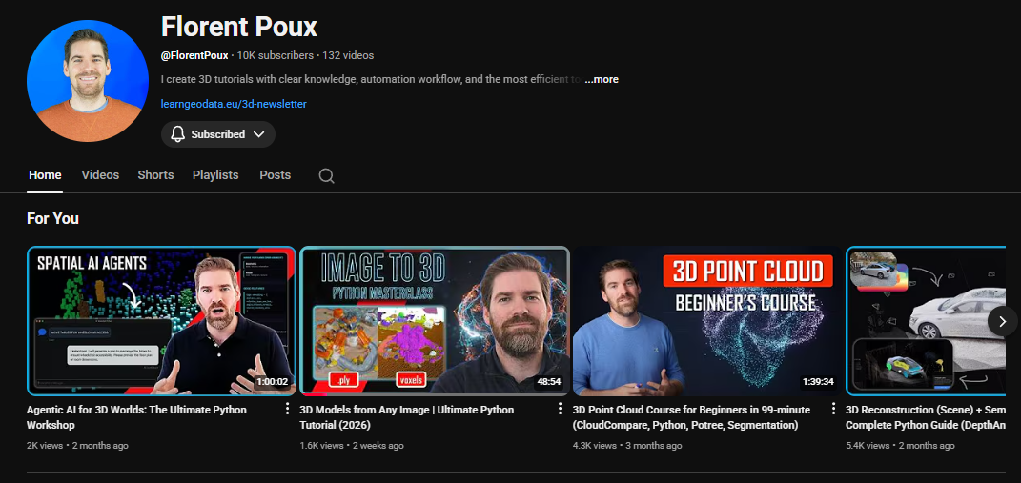


Where did I find this knowledge (EXTRA !!!)

