Slide 1
Shiro安全框架
数据应用开发组
石伟森
2019.9.4

Slide 2
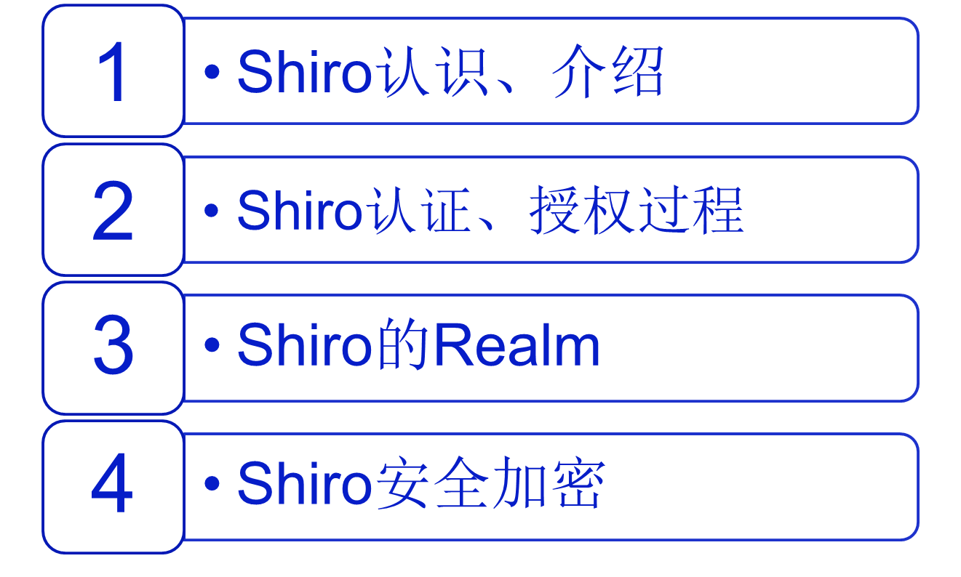
2019-9-4

Slide 3
Shiro认识和介绍
Apache的强大灵活的开源安全框架
认证、授权、企业会话管理、安全加密
什么是Shiro
2019-9-4

Slide 4
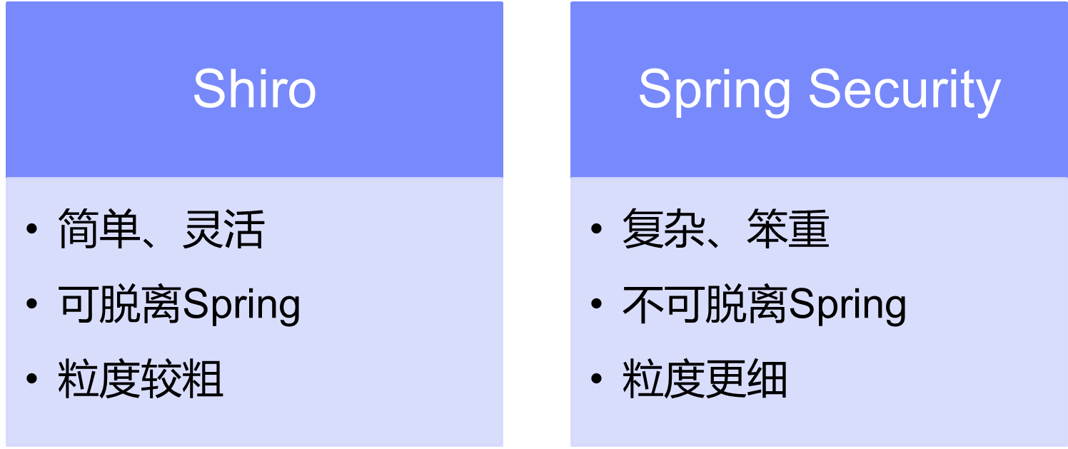
Shiro认识和介绍
Shiro与Spring Security比较
2019-9-4

Slide 5
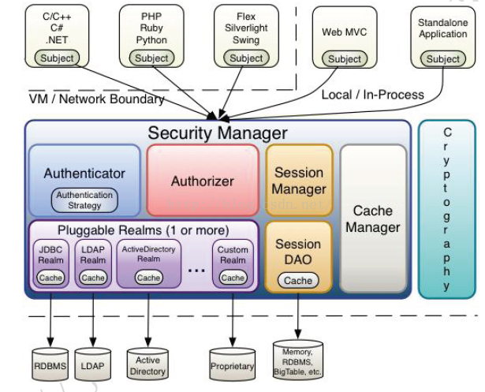
Shiro整体架构
2019-9-4

Slide 6
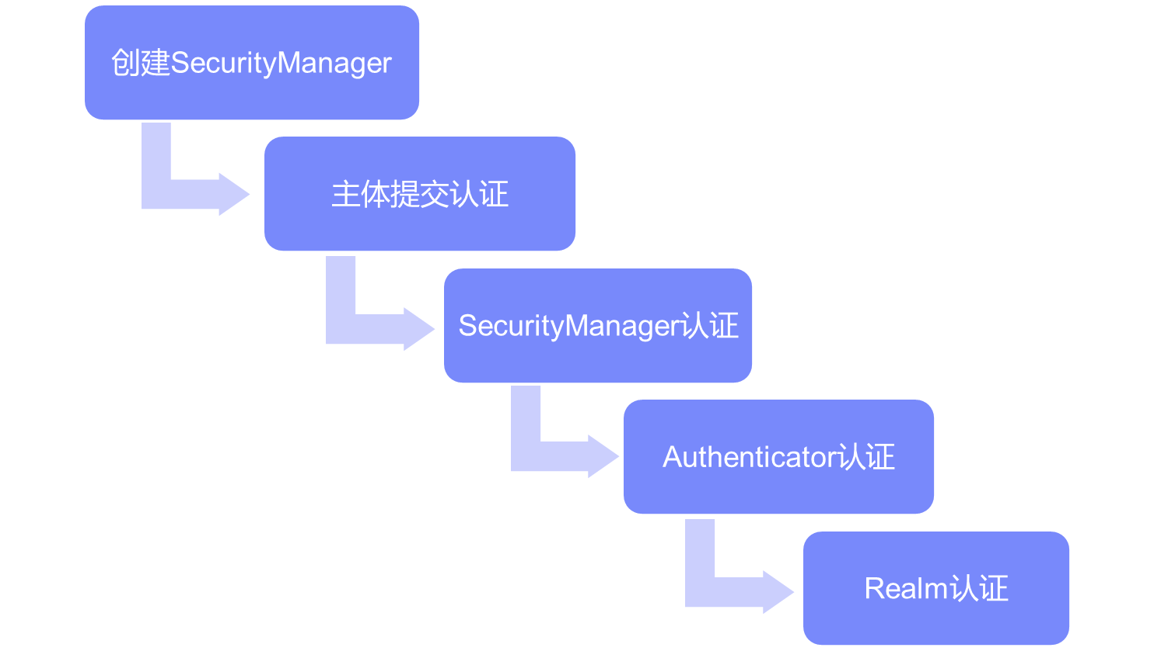
Shiro认证
2019-9-4

Slide 7
Shiro认证
//创建SecurityManager
DefaultSecurityManager defaultSecurityManager = new DefaultSecurityManager();
defaultSecurityManager.setRealm(simpleAccountRealm);
//获取主体
SecurityUtils.setSecurityManager(defaultSecurityManager);
Subject subject = SecurityUtils.getSubject();
//主体提交认证
UsernamePasswordToken usernamePasswordToken = new UsernamePasswordToken("admin", "admin123");
subject.login(usernamePasswordToken);
2019-9-4

Slide 8
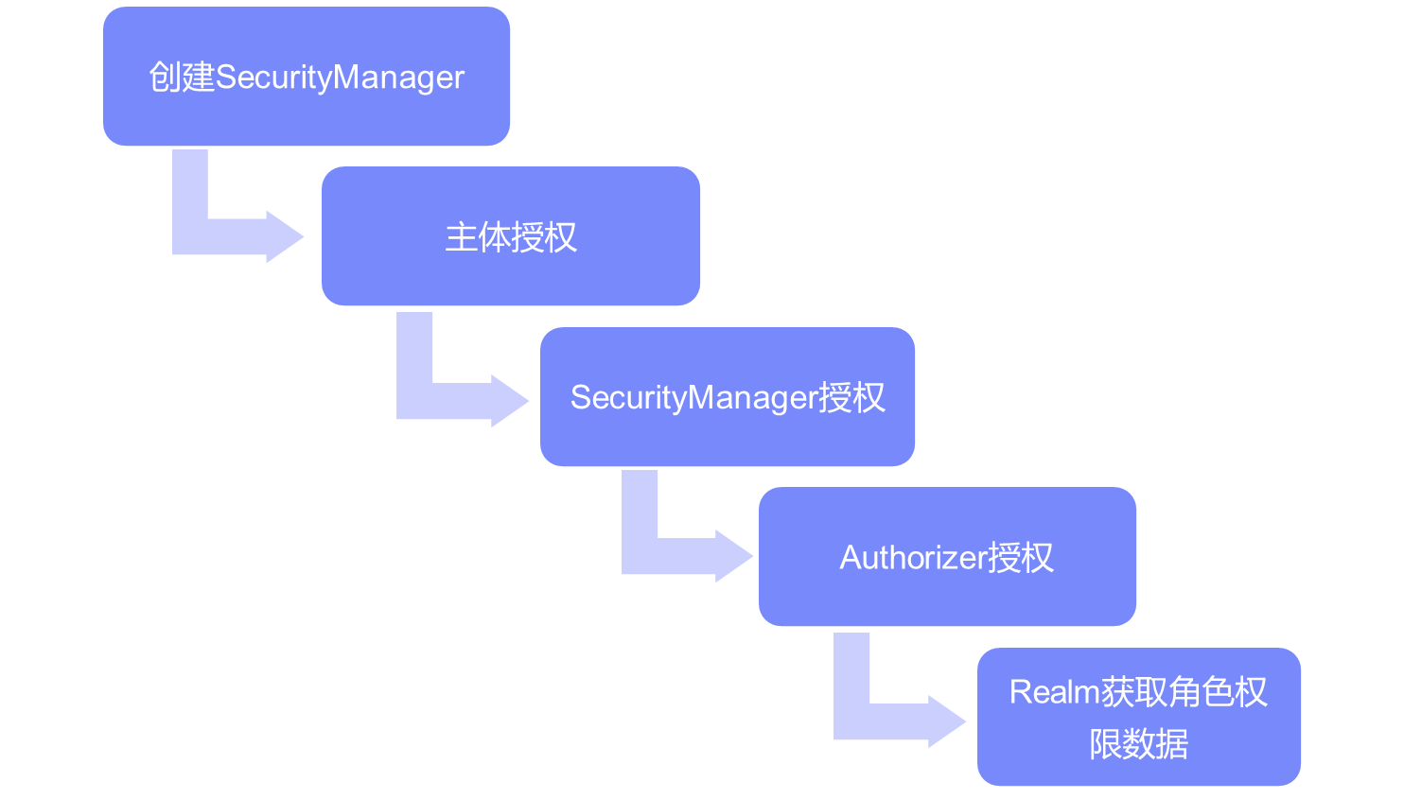
Shiro授权
2019-9-4

Slide 9
Shiro授权
simpleAccountRealm.addAccount("admin","admin123","admin","user");
subject.login(usernamePasswordToken);
System.out.println("subject.isAuthenticated: "+subject.isAuthenticated());
subject.checkRole("admin");
subject.checkRoles("admin","user");
2019-9-4

Slide 10
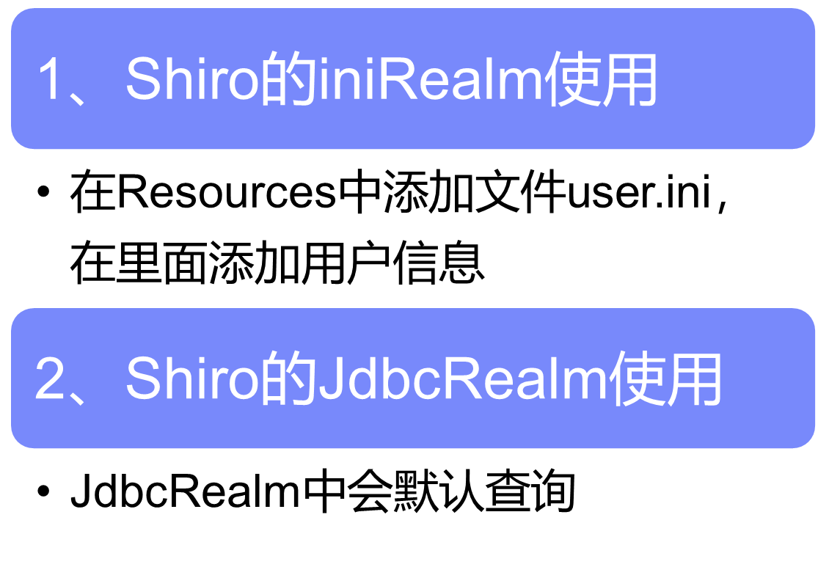
Shiro的Realm
2019-9-4

Slide 11
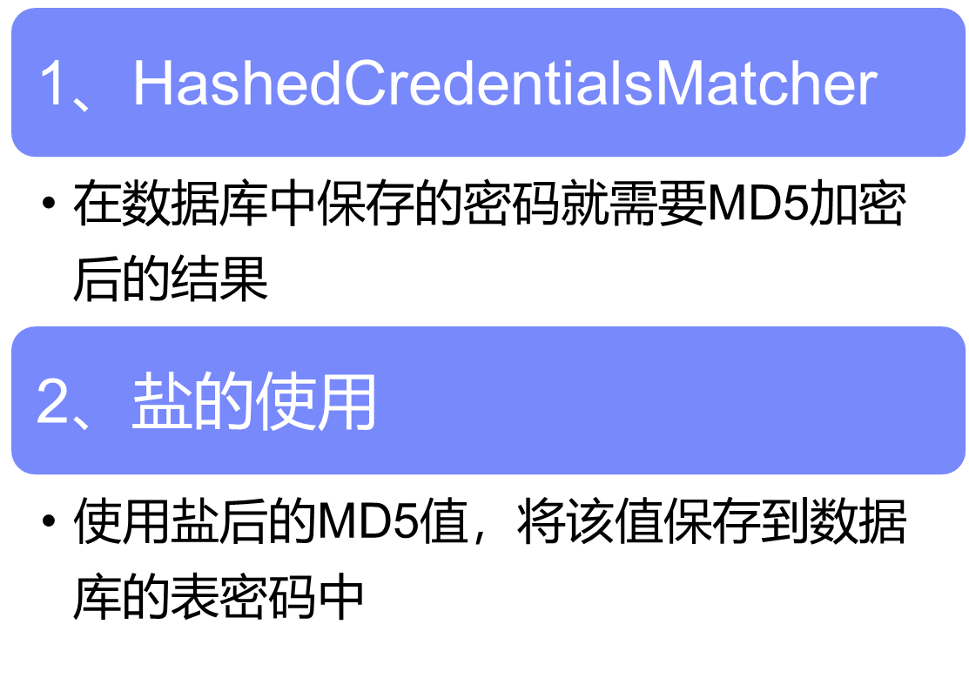
Shiro安全加密
2019-9-4

Slide 12
Shiro安全加密
1、MD5加密
public static void main(String[] args) {
Md5Hash md5Hash = new Md5Hash("admin123");
System.out.println(md5Hash.toString());
}
2、MD5加盐加密
public static void main(String[] args) {
Md5Hash md5Hash = new Md5Hash("admin123","admin");
System.out.println(md5Hash.toString());
}
2019-9-4

Slide 13
Shiro安全加密
1、shiro加密代码
HashedCredentialsMatcher matcher = new HashedCredentialsMatcher();
//加密的算法
matcher.setHashAlgorithmName("md5");
//加密的次数
matcher.setHashIterations(1);
customRealm.setCredentialsMatcher(matcher);
2019-9-4

Slide 14
谢 谢！
2019-9-4

