Slide 1
Standardized Dual-track Trial Language (SDTL) for AI-based Clinical Trial Matching
Jointly standardizing English phrasing and Machine-readable language to facilitate trial matching.

Slide 2
Background and Introduction

Slide 3
Clinical Trials
Widely used method of obtaining data on tests/experiments on people with various drugs
Look for participants determined by certain eligibility criteria
Eligibility criteria for clinical trials broken up into inclusion/exclusion criteria
Data accessible online

Slide 4
It’s difficult in the current system for participants to determine which trials they’re eligible to participate in.

Slide 5
Issue
Clinical trials suffer from low rates of participation
Only ~ 3% of cancer patients participate in clinical trials
Impact:
Loss of opportunity for patients
Roadblock to approval
Significant (~$2 billion) economic cost

Slide 6
Proposed Solutions
Structuring eligibility criteria would increase trial participation
Unstructured criteria makes it more difficult to find trials that a patient is eligible for
Lack of awareness of trials is a common reason for lack of participation

Slide 7
Proposed Solutions
Ones we’ll talk about in this presentation
Cluster the eligibility criteria to find similar ones
Find discrepancies in the writing of the clusters and propose a standardization
Proceed to make fill-in templates of the eligibility criteria for similar ones
Ones we won’t talk about in this presentation
Create an interface
Participants can use the templates to fill in about a certain topic and then have the program figure out which trials the results match up with

Slide 8
Methods

Slide 9
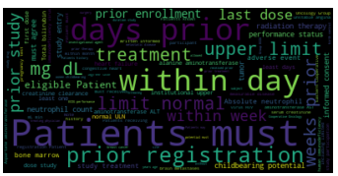
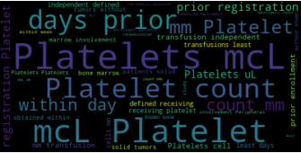
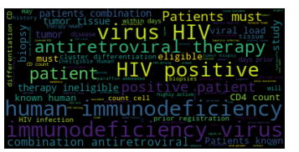
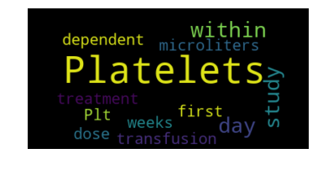
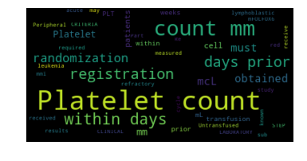
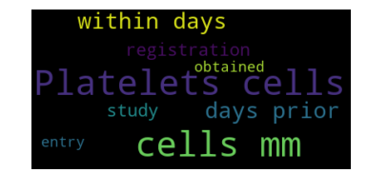
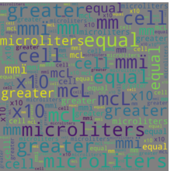
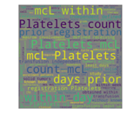
All Criteria
Unclustered Criteria
Platelet
megacluster
HIV Status
megacluster
Criteria megaclusters
. . .
Platelet
cluster 1
Platelet
cluster 2
Platelet
cluster 10
Criteria clusters
(phrasings)
. . .
Transform rules
Transform rules to reduce
phrasings, keep semantics
Platelet
Standardized Megacluster
Criteria standardized
megacluster

Slide 10
All Criteria
Unclustered Criteria

Slide 11
All Criteria
Unclustered Criteria
Platelet
megacluster
HIV Status
megacluster
Criteria megaclusters
. . .
Platelet
cluster 1
Platelet
cluster 2
Platelet
cluster 10
Criteria clusters
(phrasings)
. . .
Transform rules
Transform rules to reduce
phrasings, keep semantics
Platelet
Standardized Megacluster
Criteria standardized
megacluster

Slide 12
All Criteria
Unclustered Criteria
Platelet
megacluster
HIV Status
megacluster
Criteria megaclusters
. . .

Slide 13
All Criteria
Unclustered Criteria
Platelet
megacluster
HIV Status
megacluster
Criteria megaclusters
. . .
Platelet
cluster 1
Platelet
cluster 2
Platelet
cluster 10
Criteria clusters
(phrasings)
. . .
Transform rules
Transform rules to reduce
phrasings, keep semantics
Platelet
Standardized Megacluster
Criteria standardized
megacluster

Slide 14
All Criteria
Unclustered Criteria
Platelet
megacluster
HIV Status
megacluster
Criteria megaclusters
. . .
Criteria clusters
(phrasings)
Platelet
cluster 1
Platelet
cluster 2
Platelet
cluster 10
. . .

Slide 15
All Criteria
Unclustered Criteria
Platelet
megacluster
HIV Status
megacluster
Criteria megaclusters
. . .
Platelet
cluster 1
Platelet
cluster 2
Platelet
cluster 10
Criteria clusters
(phrasings)
. . .
Transform rules
Transform rules to reduce
phrasings, keep semantics
Platelet
Standardized Megacluster
Criteria standardized
megacluster

Slide 16
Transform rules
Transform rules to reduce
phrasings, keep semantics
Platelet
Standardized Megacluster
Criteria standardized
megacluster

Slide 17

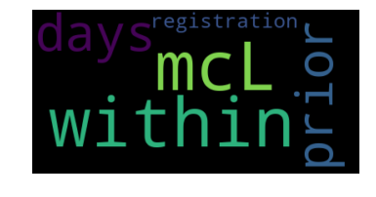
Platelet
Standardized Megacluster
Criteria standardized
megacluster
Platelet
Template
Platelet
Fill-ins
Template +
Fill-ins
+

Slide 18
Platelet
Standardized Megacluster
Criteria standardized
megacluster
Platelet
Template
Platelet
Fill-ins
Template +
Fill-ins
+

Slide 19
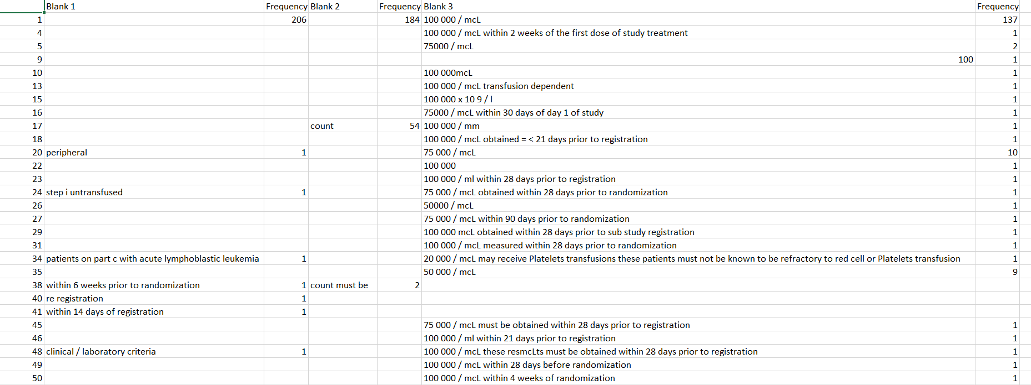
Platelet
Standardized Megacluster
Criteria standardized
megacluster
Platelet
Template
Platelet
Fill-ins
Template +
Fill-ins
+
Results:
We have a structure for platelet count eligibility criteria:
_____ Platelets _____ >= _____
We have a ‘most common’ example for platelet count eligibility criteria:
Platelets >= 100 000 / mcL

Slide 20
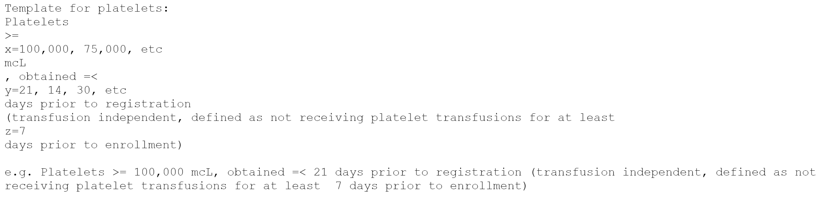
Derived Template Example
Show the fixed text of the template with blanks to fill in before and after
show options to fill in the blanks before and after
Examples at bottom
All the rest generated by computer program, but this one done manually

Slide 21
How was the clustering done?
Tf-idf vectorizer using idf (sparse matrices)
K-means clustering
Elbow method to determine optimal number of clusters
Python
sklearn, numpy, pandas

Slide 22
Results and Brief Discussion

Slide 23
342 Set

Slide 24
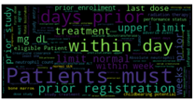
342 Set
Set of 342 cancer clinical trials
Total of 9776 eligibility criteria
Optimized at 300 clusters through elbow method
Clustered via K-means

Slide 25
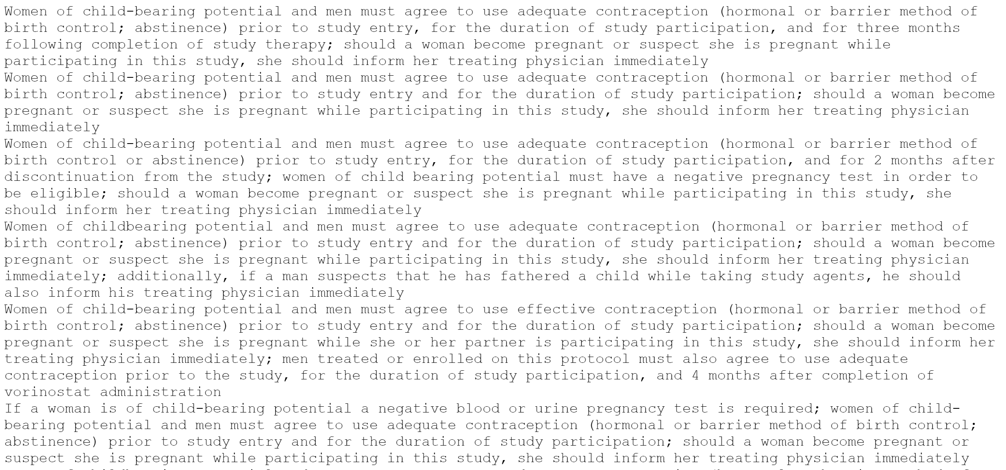
Part of an example cluster

Slide 26
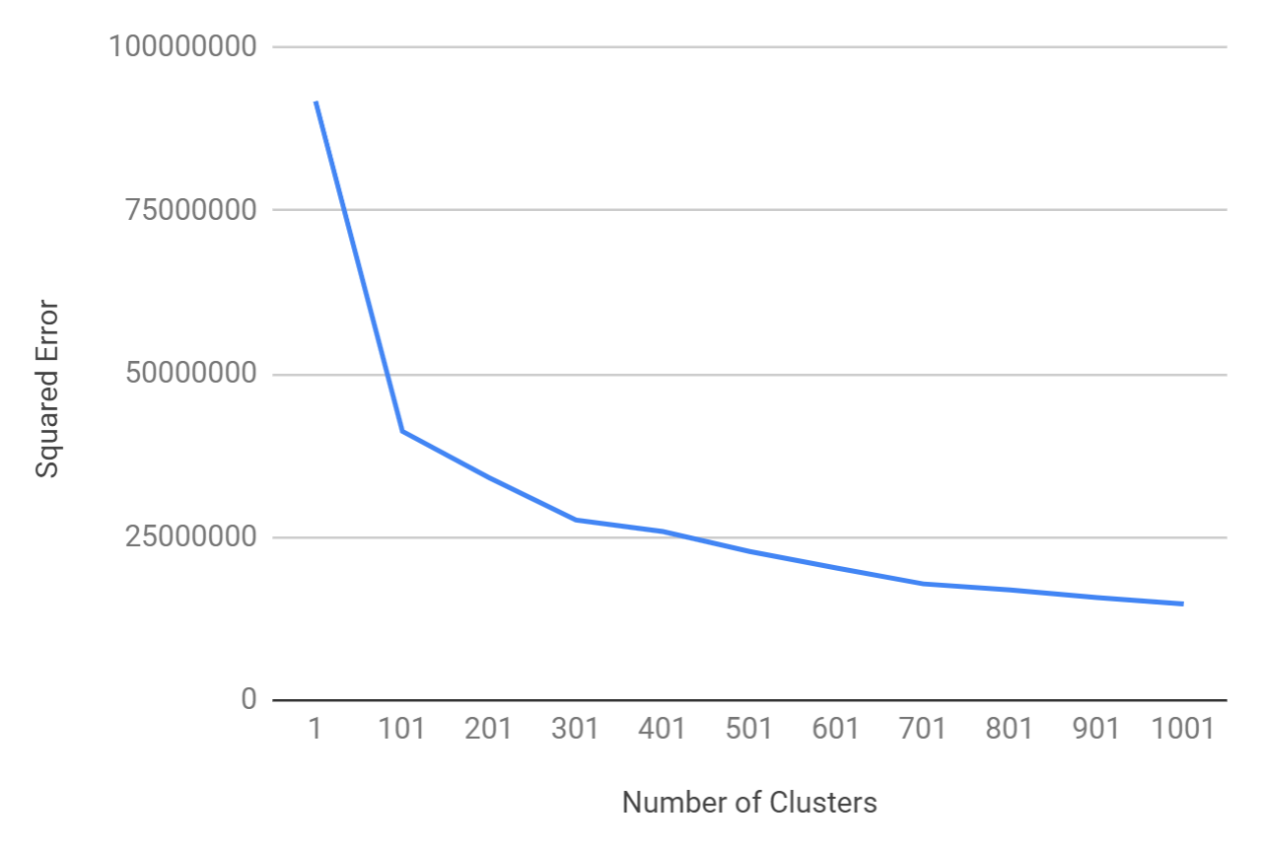
Elbow Graph for 342 Trials Set

Slide 27

Ordering - 342
Clusters were ordered so that similar clusters were closer to one another
The clusters were grouped and then the groups were arbitrarily ordered so that clusters within the group would be more similar to each other
Groups were created via affinity propagation since variable cluster size
The groups were determined by clustering the cluster centers
For each cluster, the 10 “cluster centers,” or defining words of those clusters, were generated
Affinity propagation generated 70 “groups,” or clusters of cluster centers
Example of platelet cluster

Slide 28
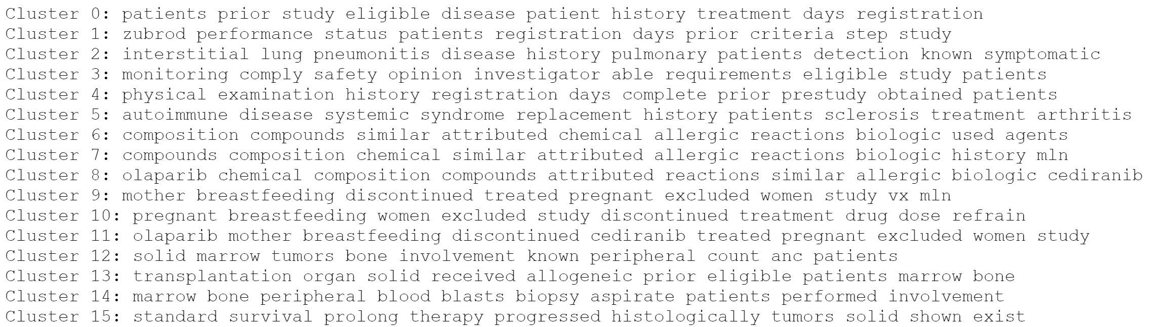
Example ordering of cluster centers

Slide 29
Summary - Final 342 Clustering Results
Clustered eligibility criteria of 342 trials
300 clusters of 9776 criteria with k-means
Ordered via affinity propagation

Slide 30

What is a megacluster?
A collection of similar clusters with a similar theme, or tag. An example would be all the clusters regarding platelets forming one platelet-related megacluster. Megaclusters are great for finding discrepancies within the standardization of how criteria are being written. For example, in a megacluster it might become evident which repeated pieces have equivalent meanings but are expressed differently, causing them to be clustered differently even though they mean the same thing.
Platelet megacluster wordcloud

Slide 31
Generating Megaclusters
After clusters were ordered it was easier to determine megaclusters
For the 342 set mostly done by hand due to small size
107 megaclusters generated
Some were only composed of one cluster
Others were composed of tens of clusters
Some big megaclusters: bilirubin, creatinine, hemoglobin, platelets, hiv, performance, pregnant (biggest), WBC, consent, investigational agents

Slide 32
Example megacluster in box based off breastfeeding

Slide 33
Finding Discrepancies
Change-To rules were generated for most megaclusters to determine equivalent phrasings and establish some standardization
It was a partially subjective process to determine repeated equivalent phrasings
After the change-to rules were generated for some of the bigger megaclusters, they were implemented in find-and-replace to create new pieces of text with standardization in how they are written

Slide 34
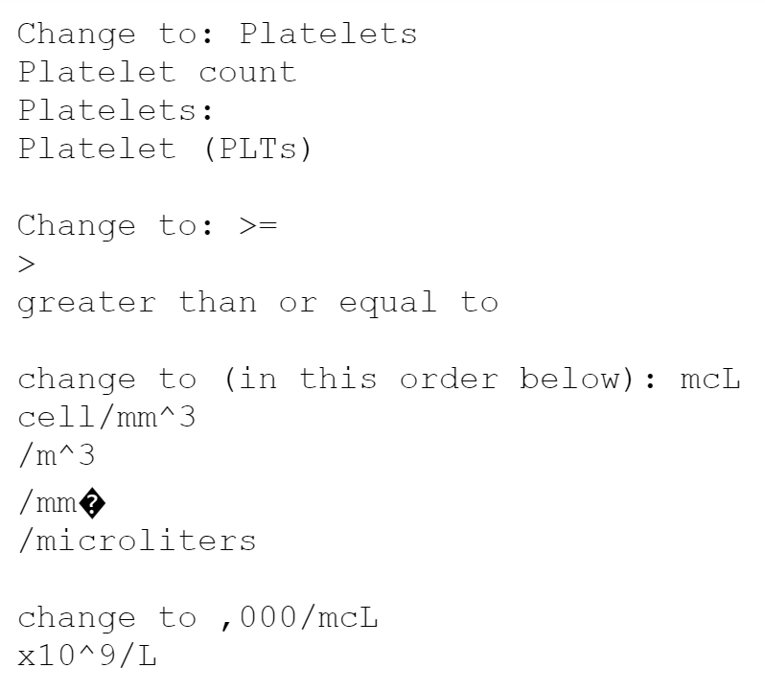
Example changeto rules for platelet megacluster

Slide 35
Reclustering after Change-To
To determine how effective the change-to rules actually were, the megaclusters were reclustered after the change-to rules were implemented
Could possibly alter how accurate clusters are and the optimal number of clusters
Could change the average variance in the clusters significantly, meaning better clusters and more similar eligibility criteria within them

Slide 36
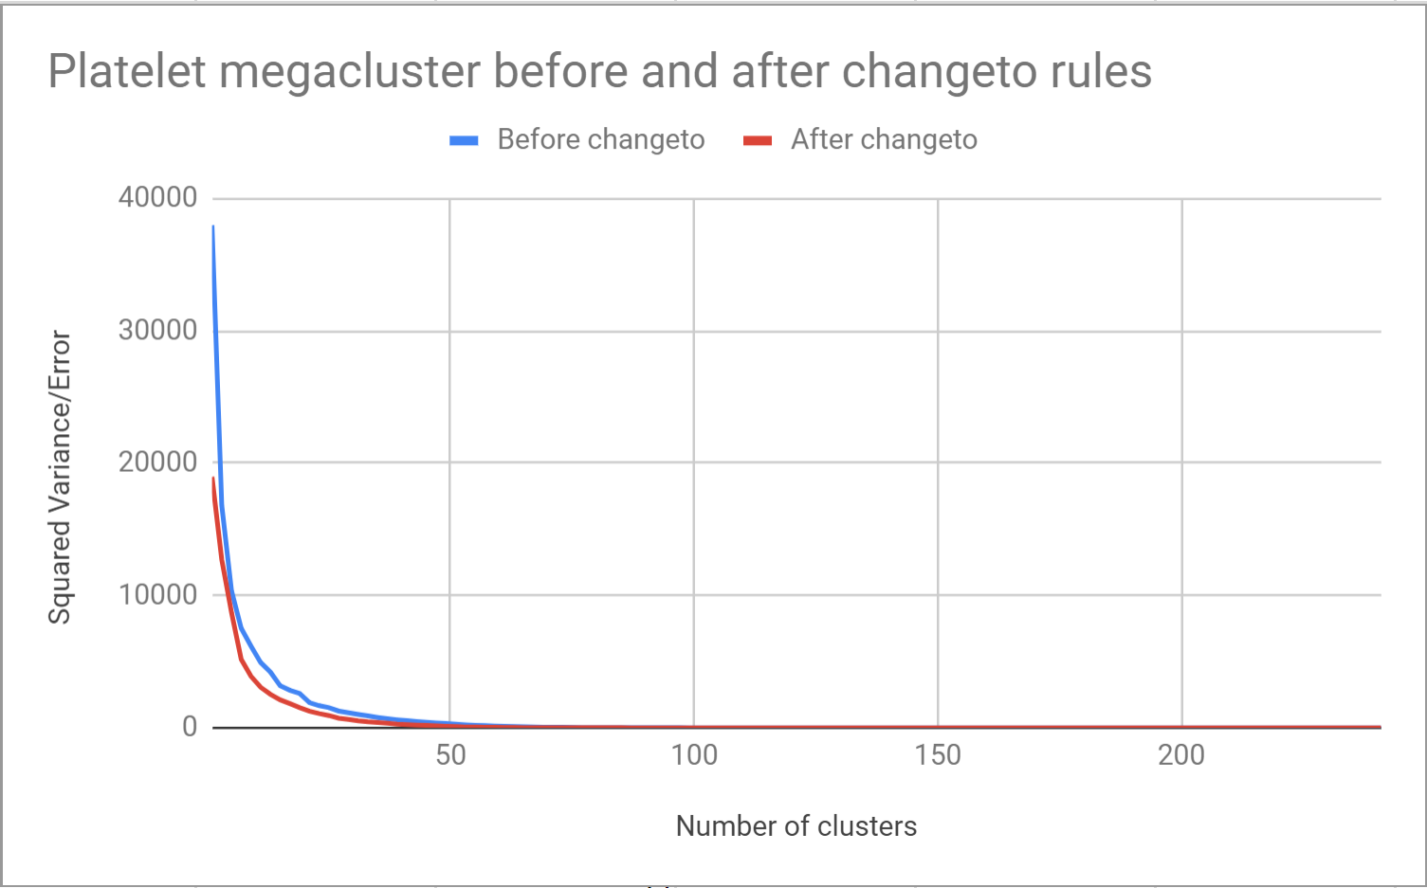
Platelet Reclustering Results

Slide 37
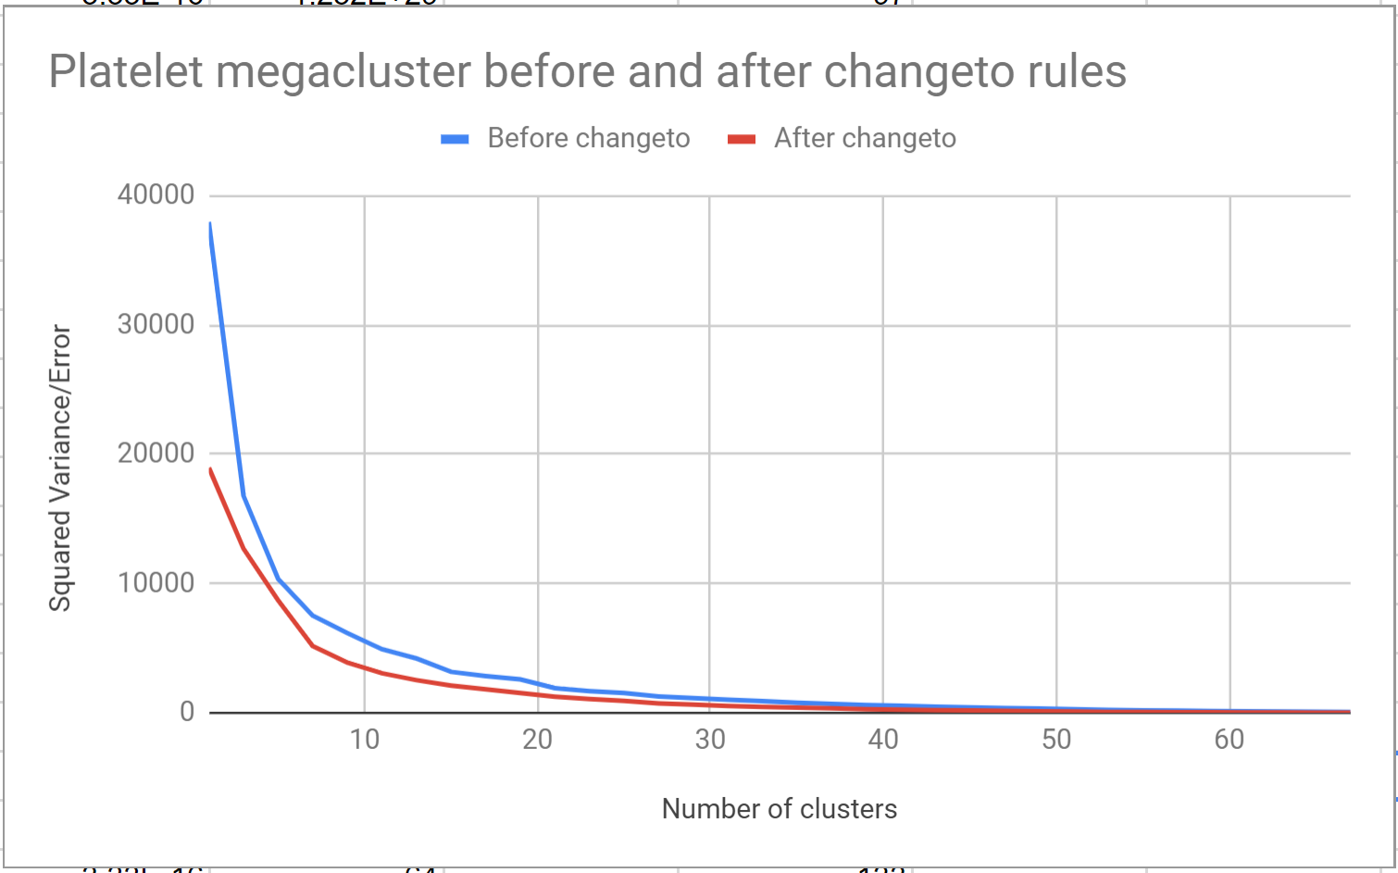
Platelet Reclustering Results

Slide 38
Platelet Reclustering Results
The number of optimal clusters went up from 9 → 11, but the average variance at the optimal cluster amount went from 6180.248111 → 3060.113113, a drop of 50.49%.
Before
Platelet Megacluster Wordclouds
After

Slide 39
Discussion of Platelet Reclustering
The variance in each cluster was about halved on average, meaning significantly more similar and better clusters that would allow for better fill-in template production later on. It also means that the current lack of standardization has a significant and non-negligible impact that has to be dealt with.

Slide 40
Other 340 Set Work
Participants were added to weight how much each criterion actually mattered
The program-generated “groups” of clusters could be counted as megaclusters, which is what happened in the future

Slide 41
We can structure eligibility criteria using templates
We created an algorithm that outputs structured templates from sets of similar text
Example:
Input - Output - Template
Fill-Ins
Signed, dated informed consent
Signed, written informed consent
Written informed consent
Written informed consent
BLANK | informed consent
signed dated
signed written
written
written

Slide 42
Our framework for structuring eligibility criteria:
Unstructured eligibility criteria
Clustered criteria
Megaclusters
Run Template algorithm
Structured eligibility criteria
Perform unsupervised clustering
Combine similar clusters and implement change-to rules

Slide 43
Input: unstructured eligibility criteria
Found on ClinicalTrials.gov
Unstructured eligibility criteria

Slide 44
Clustering
Unsupervised K-means clustering in Python was used to group eligibility criteria with similar free text
Unstructured eligibility criteria
Perform unsupervised clustering

Slide 45
Combining similar clusters and implementing change-to rules
Often, there were several clusters with the same “theme” (e.g. platelet count, informed consent). These clusters were combined to create ‘megaclusters.’
Megaclusters were altered to be more uniform using a set of manually created ‘change-to’ rules. For example, we might write a ‘change-to’ rule that changes “>=”, “greater than or equal to”, and “at least” to “>=”.
Unstructured eligibility criteria
Clustered criteria
Perform unsupervised clustering
Combine similar clusters and implement change-to rules

Slide 46
Running Template Algorithm
Template Algorithm was run on megaclusters to structure data
Unstructured eligibility criteria
Clustered criteria
Megaclusters
Run Template algorithm
Perform unsupervised clustering
Combine similar clusters and implement change-to rules

Slide 47
Output: structured eligibility criteria
Unstructured eligibility criteria
Clustered criteria
Megaclusters
Run Template algorithm
Structured eligibility criteria
Perform unsupervised clustering
Combine similar clusters and implement change-to rules

Slide 48
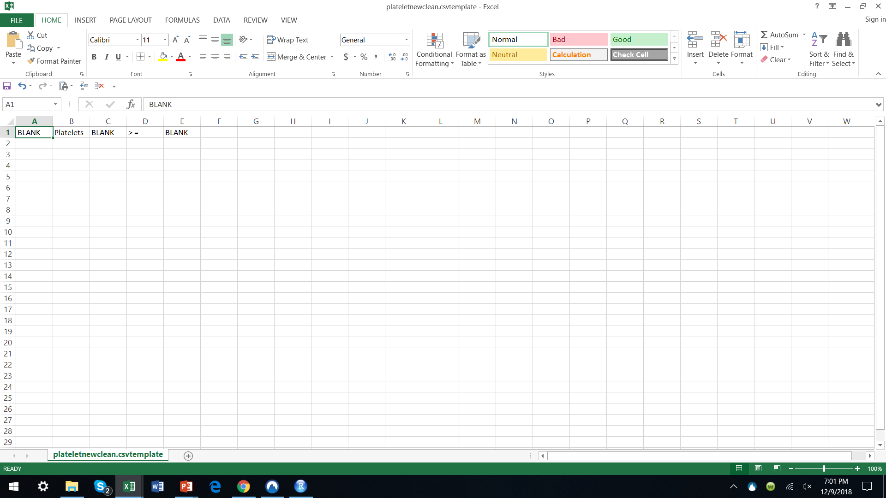
Example result: platelet count
Template

Slide 49
Example result: platelet count, cont.
Fill-ins (excerpt)

Slide 50
Example result: platelet count, cont.
We have a structure for platelet count eligibility criteria:
_____ Platelets _____ >= _____
We have a ‘most common’ example for platelet count eligibility criteria:
Platelets >= 100 000 / mcl

Slide 51
Summary

Slide 52
Summary
Clustered clinical trials
Generated generalized clusters, or megaclusters for the 342 cancer sets
Found discrepancies in standardization and made changeto rules to fix them
The changeto rules had significant impacts as shown after reclustering
Templates were generated for user-use out of the clusters and megaclusters

Slide 53
Thanks!

