Slide 1
Prestige Worldwide Progress Report 2
Chris Chang
Josh Fram
Kyle Jackson
Cassie Wes

Slide 2
Brief Overview
3D Flappy Bird now can be “flown” by user
New additions:
Start Menu With Leaderboard, Username Entry
Wand (Cylinder Target) – for destroying cloud obstacles!
Cube (Virtual Button) – for flying the Flappy Bird!
New Collectibles – treasure chest and coin (with movement)
New Obstacles – Flappy Bird pipes, clouds

Slide 3
Roles
Josh – Leaderboard, high score session and scene persistence, design, 3D Interaction, Start Menu
Chris – collectible game objects and documentation
Cassie, Kyle – Image targets, obstacles, flappy bird control, general gameplay

Slide 4
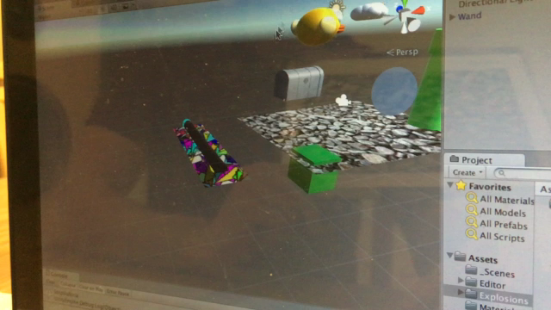
Video Demo
Notes:
https://drive.google.com/open?id=0B5WGSN5NL4txQTVaM056VDBiLUE

Slide 5
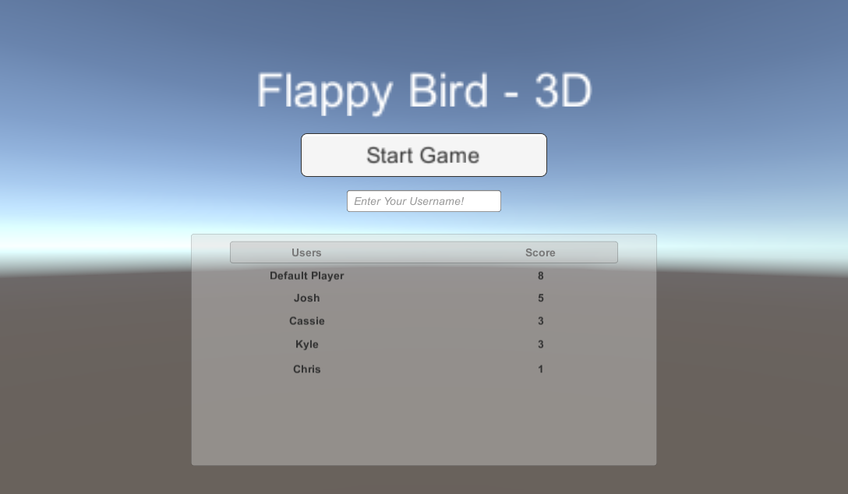
Preliminary Menu Screen

Slide 6
Next Steps
Moving game track (obstacles and collectibles move through scene)
Scoring (current game score display, collectible bonuses, high score recording)
Collision events (animate, exit, save, load menu)
UI Improvements (look and feel consistency, improve 3D interaction).

