Slide 1
Flappy Bird 3D 2.0
Josh Fram
Cassie Wes
Kyle Jackson
Chris Chang

Slide 2
Flappy BIRD 3D 1.0
Flappy Bird is an inherently 2D game
2D prevents the user from taking advantage of the DOFs that 3D provides
Problem: how to implement selection, manipulation, travel, and wayfinding without jeopardizing the integrity of the game
Solution: Flappy Bird 3D 2.0 – a combination of Flappy Bird, Flappy Bird 3D 1.0, Asteroids, and Super Mario Land

Slide 3
Flappy Bird 3D 2.0
Newly designed game track and setting
Health bar
Travel and translation of the flappy bird using the joystick
Wayfinding using two minimaps
Selection with a wand that destroys clouds to make travel easier
Score tracker
Scaling the flappy bird by tilting the phone left or right

Slide 4
The Playing Field
Keeps the flappy bird within the boundaries of the stadium
Pipes, clouds flow in a well-defined space
Objective: to dodge clouds, pipes and collect coins for points
Helps determine the position of the flappy bird
Makes travel easier and prevents the user from committing errors during travel

Slide 5
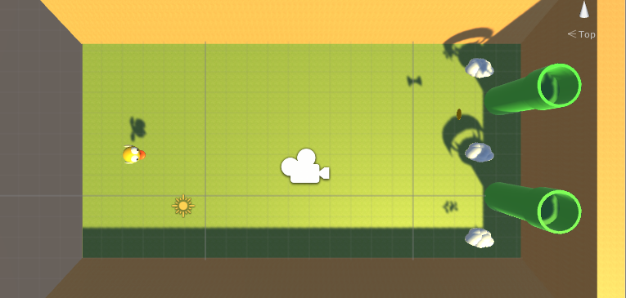
The Playing Field

Slide 6
HEALTH BAR
Puts less stress on the user – no longer a one and done deal like the original Flappy Bird
Makes the game more fun
Looks cool

Slide 7
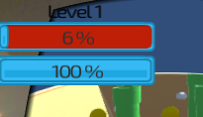
Health BAr

Slide 8
Travel
Atari-like joystick
Move joystick up and down to change the height of the flappy bird
Rotate joystick forward backward for forward and backward movement of the flappy bird
Rotate joystick left and right for left and right movement of the flappy bird
Mimics an actual joystick for flying games
Use of a cup below the image target makes rotation easier with down and up movements

Slide 9
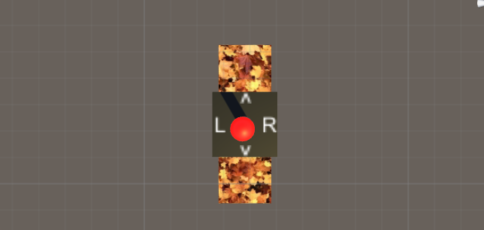
Travel

Slide 10
Wayfinding
Two minimaps
First person
Aerial
User can see the dispersion of clouds, coins, and pipes to determine the best path to gather coins
User can see when he/she is about collide with a cloud/pipe or when he/she is about to pick up a coin
Helps determine the best route and how to navigate the flappy bird toward collectibles and away from obstacles
Troubleshooting displaying minimaps with the Google Cardboard Main Camera

Slide 11
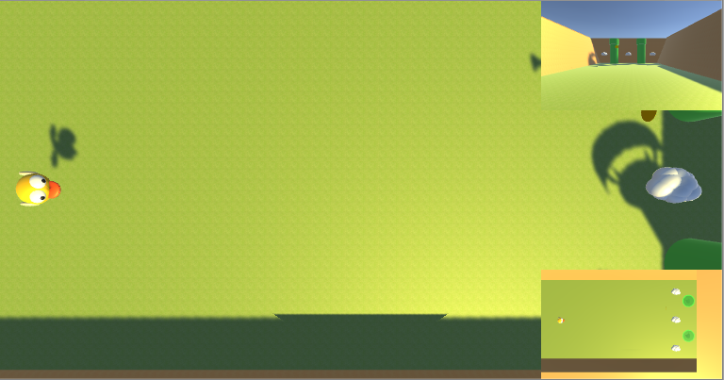
Wayfinding

Slide 12
Selection
Selection also occurs when the user gathers collectibles to gain points via navigation of the flappy bird
We are debugging a wand that can select and destroy clouds, removing the obstacles from the path of the Flappy Bird.

Slide 13
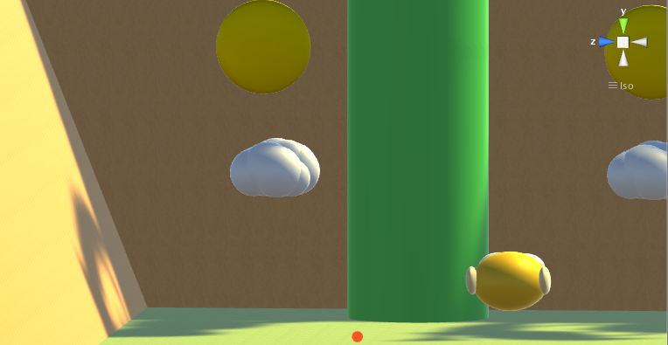
Selection

Slide 14
Score tracker
Keeps the user aware of his/her score
Score based on collectibles and distance travelled
Helps the user gauge how well he/she is doing
Match between our game and actual Flappy Bird

Slide 15
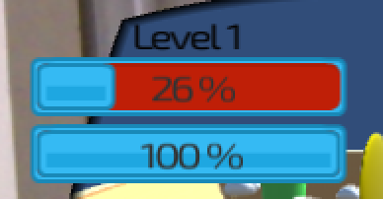
Score and health tracker

Slide 16
Scaling the flappy bird
Tilting the phone will scale the bird smaller or bigger
Makes the game easier and harder, respectively
Changes the score multiplier – the smaller the flappy bird, the slower the user’s score increases as they traverse through the obstacles.

Slide 17
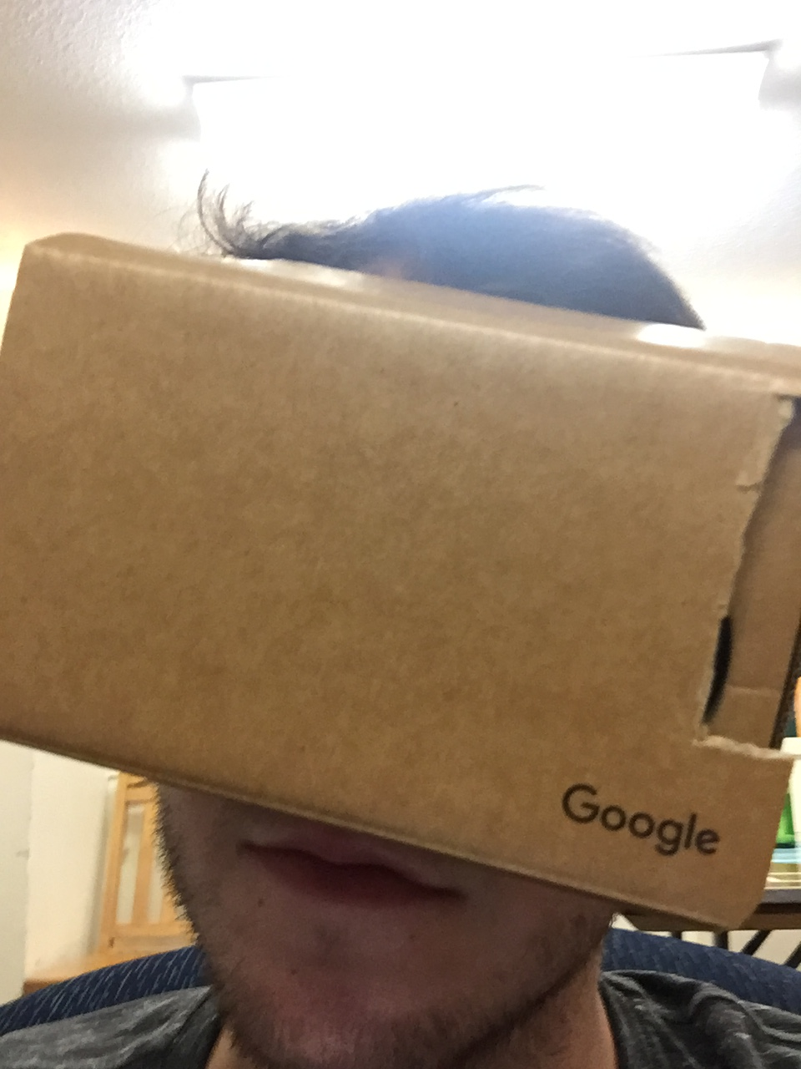
Scaling

Slide 18
Questions, Comments, Concerns

