Slide 1




Smart City Hackathon
Submission

Slide 2
TeamName.getBestOne()
Veeramanohar A Sakthivel S Nithiesh P N
THEME:
Smart Mobility

Slide 3
Problem Statement
The implementation of speed violation and vehicle tracking enables effective monitoring of mobility of vehicles in the city. It results in an effective penalty system compared to manual monitoring. Penalties are automatically imposed in the event of a violation. Digitizing the vehicle data and its owner's data leads to much efficient analytics of vehicle usage. According to the report released by the ministry’s Transport Research Wing, 1,51,113 people were killed, and 4,51,361 persons were injured in 4,49,002 road crashes in India in 2019. The country saw 1,230 road crashes and 414 deaths every day or 51 crashes and 17 deaths every hour.

Slide 4
Solution
Without manual labor we can use our model to examine whether a vehicle is following the traffic rules if not then fine will be imposed on the driver . Most of the accidents happen due to over speeding or not obeying the traffic rules . With our model we will be able to detect the speed of the vehicle using a camera and proper prompt will be executed.
Wherever there is traffic signal camera or CCTV camera in the roads we will be able to capture the mobility of the vehicles.
The speed of each vehicle is measured and checked with the speed limit of that specific road.

Slide 5
Technical Stack Description
Python, OpenCV, SQL, PHP and JQuery
The vehicles and speed of them are detected using Python libraries and Open CV
The monitored data is stored in a relational database(MySQL) using SQL queries.
The data from database is fetched and served in frontend using PHP, HTML, CSS and Jquery.

Slide 6
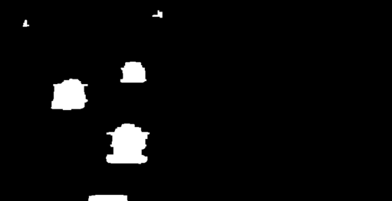
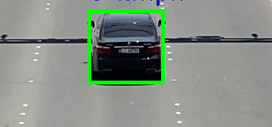
Working
Vehicle Detection
The vehicles are masked and eroded.
Then based on that contours are detected.
Finally when a vehicle is detected a bounding box is added to it.

Slide 7
Working
Speed Estimation
A specific region of interest is considered.
Timers start at when the vehicle enters the region and stops when the vehicle goes out of the region.
The distance covered is calculated approximately by taking the pixels between the borders of region and the actual distance of road.
When the vehicle crossed the region of interest, an image of the vehicle is captured and stored in the DB

Slide 8
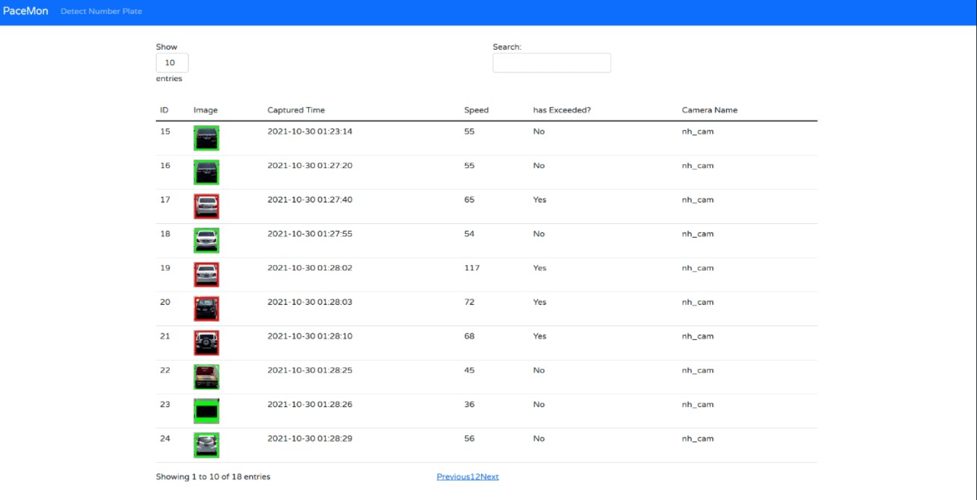
Working
Viewing Data
The data of monitored vehicles are stored in database and fetched in a web page.

Slide 9
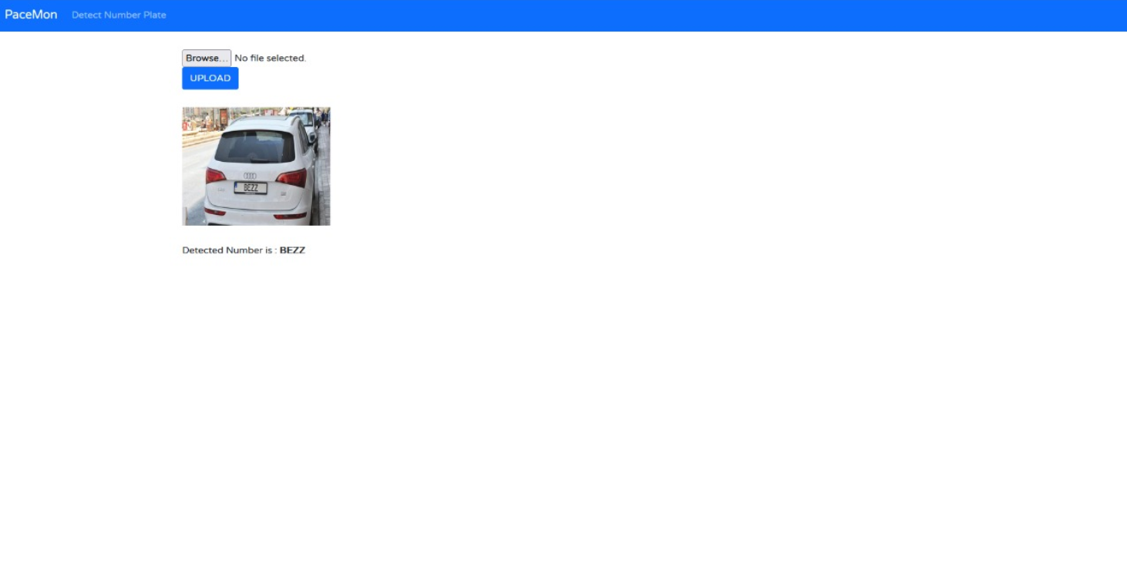
Working
Number Plate Detection
With an image as input, bilateral filter is applied to smoothen and denoise the image without affecting the edges.
Contours are drawn on the image and further processed to detect polygons in it.
Then the detected area is extracted from the original image
The extracted area is fed into OCR and the number is extracted from image.

Slide 10
Challenges
Number Plates were un-readable due to low quality of the source video. So, the images of monitored vehicles are stored in the database.
A separate feature to extract number plate from a static image is provided with the project.
Determination of actual road size was tedious and approximate size was used in the project.

Slide 11
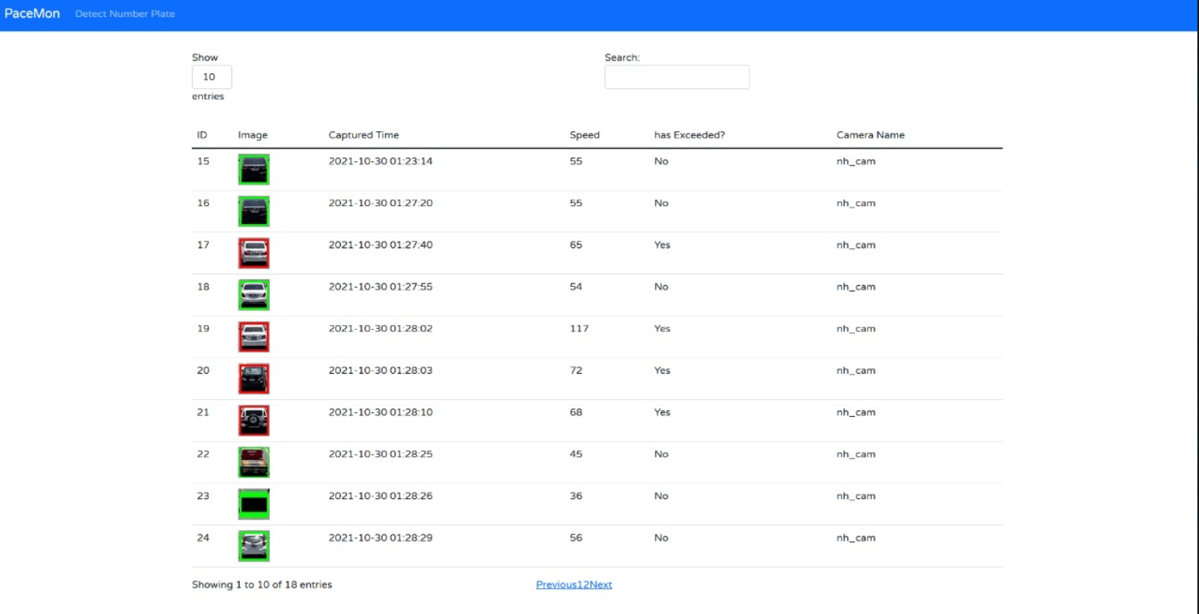
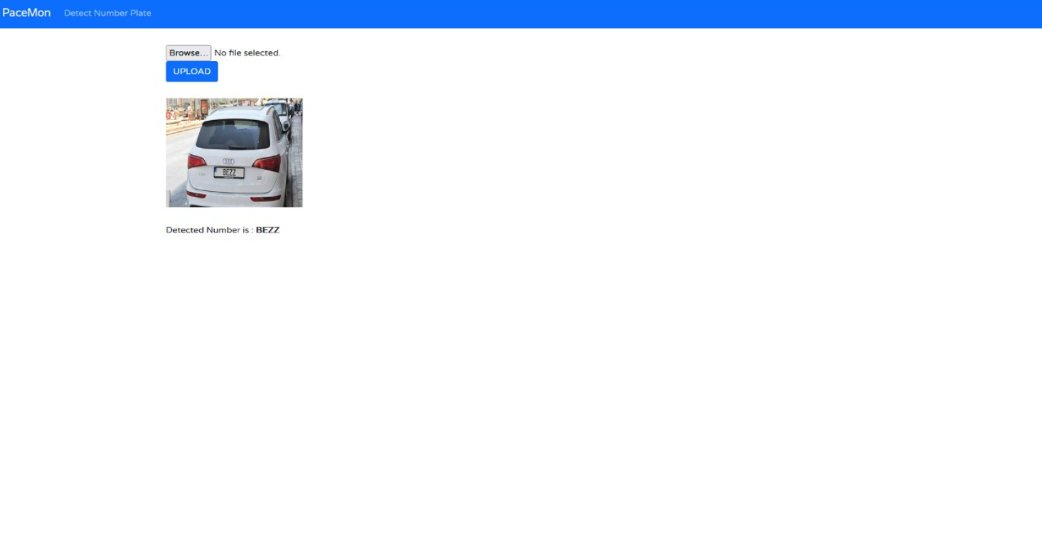
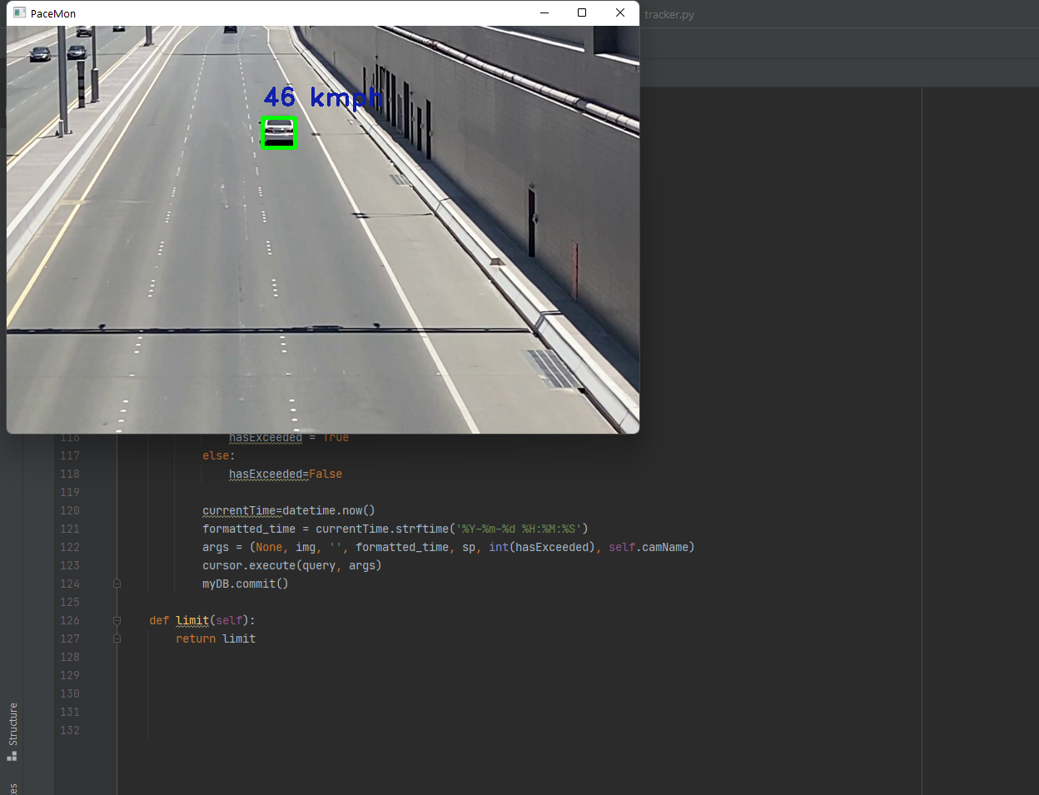
Working Prototype
Github : https://github.com/imveeru/TeamName.getBestOne_Veeramanohar
Video : https://drive.google.com/file/d/1GKh-P0X12g2v-2T7Gb3U5iLo4Jn7MPvr/view?usp=sharing

Slide 12
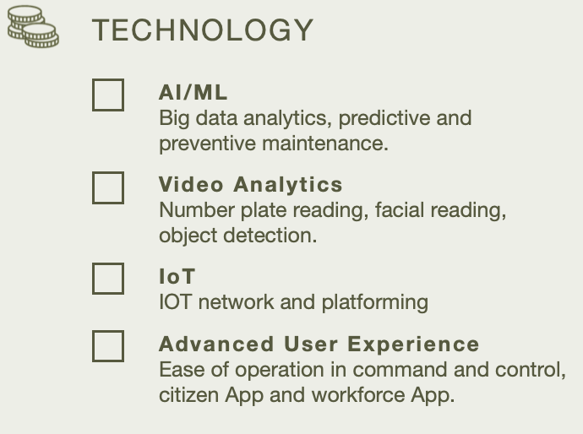
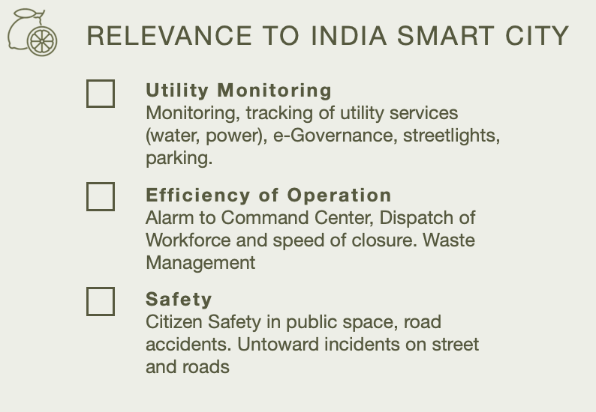

Slide 13
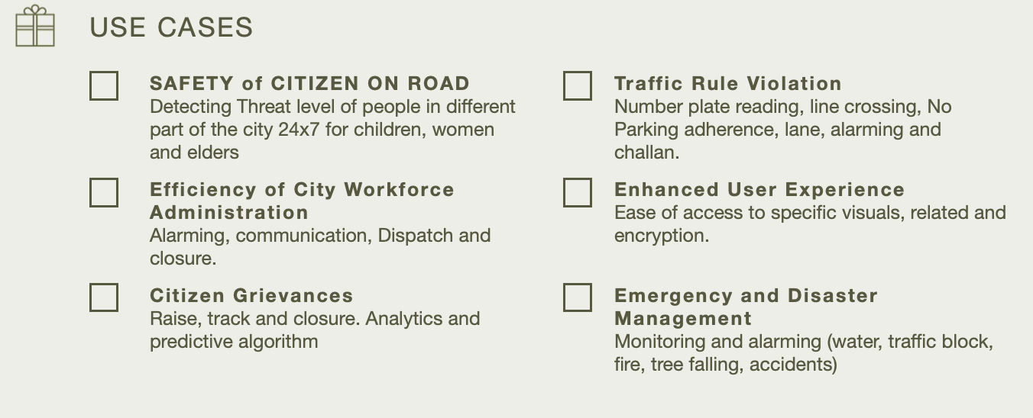

Slide 14
References: Detection of Vehicle Position and Speed using Camera Calibration and Image Projection Methods https://www.sciencedirect.com/science/article/pii/S187705091931083X Vehicle speed measurement model for video-based systems https://www.sciencedirect.com/science/article/pii/S0045790618317774 An Efficient Approach for Detection and SpeedEstimation of Moving Vehicles https://www.sciencedirect.com/science/article/pii/S1877050916311103

Slide 15
What’s next for your proposed solution?
The efficiency of this project can be further improved by the installation of high quality surveillance camera along with addition of features like detection of red signal violation, parking violation, lane changing violation, wrong side violation and many other traffic violations.
By maintaining the data of vehicle and its owner, penalty can be imposed to them on every violation of traffic rules.
By saving the record of captured camera name, we will also be able to track the mobility of vehicle.

