Slide 1

Challenge 4 members:
- Veikka Immonen
- Quoc an Nguyen
- Toki Yasir ahamed
Lateksii Hackathon 2025

Slide 2
Overview
Goal: To create a computer vision system that can keep track of the available seats in Guild room.

Slide 3
Approach
Pre-trained models
Pre-trained model with Histogram Equalization
Self-trained model

Slide 4
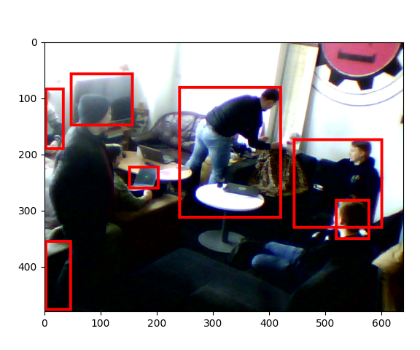
Pre-trained models
Yolov7, Yolov8, Yolov11 from Ultralytics
Figure from model Yolov11n

Slide 5
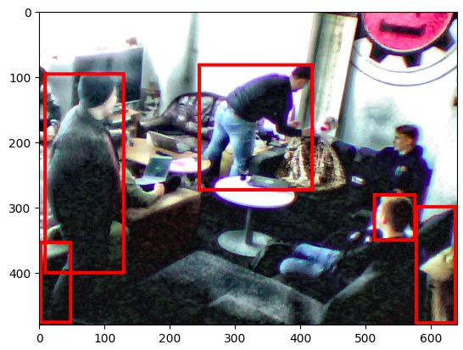
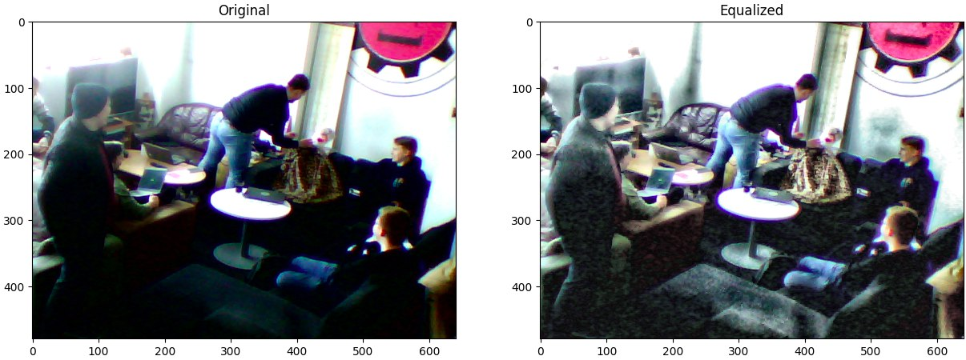
Pre-trained model with Histogram equalization
BGR -> YUV -> (Equalize Y) -> RGB

Slide 6
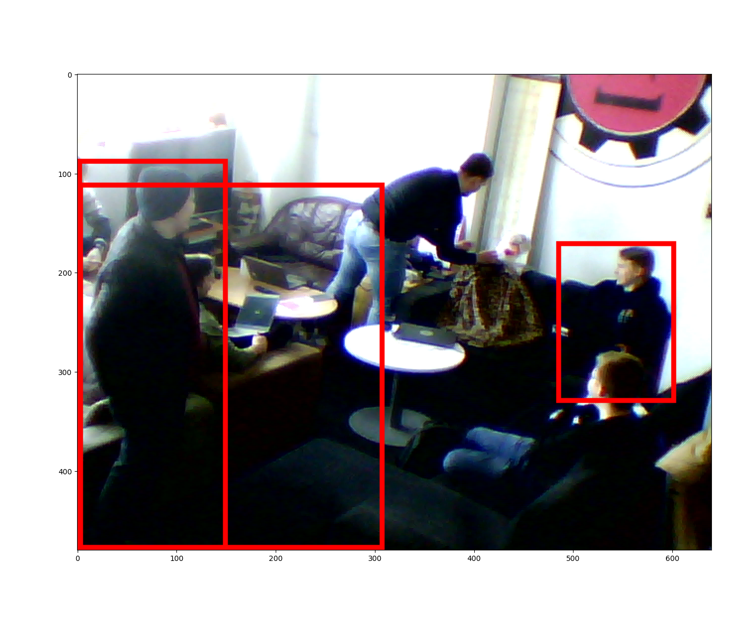
Self-trained model
Yolov11 with Human detection datasets from roboflow (CamerasDataset).
Figure from SELF-TRAINED model Yolov11n

Slide 7
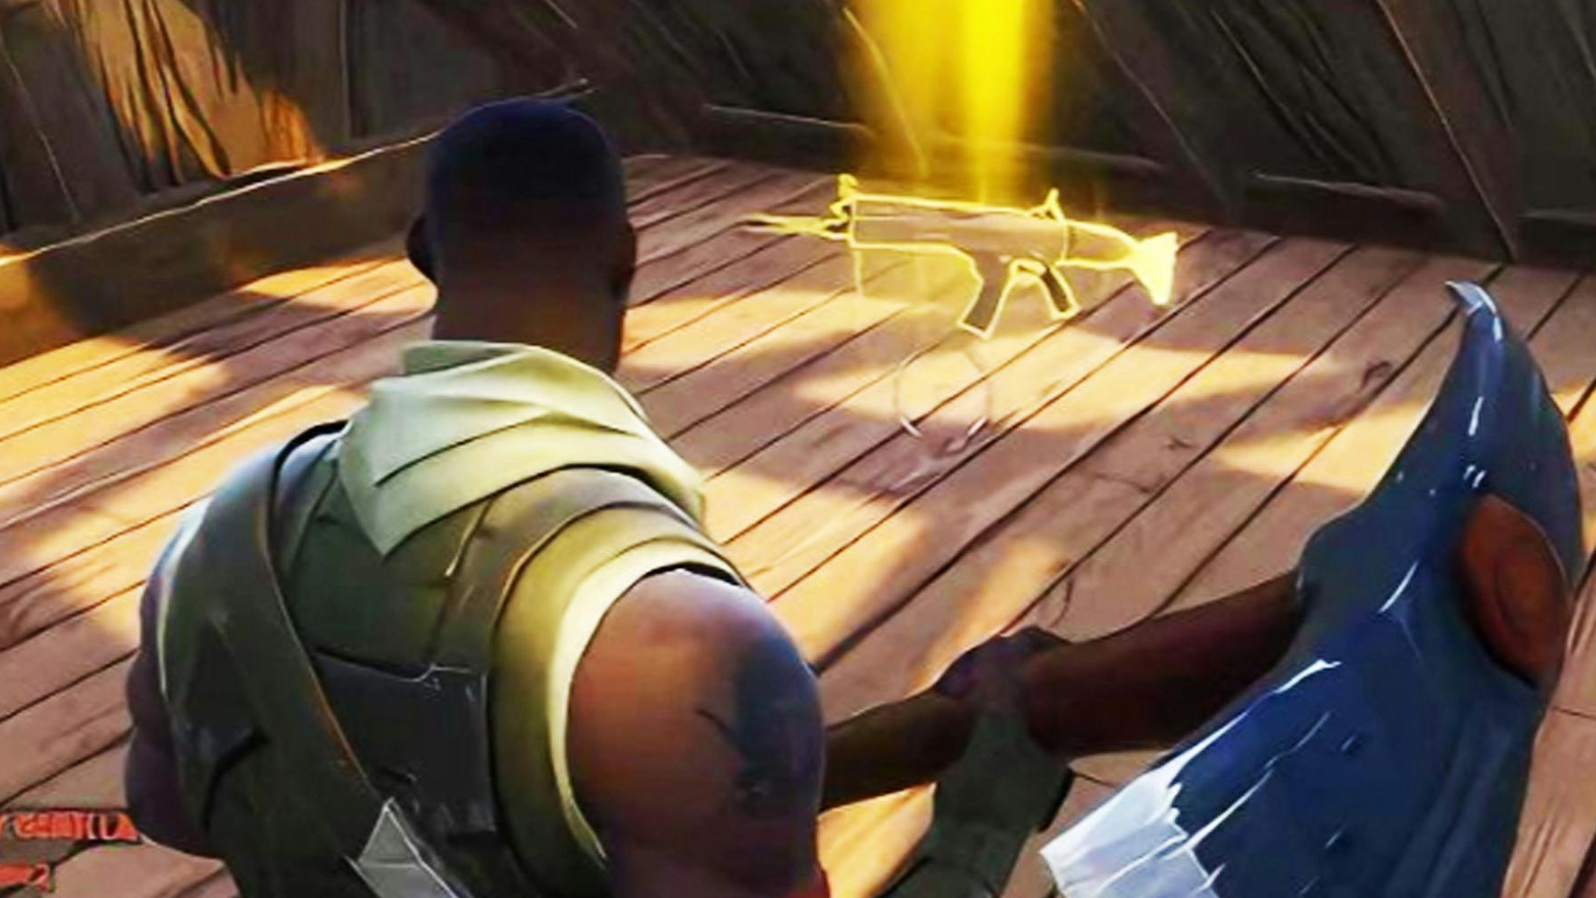
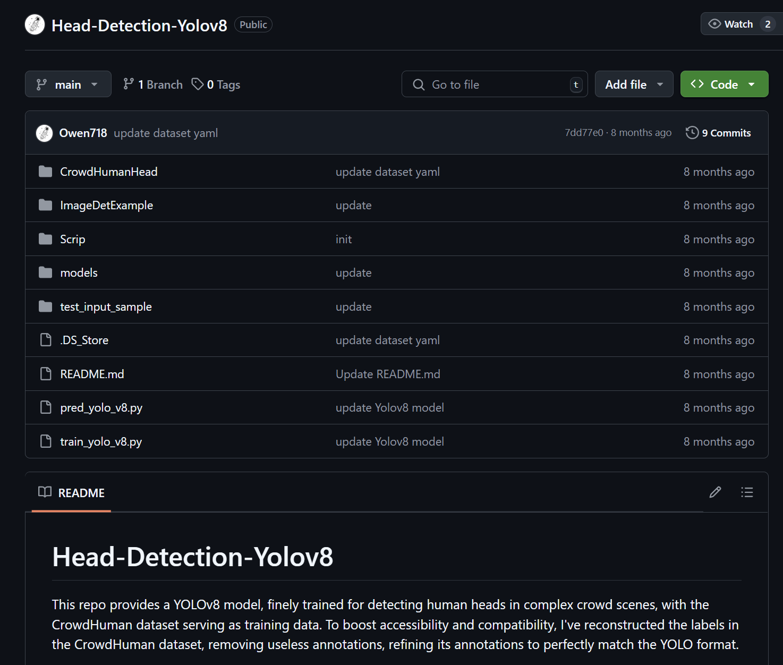

Slide 8
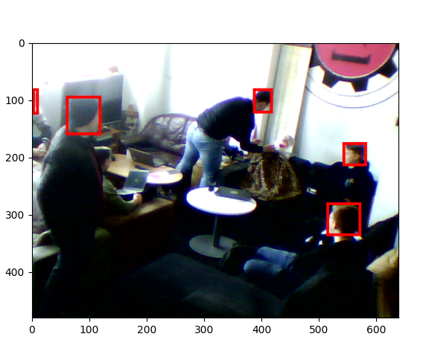
Pre-trained model for head detection
Human-Detection-Yolov8 that trained with only human head detect.
Figure from model Head-Detection-Yolov8

Slide 9
Telegram chatbot
We use @BotFather to create a chatbot for communicating with the system.
Functions: /start, /hello, /status, /view, /count, /help.
Handled commands using Python.
Images from imageio lib (ffmpeg).

Slide 10
Improvement
The model could be trained for better performance.
Face blurring to satisfy GDPR.
Fisheye lens for the whole sight of the Guild room.

Slide 11
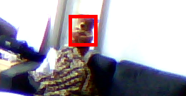
Thanks for listening

