Slide 1



BOT
AUTOMATIO N
--THE SMART CITY--

Slide 2



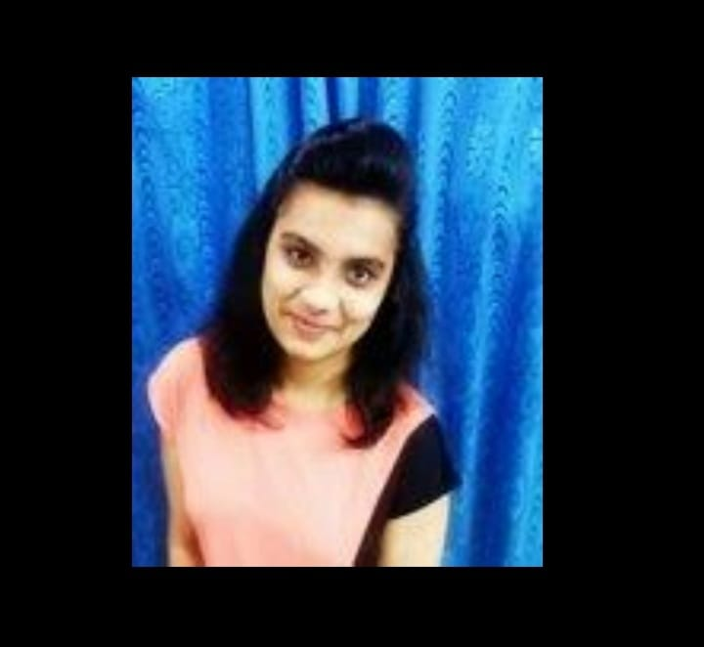

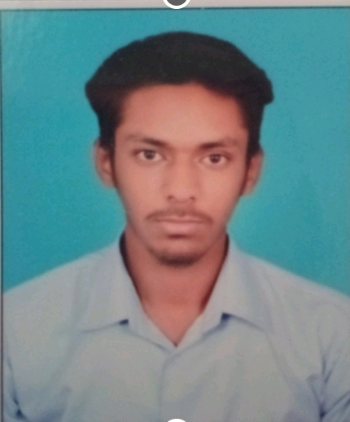
SMART
YOUTH
SMART
MIND
Mentor : Mr. Vicky Kumar
Rajasthan Institute Of Engineering and Technology
Mentor : Prof. Dinesh swami
(Rajasthan Institute Of Engineering and Technology)
Team Leader
Aakash Verma
Member 1
Ayushi Agrawal
Member 2
Garima Jaswani

Slide 3


TECHNOLOGY USED
LANGUAGES
COMPONENTS
TOOLS
HARDWARE
--ESP8266
--ULTRA SONIC
SENSOR
SOFTWARE
--ARDUINO IDE
--VISUAL STUDIO
FIREBASE FLASK FRAMEW-
-ORK GCP
MYSQL PYTHON HTML CSS

Slide 4





In our History, we saw a big change from stone
age to technical age. Previously people worked on their own, but now we are at the stage of
advance technology like robots. In cites, many people couldn't afford assistance set to control home appliance.
Growing buildings will replace the parking areas, so some people find it difficult to park!!
PROBLEMS DESCRIPTION

Slide 5

EXISTING SOLUTION!!
1.Through this web-based application we can connect our appliances directly
to the website without purchasing the google assistance set.
We use a simple machine method of 0
and 1.
Web also shows the empty parking spots in the form of grid on the screen whenever he / she enters in the parking lot.
We use entry source by making
entry book, so when people enter in the parking lot their detail is stored online.
This allows user to pay their ticket through payment gateway or UPI process.
EXISTING SOLUTION!!

Slide 6

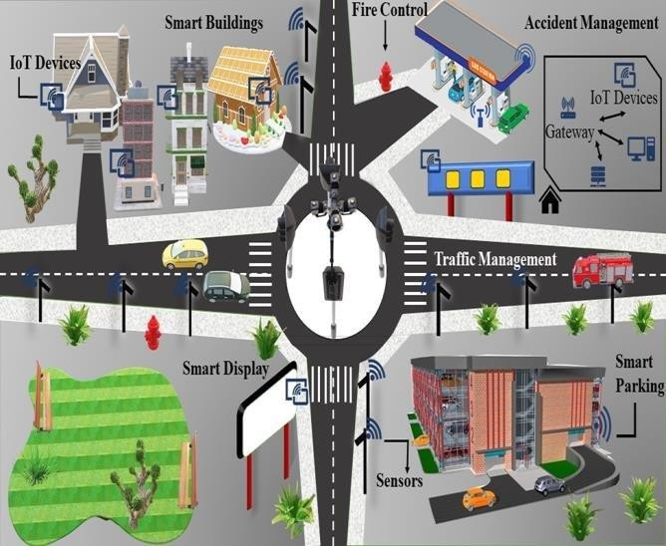
Development in rural area is possible using more advanced features of the website.
!! FUTURE IDEA!!
By this website we will be able to control
many agricultural equipment's
on larger scale.

Slide 7


MERITS !!
Entry book helps guard to recognize which person has placed the car and where?
This will allow everyone to have their parking slot secured in the parking lot.
It will save petrol by avoiding manual search for empty parking lot.
It will help customers to save electricity by turning off home appliances from our website.
Their entry data is secured
via google spreadsheet, which is also used in hotel booking.

Slide 8
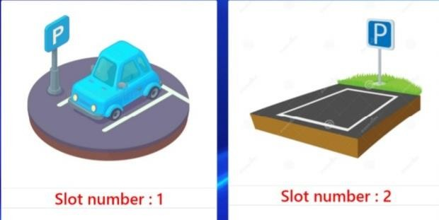

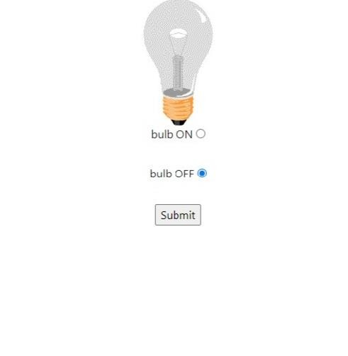
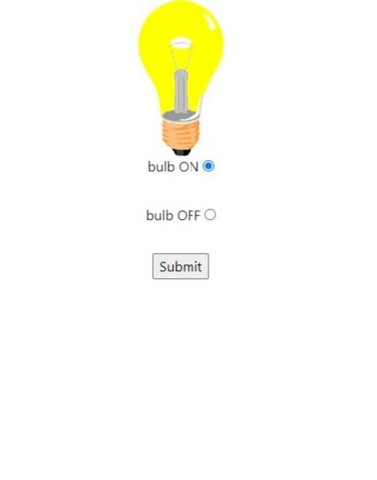
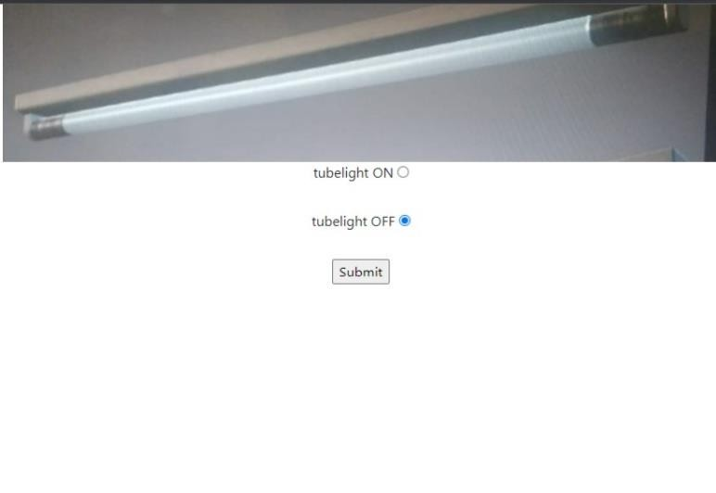
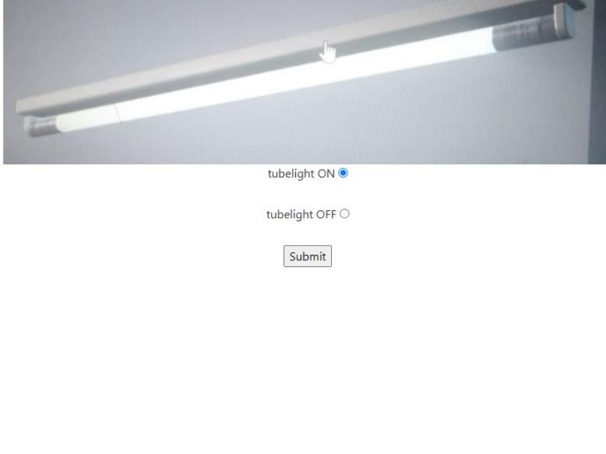
SCHEME
Our idea doesn't depend on range , if you are far away from your home and
accidently forgot to switch
off fan or tube light, it will help you to save electricity from faraway!!
OFF
ON
OFF
ON

Slide 9
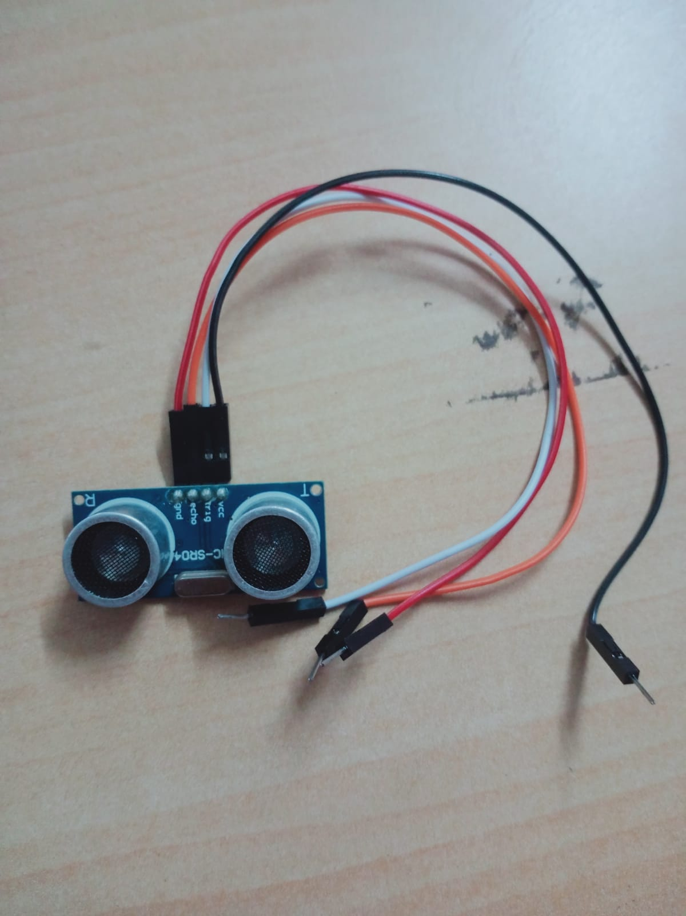
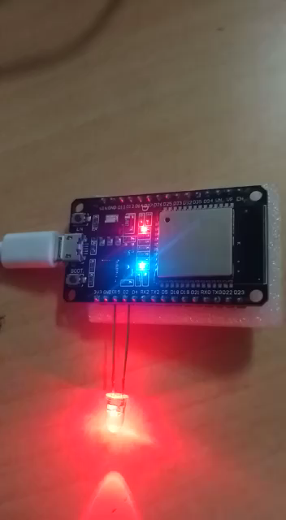
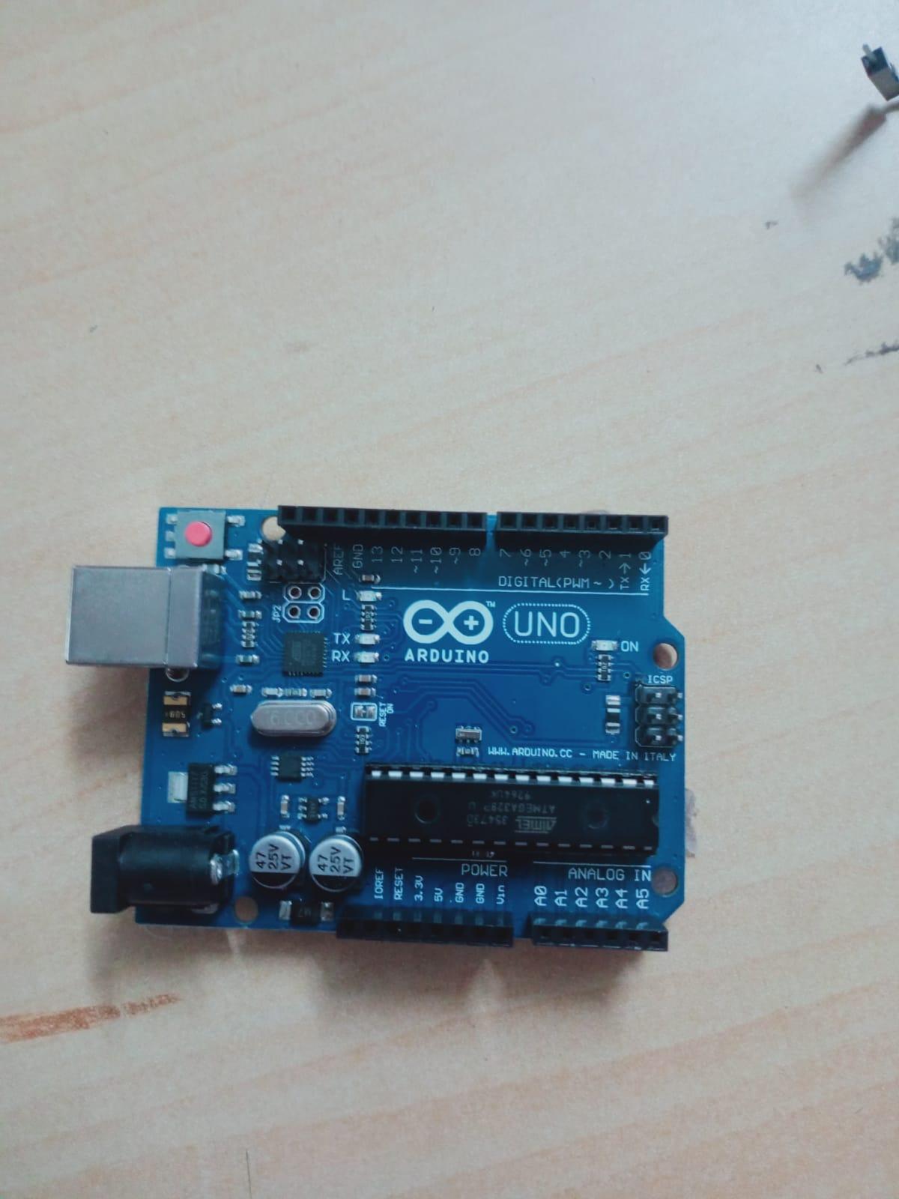
Ultra sonic sensor
Arduino
ESP8266

Slide 10
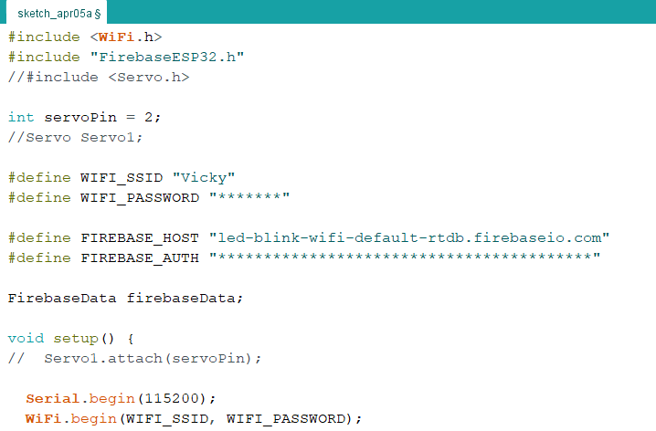
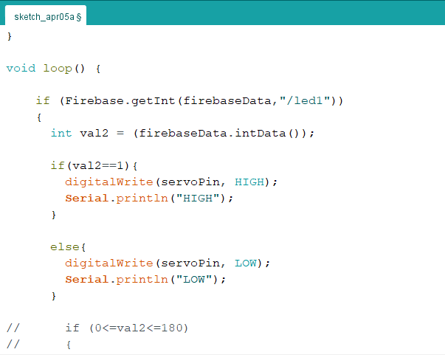
Code on Arduino for home automation
https://imvicks.herokuapp.com/#vickscroll

