Slide 1
Assignment Submission Guidelines
upGrad

Slide 2
3 Key Steps
Ensure that the solution file/files are in the correct format
Ensure that the solution files are in a zipped folder
Upload the zipped folder on the upGrad platform

Slide 3
Step - 1
Ensure that the solution file/files are in the correct format

Slide 4
Step 1
As a part of this assignment, you have the following deliverables:
Python Notebook
PPT file (in PDF format)
The Python Notebook would already be in the correct format (.ipynb)
We have to convert the PPT to a PDF file.

Slide 5
Step 1
Converting PPT to PDF can be done easily and there are a few ways to do the same.
We will look at one possible approach, which works irrespective of which platform or Office software you are using.
Once your PPT file is ready, go to https://online2pdf.com/
Using this online tool, you can easily convert your PPT file to a PDF file.
Let’s take a look at this tool in action!

Slide 6
Step - 2
Ensure that the solution files are in a zipped folder

Slide 7
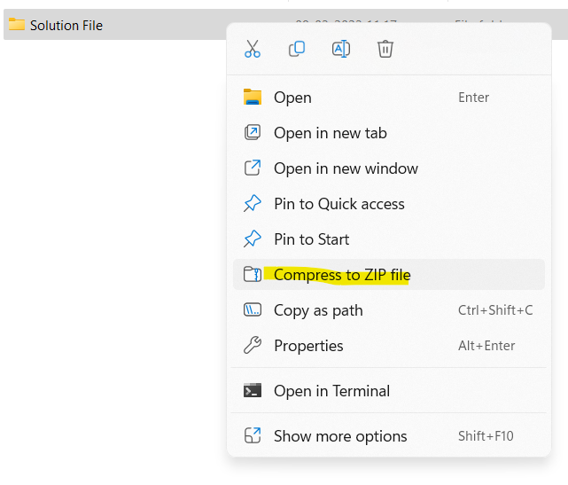
Step 2
This step is also pretty straightforward.
Right click on the folder, which contains all your solution files, and then select Compress to ZIP file

Slide 8
Step - 3
Upload the Zipped folder on upGrad platform

Slide 9
Summary
Ensure that the solution file/files are in the correct format
Convert the PPT file to pdf using the online tool https://online2pdf.com/
Ensure that the solution files are in a zipped folder
Right click on the folder, which contains all your solution files, and then select Compress to ZIP file
Upload the zipped folder on the upGrad platform
Download the zipped folder after uploading, and in case of any discrepancies, remove the previous submission and re-upload again.

